Slide 1
Geology 5640/6640
Introduction to Seismology
10 Oct 2024
Last time: Global Seismic Imaging Methods…
Analysis tools for Deep-Earth investigations include:
• Normal modes • Precursors
• Waveforms • Receiver Functions
• Tomography • Anisotropy
• Ambient Noise
Normal modes give 1D velocity/density structure (and
perturbations, e.g. mode splitting, can image laterally!)
Precursors are, e.g., slightly-earlier-than-SS arrivals with
deeper reflection points (e.g., 410 & 660 phase boundaries)
Waveforms use “all” of the information content in waves…
Receiver functions difference the arrival times of
transmitted and converted phase arrivals (e.g., at Moho, “LAB”)
Read for Tuesday 15 October: S&W 157–162 (§3.4)
© A.R. Lowry 2011-2024

Slide 2
Assignment 1
is now posted on the course website…
Along with other materials you’ll need.
Due Tuesday, 15 October at 9:00 am

Slide 3
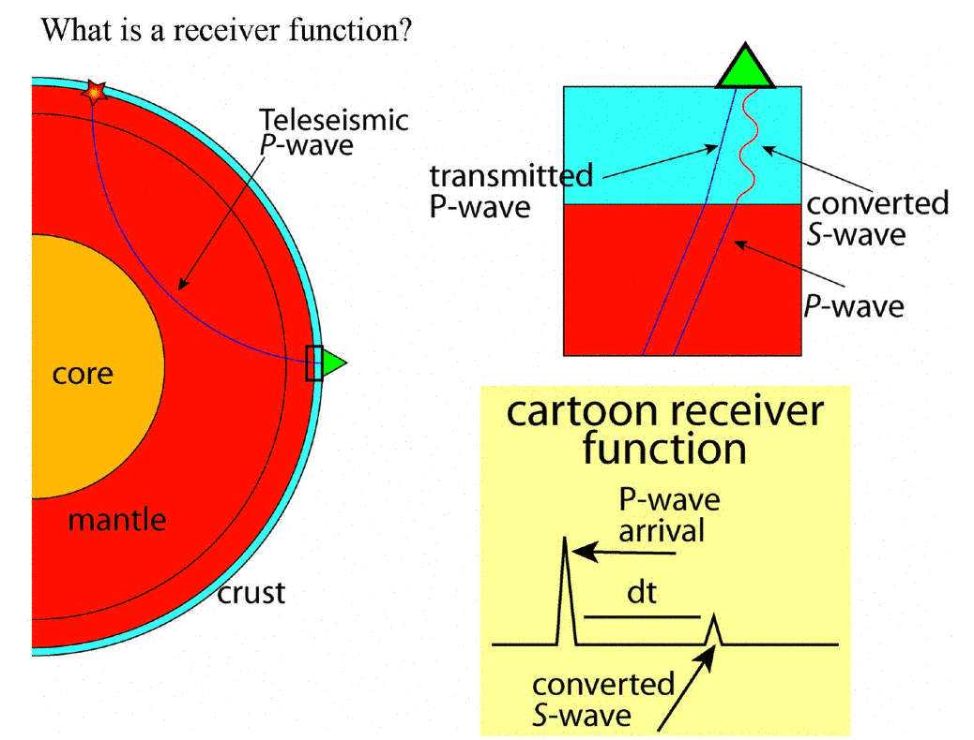
Receiver Functions
Jessie Lawrence

Slide 4
P
Ps
PpPs
PpSs
PsPs
PpSs
PsPs
P
Ps
PpPs

Slide 5
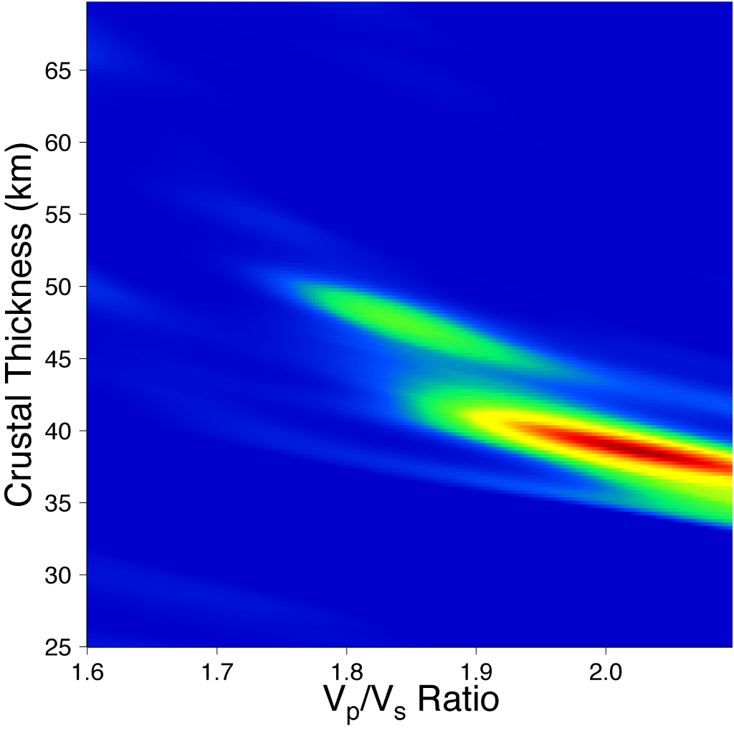
Ps
PpSs
&
PsPs
PpPs
PpSs
PsPs
P
Ps
PpPs
After Zhu & Kanamori, JGR, 2000

Slide 6
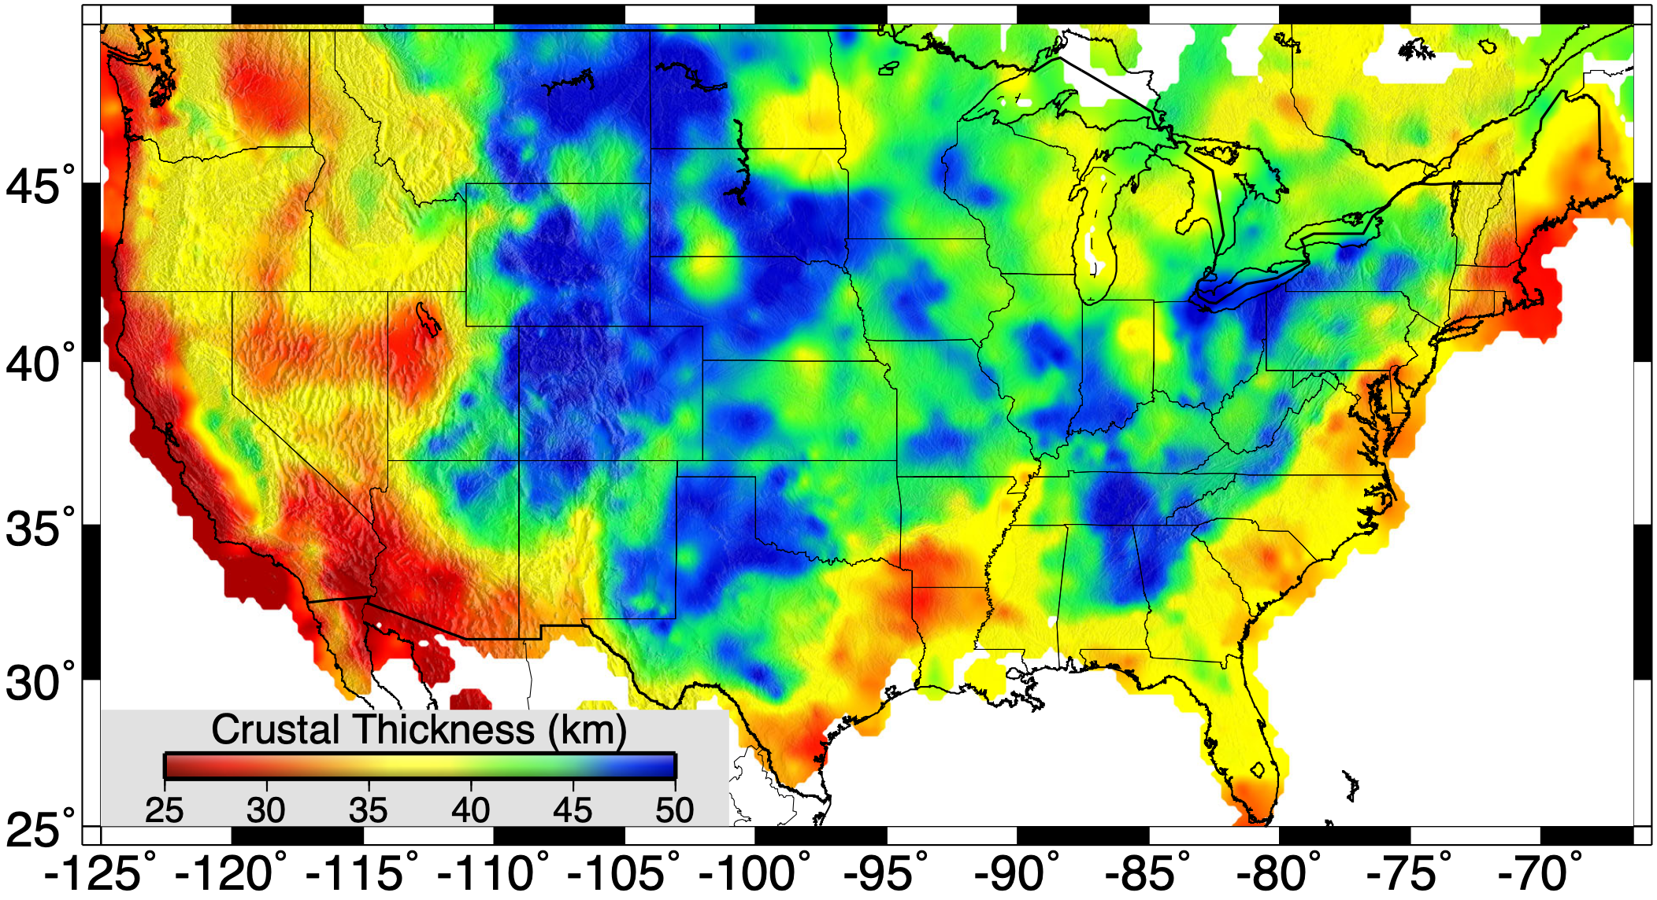
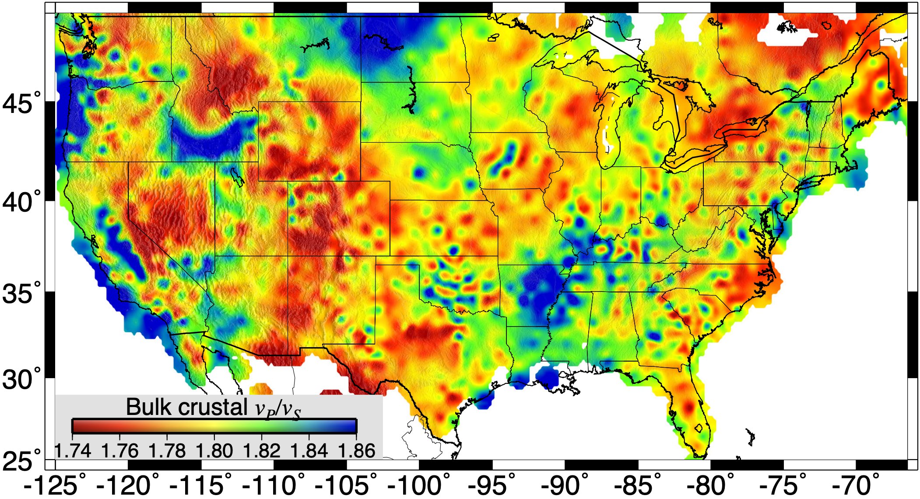
Bulk Crustal
Seismic Velocity
Ratio
Crustal
Thickness

Slide 7
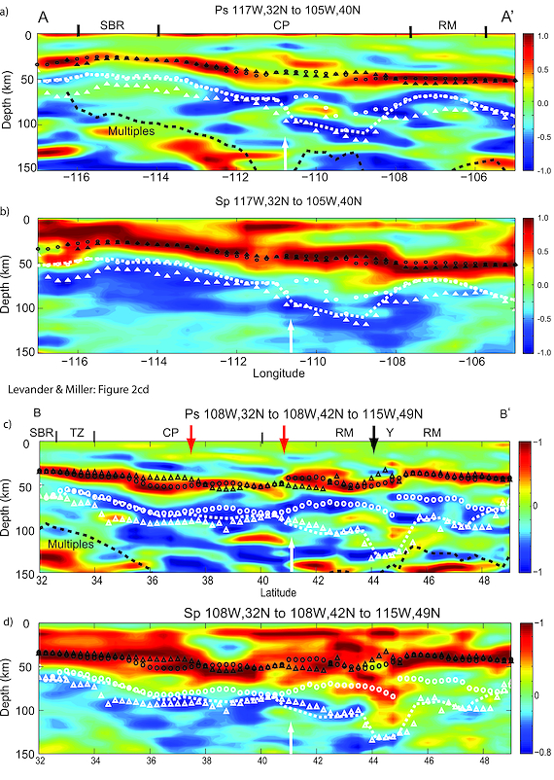
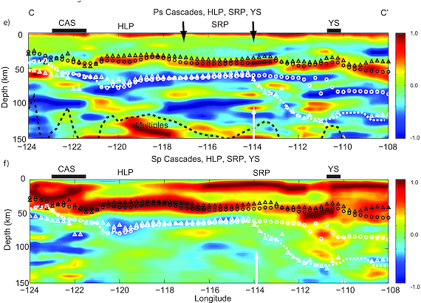
Negative Velocity Gradients
(blue = faster over slower): called
“lithosphere/asthenosphere
boundary (LAB)”; “mid-
lithosphere discontinuity
(MLD)”…
Interpreted as partial melt,
water, metasomatized layer?
(Levander & Miller, G³, 2012)

Slide 8
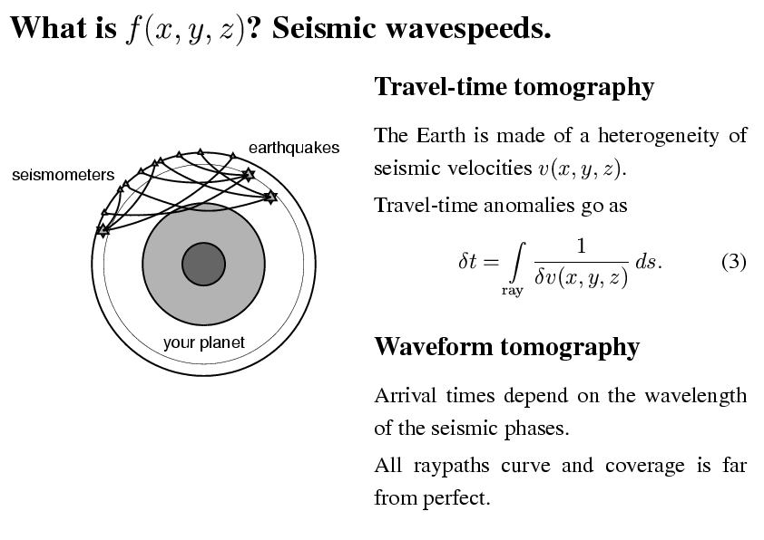
Seismic
tomography
Frederick Simons

Slide 9
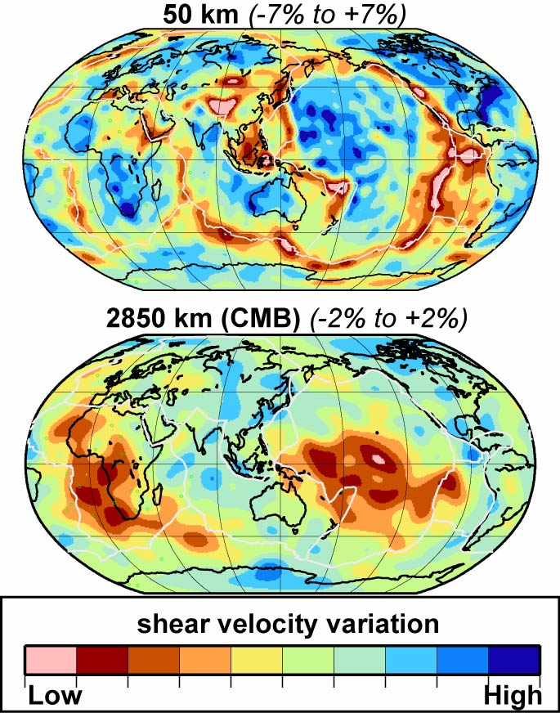
Seismic tomography
Near surface
Old oceans fast
Young oceans slow
Cratons (old parts of continents) fast
Core-mantle boundary
Past subduction fast
African and Pacific anomalies slow
Cause?
Frederick Simons
Ritsema

Slide 10
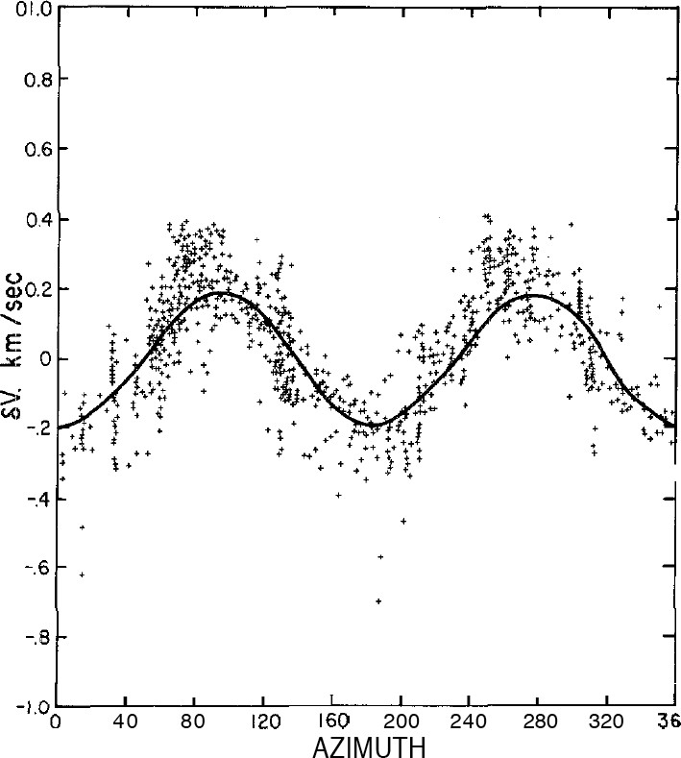
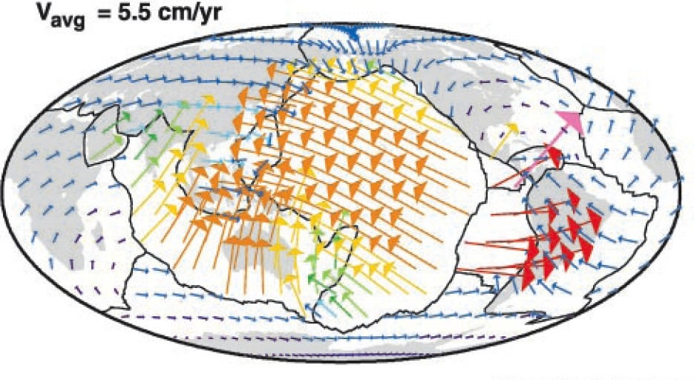
Anisotropy
Central
Pacific
West
East
Seismic wave velocity depends on
direction of:
• Propagation (P- & S-waves)
• Polarization (S-waves)
Explanation (for the mantle):
Elastic anisotropy of olivine
Alignment of olivine crystals
V_{P} anomaly (km s⁻¹)
South
PROPAGATION DIRECTION
Christensen & Salisbury (1979) JGR
Conrad & Lithgow-Bertelloni (2002) Science

Slide 11
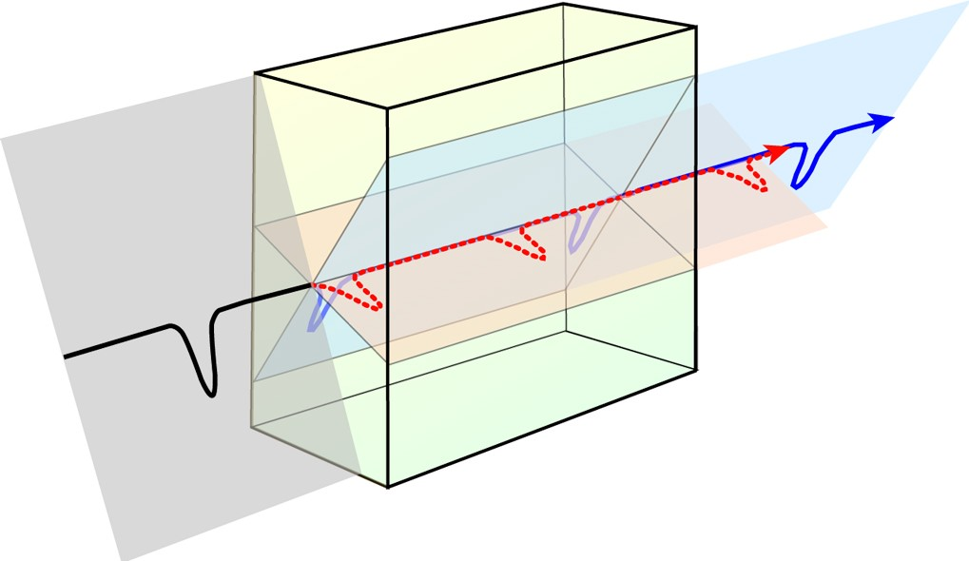
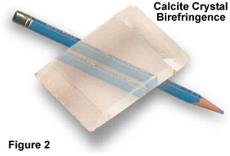
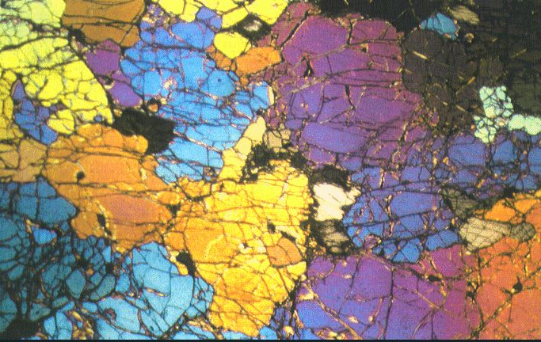
Polarization anisotropy aka shear-wave splitting
Upper mantle xenolith
Calcite: CaCO₃

Slide 12
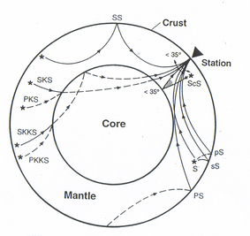
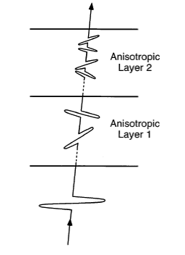
Shear-wave splitting
If back-azimuth coincides with a seismic symmetry axis, the shear wave is not split (Null case)
Delay time
Angle between back-azimuth and seismic fast axis
Anisotropic layer
Incoming SKS phase
Invert the splitting by grid-searching for combination of fast axis and delay time which best removes the splitting

Slide 13
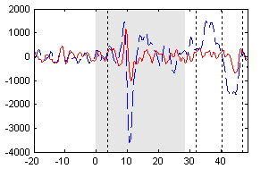
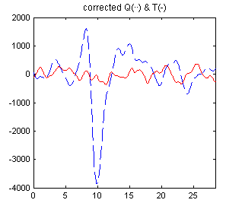
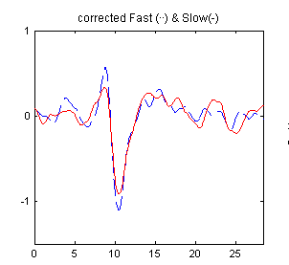
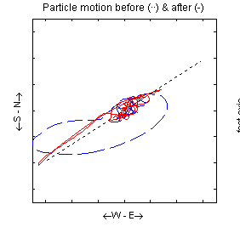
Shear-wave splitting
Remove splitting:
Radial
Transverse
1. Minimum Energy on Transverse: Remove transverse Energy
2. Rotation-Correlation: Searching for maximum correlation
3. Eigenvalue criteria: Searching for most linear particle motion

Slide 14
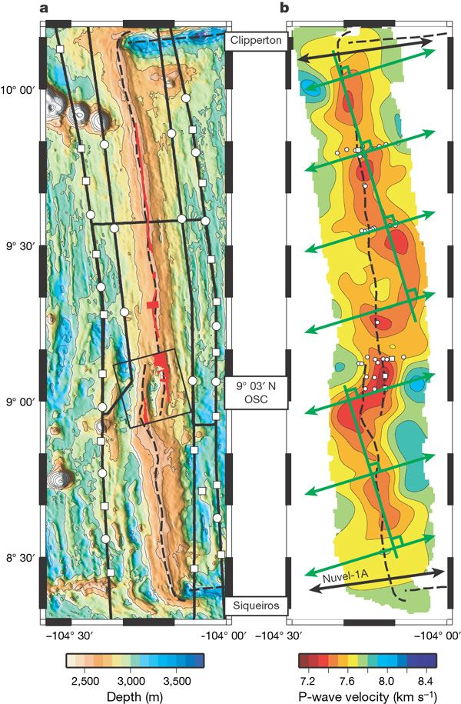
Fast axis in dry olivine (green
arrows) should correspond to
the mantle flow direction…
Contributed to the recognition
that flow at oceanic
spreading centers is not
necessarily perpendicular to
the ridge axis, but is
perpendicular to the melt
axis
And misalignment of melt
with rifting controls
segmentation!
Toomey et al. Nature 2007

Slide 15
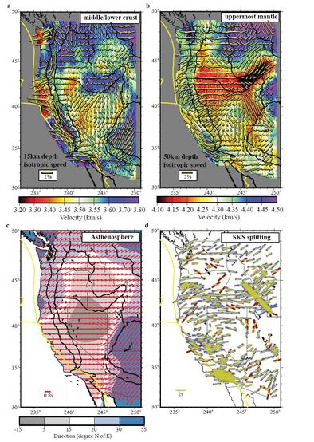
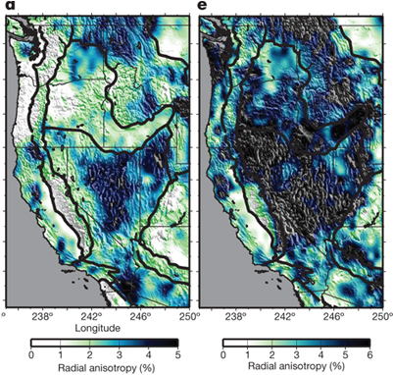
These images actually used
ambient noise tomography:
Vertical
Horizontal
Moschetti, Ritzwoller et al. in Nature
Lin, Ritzwoller et al., Nature Geoscience

