Slide 1
Geology 5640/6640
Introduction to Seismology
10 Sep 2024
Last time: Vector Properties
• Direction (propagation, particle motion, …) is a key property
in modeling seismic wave motion!
Vectors will be represented
by any of several notations…
• A vector has length given by the root-squared sum of
its components:
• A normal is the vector of unit length orthogonal to a plane
or surface at a point
Read for Thursday 12 September: S&W 29-52 (§2.1-2.3)
© A.R. Lowry 2011-2024

Slide 2
Last time continued: Vector Properties
• Matrix/vector multiplication is a product (or sum multiplying
each element of a row times each element of a column):
• The dot product is a scalar measuring how parallel two vectors
are:
(in indicial notation)
• The cross product is a vector whose length is a measure
of how orthogonal two vectors are, with direction
perpendicular to the plane described by the two vectors
||c|| = ||a×b|| = ||a|| ||b|| sinθ

Slide 3
“Introduction” to Derivatives:
In this course we will only “review” a few basics… And then
assume you have the resources to familiarize yourself with
basic rules of how to evaluate derivatives (using a
Calculus text and/or standard math tables).
Derivatives are used to describe rates of change (“slopes”)
as well as for finding minima and maxima of functions
(where slope is, by definition, zero!).
Partial derivatives are derivatives with respect to one
variable of a function having more than one variable.
The wave equation is a function of time t and space (x, y, z),
so we describe seismic waves by a partial differential
equation or PDE

Slide 4
Consider an example function: f(x,y) = x² + 2y²
Then we have the following:
partial derivatives: indicial notation:
If a function has directional elements, e.g., u_{z}, then indicial
notation for a partial derivative in the y direction would
be:
Another notation we’ll see often is the gradient operator:

Slide 5
Complex Numbers:
A complex number can be written
z = x + iy where
where x = Re{z} is the real part of z, and
y = Im{z} is the imaginary part of z.
We can graphically represent z in either Cartesian (x, y) or polar
(r, θ) coordinates as a vector quantity:
y = r sinθ
x = r cosθ

Slide 6
Now you may ask yourself:
Why, in the name of all that’s decent, rational and sensible in
the universe, would anyone ever want to use imaginary
rather than strictly real numbers?
The answer has to do with eigenfunctions, which are the
optimal functions for solving a PDE. An eigenfunction is a
(unique) functional form that simplifies solution of the PDE.
In the case of the wave equation (and many other PDE’s),
the eigenfunctions are sines and cosines!

Slide 7
Substituting polar coordinates into z = x + iy we have:
z = r cosθ + i r sinθ
= r (cosθ + i sinθ)
From Euler’s Identity,
e^{iθ} = cosθ + i sinθ
So we can write:
z = r e^{iθ}
The complex conjugate of a complex number z, which we
denote z*, is:
z* = x – iy
= r cosθ – i r sinθ
= r cos(–θ) + i r sin(–θ)
= r e^{–iθ}
Thus the squared modulus (magnitude) of z is:
|z|² = zz* = (x + iy)(x – iy) = (x² + y²) = re^{iθ} re^{–iθ} = r²

Slide 8
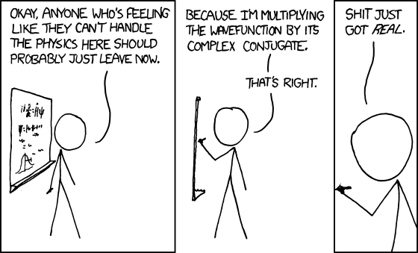
Grasping this opens up a seamy underbelly of the math world.
**
Note also that: e^{iθ} = cosθ + i sinθ & e^{–iθ} = cosθ – i sinθ
⇒ cosθ = (e^{iθ} + e^{–iθ})/2 & sinθ = –i(e^{iθ} – e^{–iθ})/2

Slide 9
Introduction to Tensors
Motivation:
Physical laws must be independent of any
coordinate system used to mathematically describe
them. Tensors are a compact representation of spatial
properties that can easily be transformed from
expression in one coordinate system to another.
Tensors are very useful for:
Stress, Strain & Elasticity (our application)
Moment Release in Earthquakes (also our application)
Deformation via other rheologies…
Hydrodynamics
Electromagnetism
General relativity
And many other applications...

Slide 10
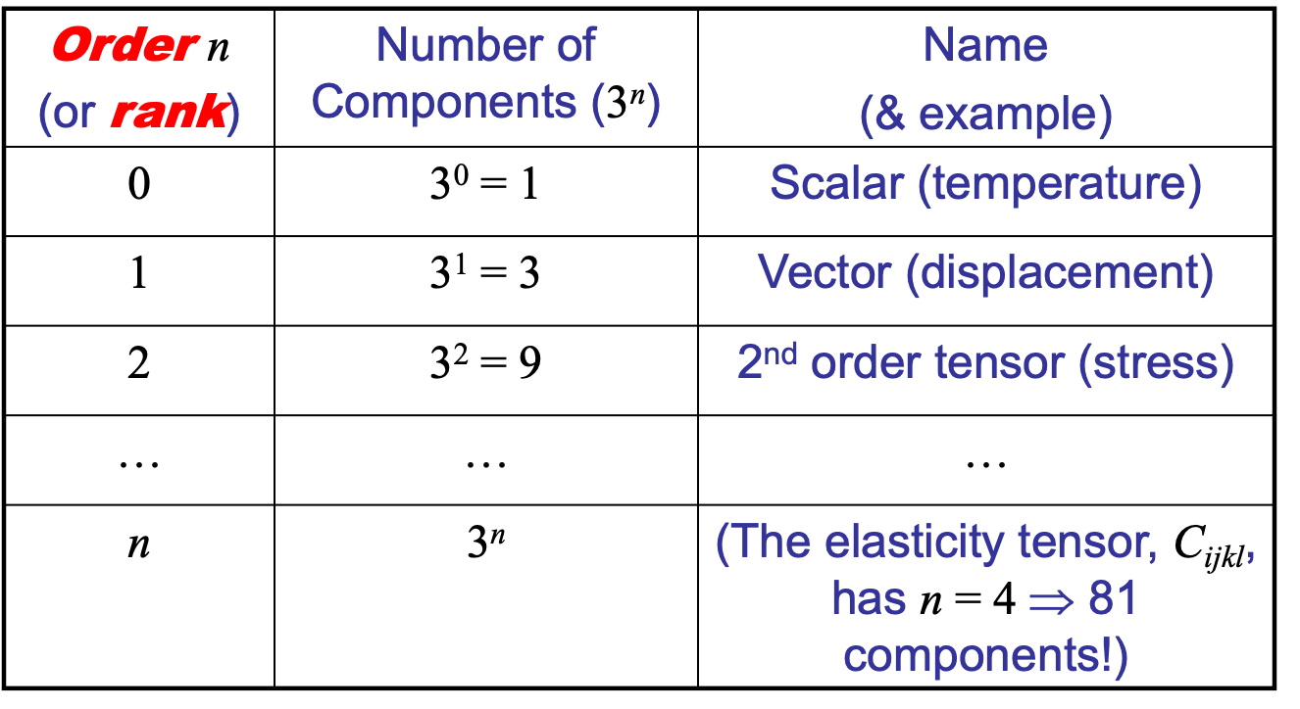
Example:
In 3D, a point is represented by three numbers (or coordinates)
as a vector. Tensors are a generalization of scalars and
vectors. The following table describes rank (or order) of
some commonly-used tensors:

Slide 11
Stress:
Consider a body acted on by external and/or internal (body)
forces. We represent these forces on arbitrary planes within
the body as stress (force/unit area). This has application in
earthquake physics, as earthquakes represent stress/strain
released by slip on
planar surfaces.
Imagine a plane or
surface dissecting the
medium:
(Note: Here,
“Imaginary” ≠
complex-valued!
Better “arbitrary”?)

Slide 12
Assume the body is in static
equilibrium (the forces balance
such that the body doesn’t move.)
Now, imagine we “remove” the
right half of the body and
consider the equivalent set of
forces acting on the plane that
equate to the effect of the forces
we removed (i.e., that are needed
to maintain the equilibrium)…

Slide 13
Now, divide up the plane into infinitesimal elements with area
ΔA, normal , and force ΔF:
The stress vector (or “traction”) is defined as:
acting on element ΔA at point P with
normal .

Slide 14
Note that we’re talking about forces on an elastic medium
which is a continuum. Thus any force acting on the
body is transmitted (via strain) through every point within
the body. Also, the orientation of our imaginary plane was
chosen arbitrarily, so we can decide to choose a plane
parallel to the yz-plane for any given x.

Slide 15
We denote the stress components acting on the plane with
normal (i.e. a plane on which x = constant) as:

Slide 16
Generally, we can denote:
σ_{ij}
index i denotes
direction of normal
to the plane acted
on by the force
index j denotes
direction of the
force
Hence σ_{xx} is a normal stress and σ_{xy} and σ_{xz} are stresses in
the yz-plane (called “shear stresses”). We can do the same
with the y direction: σ_{yx}, σ_{yy}, σ_{yz} act on the plane parallel to
xz-plane. For the z-direction, σ_{zx}, σ_{zy}, σ_{zz} act on the plane
parallel to the xy-plane. Thus we can use all nine σ_{ij} to
represent the internal force distribution at point P for any
plane passing through P.

