Slide 1
Geology 5640/6640
Introduction to Seismology
12 Nov 2024
Last time: Rayleigh Wave Amplitudes; Love Waves
• Rayleigh waves for a uniform Poisson solid have phase
velocity c_{x} = 0.92β (and no dispersion!) Displacement
amplitudes are:
• In practice, velocity increases with depth (and depth
sampling of a Rayleigh wave increases with wavelength)
so waves are dispersive
• Love waves are inherently dispersive & exist when
velocity increases with depth or the body is spherical,
and they are an interference where intersecting SH
wavefronts have identical phase.
Read for Thursday 14 November: S&W 101-115 (§2.9)
© A.R. Lowry 2011-2024

Slide 2
Reminder:
Exam 1 is posted on the course website;
Due at classtime Tues November 19

Slide 3
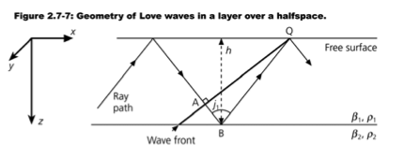
For a simple Love wave, let’s consider a (lower-velocity) layer
over a (higher-velocity) infinite half-space:
Consider a single SH wave which is a simple harmonic (sin).
As it bounces around in the layer, there are multiple places
on the wavepath where the phase is the same.
Let’s look for places where the wave might experience
constructive interference at the surface, i.e. conditions
for which the phase at point A is the same as at point Q.
(Note that for this SH
wave to generate a
Love wave, j₁ must
be post-critical.
Why?)

Slide 4
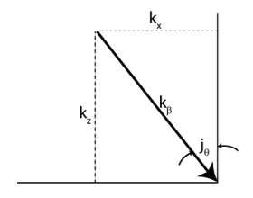
(imag)
First we need to remind ourselves what
phase is! A complex number can be
represented in the complex plane as
z = x + iy = r e^{iφ}, where φ is the
phase angle:
So for a typical SH wave represented as displacement:
the phase is φ = ωt – k_{x} x – k_{z} z. To simplify, we can rotate
our spatial axes into the propagation direction (or ray) to
get:
where k_{β} is the modulus of the
wavenumbers k_{x} & k_{z}, and d is
distance along the raypath.
r
y
φ
x
(real)

Slide 5
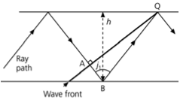
Some useful quantities in this way of
representing things are the angle
which we rotated the coordinate
axes (also angle of incidence!) j:
and by the relationship V = fλ = ω/k,
Phase is now φ = ωt – k_{β} d. If the phase difference between
point A and point Q is some multiple of 2π, then the
waves will constructively interfere! We’ll arbitrarily choose
time t = 0:

Slide 6
But now we need to consider a complicating factor: Recall
that for an evanescent wave, a phase change will occur
at the interface between the layer and the half-space if the
ray is post-critical! The phase change is given by
(S&W 2.6.23):
So we’ll get constructive interference IF
After some trig substitutions this turns out to be:
Here, μ₁ and μ₂ are shear rigidities above and below the evanescent wave layer boundary. This phase relationship arises from Zoeppritz’ equations for the special case of SH waves!

Slide 7
Since k_{z}/k_{β} = cos j and r_{β} = k_{z}/k_{x}, we can rewrite as:
If we take the tangent of both sides:
Or:
We rewrite this in terms of (S&W 2.5.28) and
k_{x} = ω/c_{x}:

Slide 8
The tangent is defined only for real values, so the square
roots above have to be real:
So β₁ < c_{x} < β₂. The equation above is transcendental,
(no, not in the Buddhist sense), meaning it can’t be
solved analytically through normal algebraic means.
But we can look at it graphically to get some intuition
about what it signifies…

Slide 9
First, we define a new variable ζ as:
Units are s. Note that ζ = 0 when c_{x} = β₁, and if c_{x} = β₂,
With ζ, our equation becomes:
The LHS of the equation is zero at ζ = nπ/ω (n = 0,1,2,…)
and goes to ±∞ at ζ = mπ/2ω for m = 1,3,5,…
The RHS decreases to zero with a 1/ζ dependence.

Slide 10
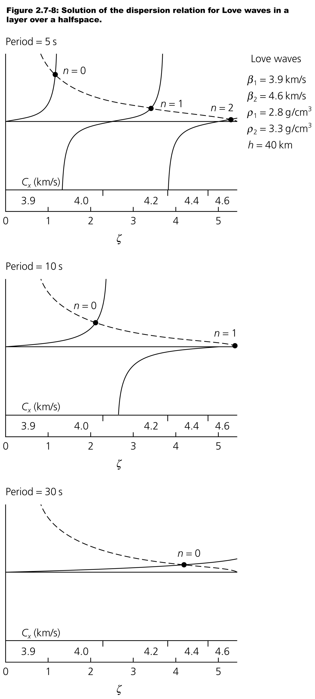
In this plot, the LHS of the equation
{tan(ωζ)} is shown by the solid lines; the
RHS is given by the dashed curve.
So, where the lines meet are values of ζ
that solve the equation (called modes).
The leftmost (n = 0) solution is called the
fundamental mode; the rest are
higher modes or overtones
(n = 1 to n_{ω}).
The number of possible modes
decreases with wave period.
The apparent velocity of the waves
increases with wave period: thus Love
waves are innately dispersive.

Slide 11
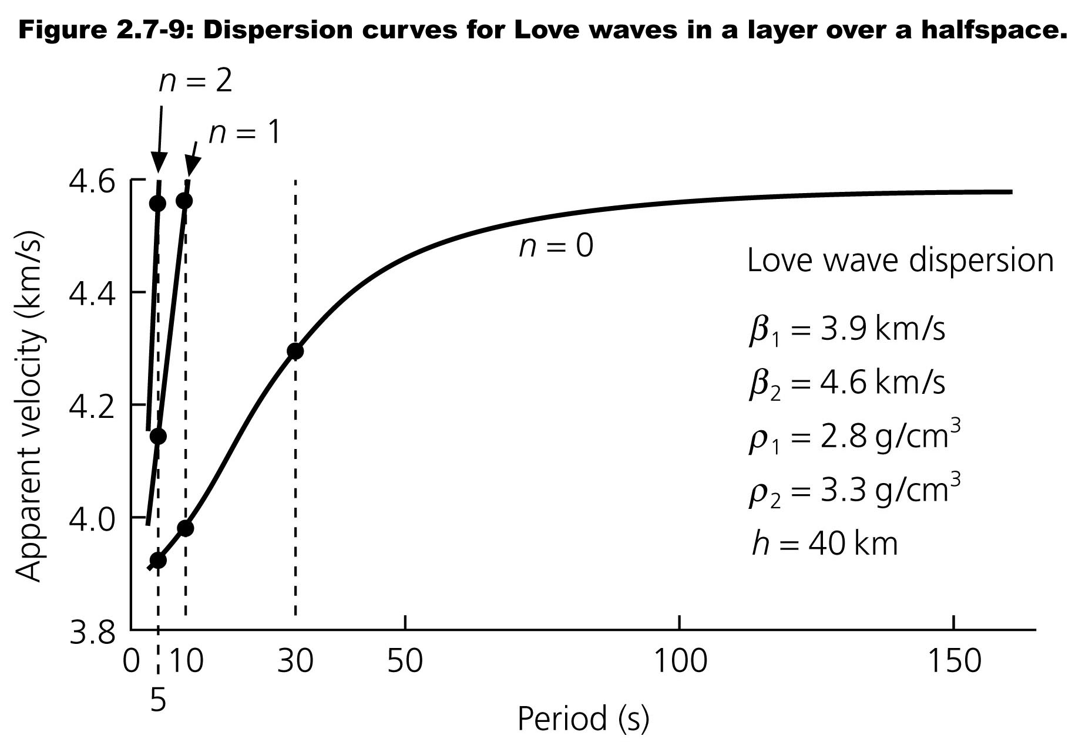
The apparent velocity of waves increases with wave period:
thus Love waves are innately dispersive.
Mode velocity vs wave period:

