Slide 1
Geology 5640/6640
Introduction to Seismology
14 Nov 2024
Last time: Love Waves
• Love waves are a constructive interference between
intersecting SH wavefronts with identical phase.
• For a layer-over-halfspace, phase is identical for an
apparent velocity c_{x} in which:
and hence β₁ < c_{x} < β₂.
• At shorter periods of seconds to a few tens of seconds,
Love waves can have higher modes in addition to
a fundamental mode seen at longer periods
• Love wave velocity c_{x} is dispersive and increases with
period and with mode number
Read for Tuesday 19 November: S&W 119-157 (§3.1–3.3)
© A.R. Lowry 2011-2024

Slide 2
Reminder:
Exam 1 is posted on the course website;
Due at classtime Tues November 19

Slide 3
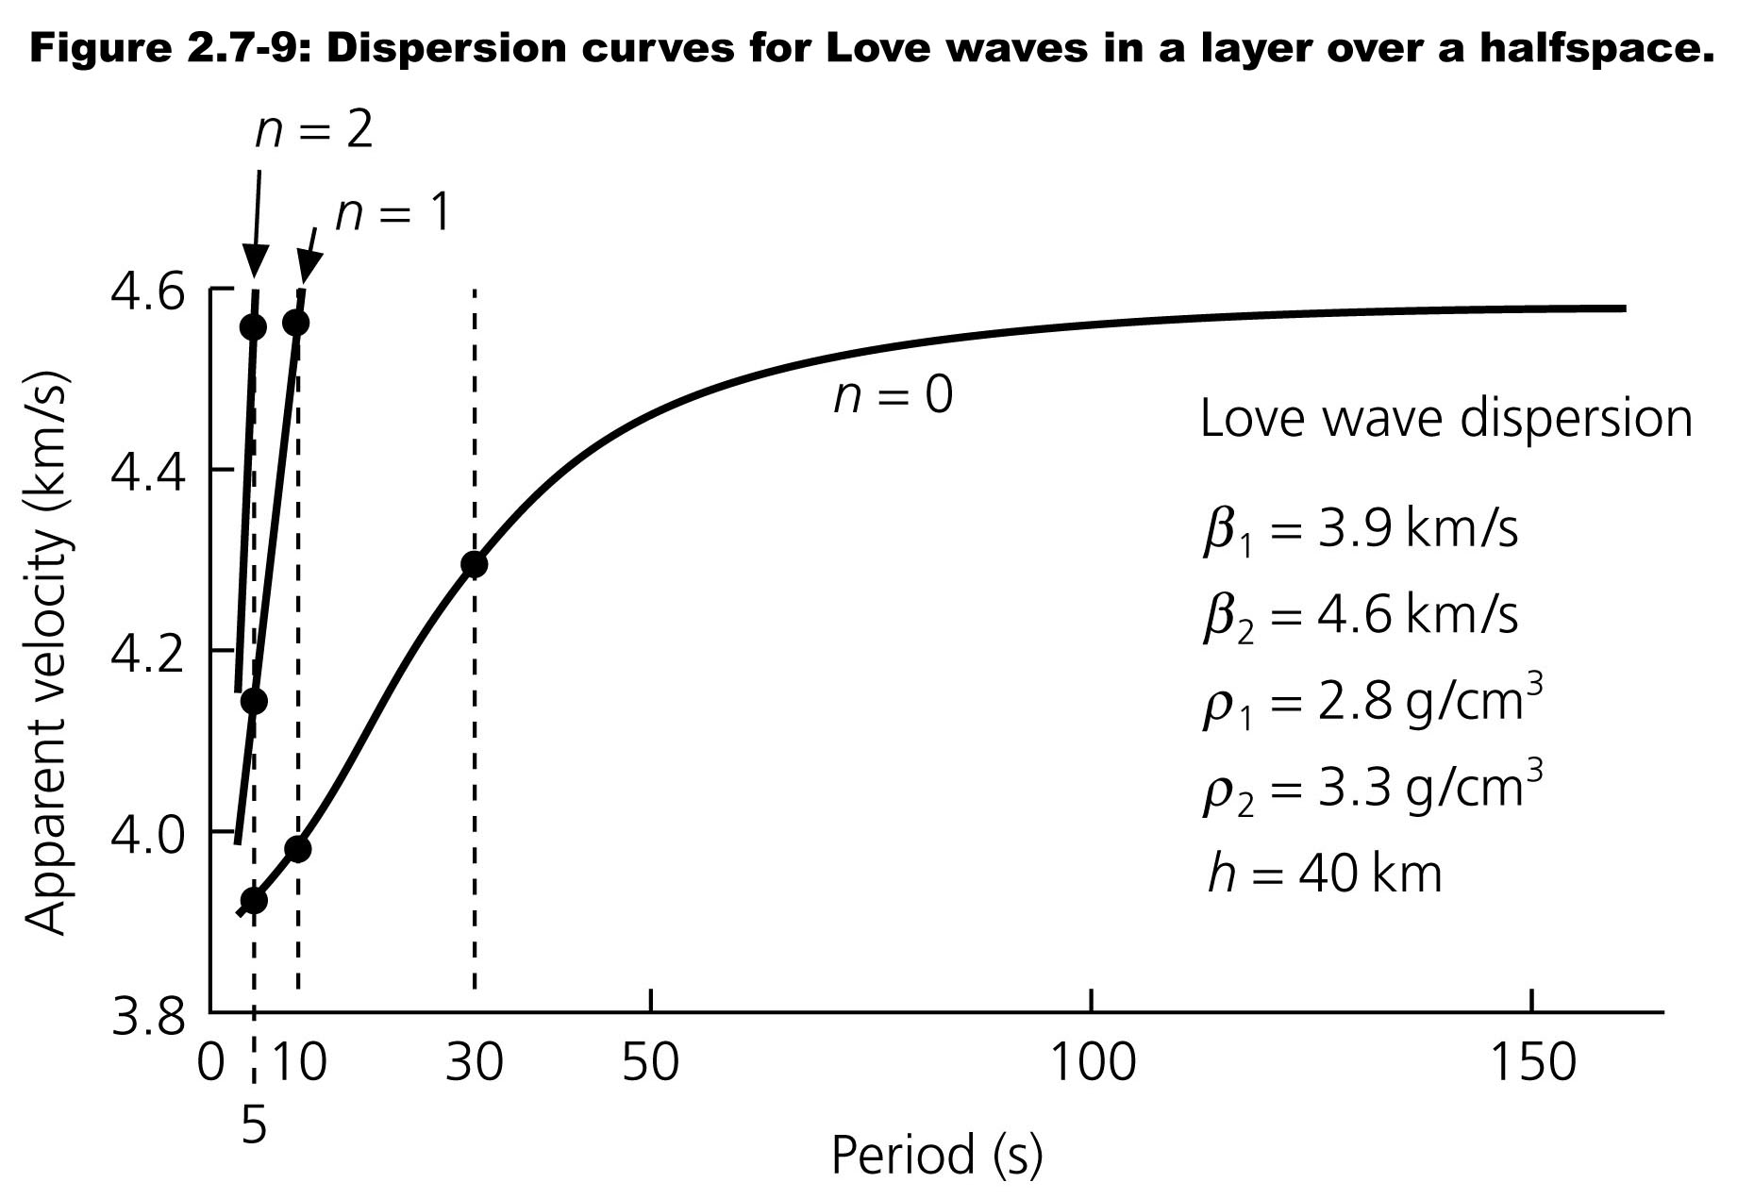
The apparent velocity of waves increases with wave period:
thus Love waves are innately dispersive.
Mode velocity vs wave period:

Slide 4
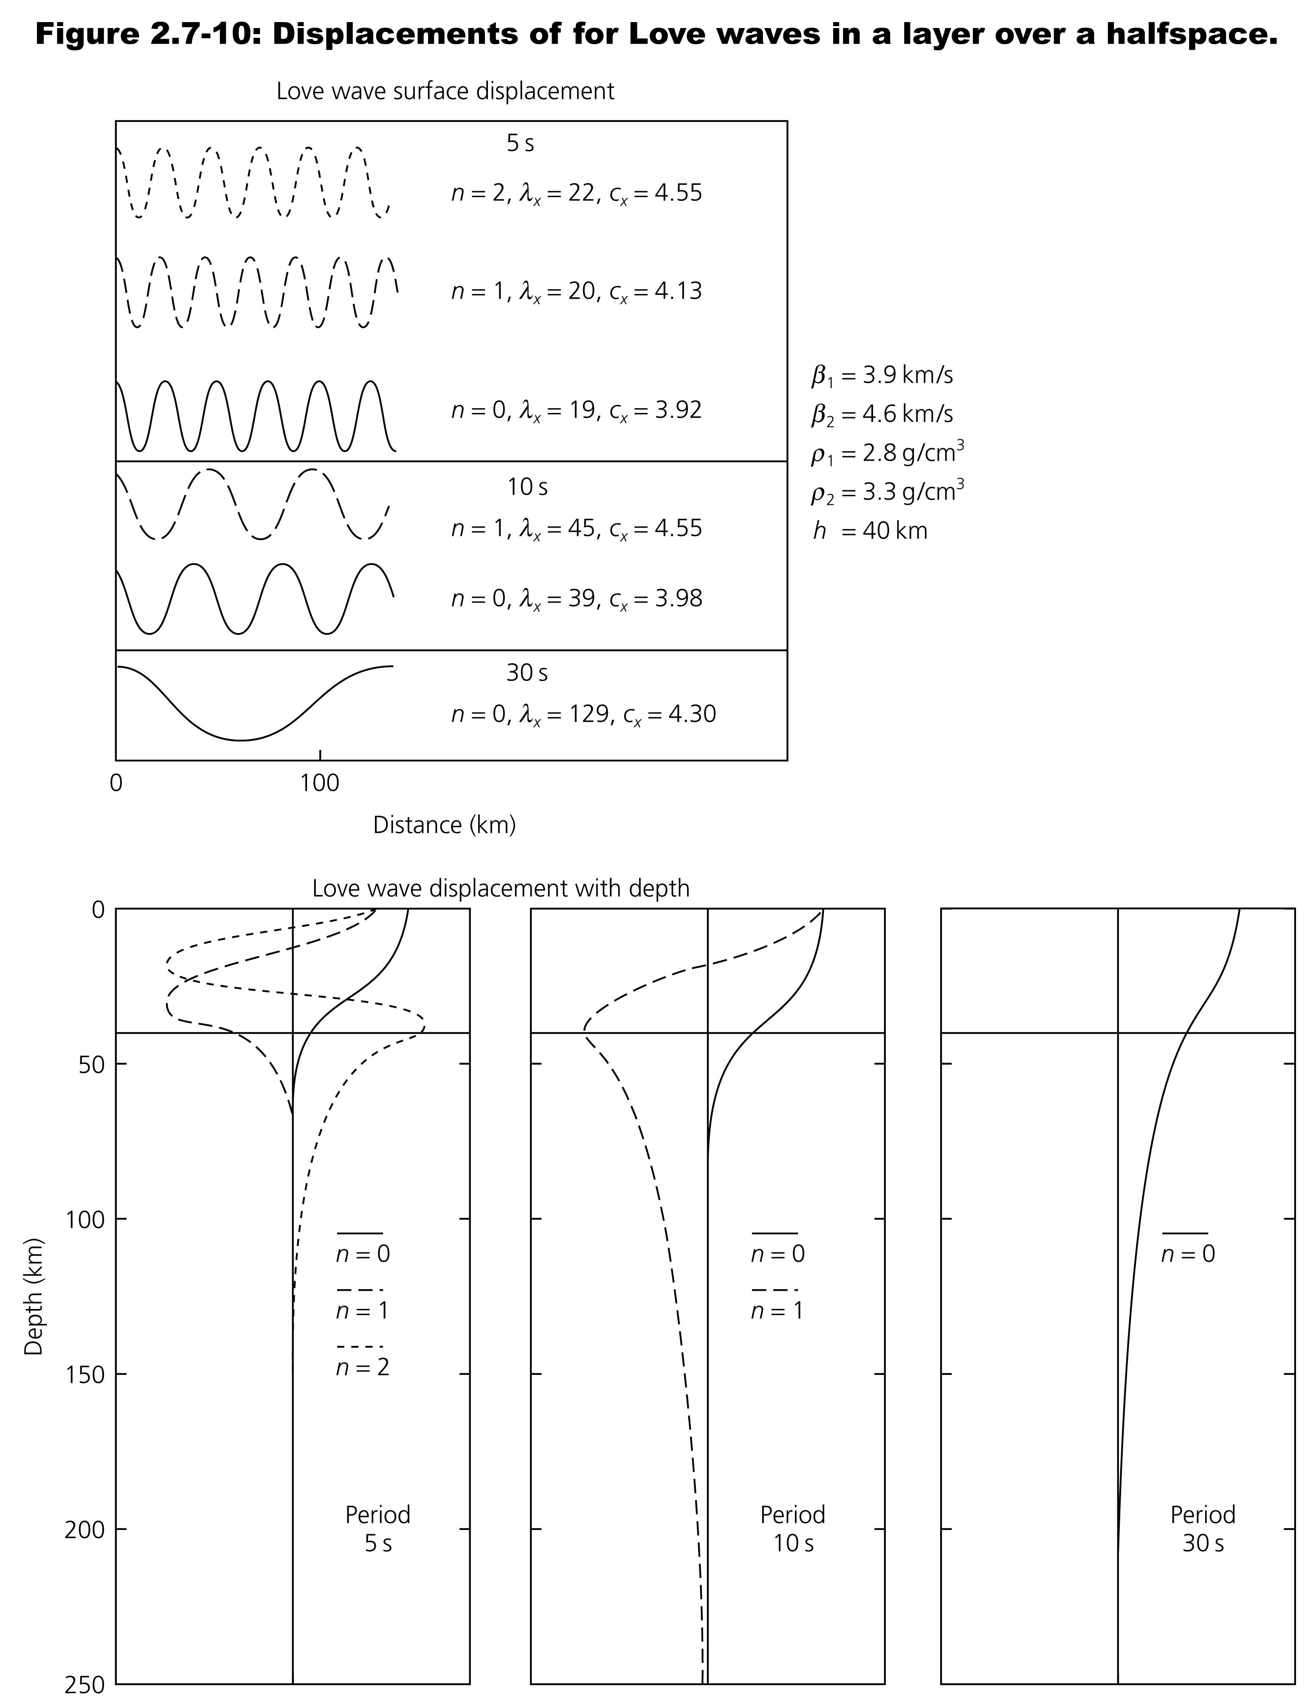
Amplitudes of
displacement:
For a plane-wave in an
idealized Earth, there is
no energy loss (these are
evanescent = “trapped”
waves) so u_{y}(x) remains
constant. (For a point
source get cylindrical
spreading; in the real
Earth have anelastic
attenuation).
In depth, amplitude u_{y}(z)
is a sinusoid in the layer
and an exponential decay
in the halfspace…
k_{x} = 2π/λ_{x}
= ω/c_{x}

Slide 5
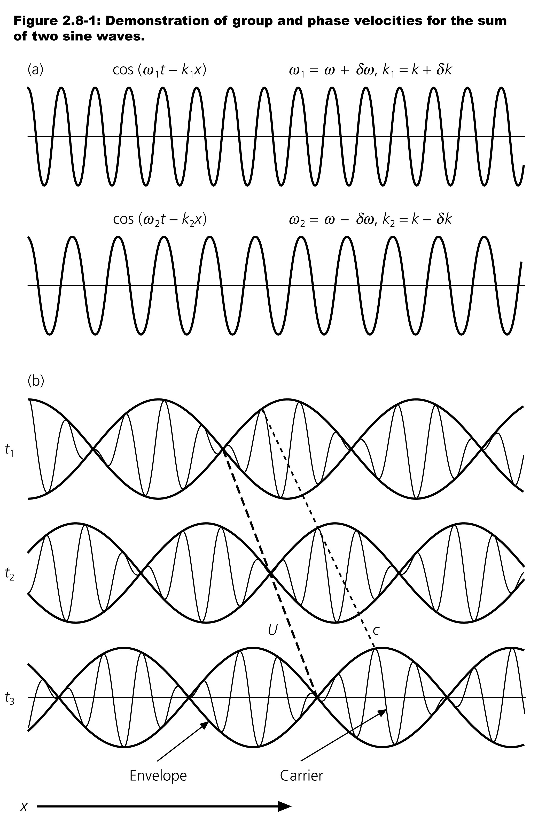
Group & Phase Velocity:
Surface waves sum all modes
and all frequencies!
Consider a sum of two waves
with differing ω and k:
u(x,t) = cos(ω₁t – k₁x) + cos(ω₂t – k₂x)
Let:
ω₁ = ω + δω ω₂ = ω – δω ω >> δω
k₁ = k + δk k₂ = k – δk k >> δk
Then we can substitute/rewrite:
u(x,t) = cos(ωt + δωt – kx – δkx)
+ cos(ωt – δωt – kx + δkx)
= 2cos(ωt – kx)cos(δωt – δkx)
The envelope (or “beat”) has
group velocity U = δω/δk;
Individual peaks move with
phase velocity c = ω/k
(Here red = c;
green = U)

Slide 6
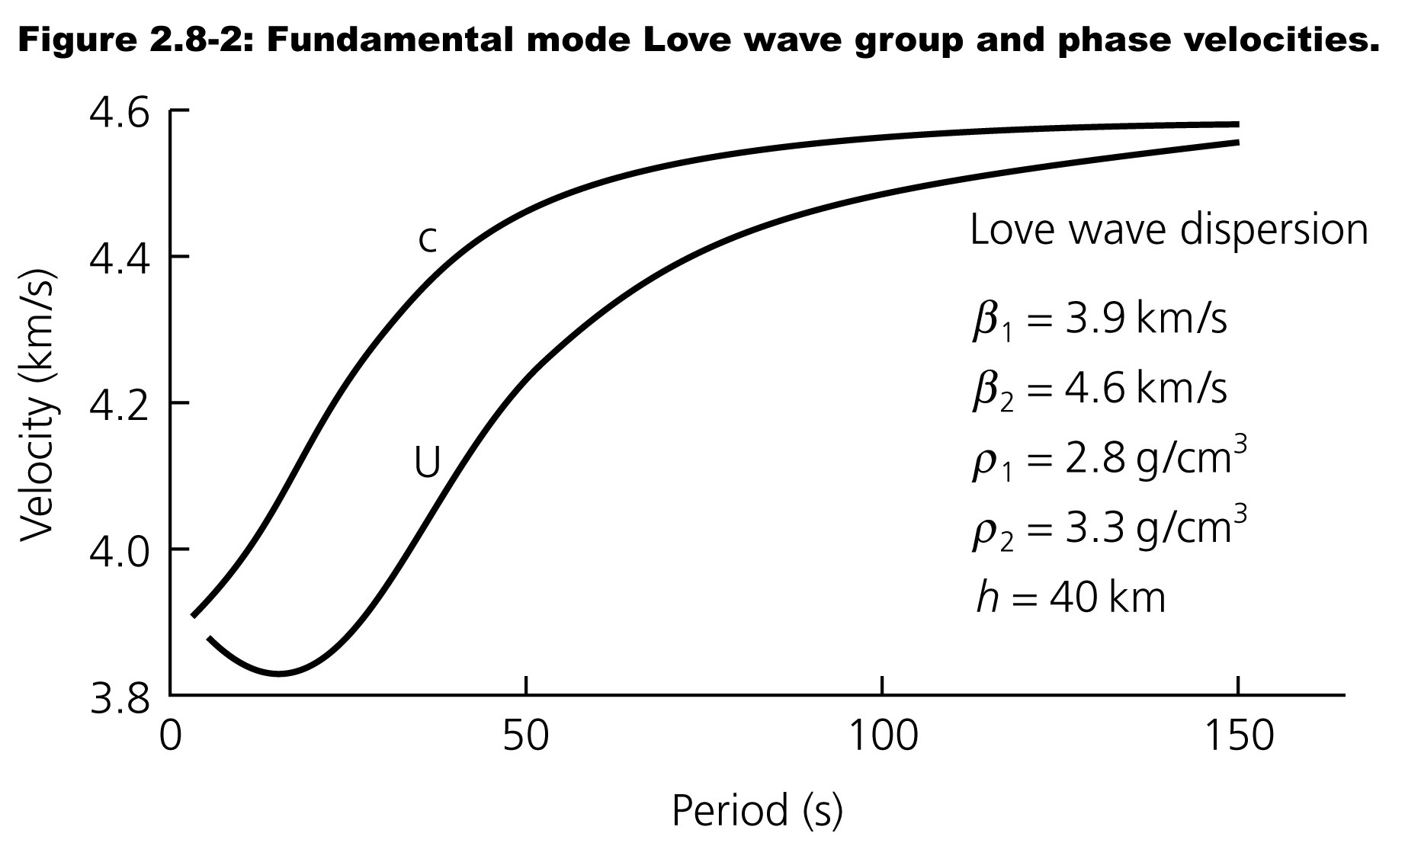
(Phase velocity)
(Group velocity)

Slide 7
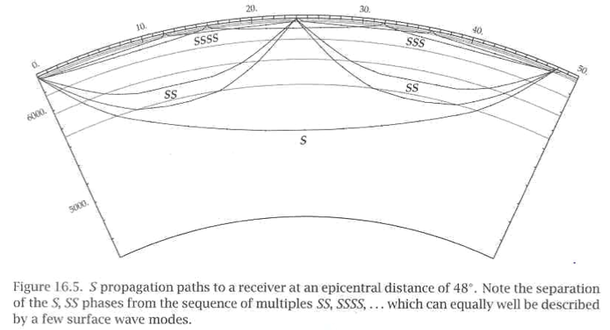
Of course the real Earth is less simple than a layer-over-
halfspace… Here the evanescent waves include turning
rays that produce S, SS, SSS, SSSS, etc. phases.
More S’s equal more bounces => shallower paths.
Kennett (2001)

Slide 8
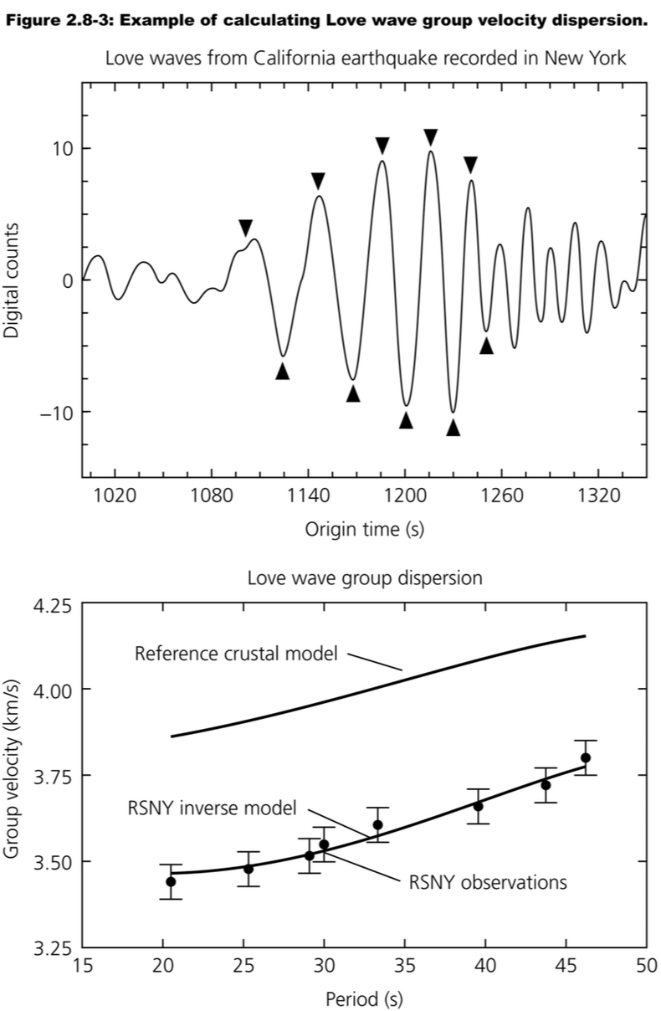
To measure Group Velocity:
• Measure period as the time
between successive peaks
or troughs
• Travel-time is the time at the
time of arrival of the wave
group minus the origin time
• Divide the source-receiver
distance by travel-time to
get the group velocity

Slide 9
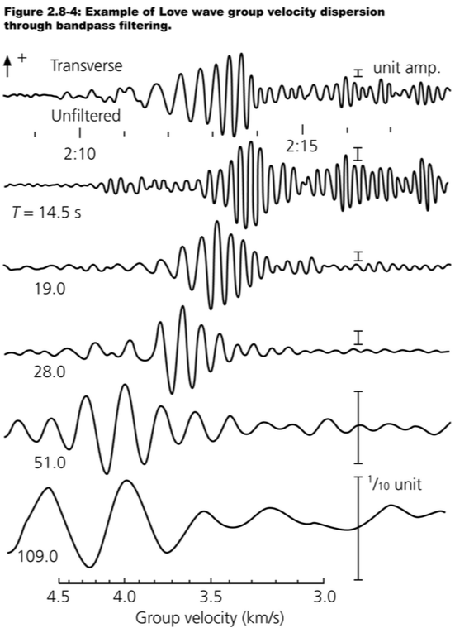
Or can get a bit more
sophisticated by filtering
the waveform (multiplying
by a “windowing function”
in the frequency domain)
to isolate elements of the
waveform that have a
particular period, using a
Fourier Transform.
To get phase velocity, can
transform to phase φ
and e.g. solve for c(φ) from
the difference in phase of
the arrivals at two sites

Slide 10
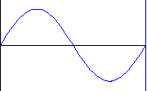
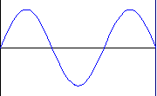
What is a free oscillation?
x
Fundamental
L
1st Harmonic
Note: These slides borrow heavily from a presentation by Michel van Camp, Royal Observatory of Belgium
2nd Harmonic
3rd Harmonic
etc.
Free oscillation = stationary wave
Interference of two counter propagating waves
(see e.g. http://www2.biglobe.ne.jp/~norimari/science/JavaEd/e-wave4.html)

Slide 11

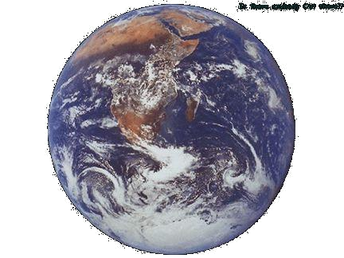
Seismic normal modes
(Duck from Théocrite,
© J.-L. & P. Coudray)
Few minutes after the earthquake
Constructive interferences ➔ free oscillations
(or stationary waves)
Few hours after the earthquake (₀S₂₀)
⇨ Periods < 54 min, amplitudes < 1 mm
⇨ Observable months after great earthquakes (e.g. Sumatra, Dec 2004 took about 5 months to decay)

Slide 12
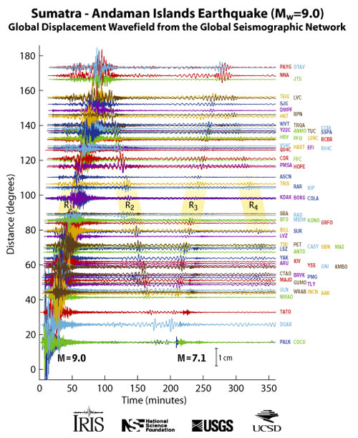
Traveling Surface Waves
Rick Aster, Colorado State University
http://www.iris.iris.edu/sumatra/

Slide 13
Normal Modes
Historic
⇨ First theories:
• First mathematical formulations for a steel sphere: Lamb, 1882: 78 min
• Love, 1911 : Earth → steel sphere + gravitation: eigenperiod = 60 minutes
⇨ First Observations:
  • Potsdam, 1889: first teleseism (Japan): Waves can travel the whole Earth!
  • Isabella (California) 1952 : Kamchatka earthquake (Mw = 9.0). Attempted to identify a « mode » of 57 minutes. Incorrect but reawakened interest!
  • Isabella (California) 22 May 1960: Chile earthquake (Mw = 9.5): Numerous modes are identified
  • Alaska 1964 earthquake (Mw = 9.2)
  • Columbia 1970: deep earthquake (650 km): overtones → IDA Network

