Slide 1
Geology 5640/6640
Introduction to Seismology
14 Oct 2020
Last time: Seismic phases; the ray parameter
• The ray parameter p also describes travel path
of a particular phase in terms of its angle from
vertical, θ, and velocity c. p is constant for a given
ray, and corresponds to the inverse horizontal velocity!
• Deep-Earth investigations use earthquakes as sources,
three-component broadband seismometers as receivers,
and are a primary tool for investigating properties and
processes in the Earth’s deep interior!
Read for Fri 16 Oct: S&W 62-75 (§2.5)
© A.R. Lowry 2020

Slide 2
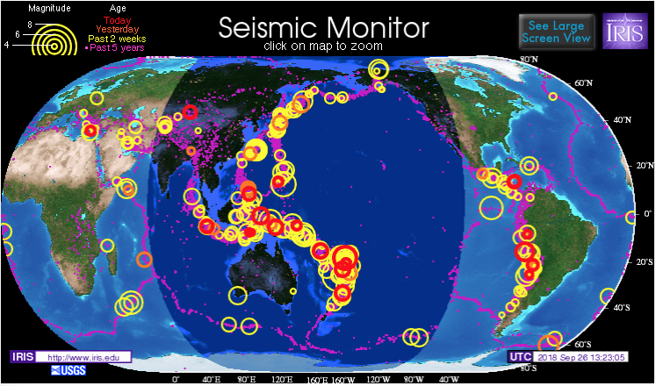
Probe: Earthquakes
Many earthquakes each year are strong enough to generate signal at antipodes:
10 major (magnitudes 7-8) 32+ megaton ~ Largest test
100 large (6-7) 1+ megaton
1000 damaging (5-6) 32+ kiloton ~ Trinity
www.iris.edu
Lars Stixrude
Notes:
2

Slide 3
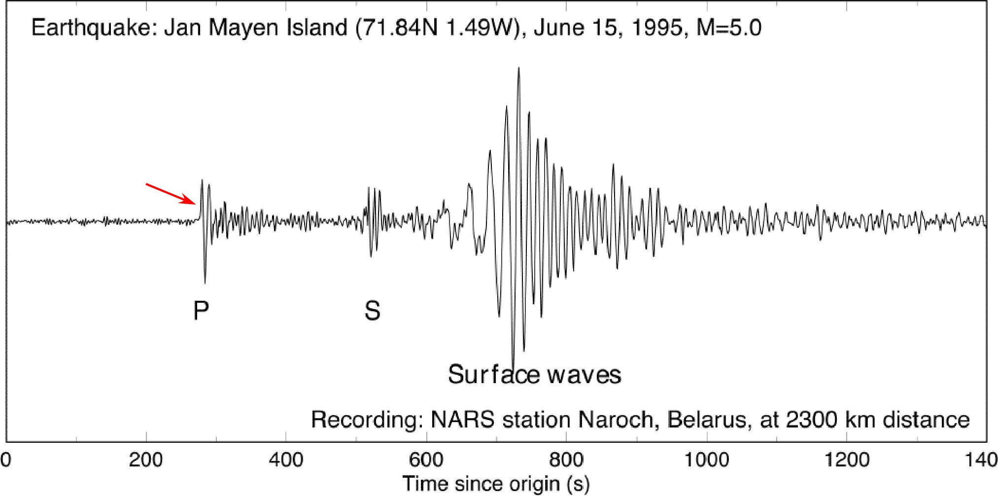
Detector: Seismograph
Lars Stixrude
Notes:
3

Slide 4
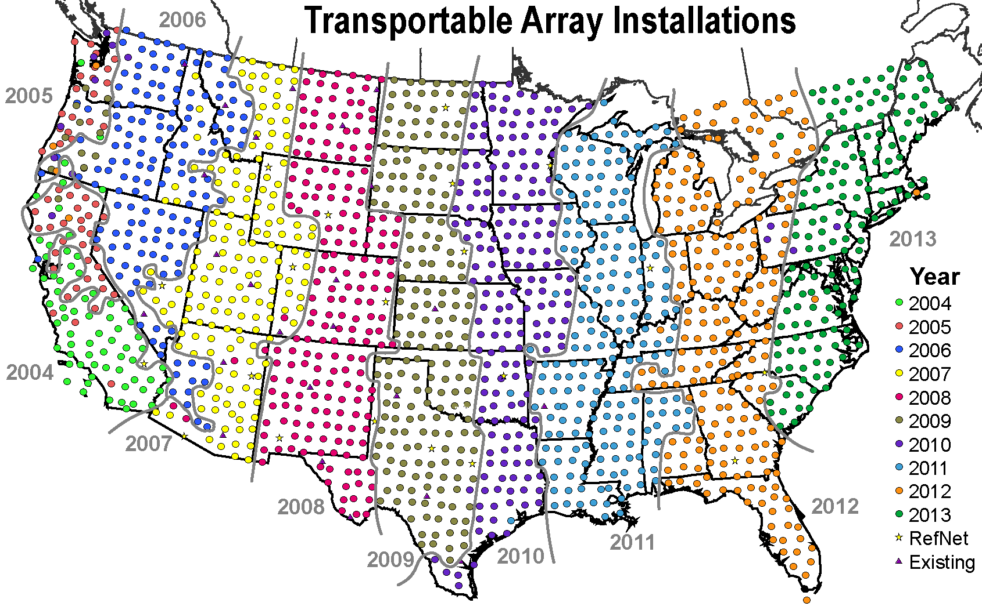
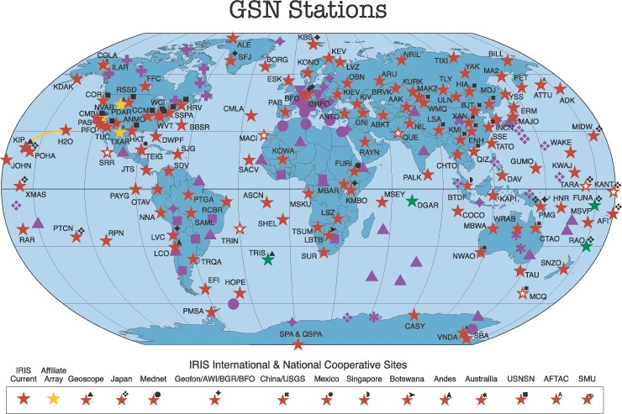
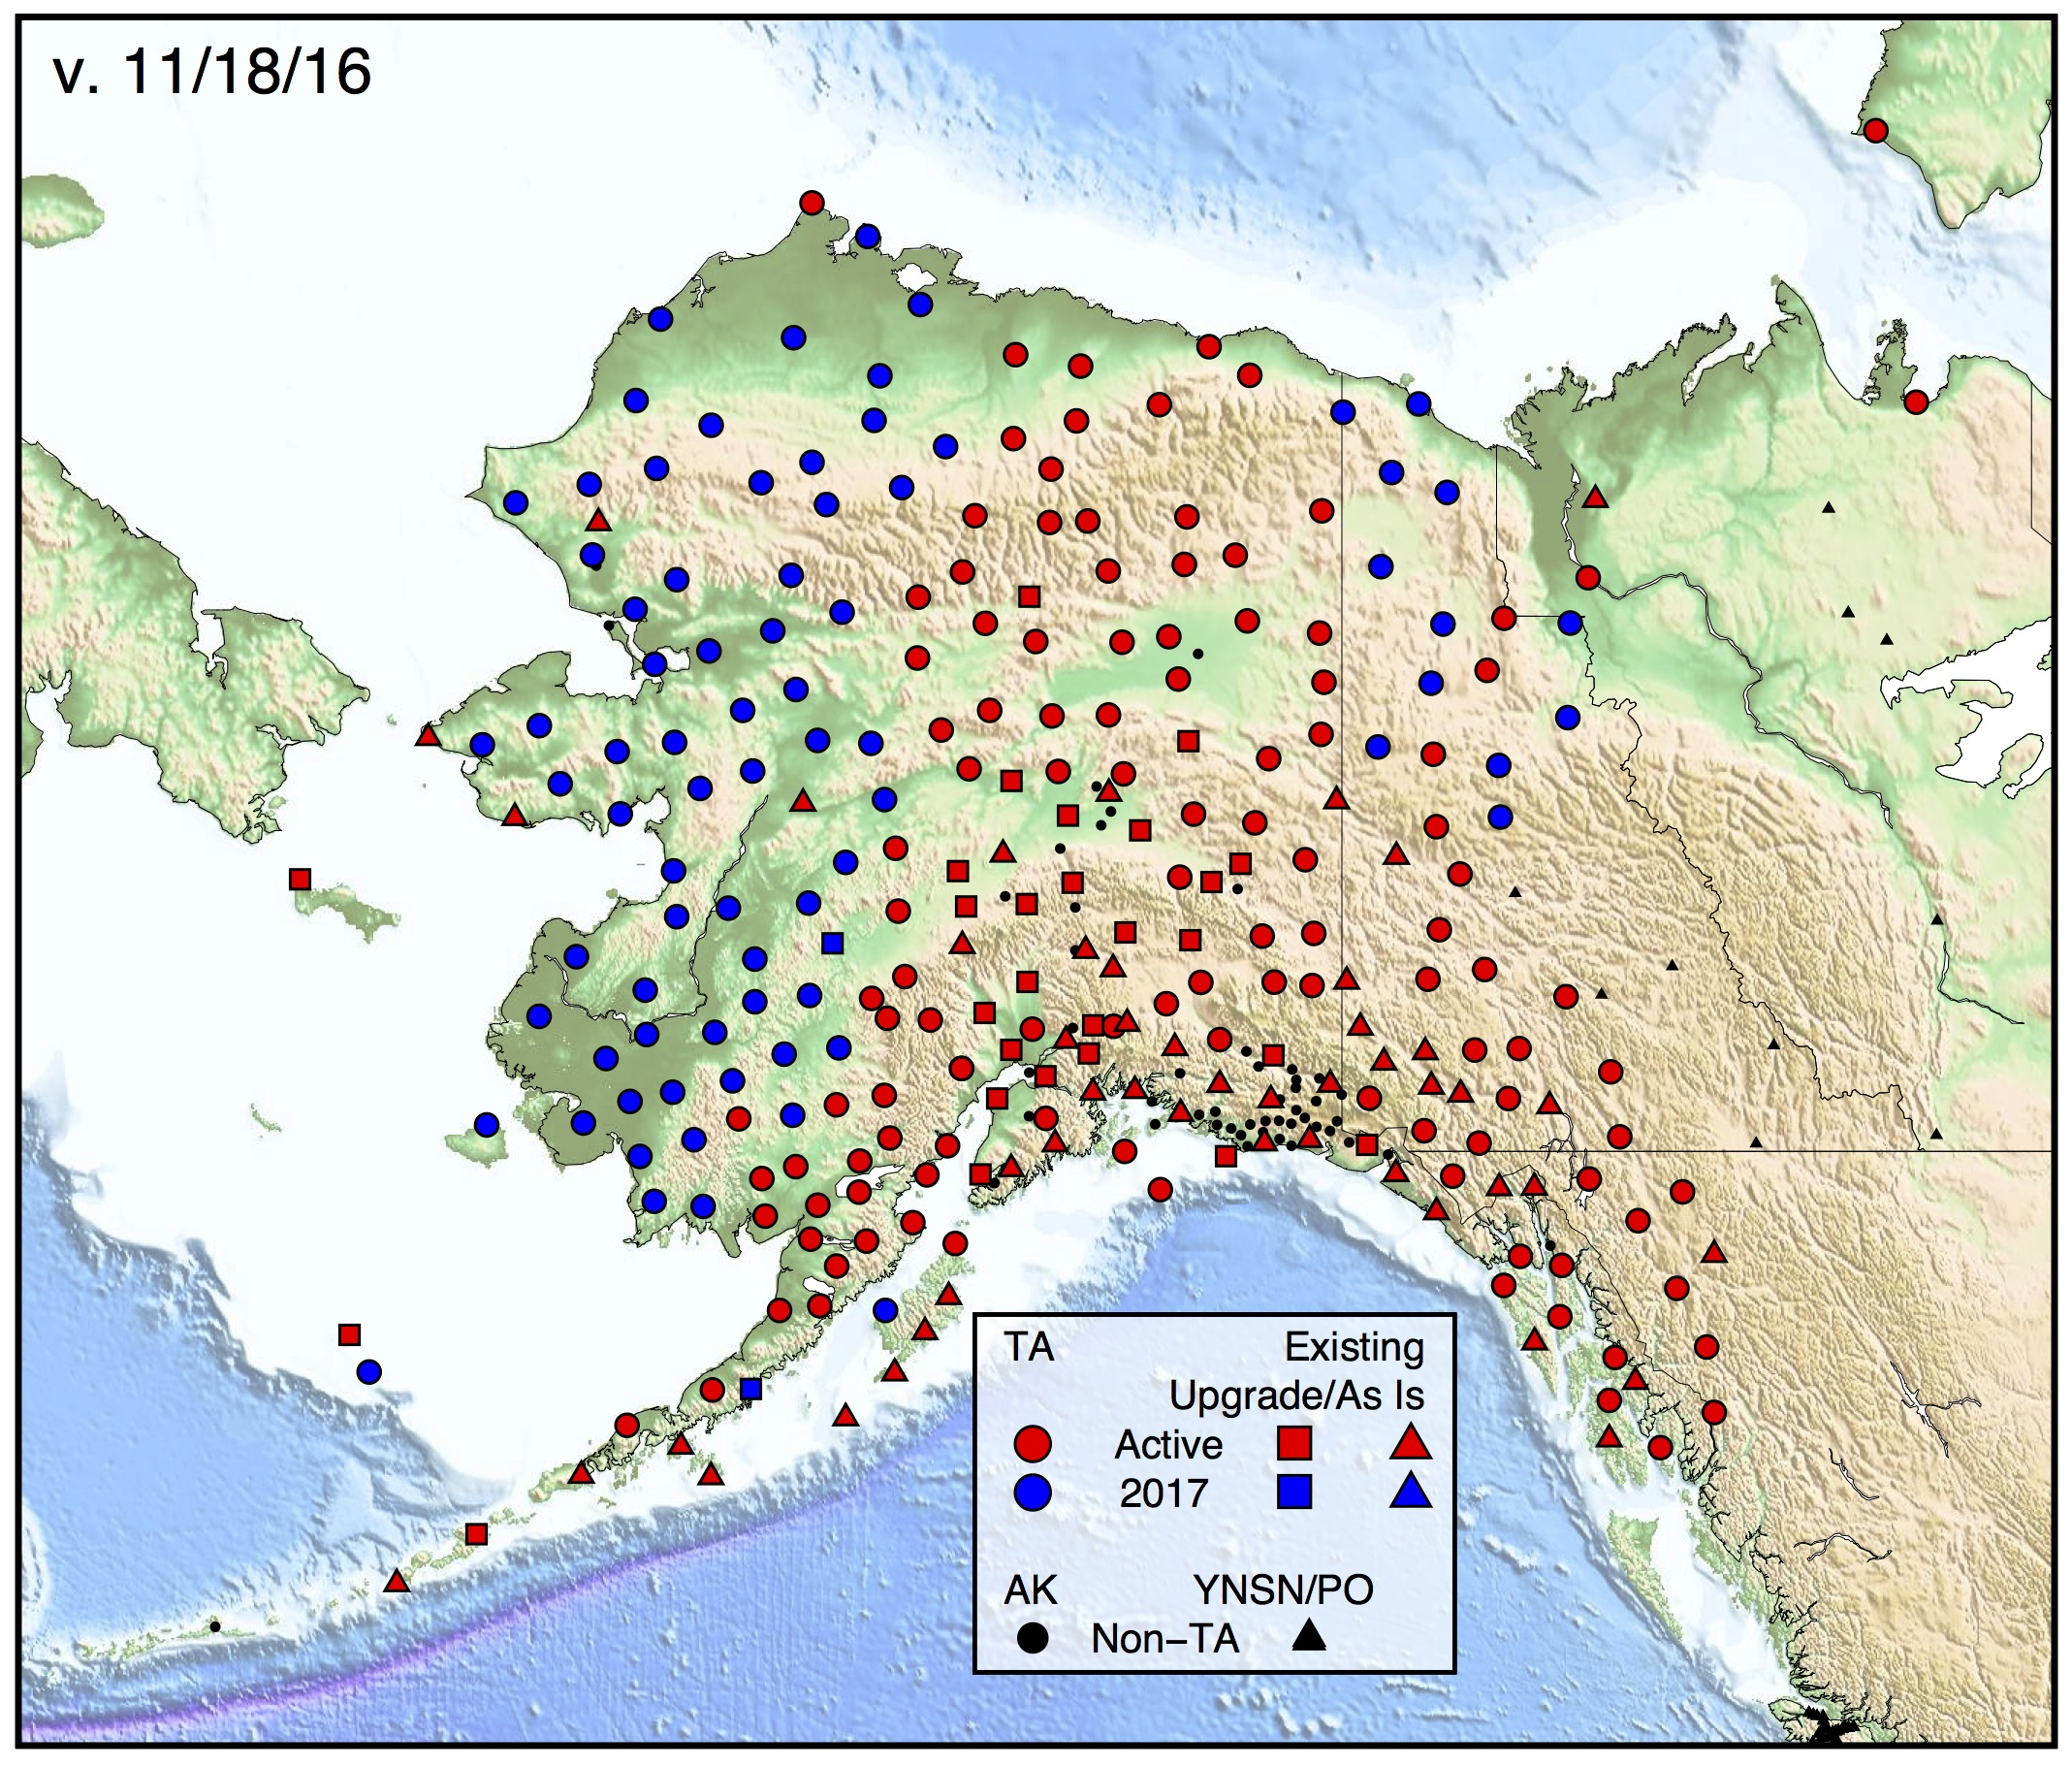
Seismic networks
USArray
Global Seismic Network
Lars Stixrude
Notes:
4

Slide 5
Types of Seismic Analysis (for Earth structure… Earthquake analysis is another topic
for another day!)
• Normal modes
• Arrival times of “precursors”
• Numerical modeling of waveforms
• Deconvolve “source term” from observed waveform:
receiver functions
• Anisotropy
• Travel-time tomography
(There are more!)

Slide 6
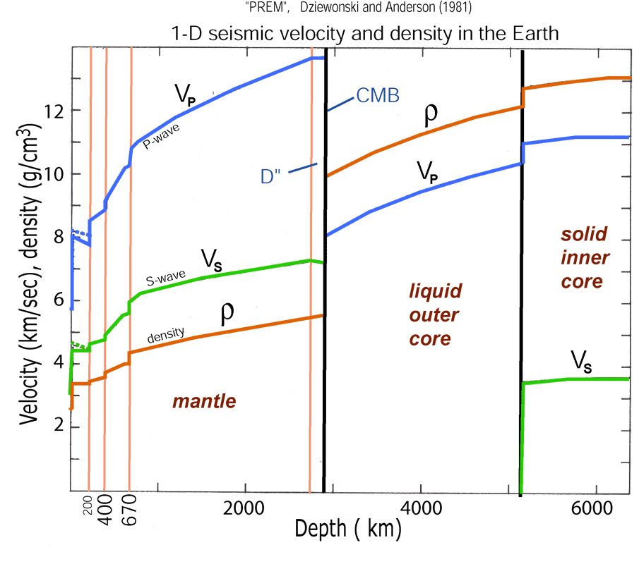
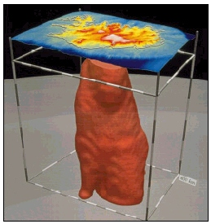
Normal Modes
PREM is derived from normal modes, but they also can be used
to image three-dimensional structure (e.g. from splitting)

Slide 7
SS and SS Precursors: Imaging upper mantle discontinuities and transition zone structure
Ed Garnero
Schmerr and Garnero [2006, JGR]

Slide 8
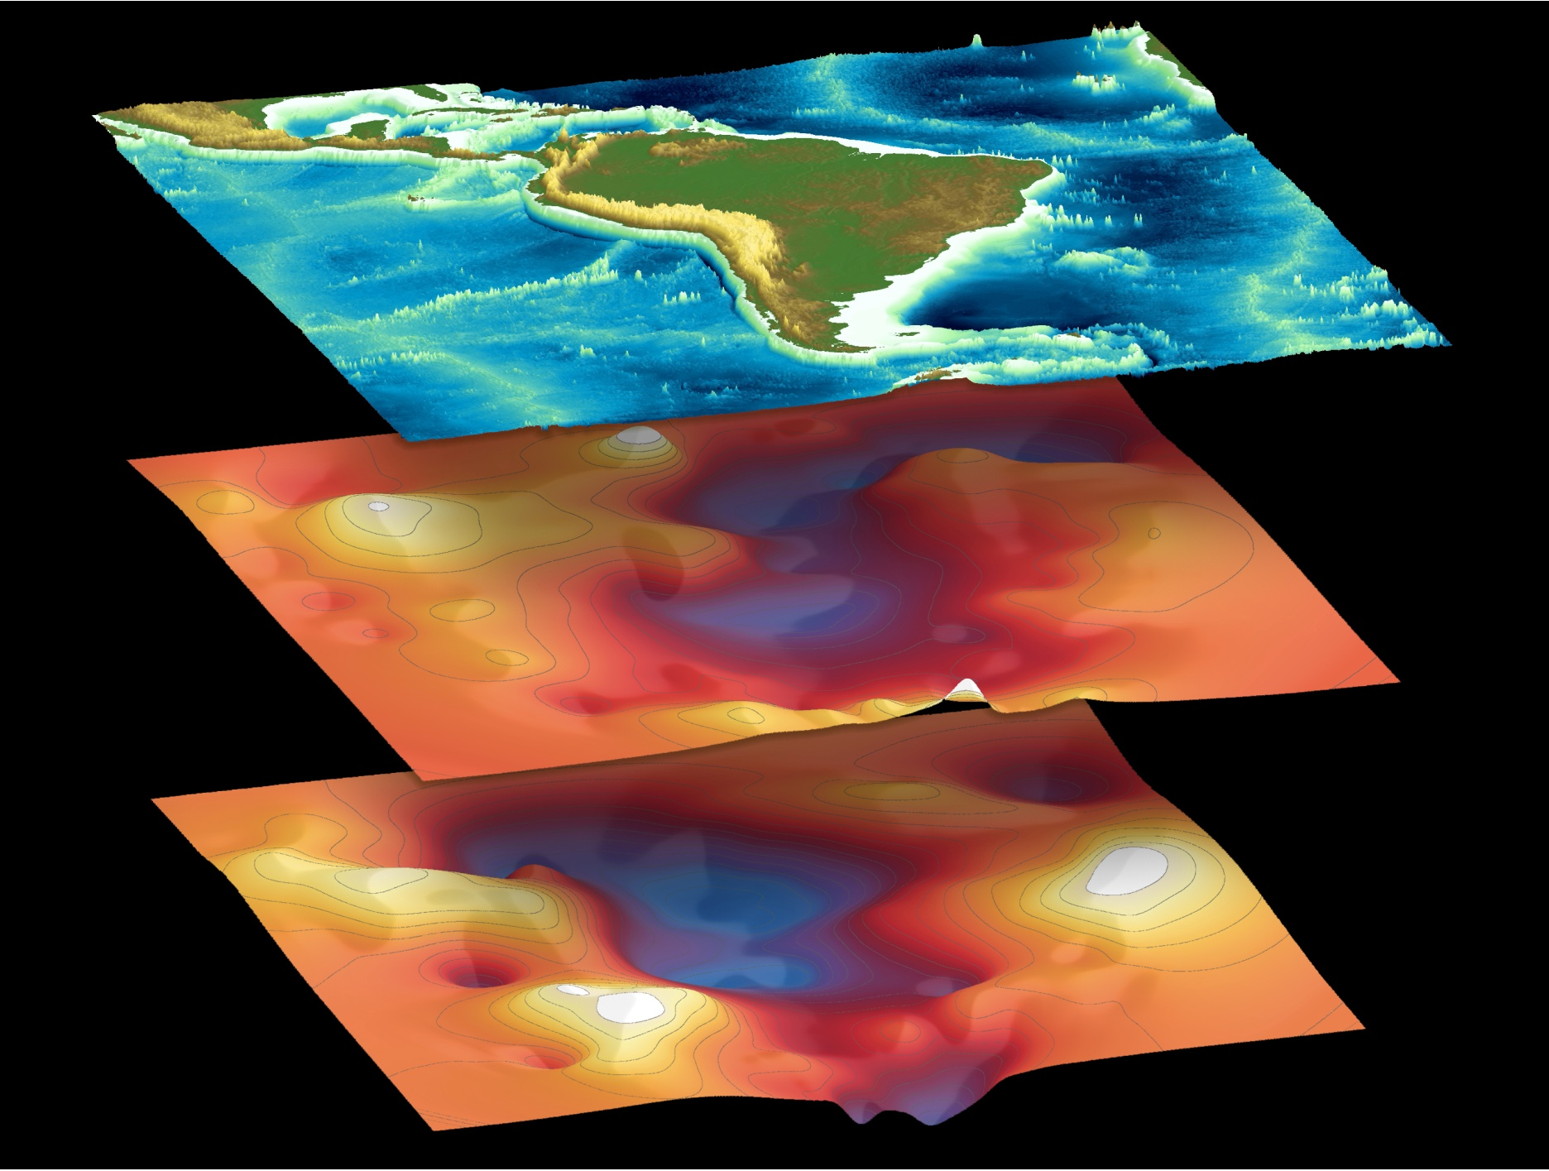
Upper mantle discontinuity topography
410
topography
660
topography
Ed Garnero
Schmerr and Garnero [2007, Science]
Notes:
8

Slide 9
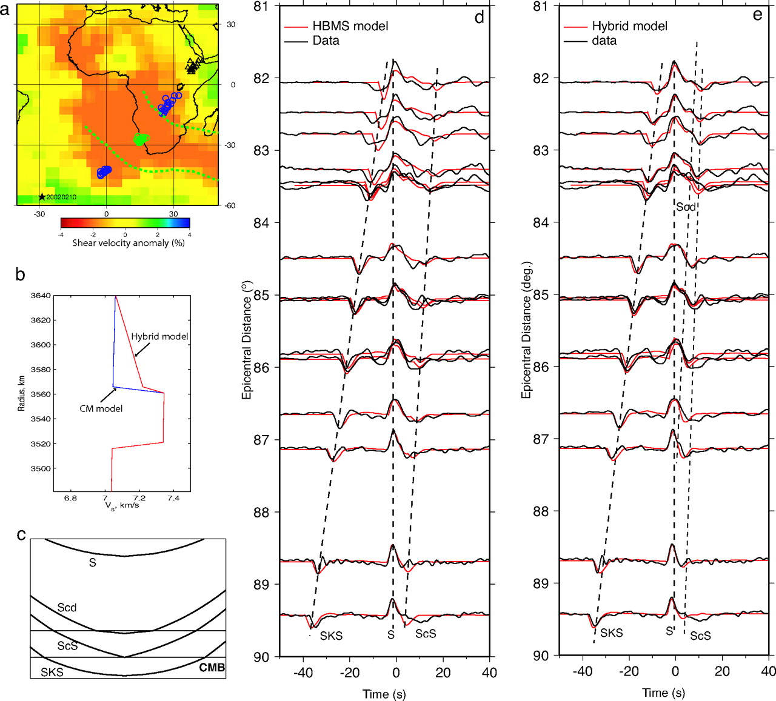
Waveform Modeling
Waveform modeling of a D” triplication from the
Ethiopia/Kenya array from a deep Sandwich Island event
HBMS = High bulk
modulus structure,
implies a lower shear
velocity, higher
temperature, higher
density chemical
layer at the core-mantle
boundary...
The inferred “fast lens”
Would be 90 km above
the CMB.
Sun D et al. PNAS 2007;104:9151-9155
Notes:
Modeling a D” triplication from the Ethiopia/Kenya array from a deep Sandwich Island event. (a) The recording geometry with solid circles indicating the SCS sampling points at the CMB. (b) We assume that the ALVS inside the green box in Fig. 1b is 1D and replace the velocities near the bottom with our preferred structure (b). We have included a model with a sharp 4% jump (CM), which is discussed in SI Text. (c) Geometric ray paths with arrival times given as lines on the data-synthetic record sections. (d) The comparison with observed waveforms against predictions from the HBMS model. (e) The comparison with observed waveforms against predictions from the hybrid model containing structure b.

Slide 10
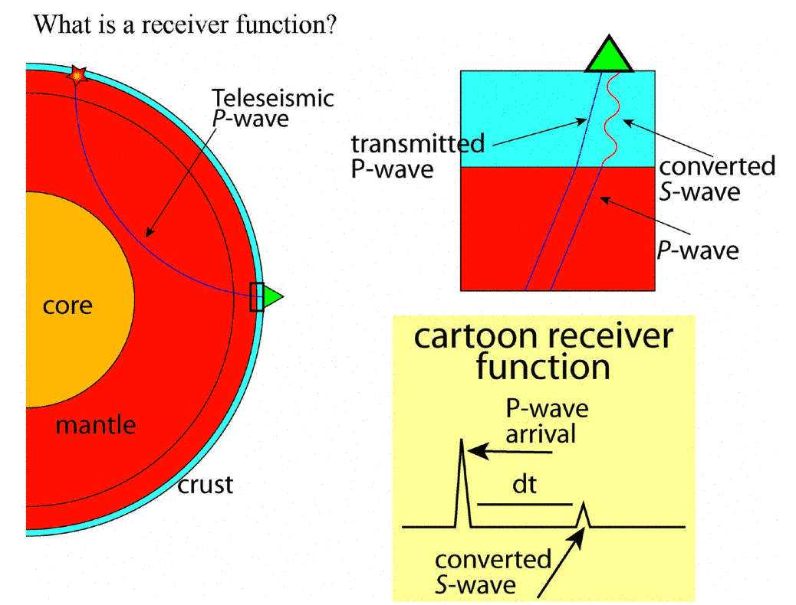
Receiver Functions
Jessie Lawrence

Slide 11
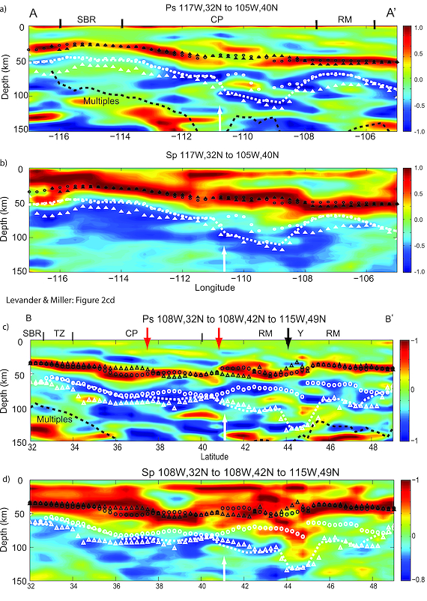
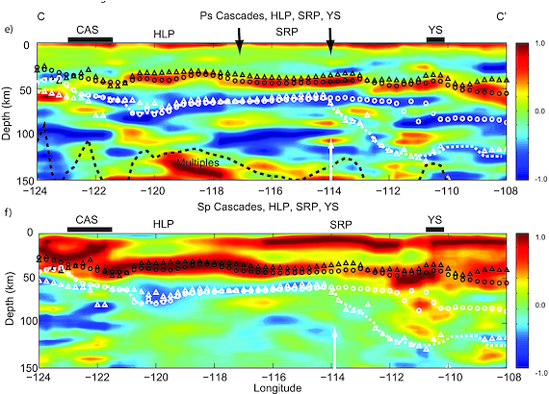
Negative Velocity Gradients
(faster over slower): called
“lithosphere/asthenosphere
boundary (LAB)”; “mid-
lithosphere discontinuity
(MLD)”…
Interpreted as partial melt,
water, metasomatized layer?
(Levander & Miller, G³, 2012)

