Slide 1
Geology 5640/6640
Introduction to Seismology
14 Sep 2020
Last time: Overview of Basic Principles of Waves
• Huygen’s Principle: Every point on a wavefront can
be considered a source for the next generation of
wavelets
• Diffractions are predicted by Huygen’s Principle
• But most modeling uses Ray Theory (i.e., the normal to
the wavefront ➔ propagation direction, which defines
travel path (distance) and relates to time by way of velocity)
Read for Wed 14 Sep: S&W 29-52 (§2.1-2.3)
© A.R. Lowry 2020

Slide 2
Geology 5640/6640
Introduction to Seismology
Last time cont’d:
• Reflections are wave energy that “bounces off” a surface
dividing media with different velocity properties, remaining
in the original medium
Refractions are energy transmitted through the boundary
into the second medium
• Conversions from P to S particle motion (or vice versa)
almost always occur at these boundaries
• All of these must obey Snell’s Law…

Slide 3
Ray representation of seismic wave propagation:
If seismic waves are (relatively) easily represented by rays
(= the direction of propagation and the normal to the
wavefront; parallel (P) or orthogonal (S) to particle motion)
But the directions are changing (by Snell’s Law) as the wave
propagates through the medium…
What are some important things we want to keep track of?
reflected P
refracted P
reflected S
refracted S
incoming P

Slide 4
Seismo-Math & Notation
(“Introduction” to Vectors)
Vectors:
z
x₃
y
x₂
x
x₁
We’ll use these notations for Cartesian coordinate systems
interchangeably…
Vectors have direction and magnitude; here we may
denote as boldface u or with an overbar or arrow .
A hat-sign denotes a unit direction vector .

Slide 5
A vector v from point Q at coordinate (0, 0, 0) to point P at
coordinate (a, b, c) may be denoted by any of
z
P (a,b,c)
Q (0,0,0)
c
a
y
b
x
More generally, v between Q at (X₁,Y₁,Z₁) and P at (X₂,Y₂,Z₂)
can be expressed as any of:
Length of a vector is the square-root of the summed-squared
elements, i.e.,

Slide 6
Addition and Subtraction of vectors is performed
element-wise. If:
Then:
(You could show this graphically too).
A scalar multiplied by a vector gives:
and

Slide 7
Properties of Vector Addition and Multiplication:
Commutative:
Associative:
Distributive:
Some Special Vectors:
Null:
Unit: has length 1: Note a unit vector in any
direction can be defined as:

Slide 8
Example Unit Vectors:
Thus we can write any vector in the form, e.g.:
Part of this course will include an “introduction” to
linear algebra…
This sort of representation of vector multiplication is
standard and will crop up a lot in this class!

Slide 9
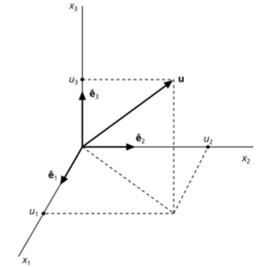
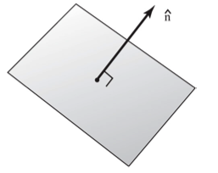
Note that other notations are common…
This is figure A.3-1 from the appendices
of Stein & Wysession. , and are
often used to denote three (arbitrarily-
oriented) orthogonal directions, which
may or may not equal , and .
A normal is a unit vector that
is perpendicular to a plane or surface.
Recall that unit means !

Slide 10
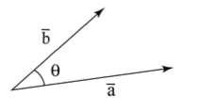
Multiplying Vectors:
A dot product represents the length of one vector multiplied
by length of its projection onto another (i.e., a measure of
how parallel
they are).
Hence, the dot product is a scalar value.
We could also write this as:
The latter, in which the repeated index implies the summation,
is called Indicial Notation (or Einstein summation
notation) & shows up a lot in seismology!
Given and ,

Slide 11
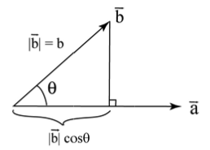
The dot product is easily shown to have associative,
commutative and distributive properties…
It is also useful for calculating the angle between two vectors:
➔
We can also use it to calculate the
projection of some vector b onto
the direction of another vector a:

Slide 12
The Cross Product of two vectors is defined as:
This produces a new vector that is orthogonal (perpendicular)
to the plane spanned by a and b (with length = area of the
parallelogram described by a and b).
We can also express this as the determinant of the matrix:
(Here, the straight lines surrounding the
matrix denote the determinant).
The determinant of a 3x3 matrix can be
derived from
2x2 matrix
determinants as
shown at left:
(a₂b₃ – b₂a₃)
(a₁b₃ – b₁a₃)
(a₁b₂ – b₁a₂)

Slide 13
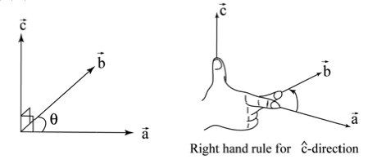
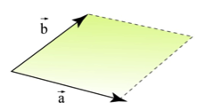
The cross product c = a×b obeys the right-hand rule:
And the length of c is defined by ||c|| = ||a×b|| = ||a|| ||b|| sinθ.
Hence, the cross-product can be thought of as a measure
of how orthogonal two vectors are.
The length ||a×b|| also equals the
area of a parallelogram defined
by a and b:
||c||

Slide 14
The cross-product is:
Anti-commutative: a×b = –b×a
Distributive: a×(b + c) = a×b + a×c
Associative: (a×b)×c = a×(b×c)

