Slide 1
Geology 5640/6640
Introduction to Seismology
15 Oct 2024
Last time: Global Seismic Imaging Methods…
Analysis tools for Deep-Earth investigations include:
• Normal modes • Precursors
• Waveforms • Receiver Functions
• Tomography • Anisotropy
• Ambient Noise
Receiver functions difference the arrival times of
transmitted and converted phase arrivals (e.g., at Moho, “LAB”)
Tomography uses travel-times for large numbers of
crisscrossing rays to image velocity structure
Anisotropy measures direction-dependence of velocity
— Shear wave splitting on SKS phase
— Azimuthal differences in travel-times from tomography
Read for Thursday 17 October: S&W 157–162 (§3.4)
© A.R. Lowry 2011-2024

Slide 2
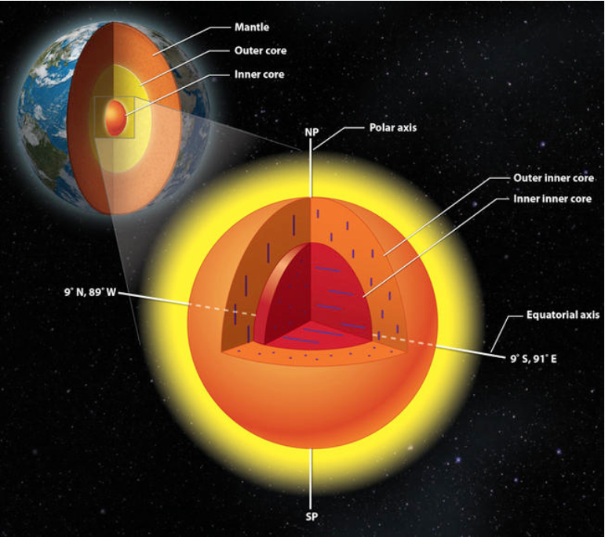
Example of deep Earth anisotropy:
Earth has an “inner inner core”…
Wang et al. (2015) Nature Geoscience
Expressed as
“east-west”
anisotropy in the
innermost core,
distinct from
north-south directed
anisotropy in the
outermost inner
core.

Slide 3
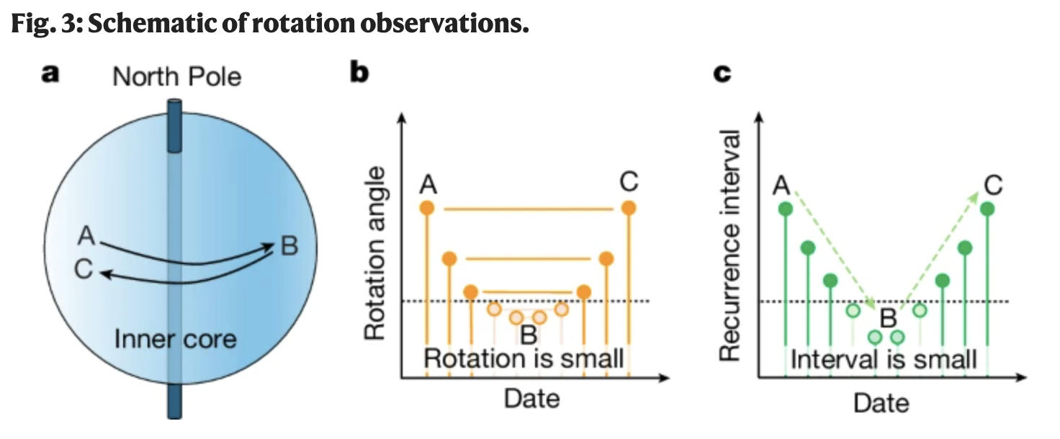
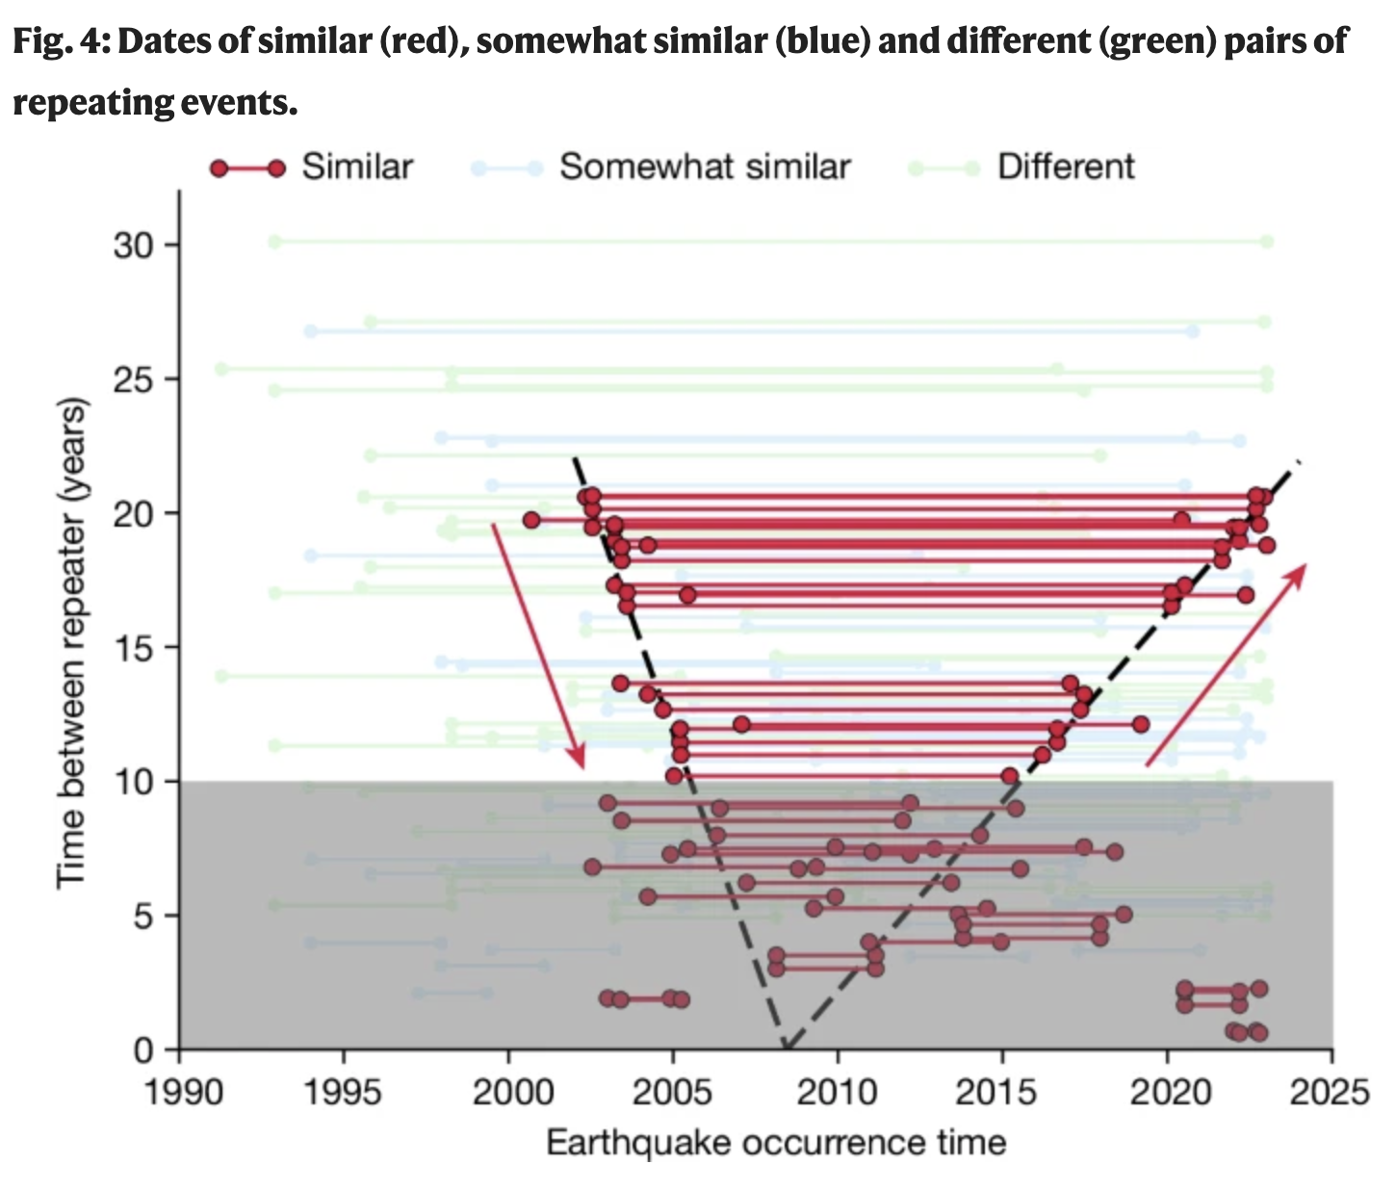
Earth’s inner core rotates relative
to the Earth’s mantle, and the
rotation rate varies over time!
Wang et al., Nature 2024
Here, compared similarity of
waveforms of PKIKP phase
from repeating earthquakes

Slide 4
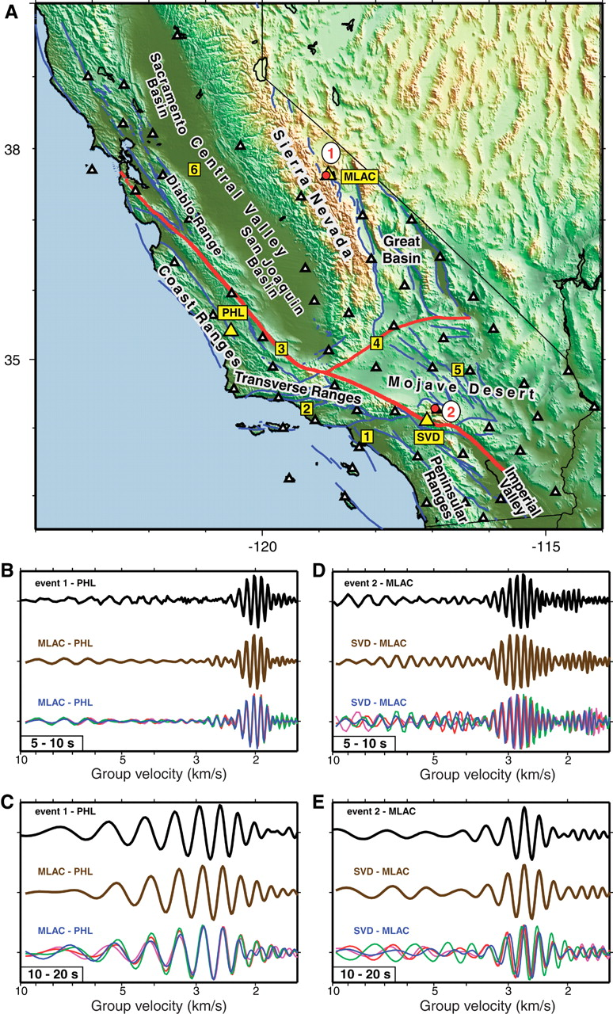
Ambient Noise
Cross-correlation of “noise”
recorded by two receivers
yields Rayleigh waves recorded
by both, traveling along a path
between...
Which is nearly equivalent to
what one would record at one
receiver from an earthquake
at the other!
This frees passive seismic
investigation from the “tyranny
of earthquakes…”
Shapiro et al., Science 2005
5-10 s bandpass
earthquake
one year
4 different months

Slide 5
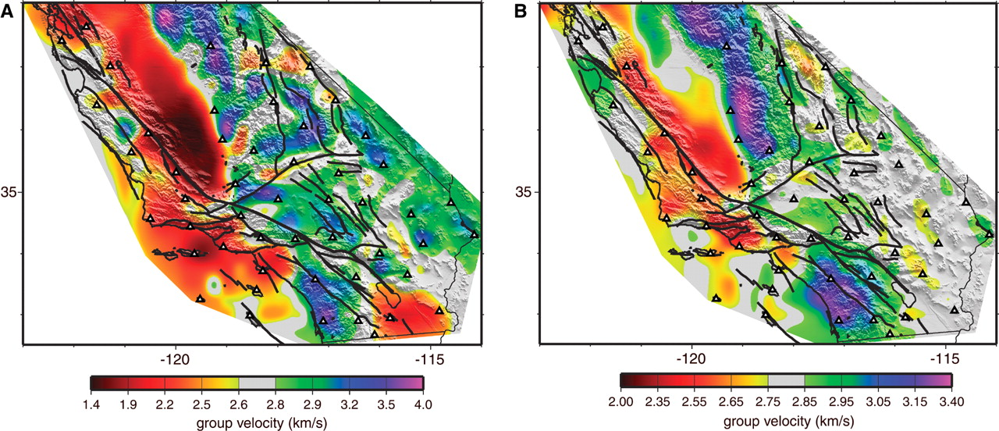
Shapiro et al., Science 2005
7.5 s
15 s
The corresponding “group velocities” can be tomographically
assigned to a spatial position via tomographic inversion
using the depth-dependent sensitivities of surface waves…
And different frequency bands are sensitive to different ranges
of depths!

Slide 6
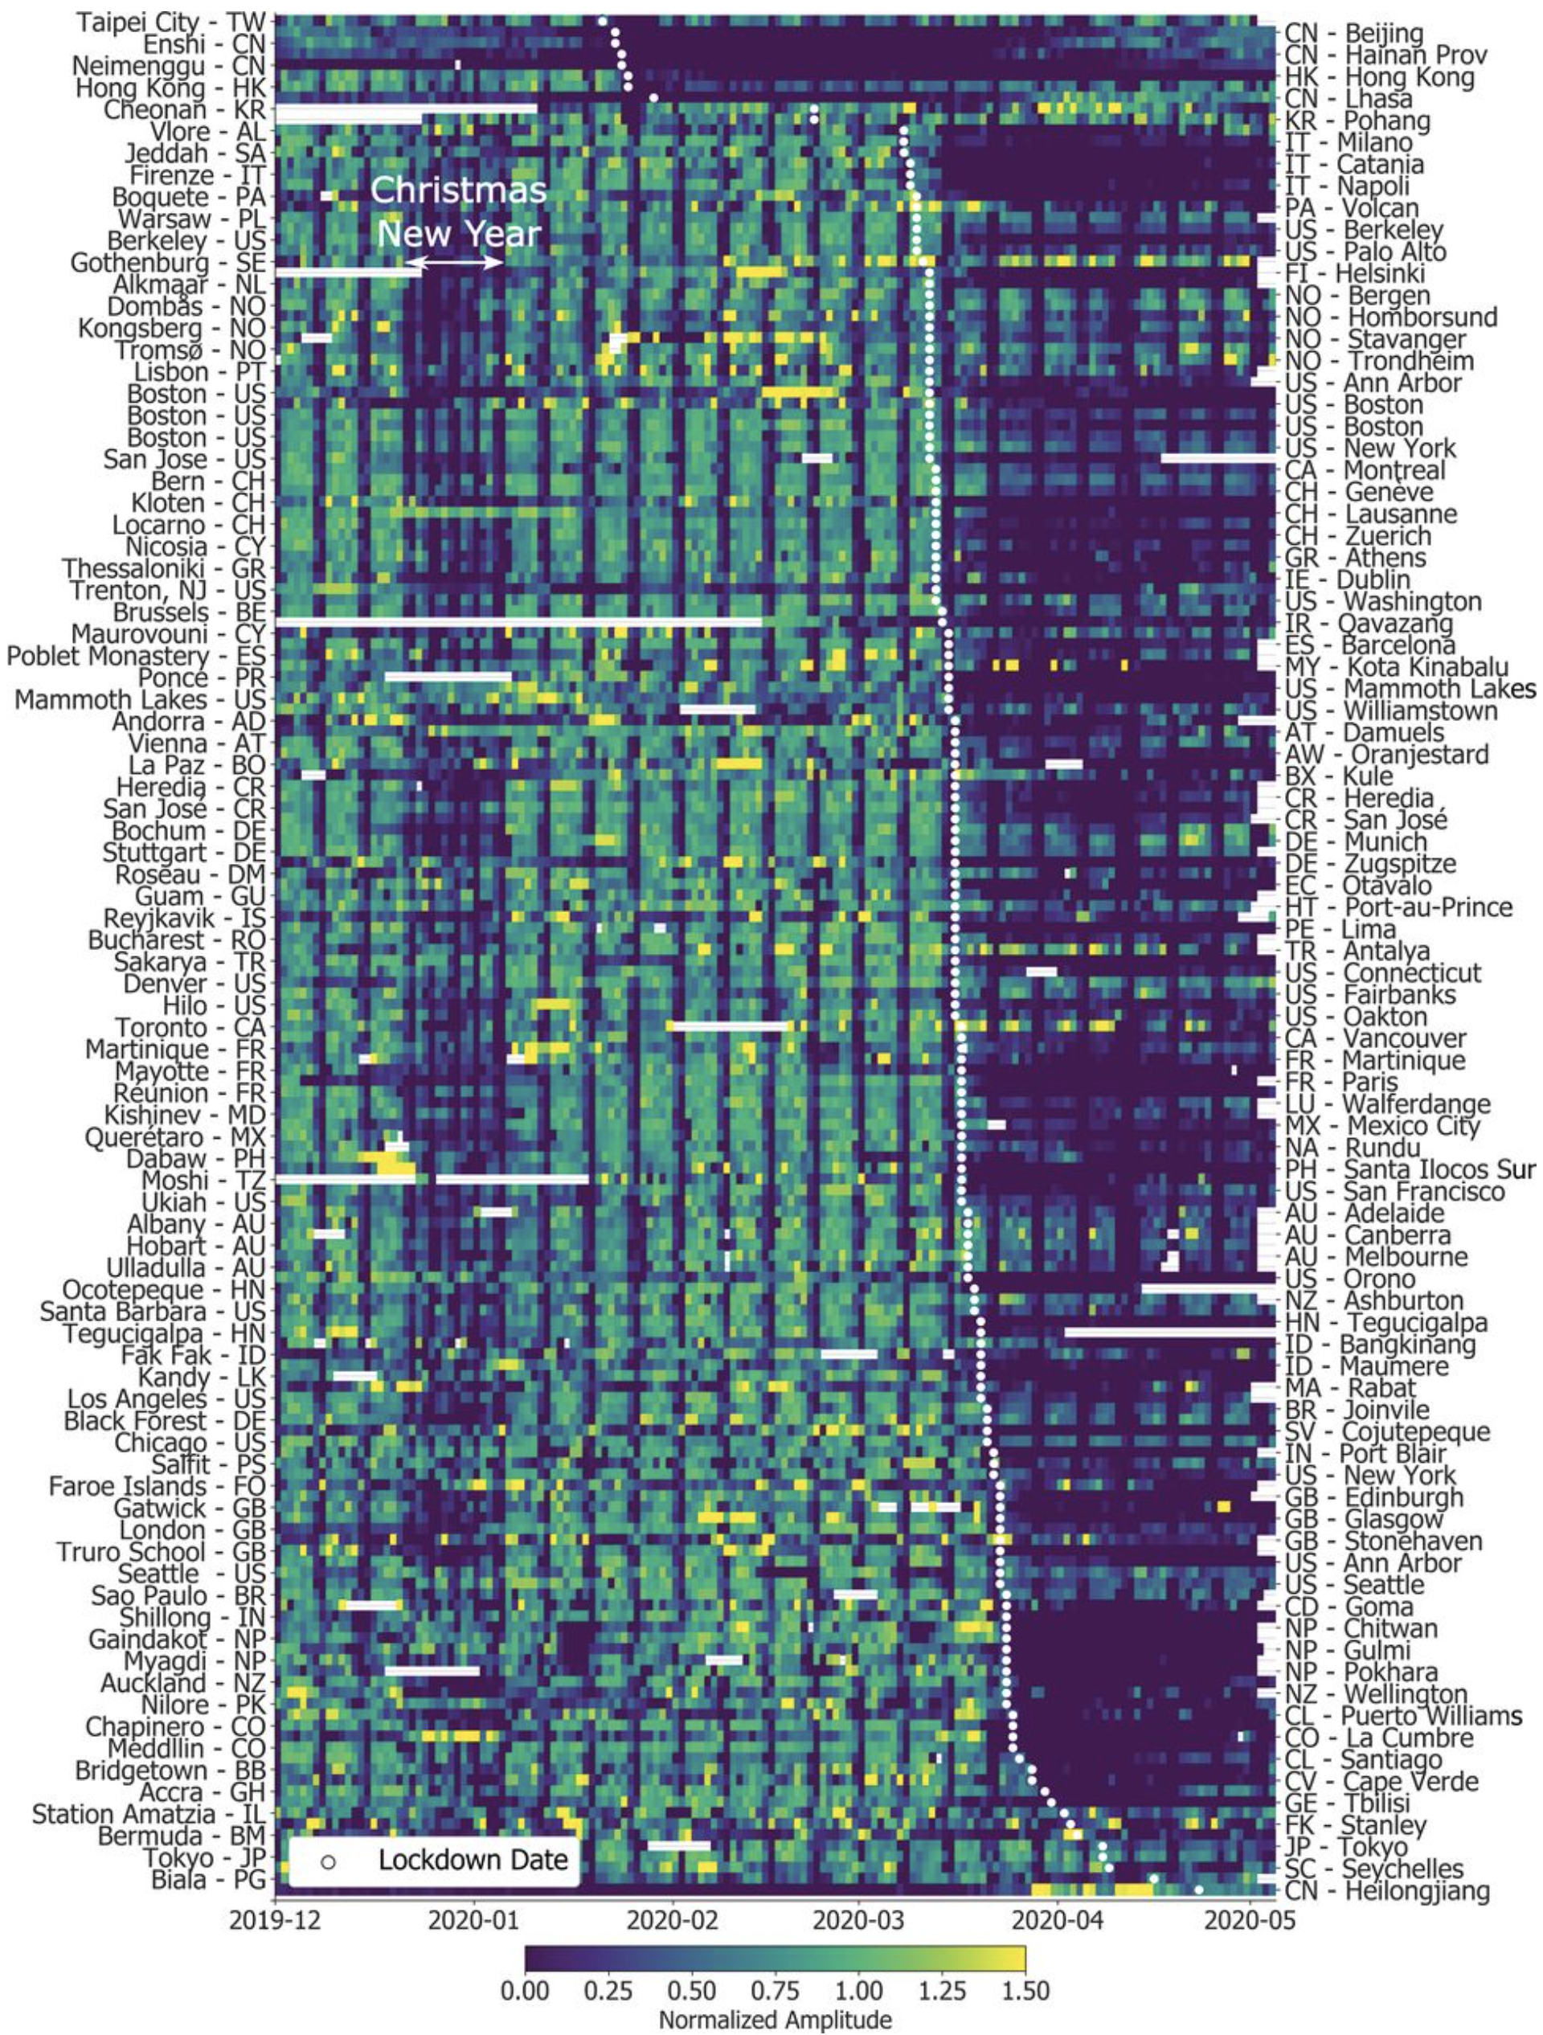
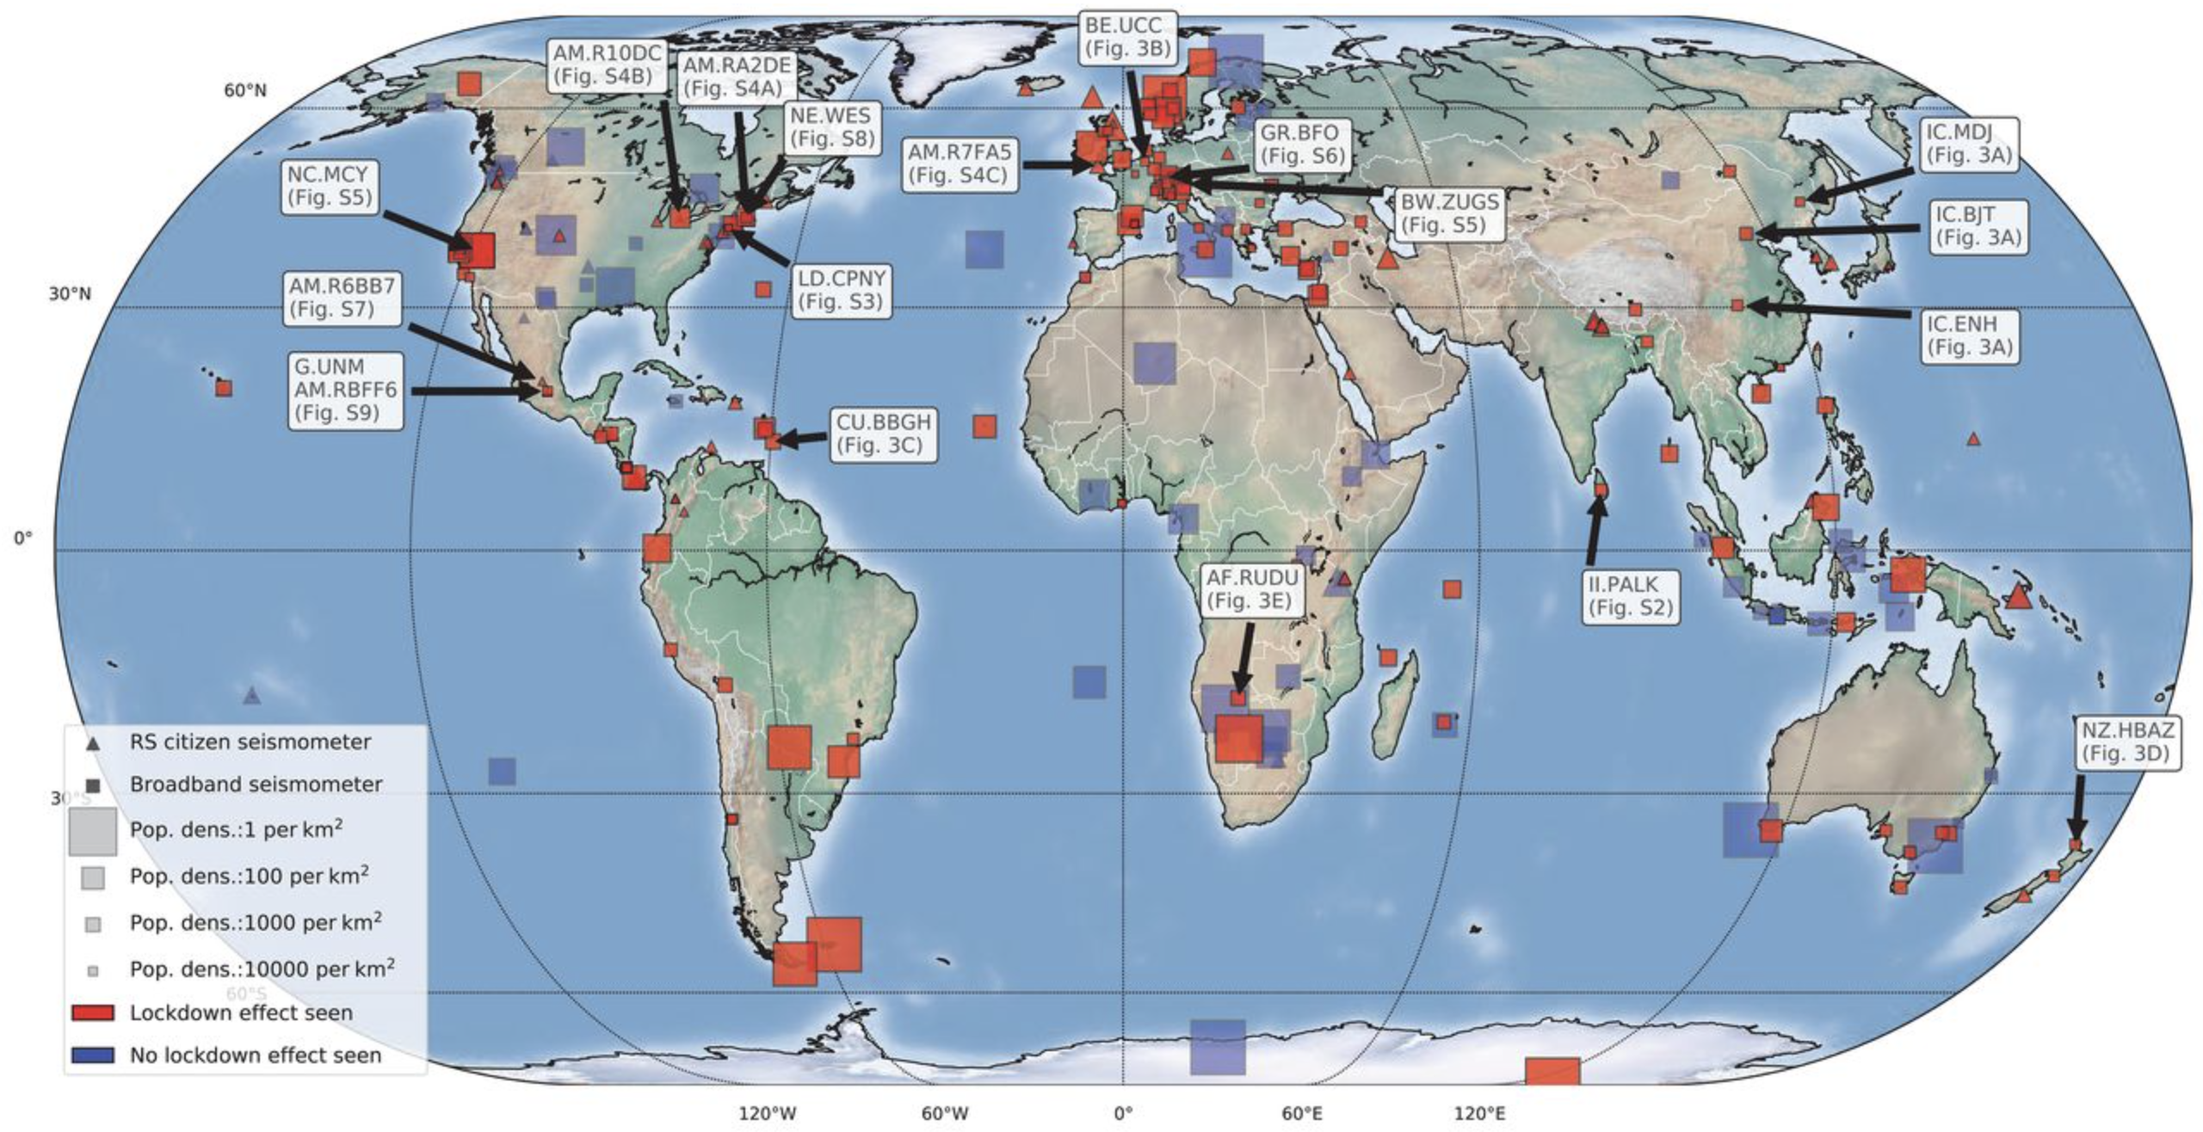
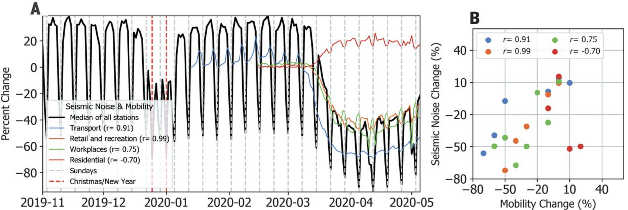
Ambient noise includes both natural
(environmental) and anthropogenic
Changes in high-frequency noise amplitudes
recorded by seismometers in 2020 recorded
“Covid Quiet”
LeCocq et al. Science 2020

Slide 7
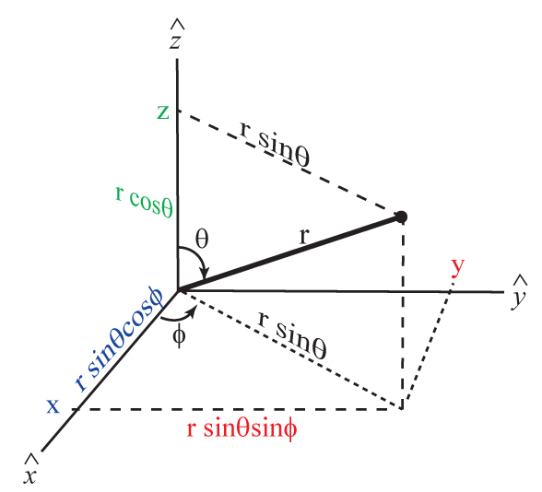
Waves in Spherical Coordinates:
Up to now we’ve used φ to denote the scalar displacement
potential, but in spherical coordinates, φ denotes an angle…
So for now we’ll use
Φ for potential.
Then our wave
equation becomes
Spherical coordinates
relate to Cartesian as:
x = r sinθ cosφ
y = r sinθ sinφ
z = r cosθ

Slide 8
Using these relations we can transform the Laplacian ∇² from
Cartesian to spherical coordinates. Recall:
To convert to spherical coords we’ll need to use the chain rule,
e.g.:
If we take derivatives of the coordinate relations we get, e.g.,
for ∂/∂x:
(1)
x = r sinθ cosφ
y = r sinθ sinφ
z = r cosθ
+
–

Slide 9
We now have three equations in the three unknown
derivatives. Solving (i.e. algebra!), we get:
Then substituting (2) into (1) we get:
Clearly by the time we do all three derivatives and evaluate
∇² this will get into some heavy trig… But suffice to say,
with the help of some identities this eventually leads us
to:
(2)

Slide 10
For a spherically symmetric solution (i.e., a point source in
a constant-velocity medium), the ∂_{φ} & ∂_{θ} terms are 0.
Then the Laplacian is simply
and our scalar potential wave equation becomes:
with solutions of the form:
(Note that if there is φ, θ-dependence, this will be Φ(r,φ,θ,t)).
Recall our earlier plane wave solutions had a f(t±x/α)
dependence, so the spherical solution has an additional
1/r dependence… Why?

