Slide 1
Geology 5640/6640
Introduction to Seismology
17 Oct 2024
Last time: Global Seismic Imaging Methods…
Analysis tools for Deep-Earth investigations include:
• Normal modes • Precursors
• Waveforms • Receiver Functions
• Tomography • Anisotropy
• Ambient Noise
Ambient noise uses environmental Rayleigh waves
derived from two-station interferometry
— Freedom from the “tyranny of earthquakes”!
— High-resolution crustal imaging on short timescales
— Source characterization is environmental seismology
— Allows for time-variable structure!
Read for Tuesday 22 October: S&W 157–162 (§3.4)
© A.R. Lowry 2011-2024

Slide 2
Last time continued: The Wave Equation in
Spherical Coordinates
Spherical coordinates express vector positions in
terms of a distance r and angles θ, φ. This frame
transforms the Laplacian, ∇², to e.g.:
The spherically symmetric solution to the wave
equation is of the form Φ(r,t) = f(t±r/α)/r… The 1/r
decay of amplitude is called spherical spreading
(and more generally, amplitude decrease due to
change of surface area of the wavefront is called
geometrical spreading).

Slide 3
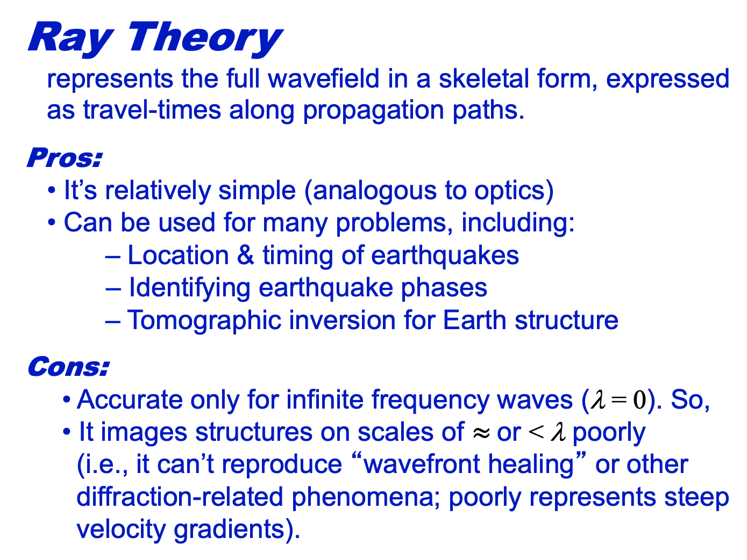
Ray Theory
represents the full wavefield in a skeletal form, expressed
as travel-times along propagation paths.
Pros:
• It’s relatively simple (analogous to optics)
• Can be used for many problems, including:
– Location & timing of earthquakes
– Identifying earthquake phases
– Tomographic inversion for Earth structure
Cons:
• Accurate only for infinite frequency waves (λ = 0). So,
• It images structures on scales of $≈$or < λ poorly
(i.e., it can’t reproduce “wavefront healing” or other
diffraction-related phenomena; poorly represents steep
velocity gradients).

Slide 4
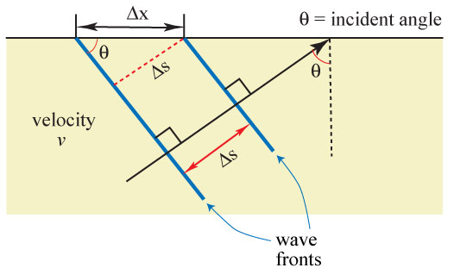
Here we return to Snell’s Law. Consider a plane wave in a
constant-velocity medium:
We can write sinθ = Δs/Δx
or equivalently Δx sinθ = Δs = VΔt.
Thus,
which we call the ray parameter.

Slide 5
We can alternatively write the wave velocity V in terms of
a “wave slowness” u, where
In that case, we can write the ray parameter p as
Both of these terms/concepts, slowness and the ray
parameter, are extremely important in seismology…
So count on seeing them again often in this class.
Examples:

Slide 6
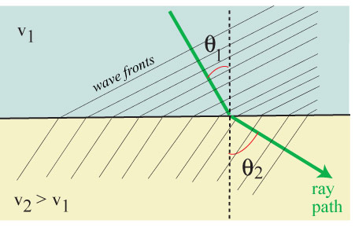
Now consider a two-layer medium:
In the top layer,
In the bottom
layer,
However, Δt/Δx
must be the same
above and below the interface… And hence p₁ = p₂.
Equivalently then
, i.e., Snell’s Law! Hence the ray parameter
is important because it is a constant
everywhere along the propagation path!

Slide 7
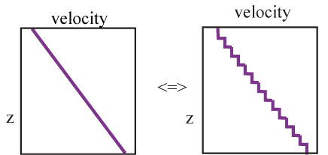
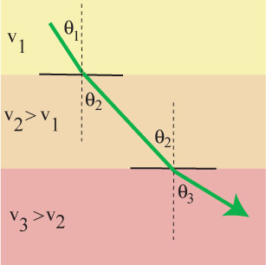
Snell’s law for seismic rays is identical to that for optics, so
ray theory is sometimes called
the optical representation.
We can approximate any
vertical velocity profile as a
stack of constant-velocity
layers (e.g., a gradient
approximated by discrete
steps). Since the ray
parameter must be constant,

Slide 8
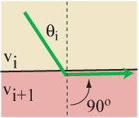
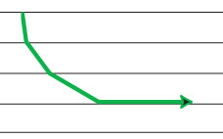
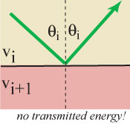
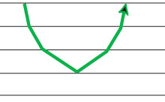
If velocity continues to increase with depth, eventually one of
two things happens. Either:
1) The ray follows the interface:
Or:
2) The ray reflects with no transmitted wave:
sinθ_{i+1} =

Slide 9
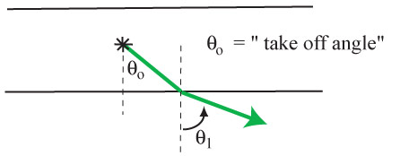
We refer to the angle (from vertical!) at which a particular
ray initially leaves its source (earthquake, explosion,
whatever) as the take-off angle. It is usually denoted
as θ₀:
Note that a source produces a continuous wavefront with an
infinite number of rays, each with a different take-off angle!

Slide 10
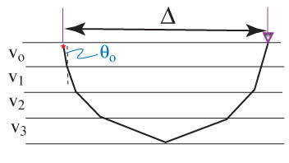
For homogeneous, isotropic layers:
1) Ray parameter p is constant along a given ray path.
2) A smaller take-off angle translates to greater distance to
where the ray path emerges at the surface (& a smaller ray
parameter).
3) For a given velocity structure, every ray parameter maps
to some distance (Δ) from the starting point, and a
corresponding travel-time T = f(V).

Slide 11
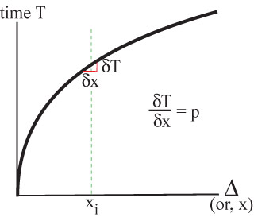
If we plot T versus x (or Δ)…
Recall the plots of the seismic phases shown in previous
lectures… The slope of the line gives the ray parameter for
the phase arriving at that given Δ!
Plots like this are common
in seismology; called “T-X”
or “T-Δ” or “time-distance”
plots.
Note the emphasis that is
being placed here: The
skeletalized information
from the wavefield here is
the travel-time; the
information we are
extracting about the Earth
is velocity along the ray!

Slide 12
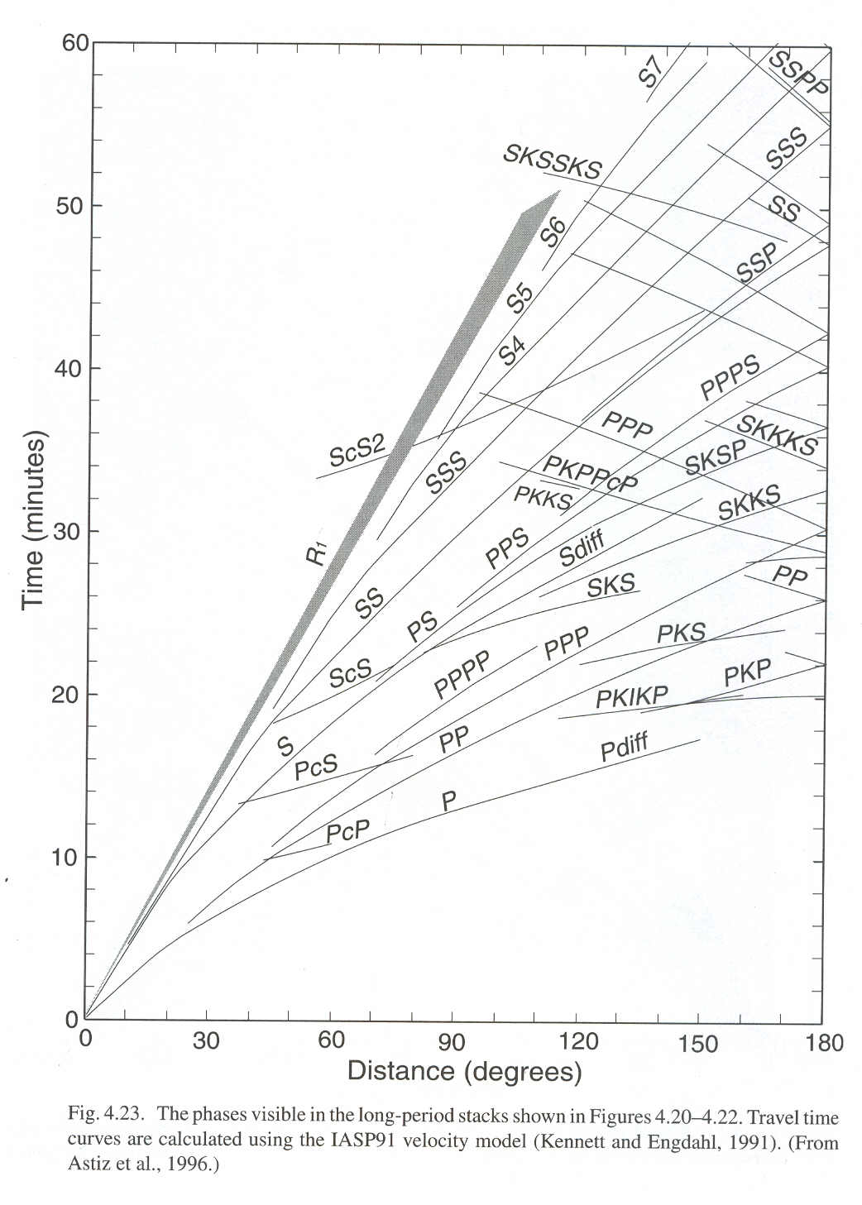
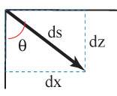
Time vs Distance:
Since we now have a simple
formula for geometry of ray
paths (Snell’s Law), if we
know the velocity structure
we can derive equations to
describe T-X for a given ray
from T(p,u) and X(p,u).
Consider a segment ds of a
raypath: Here,
Since p = u sinθ, sinθ = p/u,

Slide 13
Going the Distance…
We can rearrange dz/ds as:
Then using the chain rule:
And plugging in our raypath
relations:
If we multiply both sides
by dz and integrate:
But p is a constant! So

Slide 14
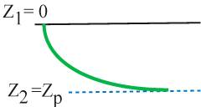
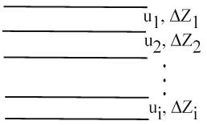
If we know u(z), we can integrate this from e.g. the surface
down to a ray’s turning depth z_{p}:
And note that if we know u(z), we know z_{p}: it’s the depth at
which u ≤ p! Having solved for x(p), the distance X at
which the ray will arrive at the surface is simply X = 2x:
Most often Earth velocity structure is represented as a
layered stack (e.g., PREM, which you looked at for
HW). In that case the integral is a
summation:

Slide 15
Getting the Time:
Now we ask ourselves, how long did it take to travel the
ray arc we just described? To travel a distance ds in a
medium with velocity V
will require dt = ds/V, so:
Again with the chain rule:
So:
And integrating:
As before we integrate to the
turning depth & double it to
get the total travel-time:

Slide 16
And for a discretized stack of layers, we have:
Note that here (as with distance) it’s physically meaningful
only if we sum over the layers for which u_{i} ≥ p.

