Slide 1
Geology 5640/6640
Introduction to Seismology
17 Sep 2024
Last time: The Stress Tensor
• Stress is a second-order tensor describing force per unit
area acting in three directions (j), and on each of three
planes (i): The stress tensor is
symmetric, i.e., only
six independent values
• The eigenvalues and eigenvectors of a stress tensor
describe principal stresses and principal axes for
a coordinate system in which shear stress is zero.
These are found by solving for non-zero scalar
eigenvalues λ and the corresponding eigenvectors .
• Typically we use deviatoric stress (i.e., after the mean
normal stress has been subtracted).
Read for Thursday 19 September: S&W 53-54 (§2.4.1)
© A.R. Lowry 2011-2024

Slide 2
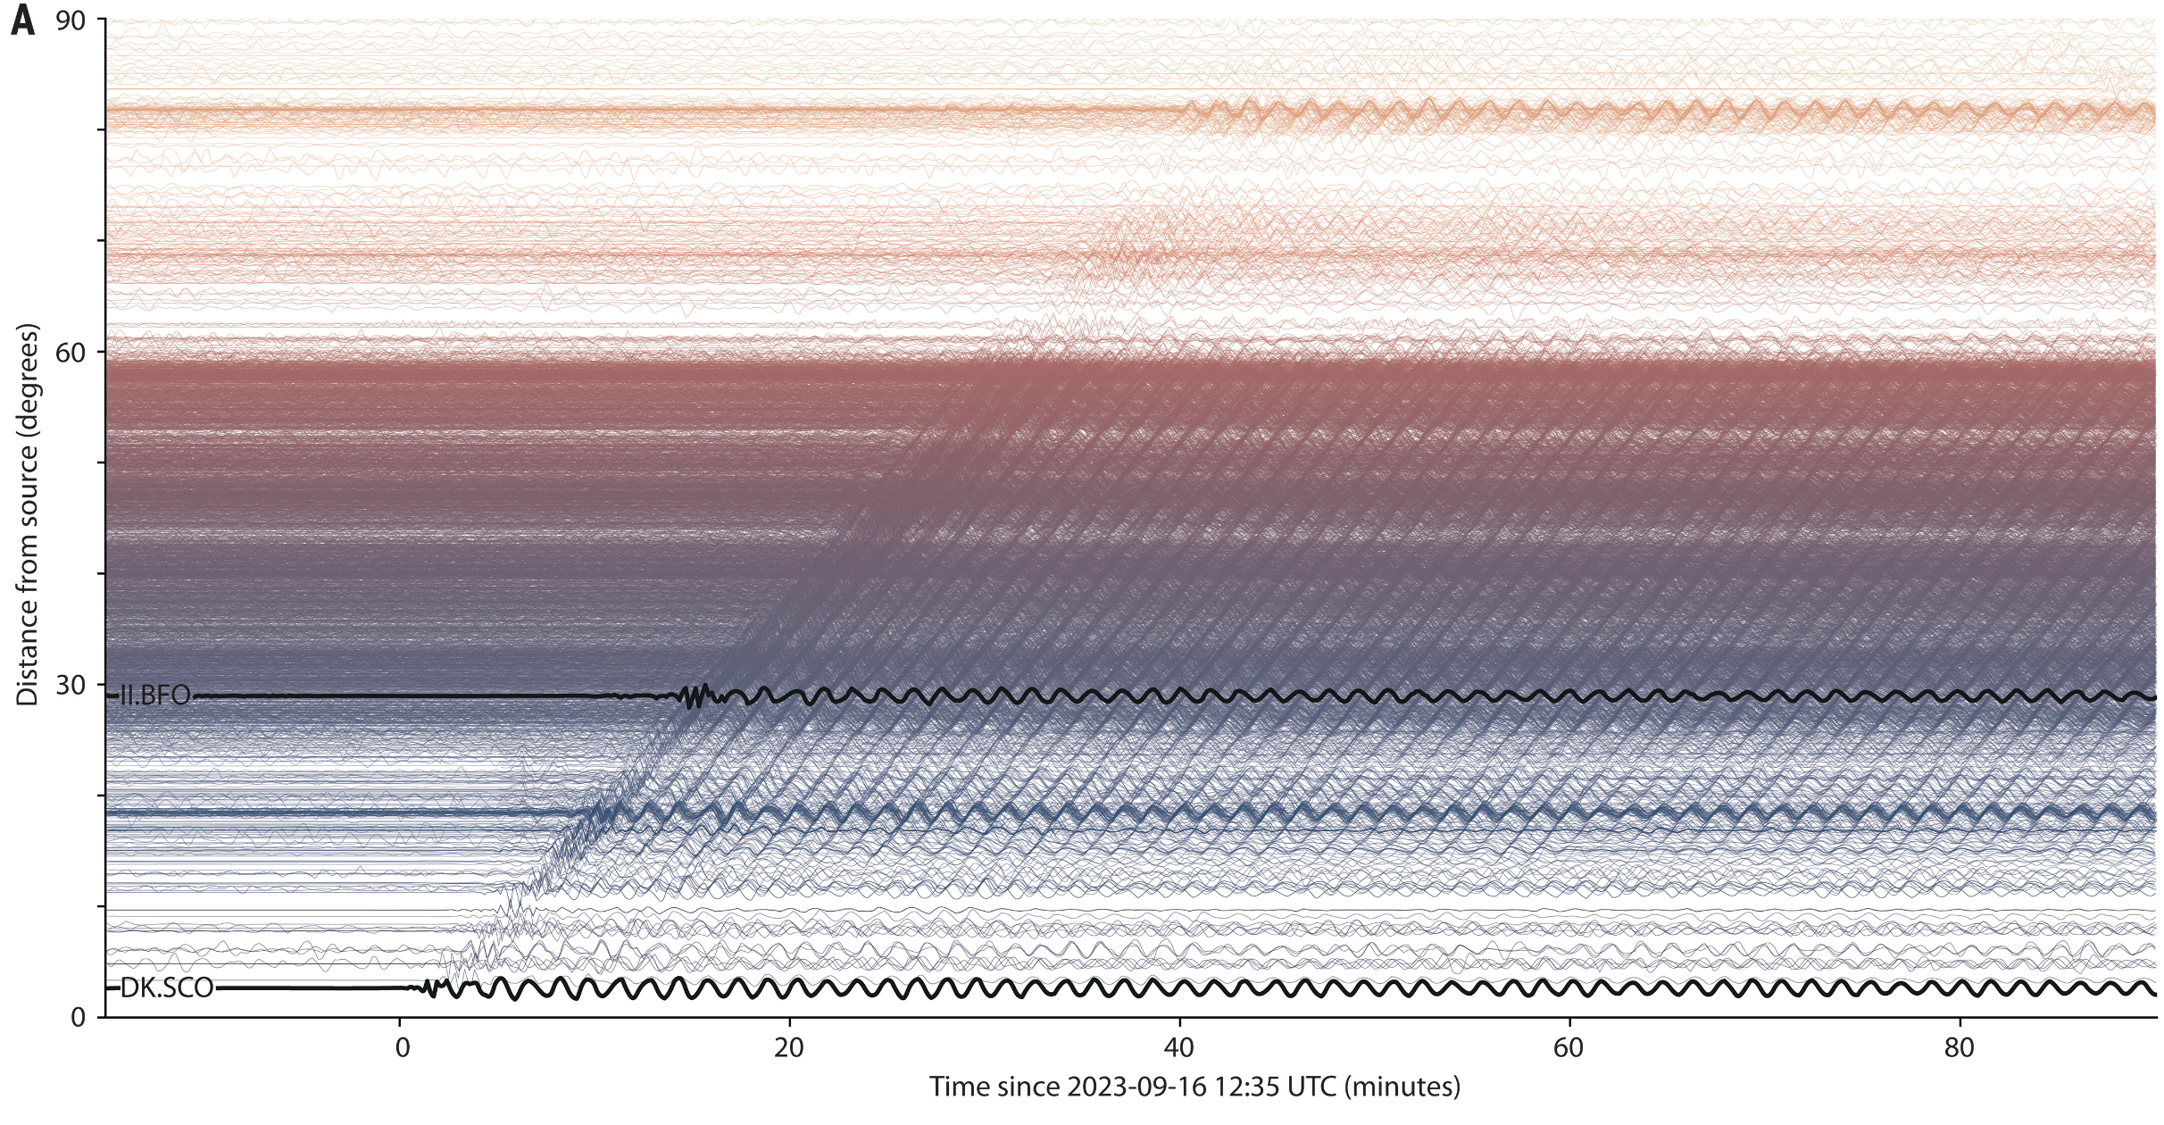
Seismology “In the News”:
Svennevig et al. (2024) Science
What the heck? An “Unidentified Seismic Object”

Slide 3
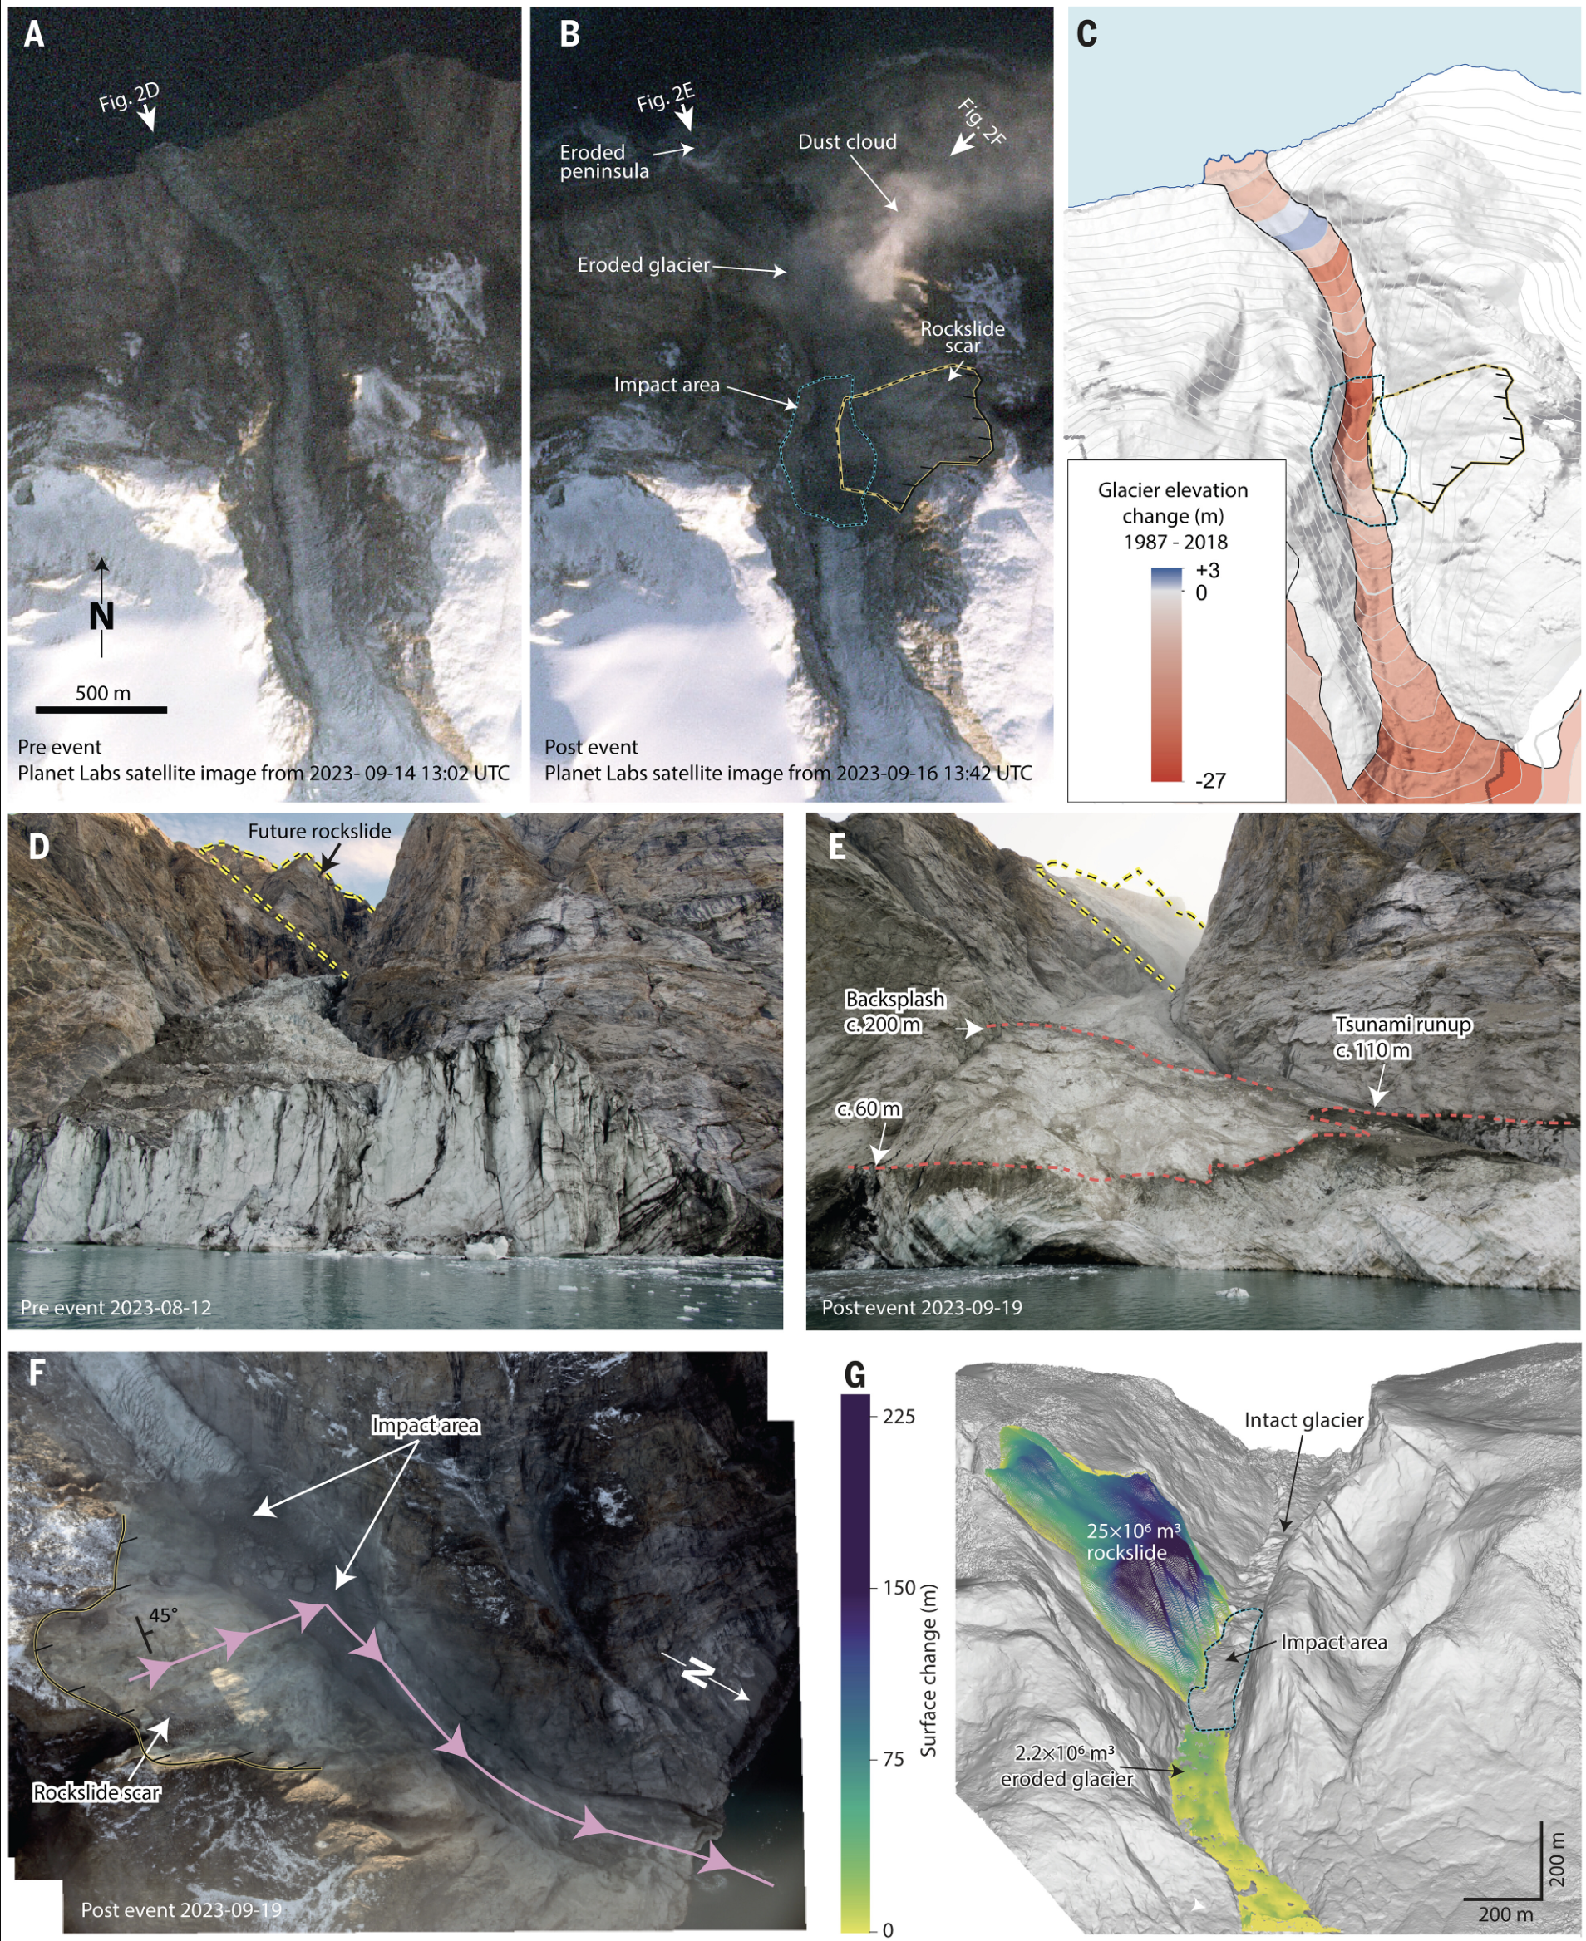

Svennevig et al. (2024) Science
Source location identified in a fjord in East
Greenland coupled with independent
observations of a landslide-induced seiche
wave, identified the culprit...
A nine-day-long standing seiche wave,
confirmed by tsunami modeling of high-
resolution bathymetry! Speaks to hazards
of climate change in polar regions…

Slide 4
Strain:
Stresses within a continuum will induce both deformation
and displacements. The text depicts an example in which
stress displaces a point by an amount , and the point
by an amount :
δu
δx

Slide 5
If is “small”, and strain is infinitesimal (i.e.,
displacements u, δu are very small relative to the scale
over which the strain occurs), we can approximate the
displacement of the point in terms of the
displacement at the point using a first-order Taylor
series approximation:
i.e.,
This term represents the deformation, but does not
capture rigid body translation/rotation. To describe
these we add & subtract ∂u_{j}/∂x_{i} and rewrite as

Slide 6
Here, e_{ij} is the strain tensor, and ω_{ij} describes the
rotation tensor. We can write these a bit more
compactly using Einstein’s indicial notation as, e.g.,
… But it’s useful to see it fully expanded also, e.g.,

Slide 7
It’s useful to keep in mind however that we did
use an approximation (truncation of the Taylor
series) to derive this relation, and we are focused
on strain at a point (i.e., in the limit as δx gets
small… The complete Taylor series would have
second-order terms ∂²u/∂x² δx², third-order
∂³u/∂x³ δx³ and so on. If strain were finite rather
than infinitesimal, these relations (which as we’ll
see are the foundation of most seismological
expressions of the wave equation) would be
inaccurate…

Slide 8
A couple of other useful things to note:
• Like the stress tensor, the strain tensor is symmetric.
Hence (also like stress) there are only six independent
terms.
• Units are dimensionless (length over length).

Slide 9
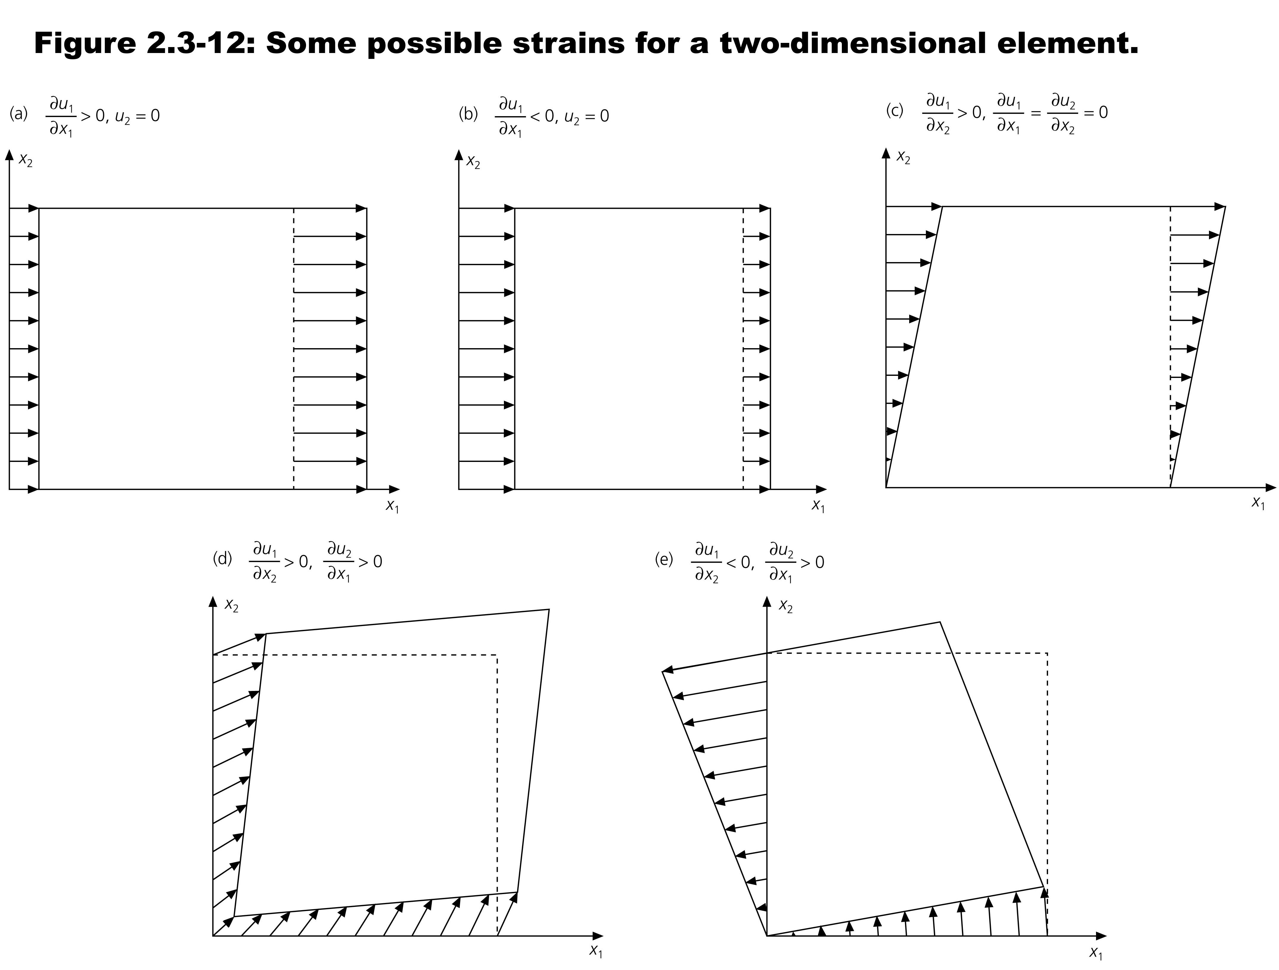
Note the sign convention here: Positive normal strain corresponds to an increase in length (= positive dilatation is an increase in volume!) Engineers sometimes use the opposite convention…
plane strain:
elongation
plane strain:
contraction
pure shear
The text provides some useful illustrations of various strains.

Slide 10
The Constitutive Relation:
A constitutive relation is any set of equations that
relate stress and strain (or their derivatives). There are
many different rheological laws that may apply in the Earth,
but on seismic timescales (typical periods of 0.001–1000 s)
stress and strain are well-described by Hooke’s Law :
i.e., the relationship of stress to strain is linear.
Recall that our indicial notation means repeated indices are
sums:
Hence, every term in
the stress tensor depends
on all nine terms in the
strain tensor AND nine of
the 81 terms in the
elasticity tensor!

Slide 11
Recall also however that the stress tensor, and hence the
strain tensor!, are symmetric:
σ_{ij} = σ_{ji} ⇒ only 6 independent terms
ε_{ij} = ε_{ji} ⇒ only 6 independent terms
This requires also that
C_{ijkl} = C_{jikl} & C_{ijkl} = C_{ijlk}
Hence, the elasticity tensor must have ≤ 6 x 6 = 36
independent constants!
It turns out there’s another symmetry relation (arising from
conservation of energy in the strain potential):
C_{ijkl} = C_{klij}
which allows us to drop another 15, for a total of just 21
independent elasticity constants… The lowest order
symmetry of a triclinic system. Other symmetries:
Orthorhombic : 21 → 9
Hexagonal : 9 → 5
Isotropic : 5 → 2

Slide 12
Most of the time, unless we are specifically interested in
anisotropy (which we’ll talk about later), we assume
isotropy (i.e., elasticity is independent of direction).
(Velocity anisotropy in the Earth rarely exceeds 5%, so it’s
negligible unless you make a special effort to look for it).
In the isotropic case, we will use two elastic constants called
Lamé’s constants, μ & λ. You may be familiar with
μ as shear rigidity (often denoted G). λ doesn’t have an
alternative to “Lamé’s constant”. These can be expressed
in terms of other elastic constants that may be familiar:
(Here E = Young’s modulus; ν is Poisson’s ratio; K is bulk
modulus or incompressibility).
Thus these are not independent: Elasticity of any isotropic
solid is fully described by any two of these elastic constants.

