Slide 1
Geology 5640/6640
Introduction to Seismology
18 Nov 2020
Last time: Love Waves
• Love waves are a constructive interference between
intersecting SH wavefronts with identical phase.
• For a layer-over-halfspace, phase is identical for an
apparent velocity c_{x} in which:
and hence β₁ < c_{x} < β₂.
• At shorter periods of seconds to a few tens of seconds,
Love waves can have higher modes in addition to
a fundamental mode seen at longer periods
• Love wave velocity c_{x} increases with period and with mode
number
Read for Fri 20 Nov: S&W 119-157 (§3.1–3.3)
© A.R. Lowry 2020

Slide 2
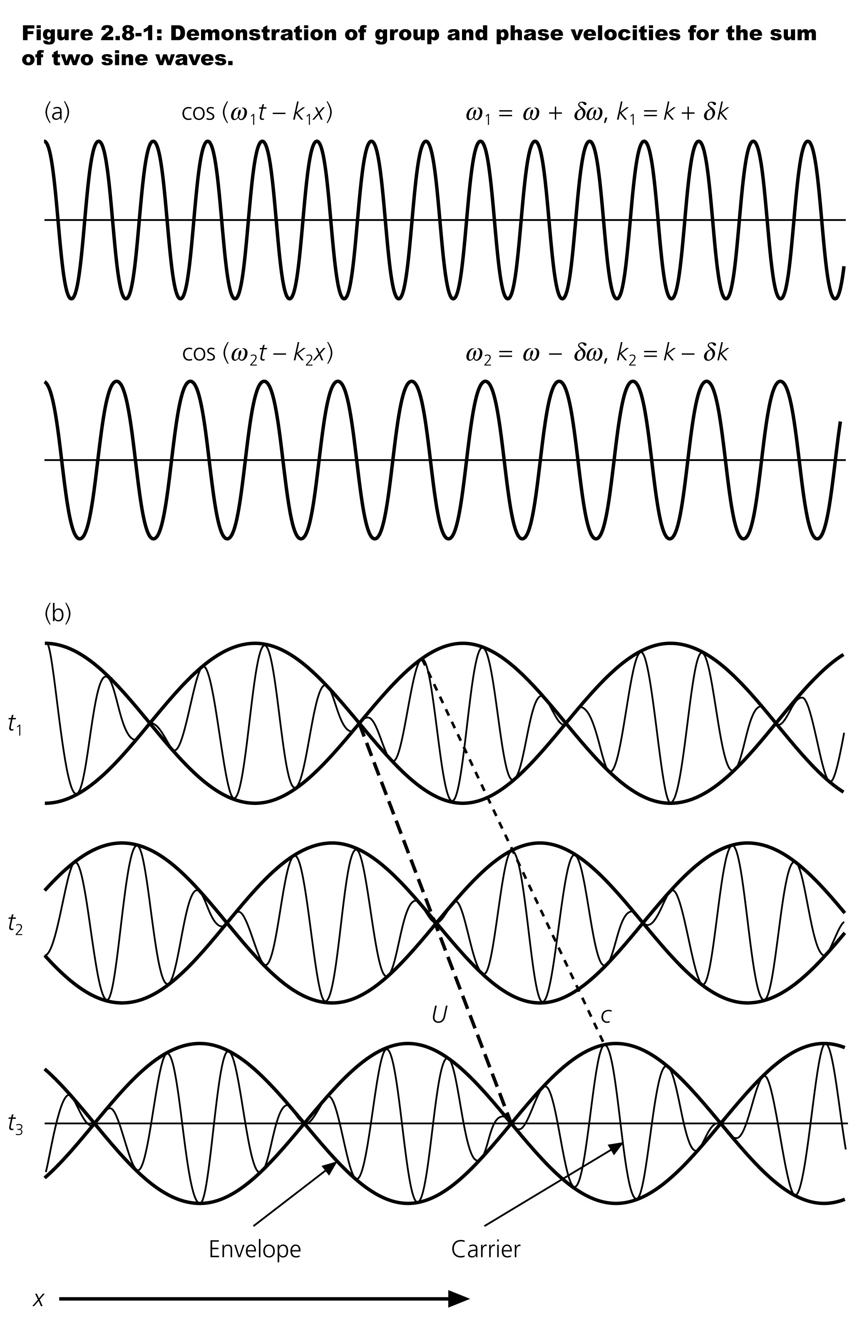
Group & Phase Velocity:
Surface waves sum all modes
and all frequencies!
Consider a sum of two waves
with differing ω and k:
u(x,t) = cos(ω₁t – k₁x) + cos(ω₂t – k₂x)
Let:
ω₁ = ω + δω ω₂ = ω – δω ω >> δω
k₁ = k + δk k₂ = k – δk k >> δk
Then we can substitute/rewrite:
u(x,t) = cos(ωt + δωt – kx – δkx)
+ cos(ωt – δωt – kx + δkx)
= 2cos(ωt – kx)cos(δωt – δkx)
The envelope (or “beat”) has
group velocity U = δω/δk;
Individual peaks move with
phase velocity c = ω/k

Slide 3
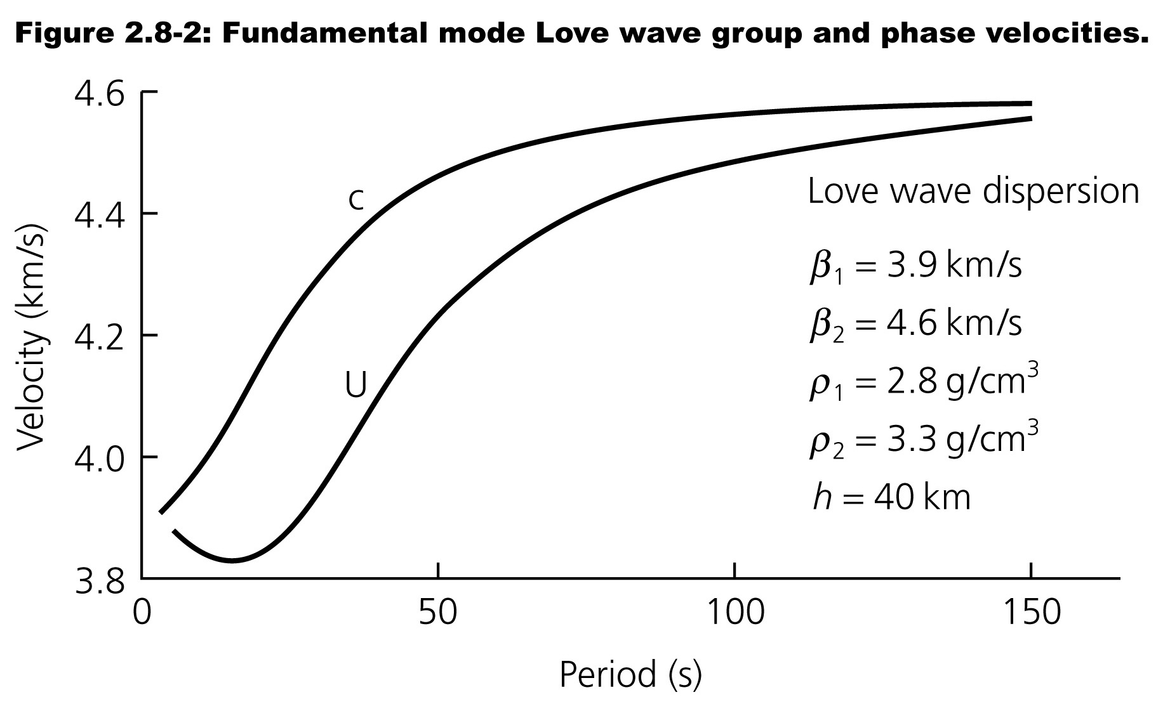
(Phase velocity)
(Group velocity)

Slide 4
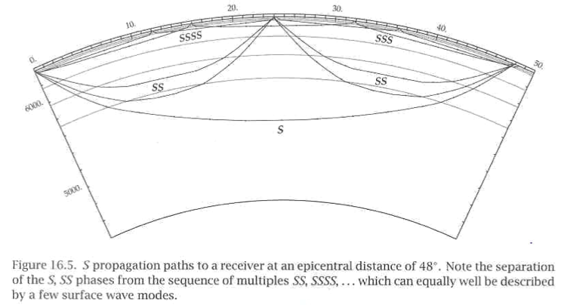
Of course the real Earth is less simple than a layer-over-
halfspace… Here the evanescent waves will be turning
rays that produce S, SS, SSS, SSSS, etc. phases.
More S’s equal more bounces => shallower paths.
Kennett (2001)

Slide 5
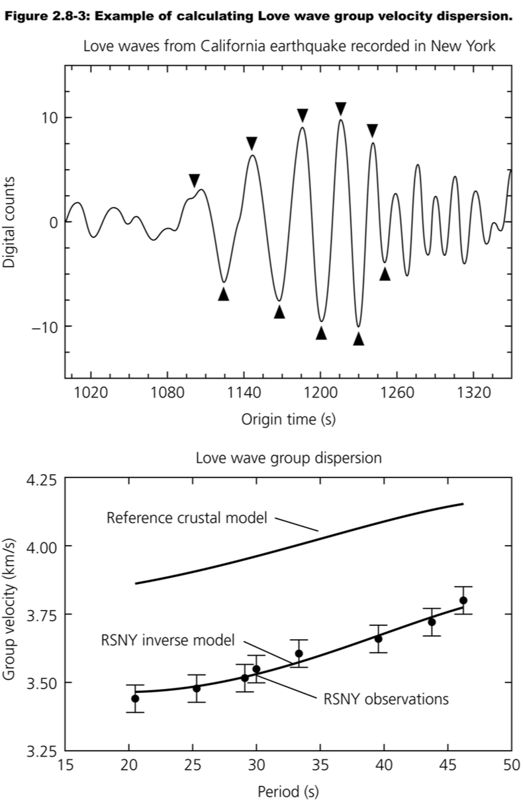
To measure Group Velocity:
• Measure period as the time
between successive peaks
or troughs
• Travel-time is the time at the
time of arrival of the wave
group minus the origin time
• Divide the source-receiver
distance by travel-time to
get the group velocity

Slide 6
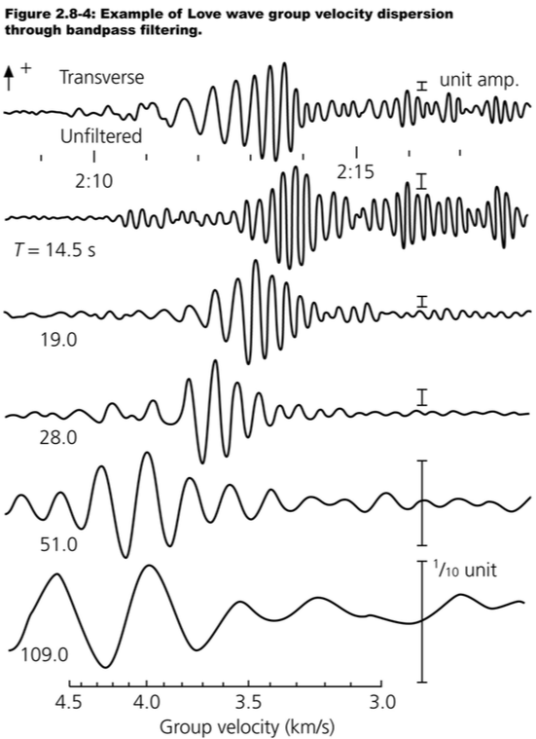
Or can get a bit more
sophisticated by filtering
the waveform (multiplying
by a “windowing function”
in the frequency domain)
to isolate elements of the
waveform that have a
particular period, using a
Fourier Transform.
To get phase velocity, can
transform to phase φ
and e.g. solve for c(φ) from
the difference in phase of
the arrivals at two sites

Slide 7
Normal Modes
Note: These slides borrow heavily from a presentation by
Michel van Camp, Royal Observatory of Belgium…
Gravimeters for seismological broadband monitoring:
Earth’s free oscillations
Michel Van Camp
Royal Observatory of Belgium

Slide 8
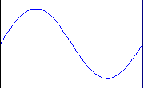
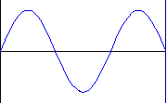
What is a free oscillation?
x
Fundamental
L
1st Harmonic
2nd Harmonic
3rd Harmonic
etc.
Free oscillation = stationary wave
Interference of two counter propagating waves
(see e.g. http://www2.biglobe.ne.jp/~norimari/science/JavaEd/e-wave4.html)

Slide 9
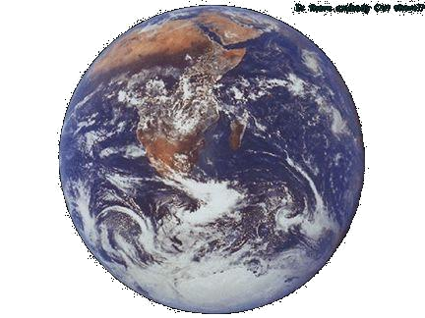
Seismic normal modes
(Duck from Théocrite,
© J.-L. & P. Coudray)
Few minutes after the earthquake
Constructive interferences ➔ free oscillations
(or stationary waves)
Few hours after the earthquake (₀S₂₀)
⇨ Periods < 54 min, amplitudes < 1 mm
⇨ Observable months after great earthquakes (e.g. Sumatra, Dec 2004 took about 5 months to decay)

Slide 10
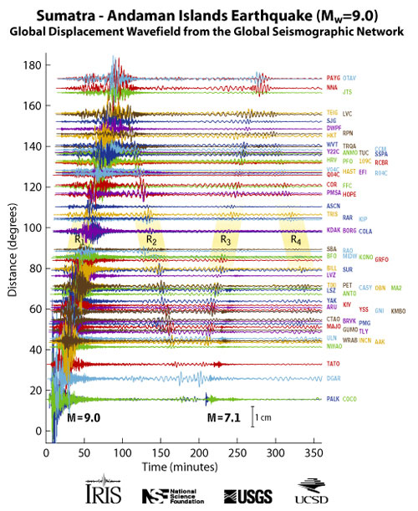
Traveling Surface Waves
Rick Aster, Colorado State University
http://www.iris.iris.edu/sumatra/
Notes:
This record section plot displays vertical displacements of the Earth's surface recorded by seismometers plotted with time (since the earthquake initiation) on the horizontal axis, and vertical displacements of the Earth on the vertical axis (note the 1 cm scale bar at the bottom for scale). The traces are arranged by distance from the epicenter in degrees. The earliest, lower amplitude, signal is that of the compressional (P) wave, which takes about 22 minutes to reach the other side of the planet (the antipode). The largest amplitude signals are seismic surface waves that reach the antipode after about 100 minutes. The surface waves can be clearly seen to reinforce near the antipode (with the closest seismic stations in Ecuador), and to subsequently circle the planet to return to the epicentral region after about 200 minutes. A major aftershock (magnitude 7.1) can be seen at the closest stations starting just after the 200 minute mark (note the relative size of this aftershock, which would be considered a major earthquake under ordinary circumstances, compared to the mainshock). Richard Aster, New Mexico Institute of Mining and Technology

