Slide 1
Geology 5640/6640
Introduction to Seismology
19 Nov 2024
Last time: Group & Phase Velocity; Normal Modes
• Dispersive waves have both group velocity U (velocity
of the envelope or “beat”) and phase velocity c (velocity
of individual peaks) where
Note in this animation, as in surface waves, c > U!
• Can measure group frequency from separation of peaks, and
group velocity as distance over time of arrival from origin
• Or more accurately by filtering frequencies in the Fourier
domain
• Can get phase velocity by differencing phase at pairs of sites
(Here red = c;
green = U)
Read for Thursday 21 November: S&W 119-157 (§3.1–3.3)
© A.R. Lowry 2011-2024

Slide 2
Last time continued: Normal Modes
Free oscillations are stationary waves that result from
interference of propagating waves
• For a string (length L, velocity v) fixed at the endpoints, the
standing waves have eigenfrequencies ω_{n} = nπv/L:
• The Amplitudes A_{n} in this equation relate to the source
that excited the string:
• Propagating waves in the string can be represented by these
normal modes.
• In the Earth, the equation is a leetle more complicated…

Slide 3
On the sphere…
Vibrating string:
On the sphere:
Radial
eigenfunction
Surface
eigenfunction
n = radial order (→ depth)
n = 0 : fundamental
n > 0 : overtones
l, m = surface orders
l = angular order
-l < m < l = azimuthal order
Here, the surface orders l and m represent an integer number of full wavelengths contained in the circumference of the Earth (~40000 km). Hence, the spatial wavelength for given l is ~40000/2πl!

Slide 4
Why study normal modes?
A_{lm}^{n} are the excitation amplitudes, analogous to A_{n} in the 1D
(string) example… So from measurements of u one can
get information about the source (provided the
eigenfrequencies ω_{lm}^{n} are known!)
Conversely, given a source function A_{lm}^{n} and known ω_{lm}^{n},
one can predict u… The modes form the basis vectors
to describe displacements if one wants to model
synthetic seismograms.
The frequencies ω_{lm}^{n} depend on density, shear modulus,
and compressibility modulus of the Earth… so are used
to get Earth structure.

Slide 5
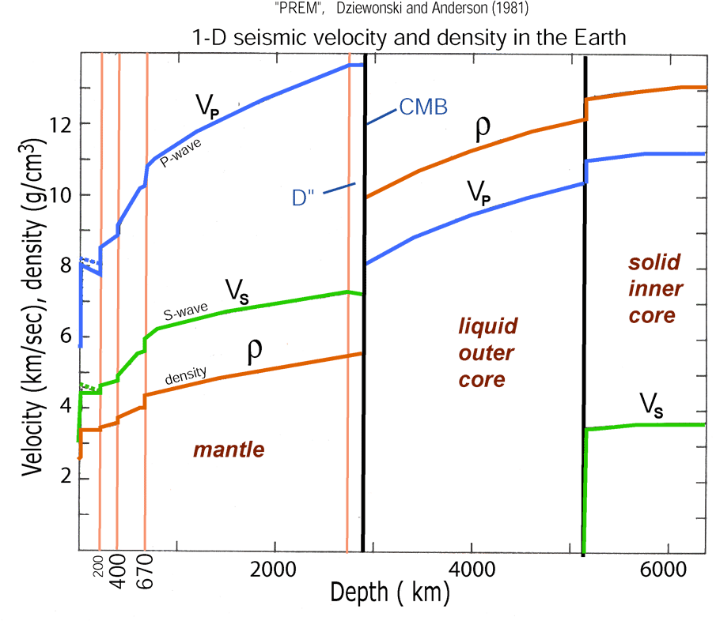
Recall PREM is derived from normal modes!

Slide 6
Toroidal and Spheroidal
Using spherical harmonics (based on a spherical surface), we can separate the displacements into toroidal (torsional) and spheroidal modes (as done with SH and P/SV waves):
T:
Radial
eigenfunctions
Surface
eigenfunctions
S:

Slide 7
Characteristics of the modes
Toroidal modes _{n}T^{m}_{l} :
Spheroidal modes _{n}S^{m}_{l} :
• No radial component: tangential only, normal to the radius: motion confined to the surface of n concentric spheres inside the Earth.
• Changes in the shape, not in volume ➔ Not observable using a gravimeter (but…)
• Do not exist in a fluid: so only in the mantle (and the inner core?)
• Horizontal components (tangential) et vertical (radial)
• No simple relationship between n and nodal spheres
• ₀S₂ is the longest (“fundamental”)
• Affect the whole Earth (even into the fluid outer core !)

Slide 8
n, l, m …
S: _{n}S^{m}_{l}:
n : no direct relationship with nodes with depth
l : relates to # nodal planes in latitude
m : relates to # nodal planes in longitude
! Max nodal planes m = l
₀S⁰₂
T: _{n}T^{m}_{l}:
n : relates to nodal planes with depth
l : relates to # nodal planes in latitude
m : relates to # nodal planes in longitude
! Max nodal planes m = l - 1
₀T⁰₃

Slide 9
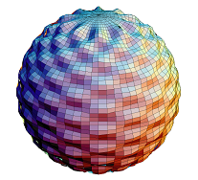
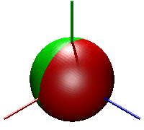
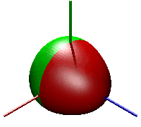
Spheroidal normal modes (examples):
...
...
₀S₀ : « balloon » or
« breathing » :
radial only
(20.5 minutes)
₀S₂ : « football » mode
(Fundamental, 53.9 minutes)
₀S₃ :
(25.7 minutes)
...
₀S₂₉ :
(4.5 minutes)
Note: ₀S₁ = translation!
Animation ₀S_{0/3} from Lucien Saviot
http://www.u-bourgogne.fr/REACTIVITE/manapi/saviot/deform/

Slide 10
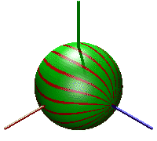
Toroidal normal modes: examples:
₀T₂ : «twisting» mode
(44.2 minutes, observed in 1989 with an extensometer)
₁T₂
(12.6 minutes)
₀T₃
(28.4 minutes)
Rem: ₀T₁= rotation
₀T₀= nonexistant
Animation from Lucien Saviot
http://www.u-bourgogne.fr/REACTIVITE/manapi/saviot/deform/

Slide 11
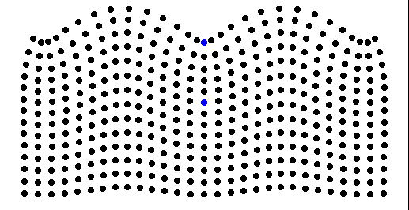
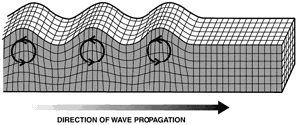
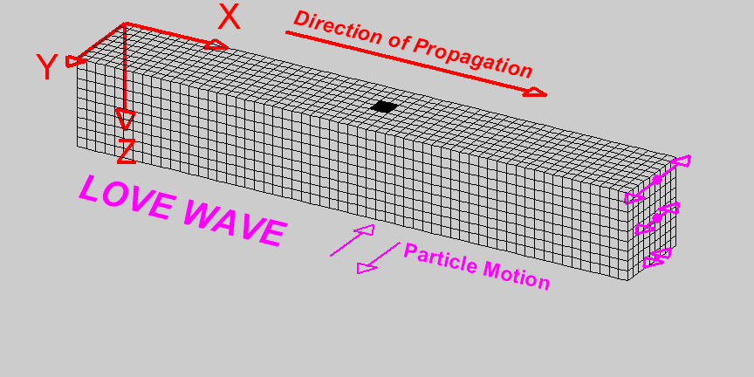
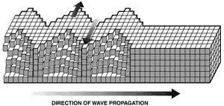
Eigenfunctions: ₀S_{l} and ₀T_{l}
₀S equivalent to interfering surface Rayleigh waves
₀T equivalent to interfering surface Love waves
www.advalytix.de/ pics/SAWRAiGH.gif
http://www.eas.purdue.edu/~braile/edumod/waves/Lwave.htm

Slide 12
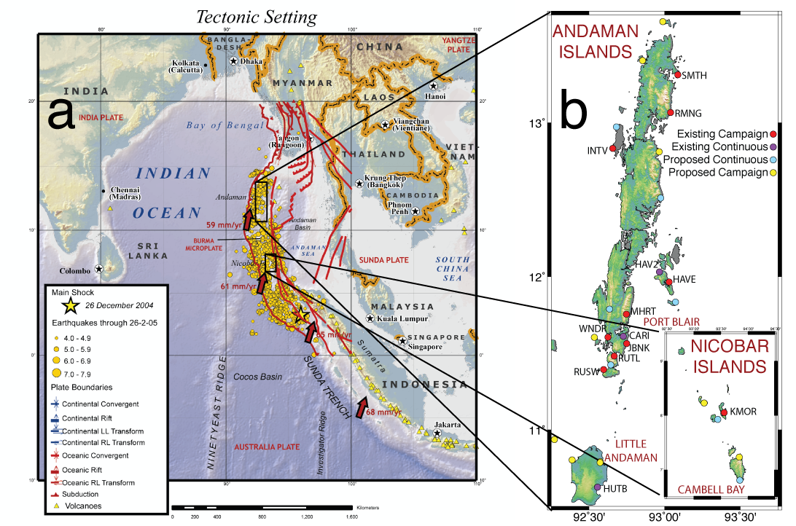
The great Sumatra-Andaman Earthquake
http://www.iris.iris.edu/sumatra/

Slide 13
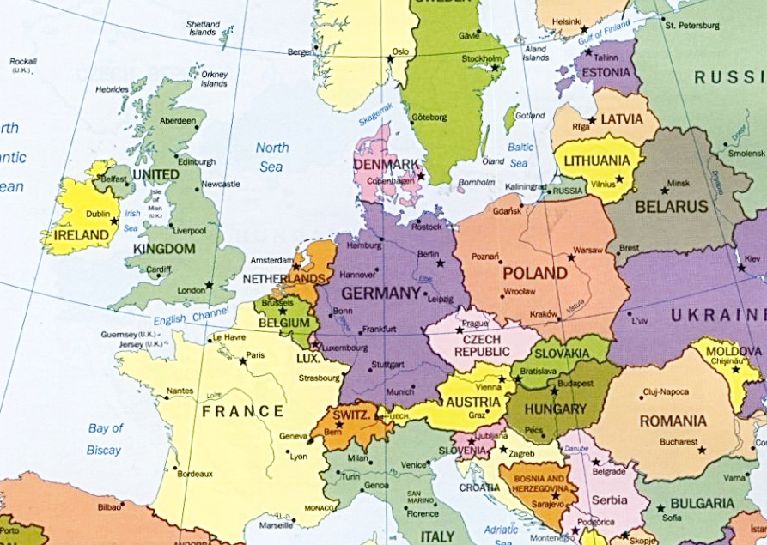
The great Sumatra-Andaman Earthquake
1300 km
300 km

Slide 14
Sumatra Earthquake: spectrum
Membach, SG C021, 20041226 08h00-20041231 00h00
₀S₄
₀S₀
₀S₃
₀S₂
₁S₂
₀T₂
₂S₁
₀T₃
₀T₄

Slide 15
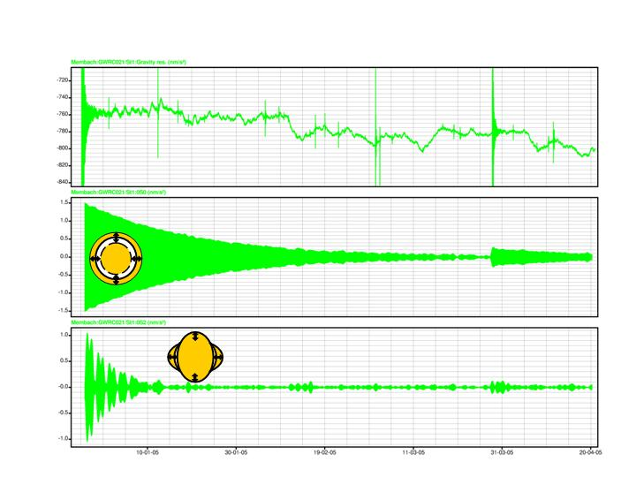
Sumatra Earthquake: time domain
Membach, SG C021, 20041226 - 20050430
Q factor 5327
Q factor 500
M. Van Camp
http://www.iris.iris.edu/sumatra/

Slide 16
Splitting
If SNREI (Solid Non-Rotating Earth Isotropic) Earth: Degeneracy:
For n and l, same frequency for all l: –l < m < l
For each m (colatitude term) = one singlet.
The 2m+1 group of singlets = multiplet
If the Earth is not spherically symmetric, there is no degeneracy:
 Coriolis
 Ellipticity
 3D
i.e., different frequencies and eigenfunctions for each l, m

Slide 17
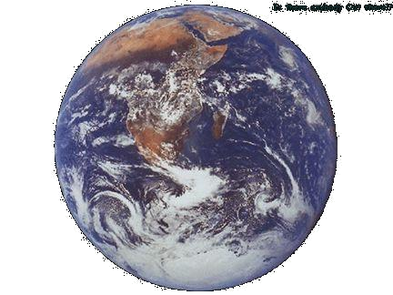
Splitting
Rotation
(Coriolis)
Ellipticity
3D
Waves in the direction of rotation travel faster
Waves from pole to pole run a shorter path (67 km) than along the equator
Waves slowed down (or accelerated) by heterogeneities

Slide 18
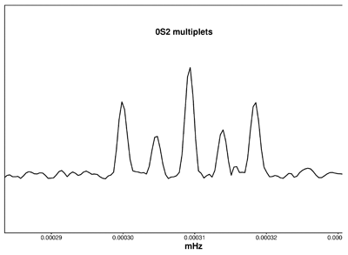
Splitting: Sumatra 2004
Membach SG-C021
₀S₂ Multiplets m=-2, -1, 0, 1, 2
“Zeeman effect”
M. Van Camp
http://www.iris.iris.edu/sumatra/

