Slide 1
Geology 5640/6640
Introduction to Seismology
19 Sep 2024
Last time: The Strain and Elasticity Tensors
• Stress within a continuum causes deformation, or strain
ε_{ij}, and rigid-body rotation ω_{ij}.
• Infinitesimal strain assumes small relative displacement
in which case the vector between two points changes by:
Note however this neglects higher-order terms (n ≥ 2) in a
Taylor series approximation…
• The strain tensor is symmetric (like stress) and unitless
Read for Tuesday 24 September: S&W 53-54 (§2.4.1); 458-462
© A.R. Lowry 2011-2024

Slide 2
Last time: Strain; Hooke’s Law (Elasticity)
• The constitutive relation for seismology is Hooke’s Law:
• The elasticity tensor has up to 21 independent terms, but
for an isotropic solid, we only need two (shear rigidity and
one other…)
• In elastic wave theory, these are Lamé’s constants,
μ & λ, with units of stress (Pa):
(where μ is shear rigidity, E = Young’s modulus; ν
is Poisson’s ratio)

Slide 3
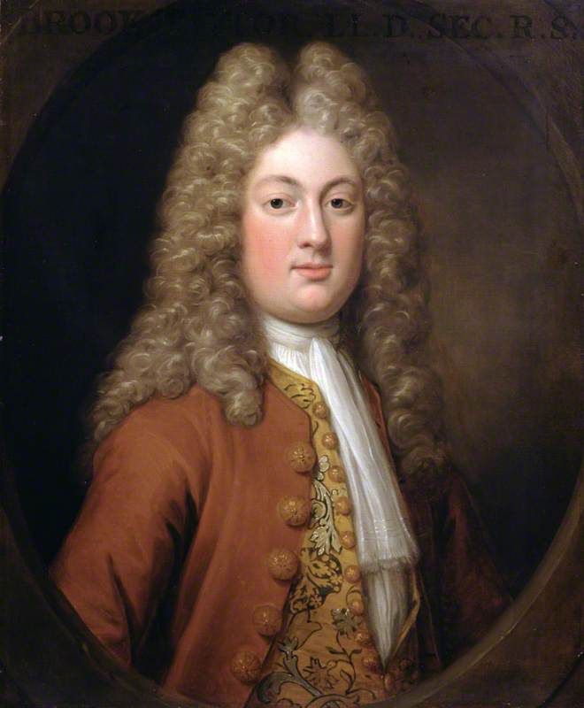
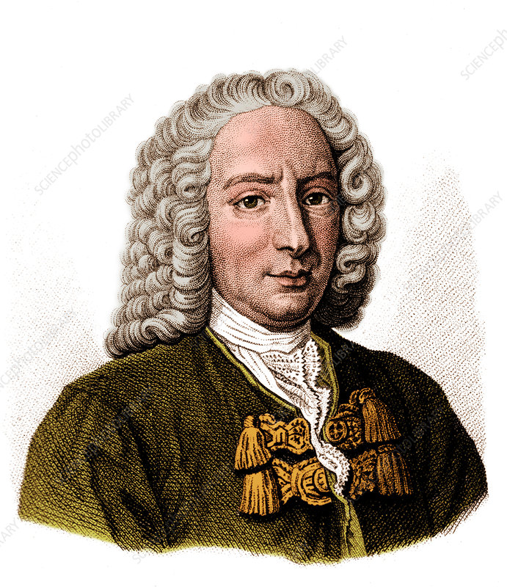
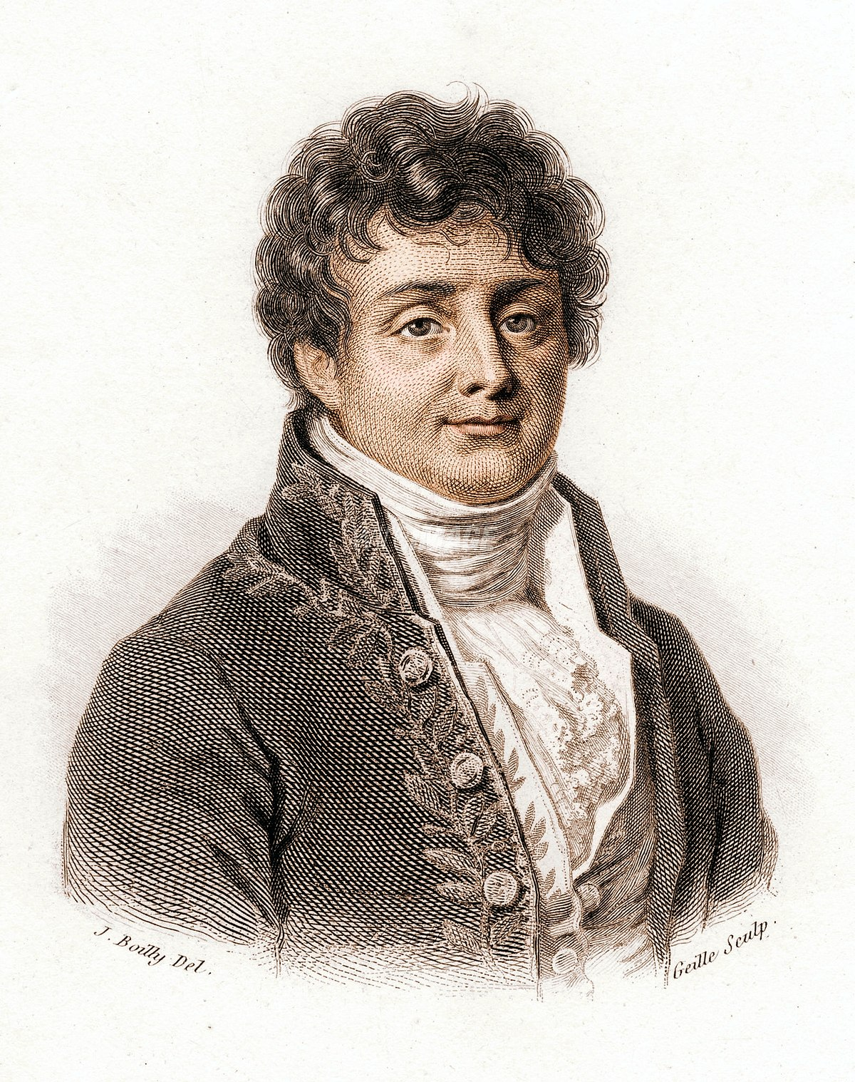
Aside: on the history of the wave equation…
• Elastic wave equation first derived by
Brook Taylor (English mathematician who
developed Taylor’s Theorem, Taylor series)
ca. 1720s, using a recent derivation of
Newton’s Laws
• General solution using sums of sinusoids
first developed by Swiss mathematician
Daniel Bernouli
• Recognition that all functions can be
exactly represented as a sum of sinusoids
by (French mathematician) Jean Baptiste
Joseph Fourier

Slide 4
The isotropic elasticity tensor can be expressed in terms of
Lame’s constants as:
If we substitute this into our constitutive law, we can write
Here, θ is the volumetric dilatation:
The gradient operator is also sometimes called the
divergence, and is defined as:
What does the elasticity tensor “look like”?
(It’s four-dimensional, so it’s complicated to think about it or write it out! We’ll come back to this when we consider anisotropy.)

Slide 5
The Equations of Motion:
Up to this point, we’ve assumed static equilibrium (i.e.,
boundary stresses on our infinitesimal cube balance out).
If they don’t balance,
we must have
motion!
The Equations of Motion treat spatial changes in stress as a disequilibrium that is balanced by motion!
Stresses
are
σ₂₁, σ₂₂, σ₂₃
σ₁₂ must equal
σ₂₁ in equilibrium

Slide 6
^
Suppose we add a small incremental stress on +x₁ face, so
that stresses on this face are:
σ₁₁ + Δσ₁₁, σ₁₂ + Δσ₁₂, σ₁₃ + Δσ₁₃
Summing the forces on the ±x₁ faces (& recalling F = σA):
^

Slide 7
We can do the same for shear stress acting on the other
two faces and sum to get the total force acting in the
x₁-direction:
The other force vector elements work similarly, so
(by symmetry). These must be balanced by motion per
Newton’s second law:
F = ma
Here, we are interested in relating the force balance
back to displacement u, so we will express
Motion arises here because the stress disequilibrium is an “extra force” that results in an acceleration!

Slide 8
In Einstein summation notation, time derivatives are
expressed with an overdot, so we’ll also use a_{i} = ü_{i}.
Mass m is equal to density times volume,
m = ρV = ρdx₁dx₂dx₃,
so we can write the force balance in the x₁-direction as
or
In indicial notation,
Note that in the wave equation, acceleration and stress
vary in both space and time!
Now we’d like to express our equations as derivatives acting on a single property. For now let’s choose displacement u as that property:

Slide 9
We may also consider body forces f_{i} = F_{i}/V, in which case
the dynamic equations of motion are
In the Earth the only significant body force is gravity:
f_{i} = (0, 0, ρg)
and in practice we neglect it (⇒ assumed negligible) for
body waves (although it is important for surface waves).
Now we have the equations in terms of stress; we’d like to
get them entirely in terms of displacement. Recall:
and:
Substituting these back into the equations of motion (&
letting f_{i} = 0), we have:
To get stress in terms of the displacement u, we first have to convert it to equivalent strain via the elasticity tensor:

Slide 10
(For e.g. the x₁-direction):
And we have
Recall also:
And we have:

Slide 11
By taking the derivative of the displacement u, we can express both sides of the equation in terms of dilatational strain θ .
The result expresses the wave equation in terms of strain and material properties (the propagation velocity squared!)
Now we introduce an additional notational sleight-of-hand:
Take the derivative of both sides:
And reorder:
If we do this for all three coordinates and sum,
We have:

Slide 12
We arrived at the P-wave equation using
by taking the derivative with respect to x_{i} and summing over
i. We could instead take derivatives with respect to x_{j} and
by a similar set of steps arrive at:
the S-wave equation, in which the S-wave propagation
velocity is given by
Note the important implication: For the P-wave we have
dilatation, but no shear; for the S-wave we have shear,
but no dilatation!

Slide 13
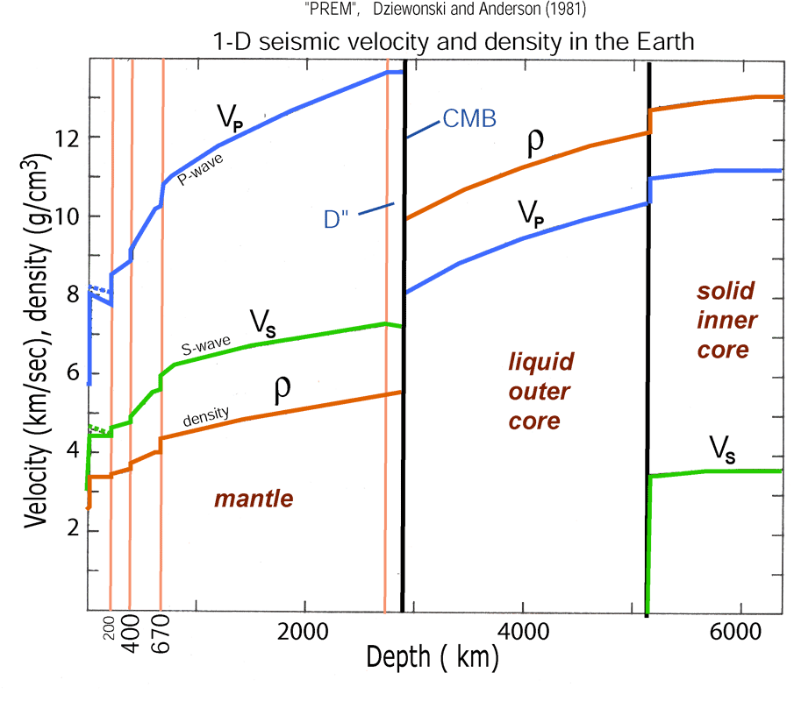
• Here and represent the
propagation velocities for the P and S waves
respectively.
• Note changes in elastic properties contribute more to
velocity variation than changes in density
• Velocity is sensitive to rock chemistry, packing structure,
porosity & fluid type, pressure and temperature. The
tricky part is distinguishing which we’re seeing…

