Slide 1
Geology 5640/6640
Introduction to Seismology
21 Nov 2024
Last time: Normal Modes
On a sphere, free oscillations are described in terms of
spherical harmonics as:
Here n is radial order (i.e., depth dependence with 0 for
fundamental; > 0 for overtones); l (colatitude) and m (longitude)
are surface orders; A_{lm}^{n} describe source displacement; ω_{lm}^{n} are
eigenfrequencies; & y_{l}^{n}(r) (at depth) and x_{lm} (surface) are
eigenfunctions.
• Spherical harmonics are basis functions on a sphere:
orthonormal and can completely describe any function on
or within the sphere.
Read for Tuesday 26 November: S&W 157-176 (§3.4–3.5)
© A.R. Lowry 2011-2024

Slide 2
Last time continued: Normal Modes
• Normal modes are used for source modeling and estimation
of global structure (including PREM)
—> Include toroidal (SH excitation of Love waves) and
spheroidal (P-SV excitation of Rayleigh waves),
each harmonic has a different period…
—> Verified earlier inferences of solid inner core
—> Source of PREM!
• Decay of normal modes over time provides a measure of
global-scale attenuation properties
• Longitude terms (m) degenerate to a singlet for given n, l
except when coriolis, ellipticity, 3D are important (l = 2!)

Slide 3
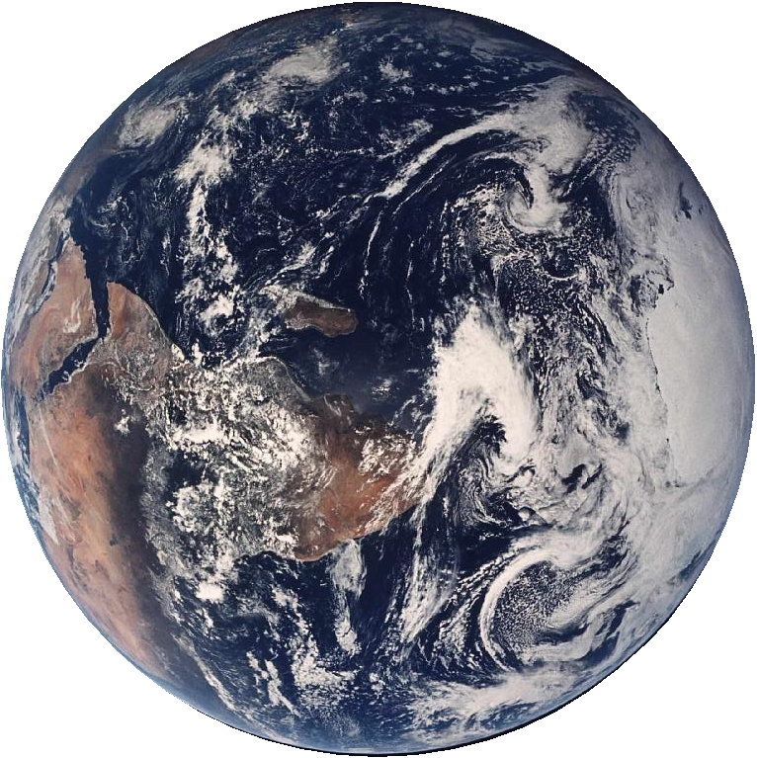
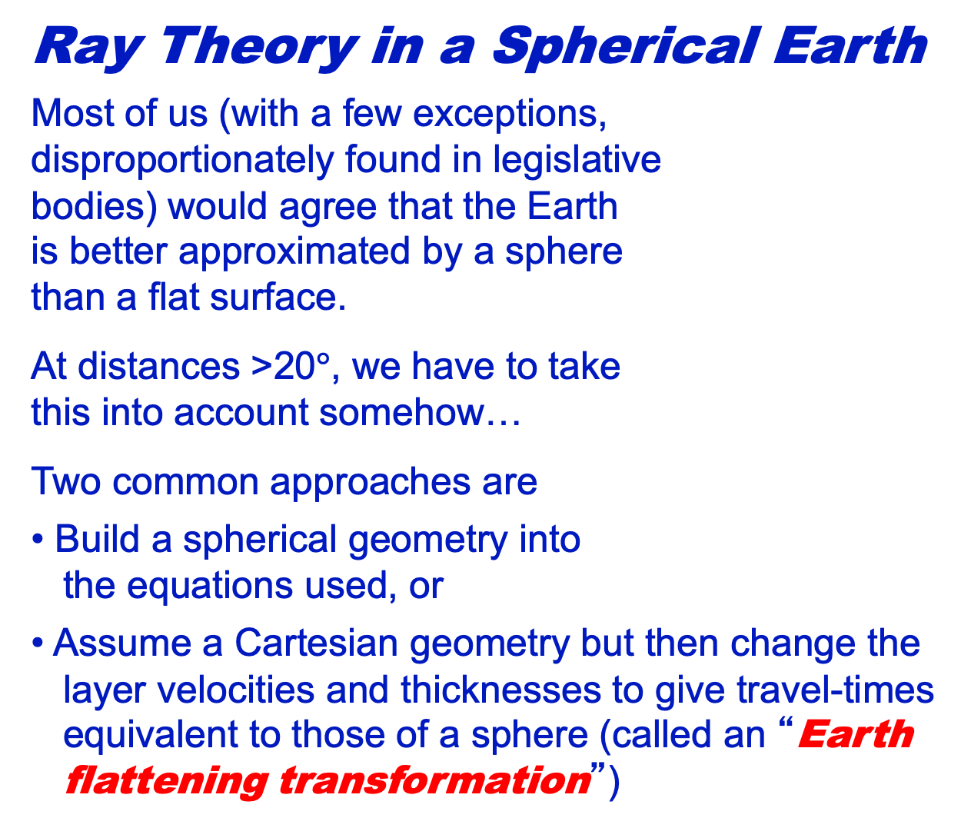
Ray Theory in a Spherical Earth
Most of us (with a few exceptions,
disproportionately found in legislative
bodies) would agree that the Earth
is better approximated by a sphere
than a flat surface.
At distances >20$°$, we have to take
this into account somehow…
Two common approaches are
• Build a spherical geometry into
the equations used, or
• Assume a Cartesian geometry but then change the
layer velocities and thicknesses to give travel-times
equivalent to those of a sphere (called an “Earth
flattening transformation”)

Slide 4
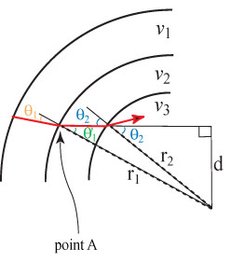
Let’s consider Snell’s Law in a spherical geometry:
Here the ray path is in red;
velocity is constant within
spherical shells and increases
at each layer boundary.
At point A, locally the boundary
is ~flat & we can use regular
Snell’s Law at the interface:
But even though v₂ is constant,
θ'₁ does not equal θ₂!
Consider the right triangles
formed by d, r₁ and r₂: Since sine = opposite/hypotenuse,
sinθ'₁ = d/r₁ and sinθ₂ = d/r₂, or d = r₁sinθ'₁ = r₂sinθ₂.

Slide 5
Snell’s Law in a spherical geometry:
Now, multiply both sides of
Snell’s Law:
by r₁:
Since:
we can write Snell’s Law
in spherical coordinates
as:

Slide 6
Snell’s Law in a spherical geometry:
We can alternatively write
in terms of slowness as:
which for an arbitrary i^{th} layer
is simply:
Thus the r multiplier corrects
for the change in orientation of
the interface normal as the ray
approaches the center of the
Earth.

Slide 7
Snell’s Law in a spherical geometry:
But haven’t we changed the
units of the ray parameter?
Short answer: yes! p has units
of [time/distance]*radius, but
recall that arc length on a circle
is equal to radius * angle in
radians. Thus p actually can be
thought of as having units of
[time]/[∠ in radians].
In other words (and this
shouldn’t come as a surprise):
rΔ
r
Δ

Slide 8
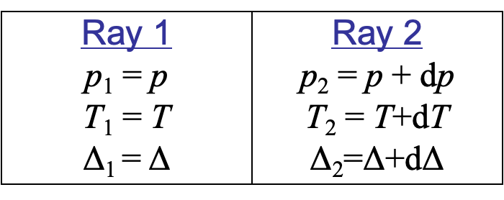
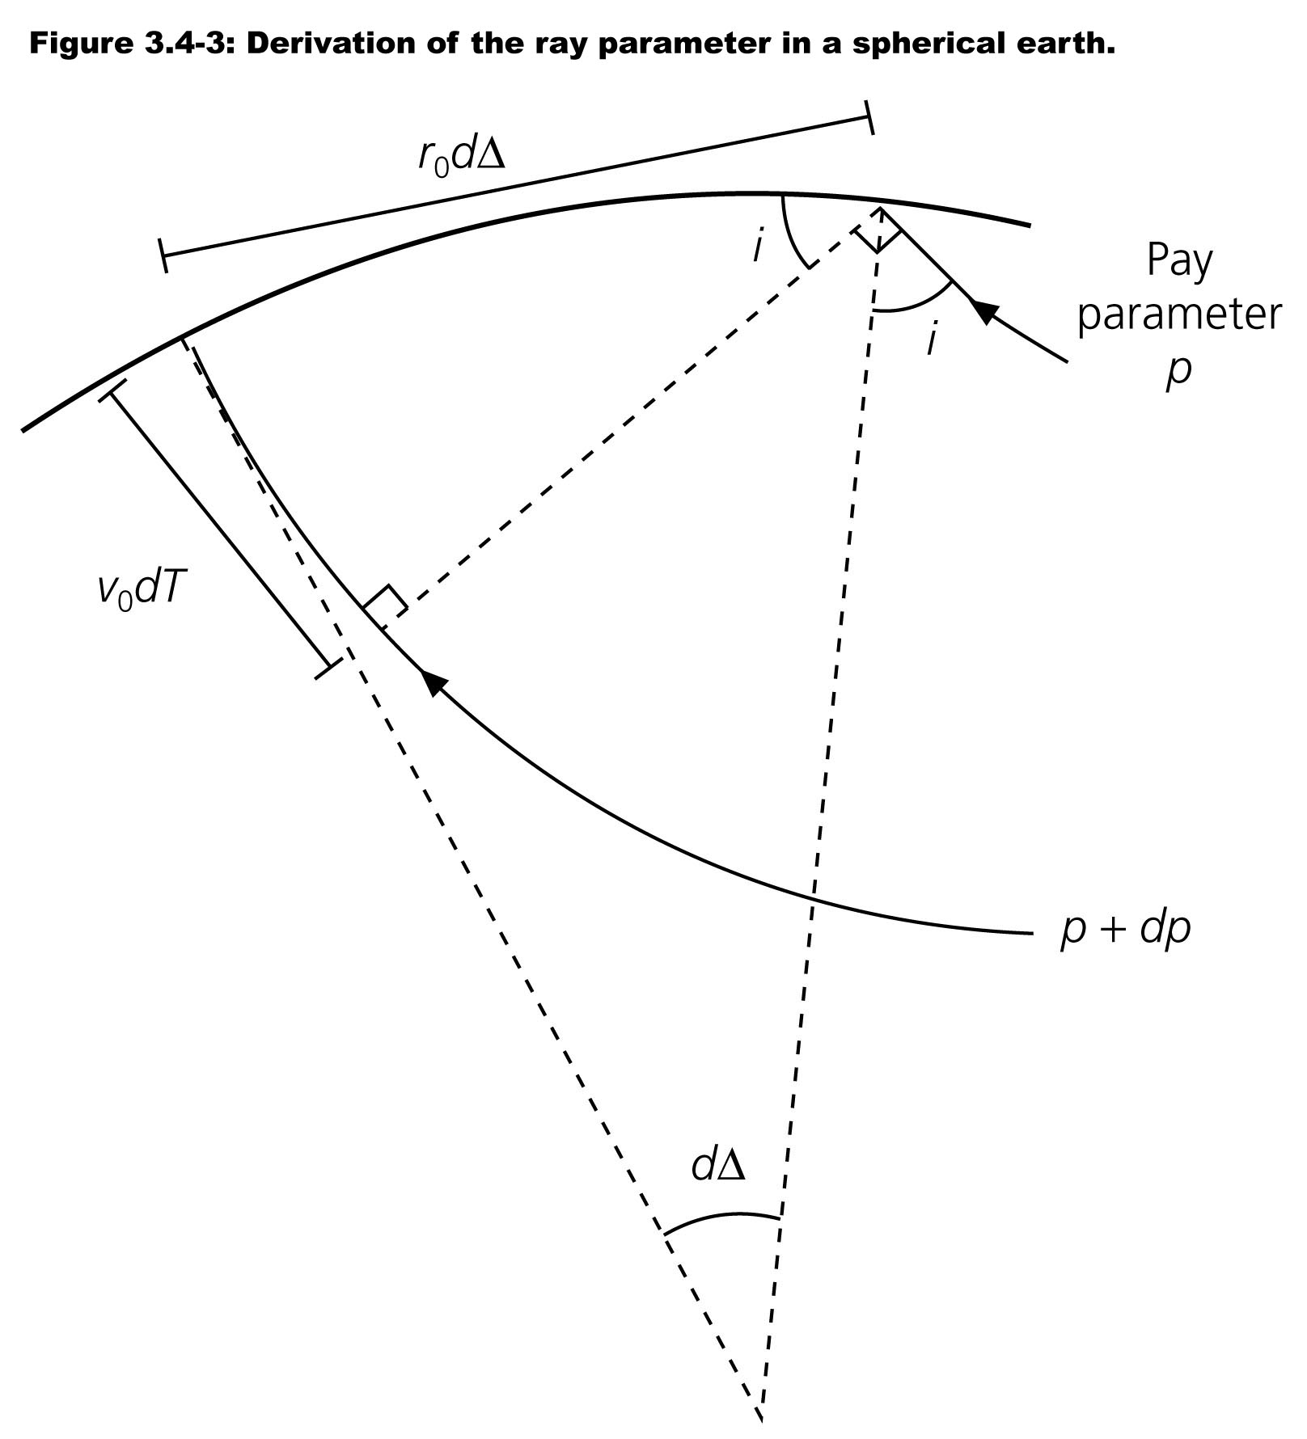
More rigorously, let’s consider two rays with slightly different
ray parameters:
In the limit as dΔ goes to zero,
the “triangle” at right satisfies:
and thus:
Similar to the Cartesian case
where the ray parameter is the
inverse of the apparent velocity c_{x} along the surface, we have:

Slide 9
With some easy math, which we’ll skip (but you can see p159
eqns 9-15), we can show that travel-time is:
where: r₀ = surface radius
r_{p} = deepest point on ray path (“turning radius”)
ζ = r/v;
Angular distance is:
And in this format, the Δ = 0 “intercept” for slope dT/dΔ at Δ is:

Slide 10
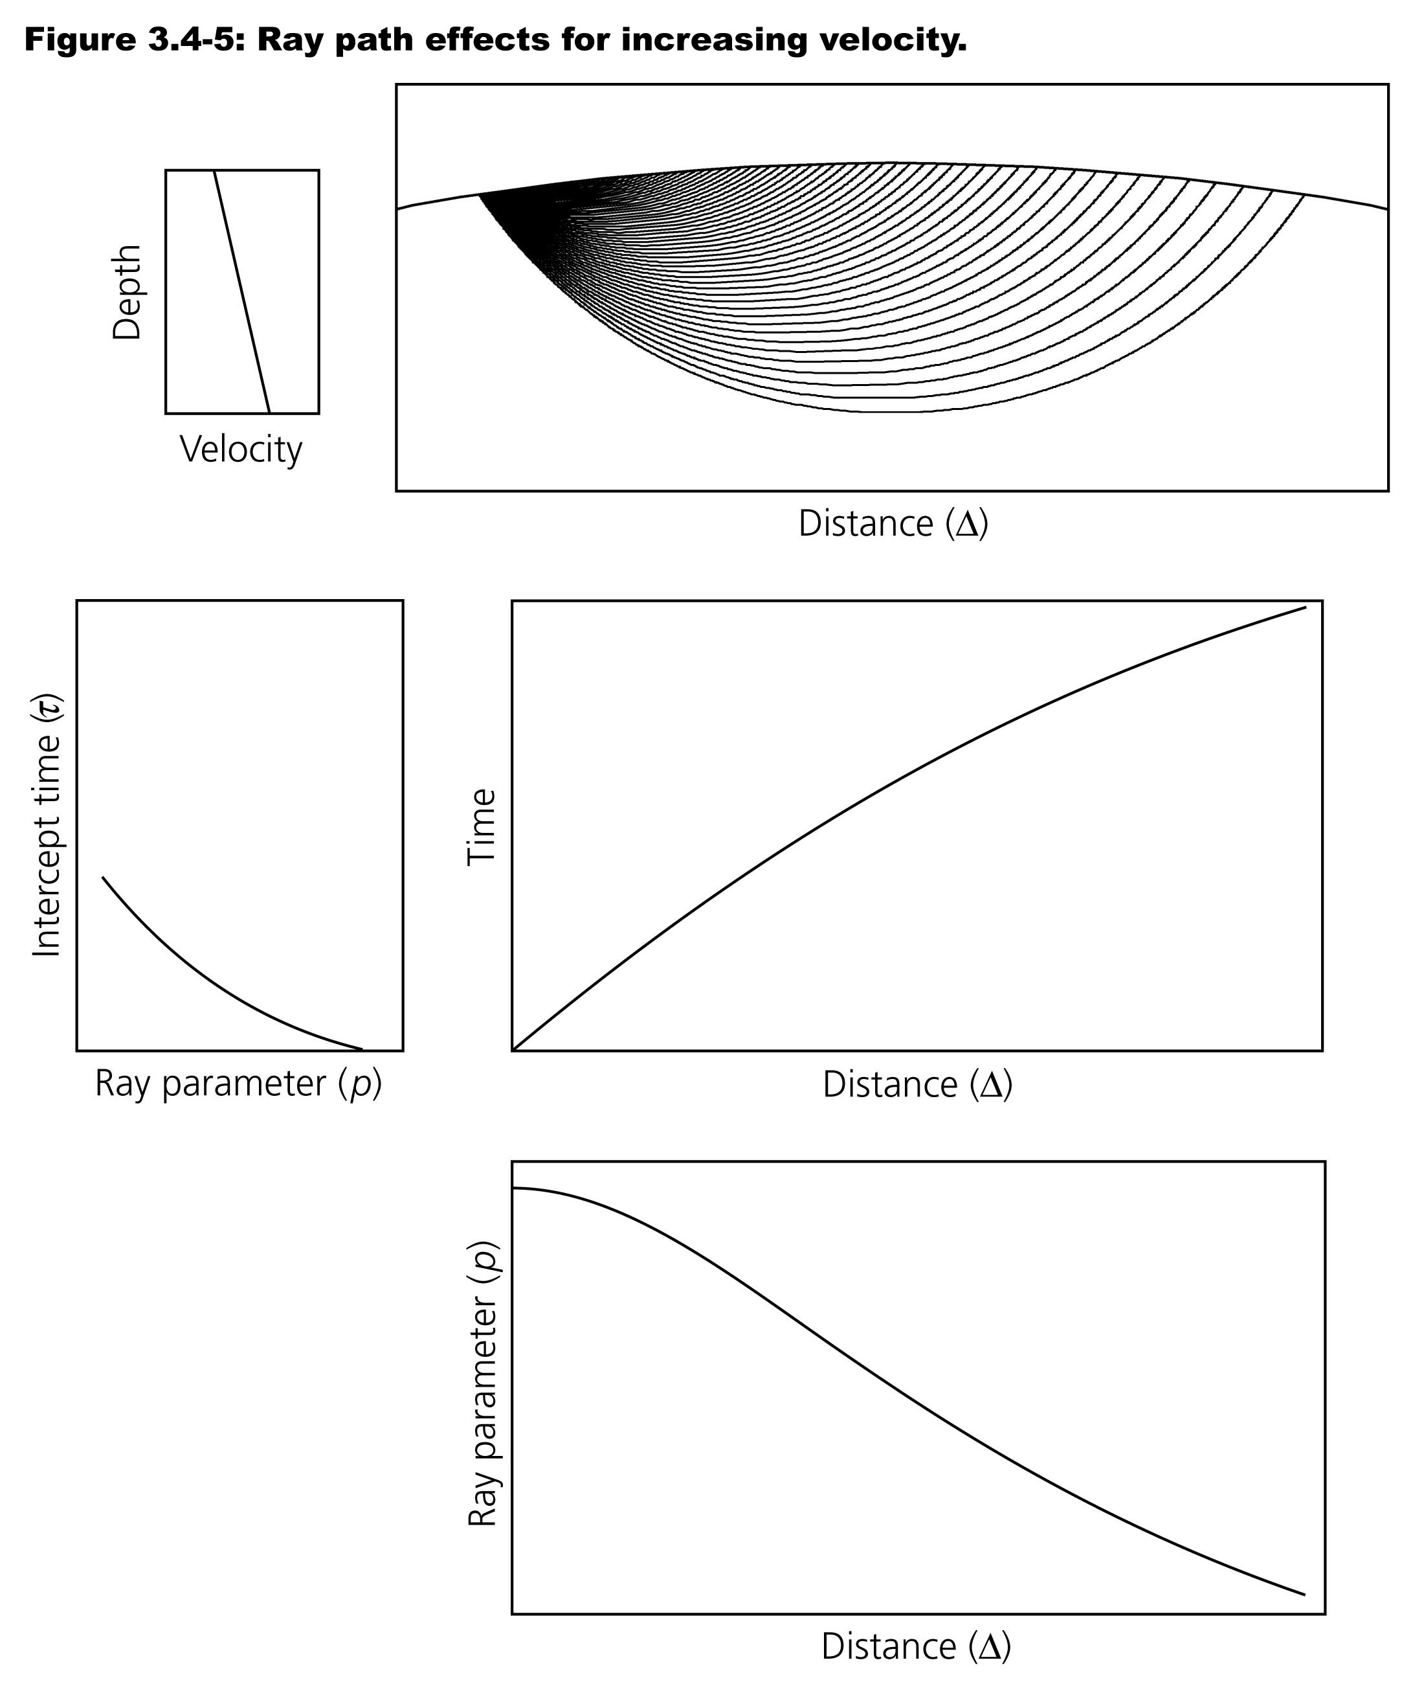
For a slowly increasing
velocity with depth,
slope of the travel-time
curve (= p) decreases
with Δ and the intercept
(= τ) increases with Δ
(so decreases with p).

Slide 11
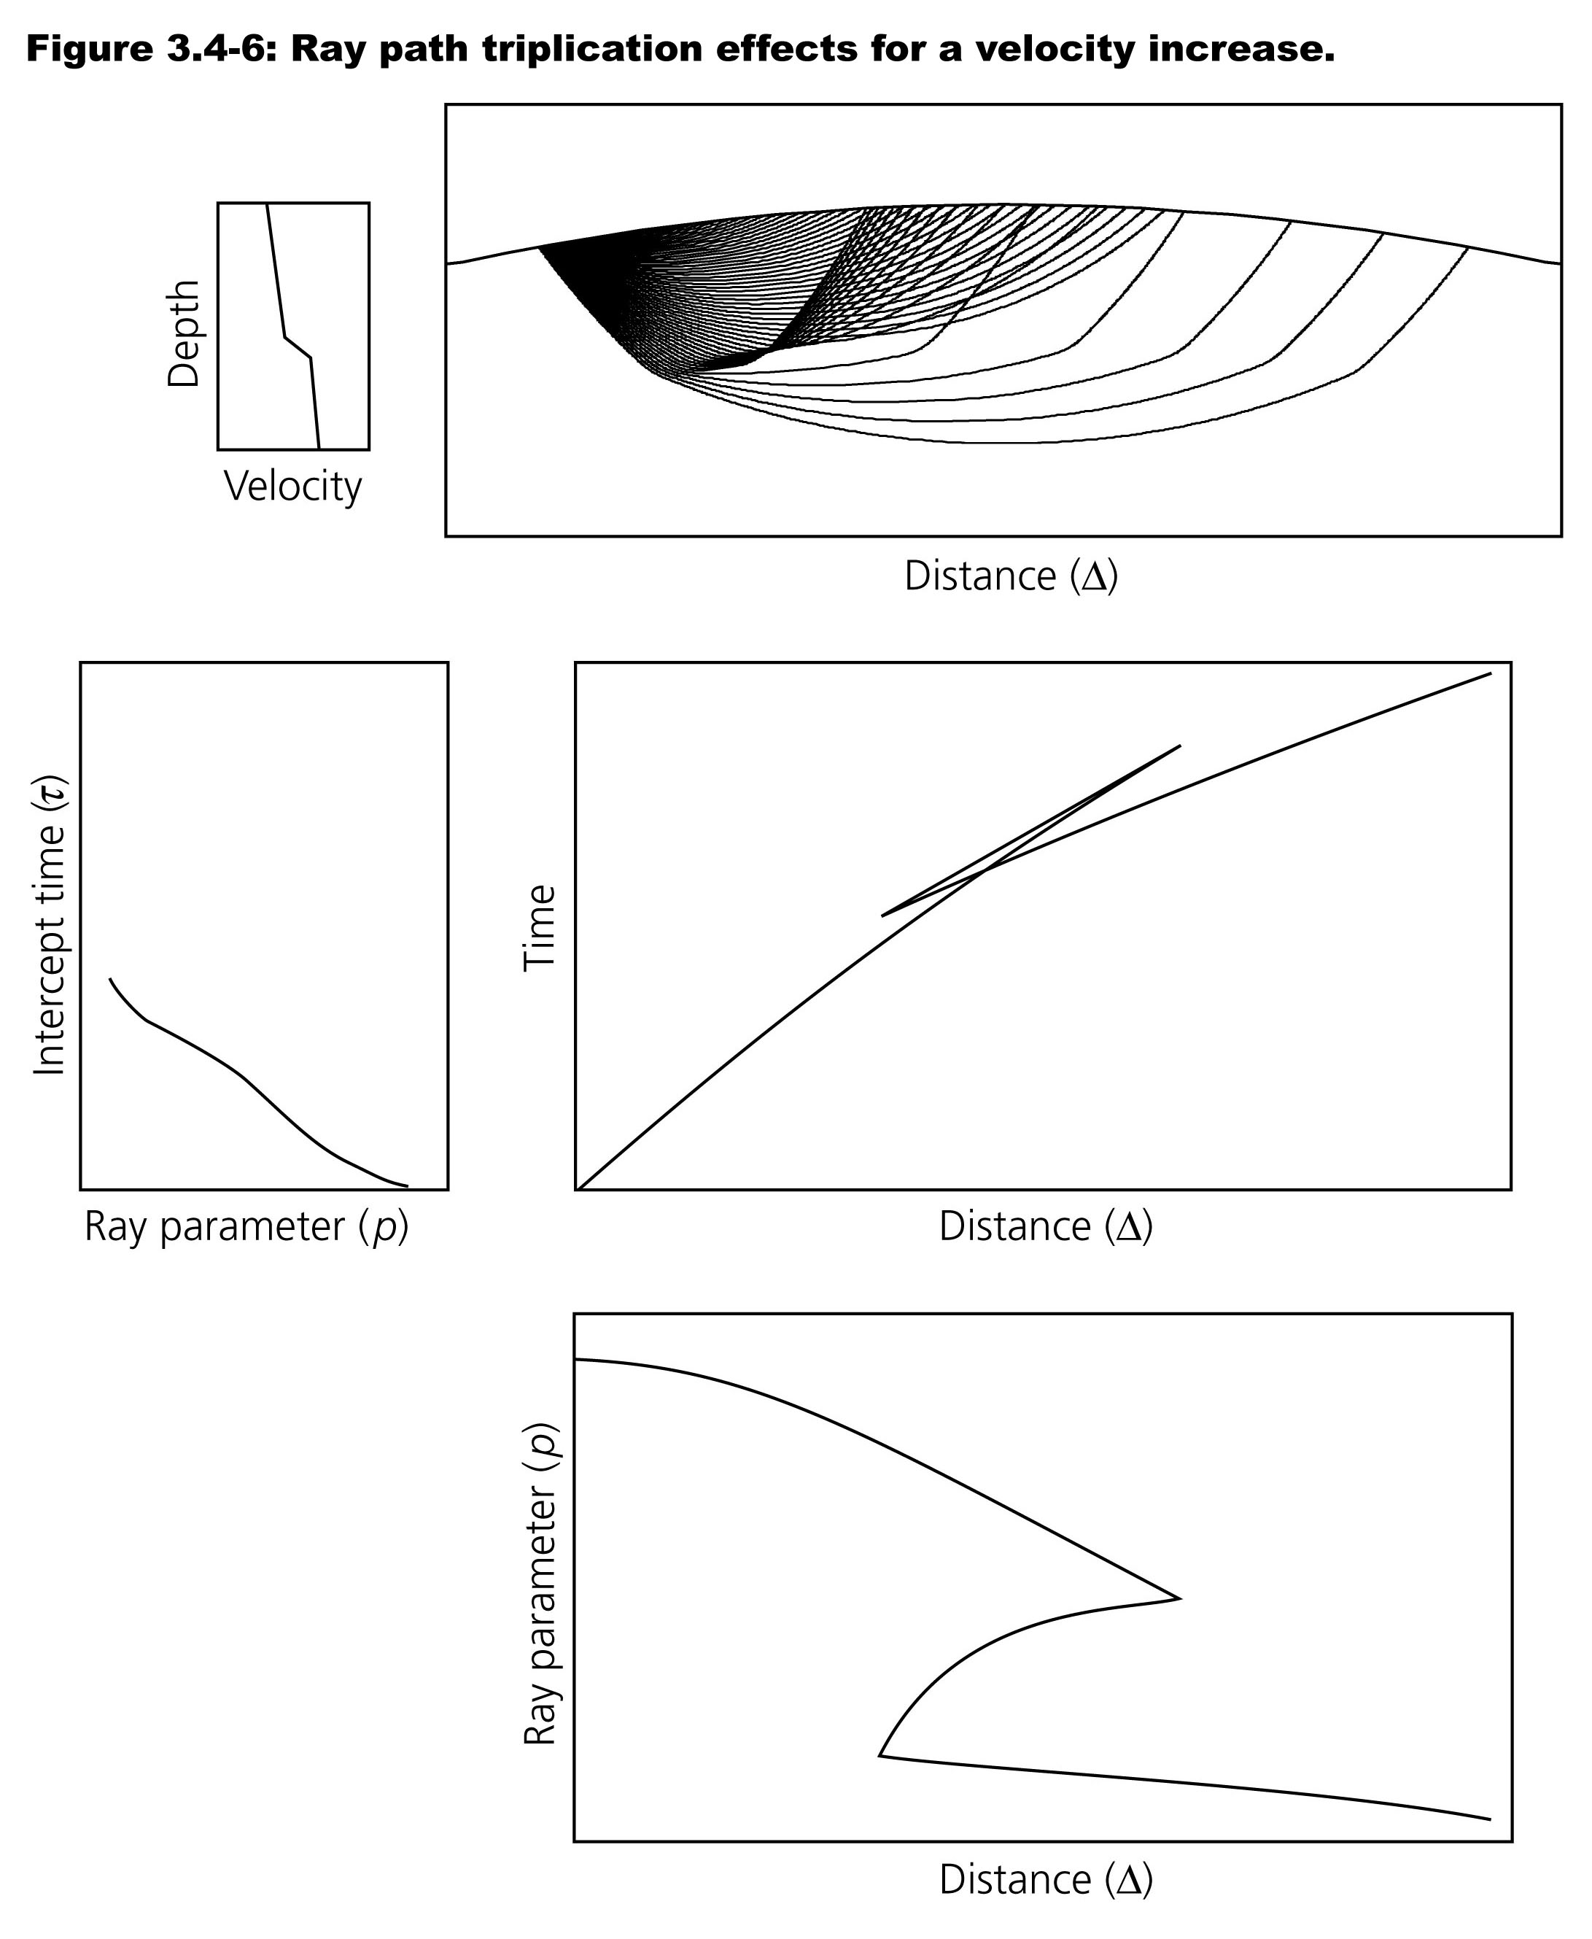
With a sufficiently sharp
change in gradient of
velocity over a small
distance, can get
triplication (as in the
Cartesian case).

Slide 12
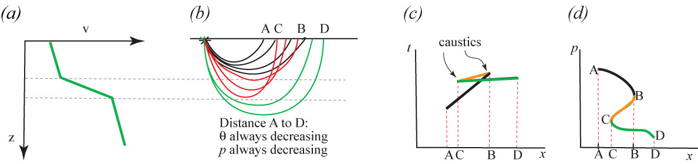
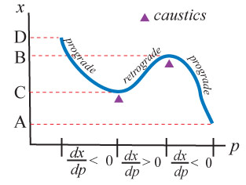
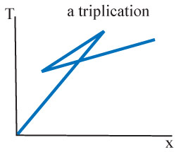
(Recall what the Cartesian case looked like:)

Slide 13
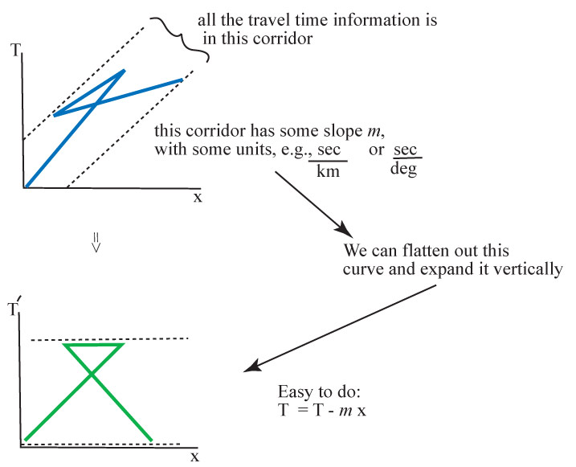
Note that it’s common for regional studies to represent the travel time as “reduced time”, to better highlight changes in slope of the travel-time curve…

Slide 14
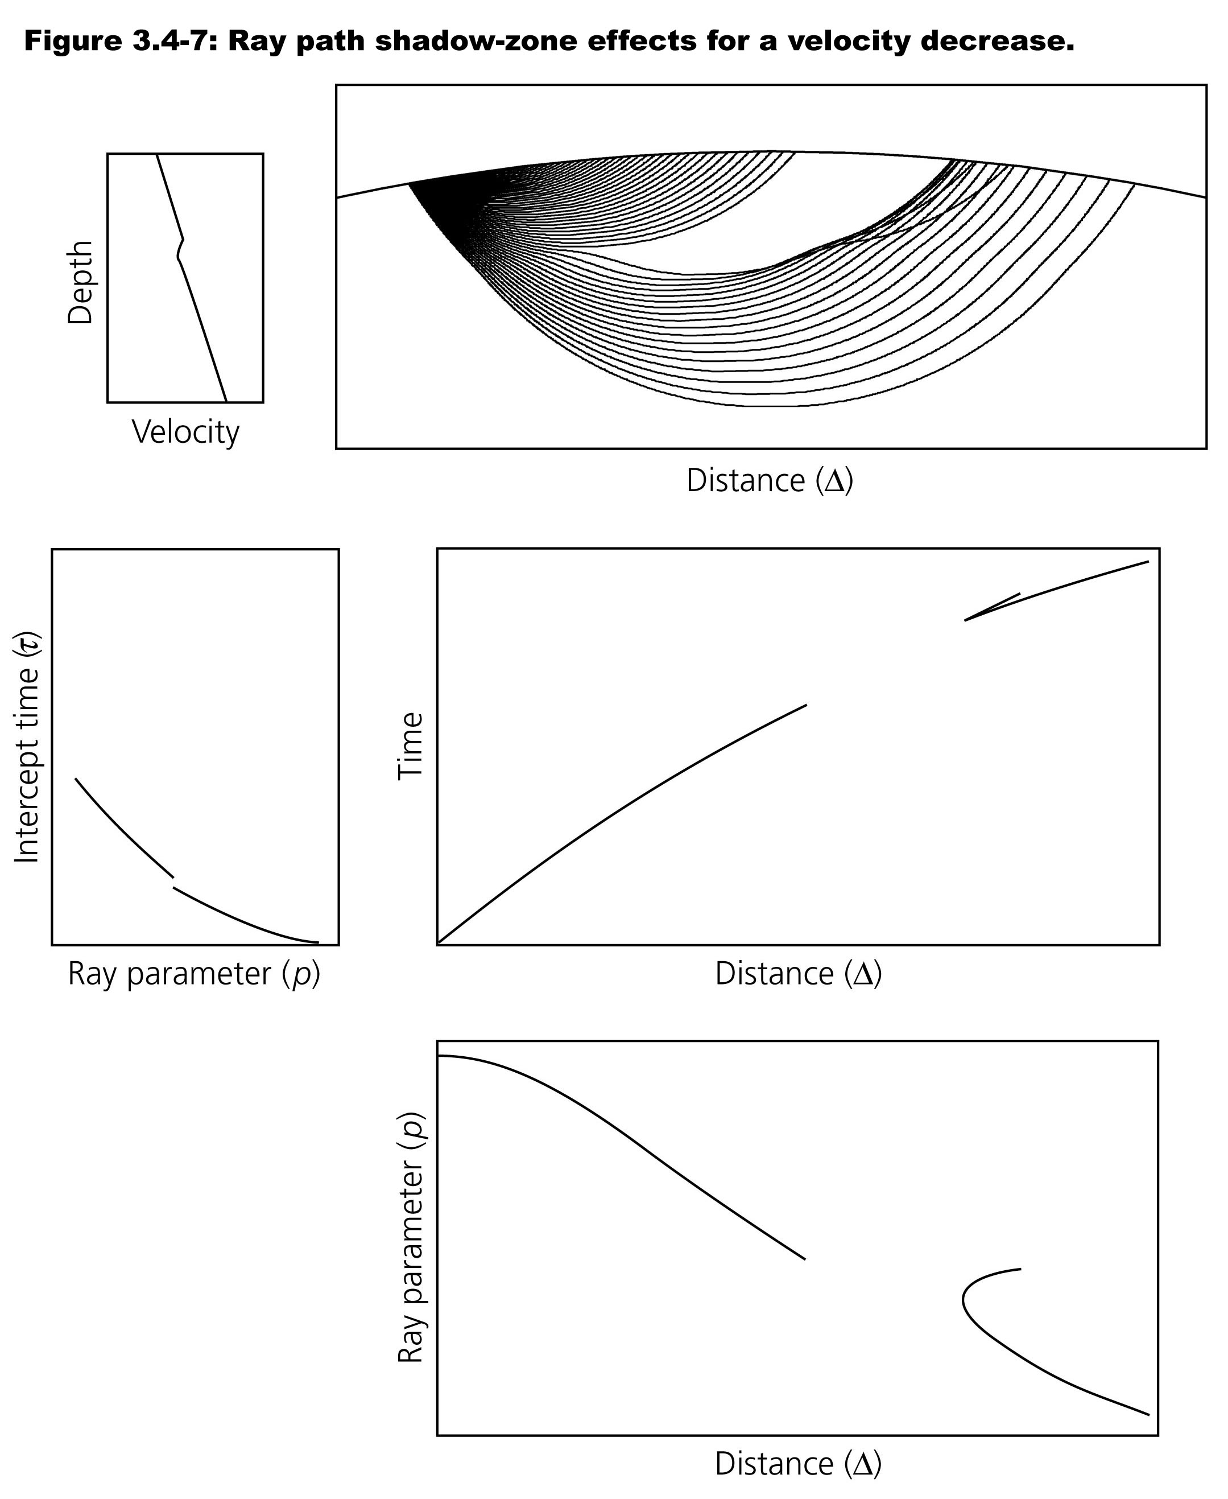
Low-velocity zones in ray theory are accompanied by a gap in the arrivals with distance (low amplitudes with dispersion) and a shift in intercept times

Slide 15
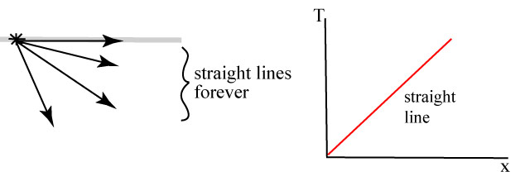
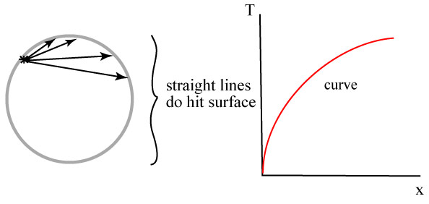
Note that part of the T vs Δ slope in a spherical geometry is just
geometry,
while part
reflects the
change in
velocity with
depth…

Slide 16
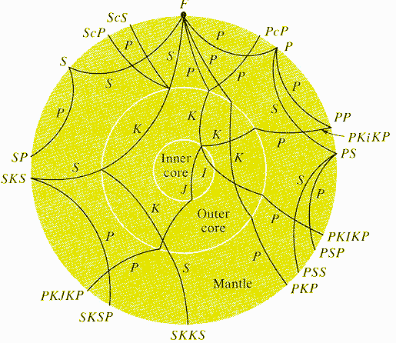
Recall that
our early
understanding
of travel-times
for the various
phases in the
Earth (and
hence
structure of
the Earth’s
interior) relied
on ray theory
in a spherical
Earth!

Slide 17
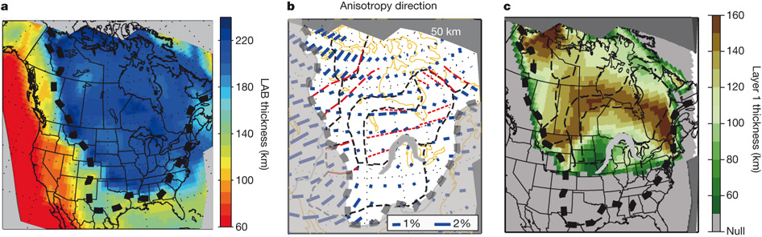
Previously we briefly touched on the topic of anisotropy,
the observation that velocity sometimes depends on the dip &
azimuth at which a wave propagates:
Here, lithosphere/asthenosphere boundary (LAB) has been
defined partly in terms of a rotation of the anisotropy fast axis
toward the absolute plate motion direction (loosely
corresponding to the depth of a slight decrease in shear
wave velocity). Why might that happen?
Yuan and Romanowicz, Nature, 2010

Slide 18
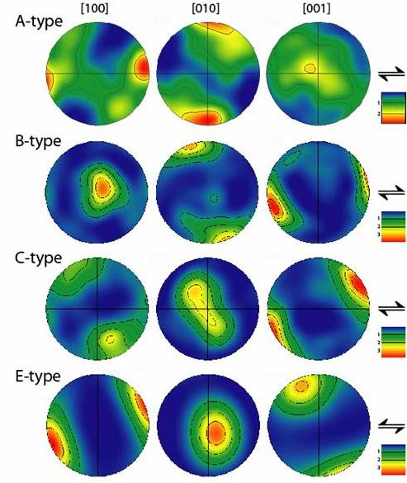
Anisotropy:
Mantle shear wave
anisotropy is “usually”
interpreted as alignment
of the olivine fast axis with
flow direction… But recall
where this comes from!
Hooke’s law generalizes
to:
And there are 81 terms in
the fourth-order elasticity
tensor, with as many as
21 different elastic
constants needed to fully
describe the response!

