Slide 1
Geology 5640/6640
Introduction to Seismology
22 Oct 2024
Last time: Ray Theory
• Ray Theory approximates wave propagation as rays
(= normals to wavefronts = propagation paths) with
infinite frequency (λ = 0).
• Rays follow Snell’s Law:
where θ is angle of incidence
• From Snell’s Law, the ray parameter
p is constant for a raypath (here u is
wave slowness)
• In a one-dimensional Earth, p = Δt/Δx is the inverse of the
(horizontal component of) velocity of propagation as it
would be observed at the surface… Constant over the
travel path!
Read for Thursday 24 October: S&W 75–86 (§2.6)
© A.R. Lowry 2011-2024

Slide 2
Last time continued: Ray Theory
• In a one-dimensional Earth, p = Δt/Δx, and the slope of
arrivals on a time-distance plot = p. If it’s a turning
ray (i.e., was critically refracted rather than reflected
back to the Earth’s surface), the slope is also the inverse
of the fastest velocity traveled!
• The distance traveled and travel-time of a (Cartesian) ray
with given take-off angle, θ₀, and ray parameter p is:
Discrete Layers: Continuous:
Distance:
Time:

Slide 3
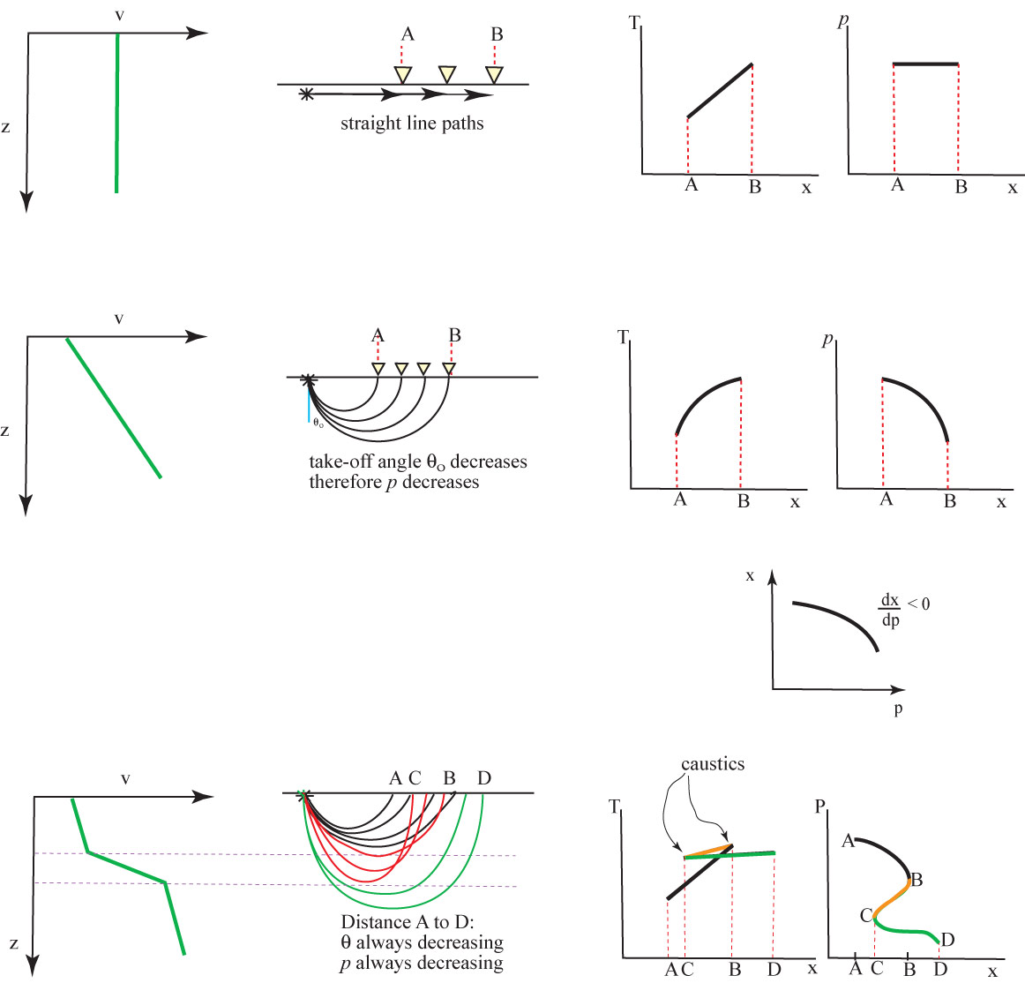
Now let’s
consider
some
examples:
V = constant with depth
V increases linearly with depth
V(z) has a rapid velocity increase
prograde: dx/dp < 0
retrograde:
dx/dp > 0

Slide 4
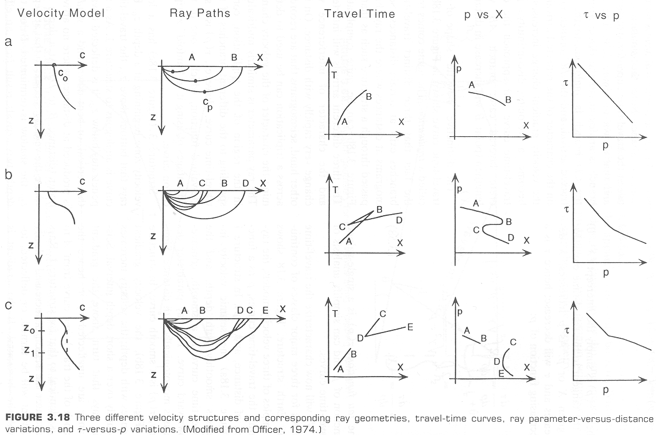
*
*
*
*
(From Lay & Wallace, 1995)
*τ is intercept on a T–X plot… We’ll talk about this more later.

Slide 5
Always bear in mind that rays represent just one skeletal
element of the wavefield: Note curving rays correspond
to diverging wavefronts in the direction of convexity of
the ray!
(Also from Lay & Wallace, 1995)
Of course wavefronts are further apart where velocity is
greater. But this is all still consistent with Snell’s Law…

Slide 6
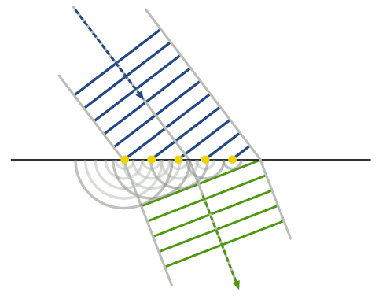
Note that we could also derive Snell’s Law using
Huygens’ Principle:
Each point on a wavefront can be considered a fresh
disturbance that acts as a point source generating
new waves.

Slide 7
Reminder: while we can get Snell’s Law from Huygen’s
Principle, we can’t get diffractions from Snell’s Law!

Slide 8
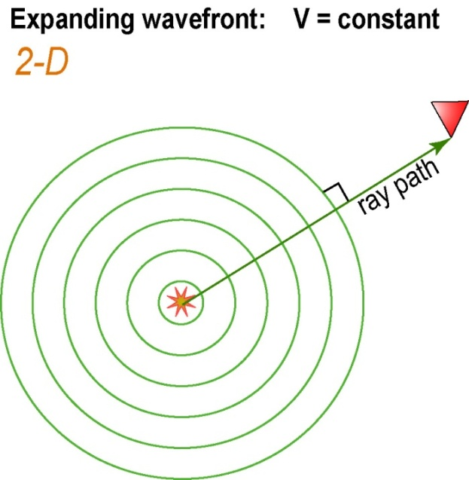
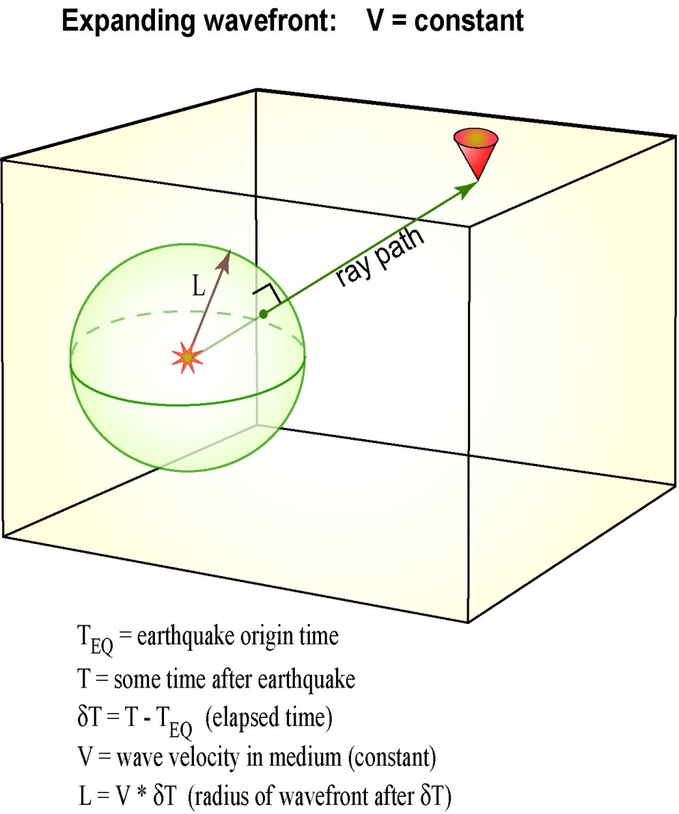
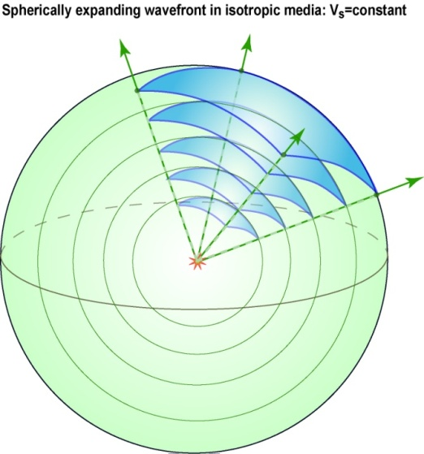
A bit more on Spherical Waves:
Recall from earlier we had the spherical Laplacian (for
radial component only):
And hence the
wave equation
& solutions:
What happens at
r = 0?

Slide 9
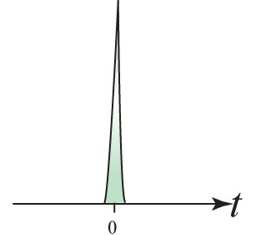
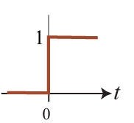
To wrap our heads around this singularity, we introduce the
Dirac Delta Function:
And we’ll throw in the Heaviside step function:
Paul Dirac
Oliver Heaviside

Slide 10
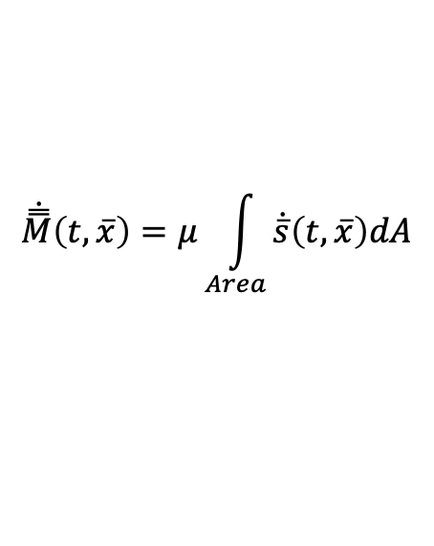
Then the solution to the spherical wave equation
we derived earlier:
can be shown to solve:
in which the right-hand side of the equation is called
the source term.
For example, in an earthquake, the f(t) in the source term
of the wave equation is a (tensor) moment rate of
energy release:
$$\dot{\overset{̿}{M}}\left(t,\overline{x}\right)=μ\int_{Area}{\dot{\overline{s}}\left(t,\overline{x}\right)dA}$$

Slide 11
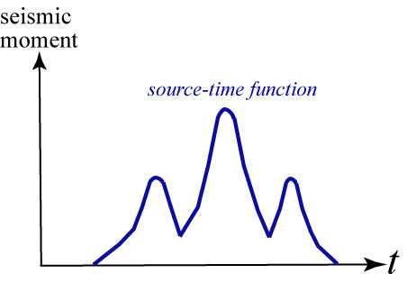
Earthquake sources can be characterized as energy release
(parameterized as seismic moment, ) vs. time…
Moment is a way of
representing energy
released in the event.
This physical
grounding is part of
why the moment
magnitude is now the
preferred measure of
earthquake size.
The source-time function provides information about how
much the fault slipped; and can be used to examine where
slip occurred and how fast the rupture propagated.
In geophysics/seismology, we talk about moment as being a
tensor—more on this later.

Slide 12
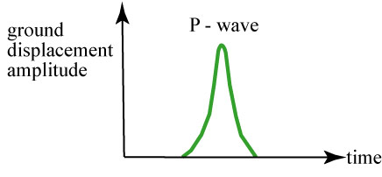
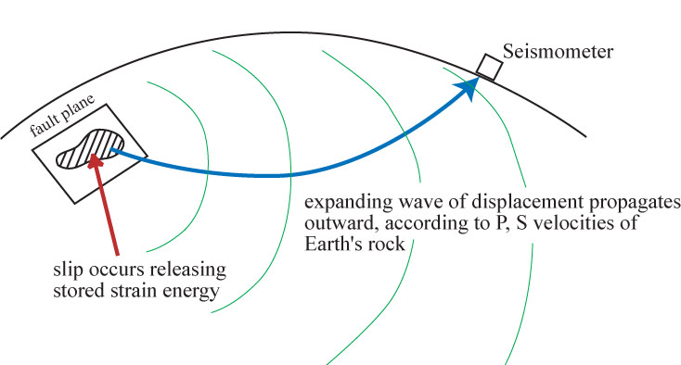
We can think of a seismogram as containing this history of
energy release. For example, we might record P-wave
arrivals from an earthquake that “look like”:
Although the solution is not unique, this motion can be used
to model slip on the fault
where the earthquake
originated: On a single,
contiguous patch of the
fault (as we’ll discuss
more later).
(They only look like
this if we take the
absolute value and
connect the peaks:
called an “envelope”)

Slide 13
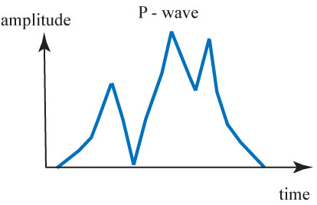
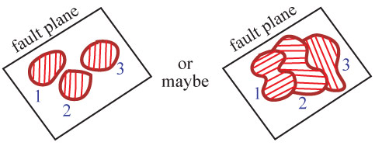
Alternatively, the P-wave arrivals
might look like the example at
left… Indicating the history of slip
was somewhat more complicated.
2
3
1
This suggests a slip history that involves slip on several
different patches of the fault, e.g. something like:

