Slide 1
Geology 5640/6640
Introduction to Seismology
23 Oct 2020
Last time: Ray Theory
• Ray Theory approximates wave propagation by rays
(= normals to wavefronts = propagation paths) with
infinite frequency (λ = 0).
• Rays follow Snell’s Law:
where θ is angle of incidence
• From Snell’s Law, the ray parameter
p is constant for a raypath (here u is
wave slowness)
• In a one-dimensional Earth, p = Δt/Δx is the inverse of the
velocity of propagation as it would be observed at the
surface… Constant over the travel path!
Read for Mon 26 Oct: S&W 157-162 (§3.4)
© A.R. Lowry 2020

Slide 2
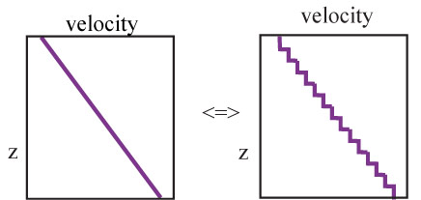
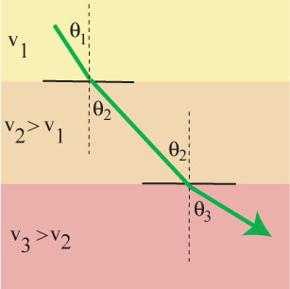
Snell’s law for seismic rays is identical to that for optics, so
ray theory is sometimes called
the optical representation.
We can approximate any
vertical velocity profile as a
stack of constant-velocity
layers (e.g., a gradient
approximated by discrete
steps). Since the ray
parameter must be constant,

Slide 3
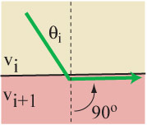
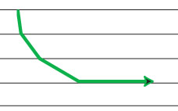
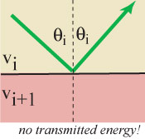
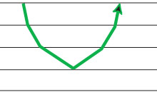
If velocity continues to increase with depth, eventually one of
two things happens. Either:
1) The ray follows the interface:
Or:
2) The ray reflects with no transmitted wave:
sinθ_{i+1} =

Slide 4
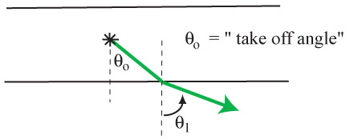
We refer to the angle (from vertical!) at which a particular
ray initially leaves its source (earthquake, explosion,
whatever) as the take-off angle. It is usually denoted
as θ₀:
Note that a source can produce an infinite number of rays,
each with a different take-off angle!

Slide 5
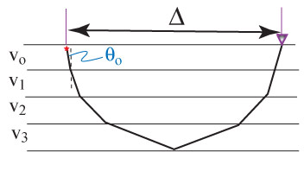
For homogeneous, isotropic layers:
1) Ray parameter p is constant along a given ray path.
2) A smaller take-off angle translates to greater distance to
where the ray path emerges at the surface (& a smaller ray
parameter).
3) For a given velocity structure, every ray parameter maps to
some distance (Δ) from the starting point, and corresponding
travel-time T = f(V).

Slide 6
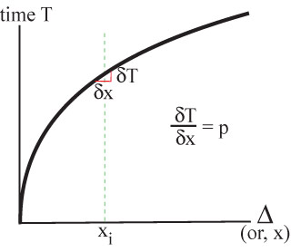
If we plot T vs. x (or Δ)…
Recall the plots of the seismic phases shown in previous
lectures… The slope of the line gives the ray parameter for
the phase arriving at that given Δ!
Plots like this are common
in seismology; called “T-X”
or “T-Δ” or “time-distance”
plots.
Note the emphasis that is
being placed here: The
skeletalized information
from the wavefield here is
the travel-time; the
information we are
extracting about the Earth
is velocity along the ray!

Slide 7
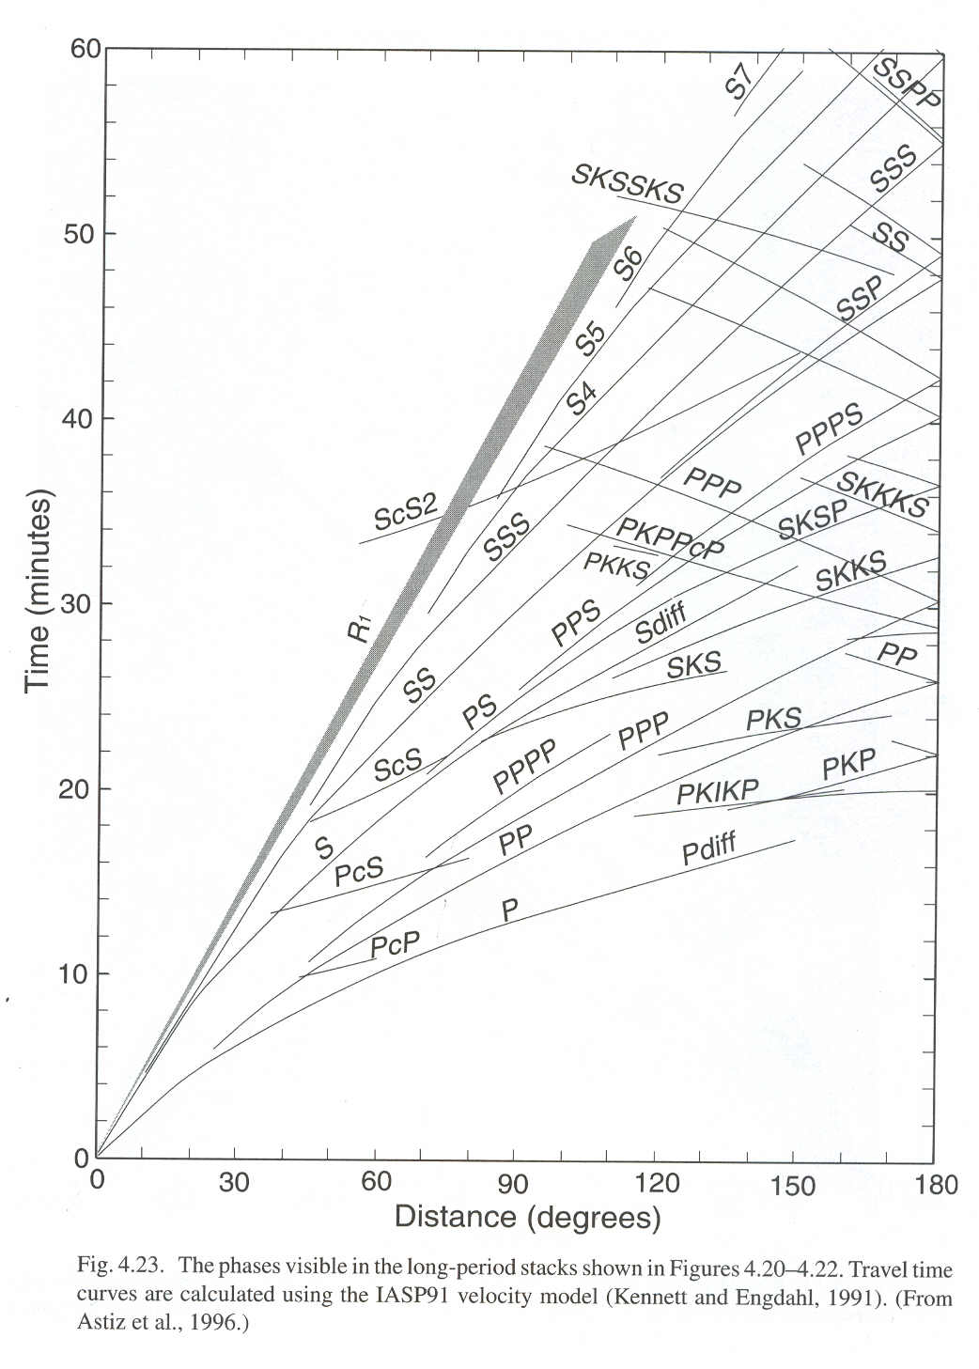
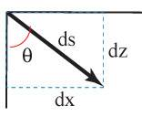
Time vs Distance:
Since we now have a simple
formula for geometry of ray
paths (Snell’s Law), if we
know the velocity structure
we can derive equations to
describe T-X for a given ray
from T(p,u) and X(p,u).
Consider a segment ds of a
raypath: Here,
Since p = u sinθ, sinθ = p/u,

Slide 8
Going the Distance…
We can rearrange dz/ds as:
Then using the chain rule:
And plugging in our raypath
relations:
If we multiply both sides
by dz and integrate:
But p is a constant! So

Slide 9
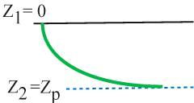
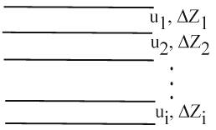
If we know u(z), we can integrate this from e.g. the surface
down to a ray’s turning depth z_{p}:
And note that if we know u(z), we know z_{p}: it’s the depth at
which u ≤ p! Having solved for x(p), the distance X at
which the ray will arrive at the surface is simply X = 2x:
Most often Earth velocity structure is represented as a
layered stack (e.g., PREM, which you’re looking at for
HW). In that case the integral is a
summation:

Slide 10
Getting the Time:
Now we ask ourselves, how long did it take to travel the
ray arc we just described? To travel a distance ds in a
medium with velocity V
will require dt = ds/V, so:
Again with the chain rule:
So:
And integrating:
As before we integrate to the
turning depth & double it to
get the total travel-time:

Slide 11
And for a discretized stack of layers, we have:
Note that here (as with distance) it’s physically meaningful
only if we sum over the layers for which u_{i} ≥ p.

