Slide 1
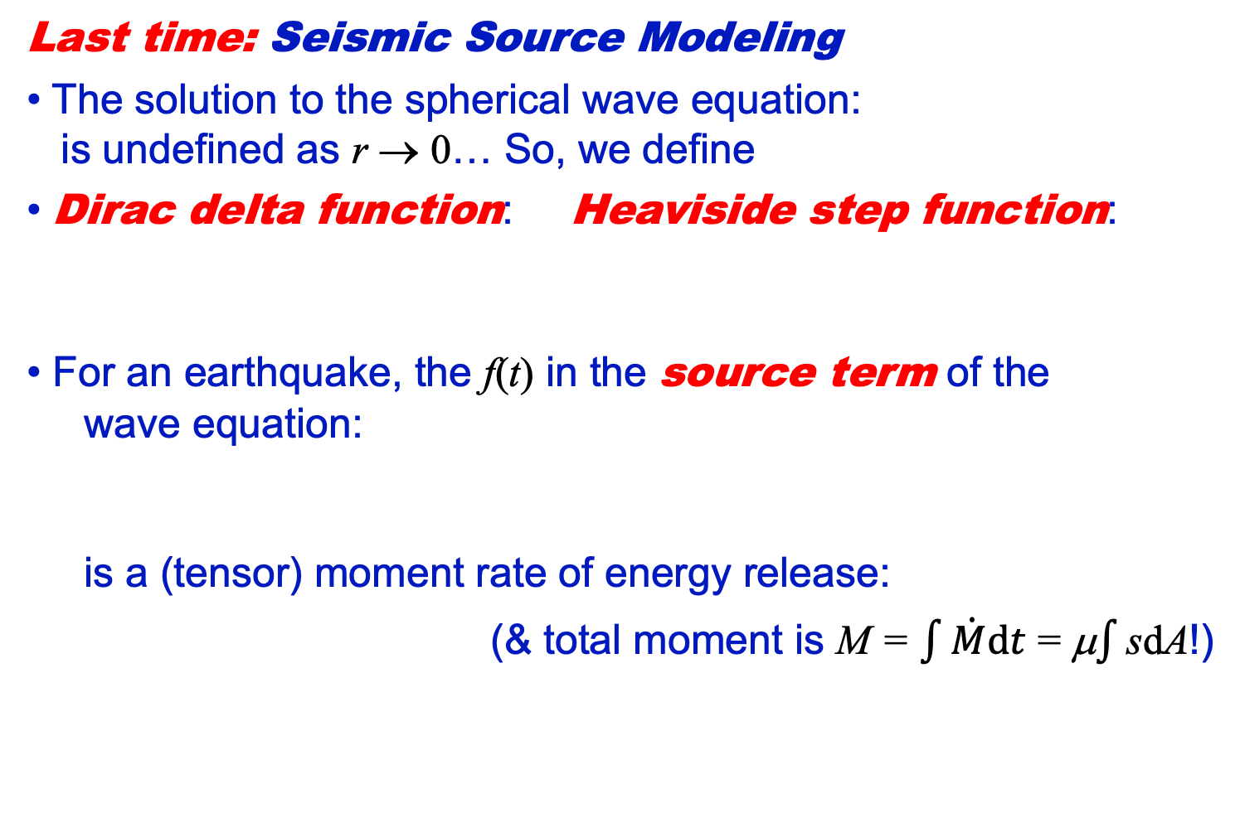
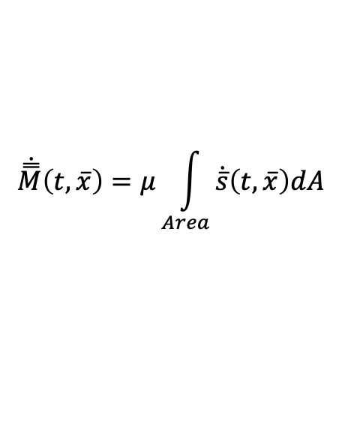
Geology 5640/6640
Introduction to Seismology
24 Oct 2024
Last time: Seismic Source Modeling
• The solution to the spherical wave equation:
is undefined as r → 0… So, we define
• Dirac delta function: Heaviside step function:
For an earthquake, the f(t) in the source term of the
wave equation:
is a (tensor) moment rate of energy release:
(& total moment is M = $\int{\dot{M}dt}$ = μ$\int{\text{s}\text{d}\text{A}}$!)
$$\dot{\overset{̿}{M}}\left(t,\overline{x}\right)=μ\int_{Area}{\dot{\overline{s}}\left(t,\overline{x}\right)dA}$$
Read for Tuesday 29 October: S&W 75–86 (§2.6)
© A.R. Lowry 2011-2024

Slide 2
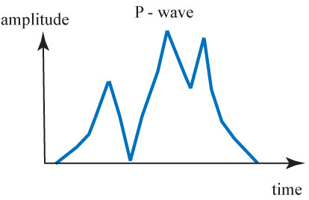
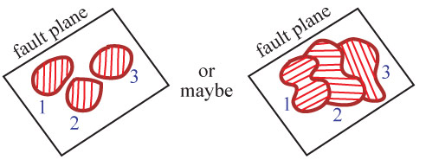
Alternatively, the P-wave arrivals
might look like the example at
left… Indicating the history of slip
was somewhat more complicated.
2
3
1
This suggests a slip history that involves slip on several
different patches of the fault, e.g. something like:

Slide 3
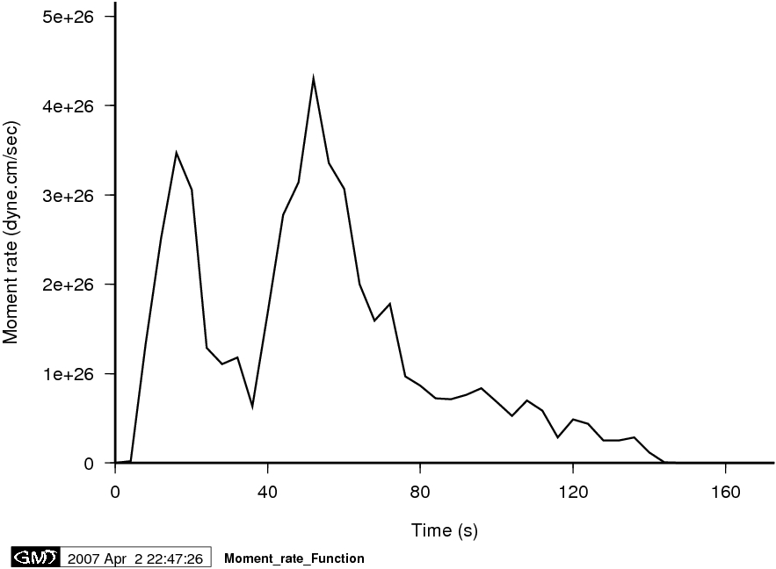
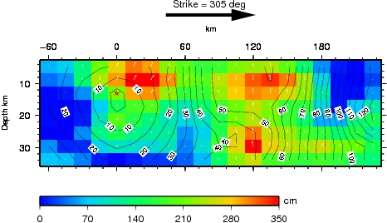
Calculated (scalar)
moment-rate
vs. time for the 2007
Solomon Island
earthquake, M_{w} = 8.1
(Solution by Chen Ji)
How the fault slipped
over time.

Slide 4
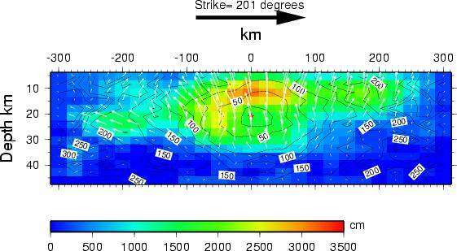
Finite fault solution for the 2011 Tohoku-Oki (Japan)
M_{w} = 9.1 earthquake… Peak slip greater than 30 m.
Note this used both P-wave teleseisms and local
GNSS (GPS) waveform displacements, which are
key to accurate gauging of early moment release!
Ji et al., CalTech slip history database

Slide 5
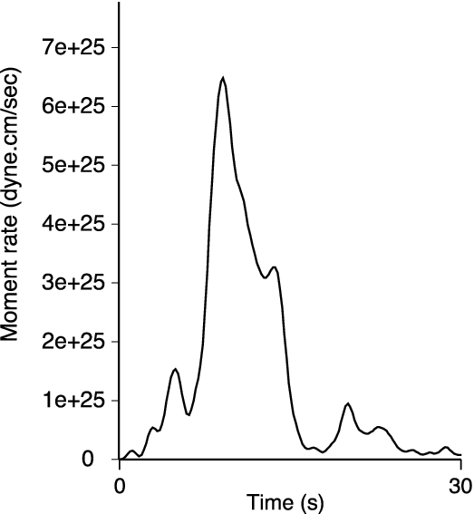
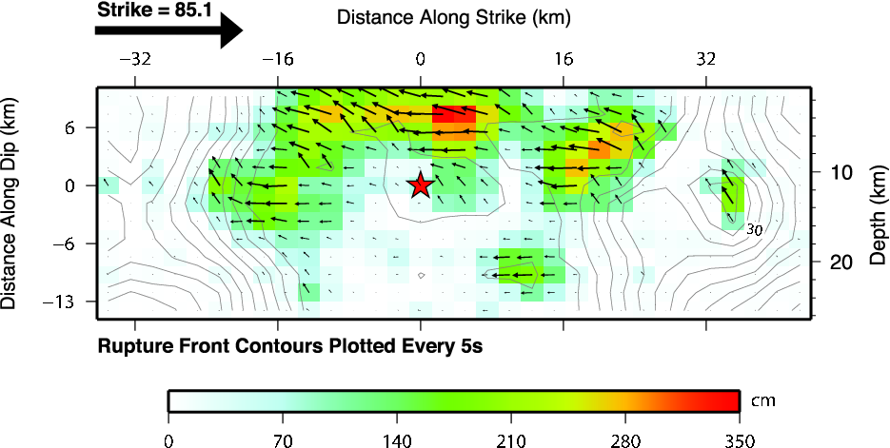
Source-time function
and finite fault solution
for the M7.0 Christchurch
NZ event in 2010
(Gavin Hayes, NEIC)

Slide 6
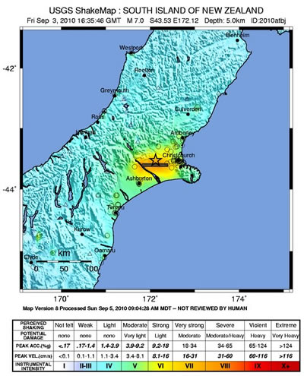
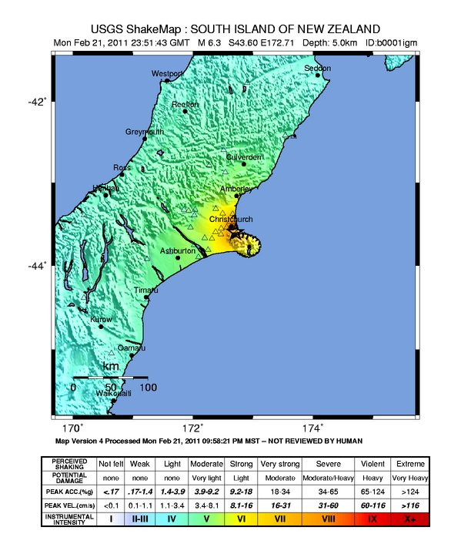
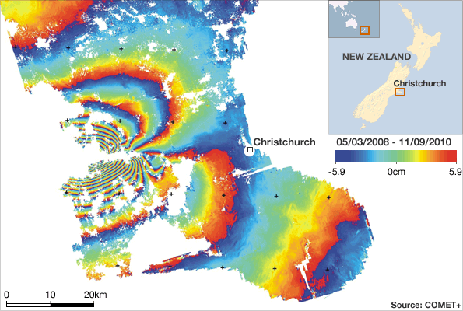
Source Seismology
2011 Christchurch earthquake, M6.3, after the
larger M7.0 eq further west in 2010…
2010
M7.0
2011
M6.3
2 injured
NZ $4B
Difference is
proximity…
185 dead
NZ $15B

Slide 7
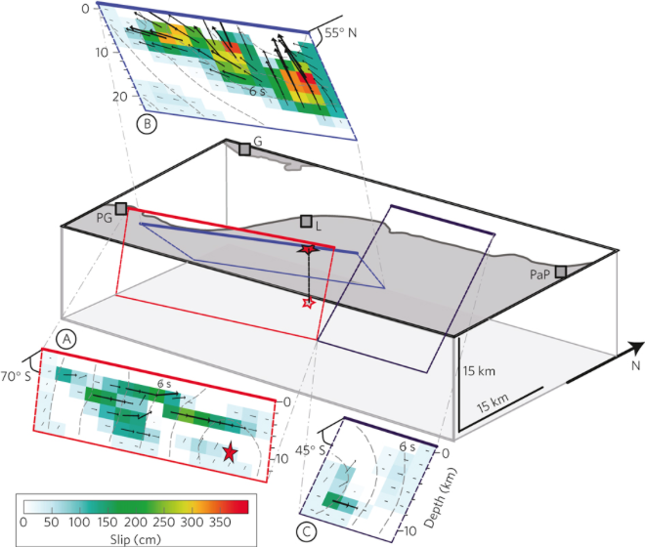
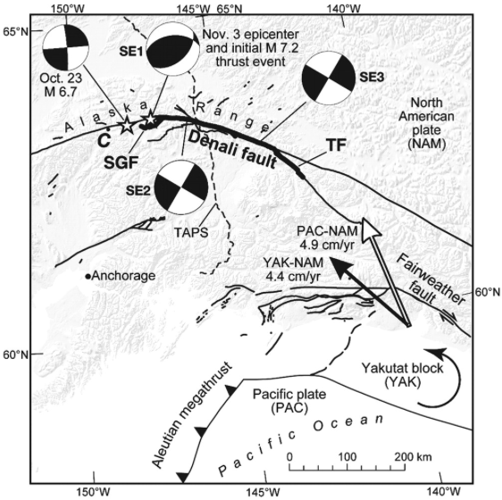
… Feeds our growing recognition that many large earthquakes
involve complex rupture simultaneously on several faults that
may have completely different dip and orientation.*
2010 M7.0
Haiti
2002 M7.9
Denali
Crone et al.,
BSSA, 2004
Hayes et al., Nat. Geosci., 2010
*Lesson for Utah! Ya think future Wasatch rupture won’t cross
segment boundaries? Ya got another think comin’…

Slide 8
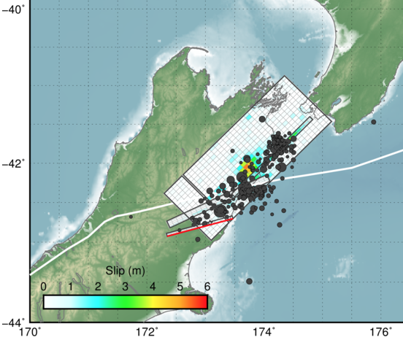
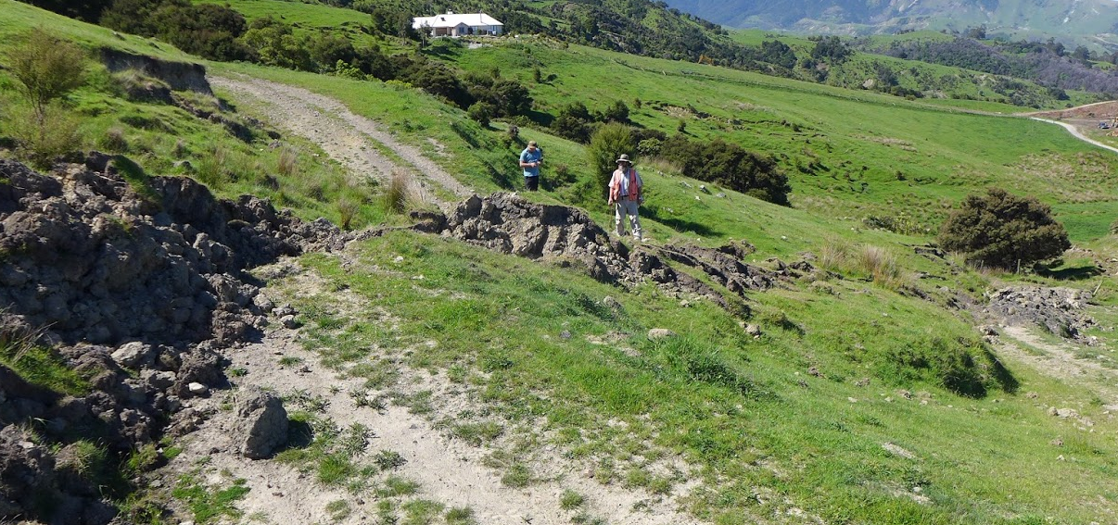
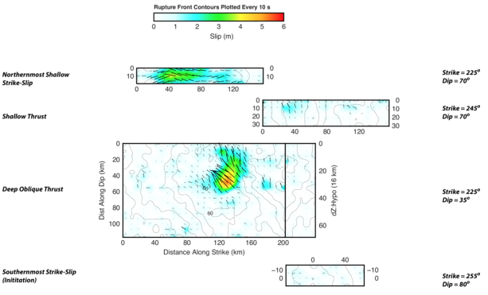
Source Seismology
2016 New Zealand
earthquake, M_{w} 7.9…
Multiple ruptures
on adjoining thrust
and strike-slip faults!

Slide 9
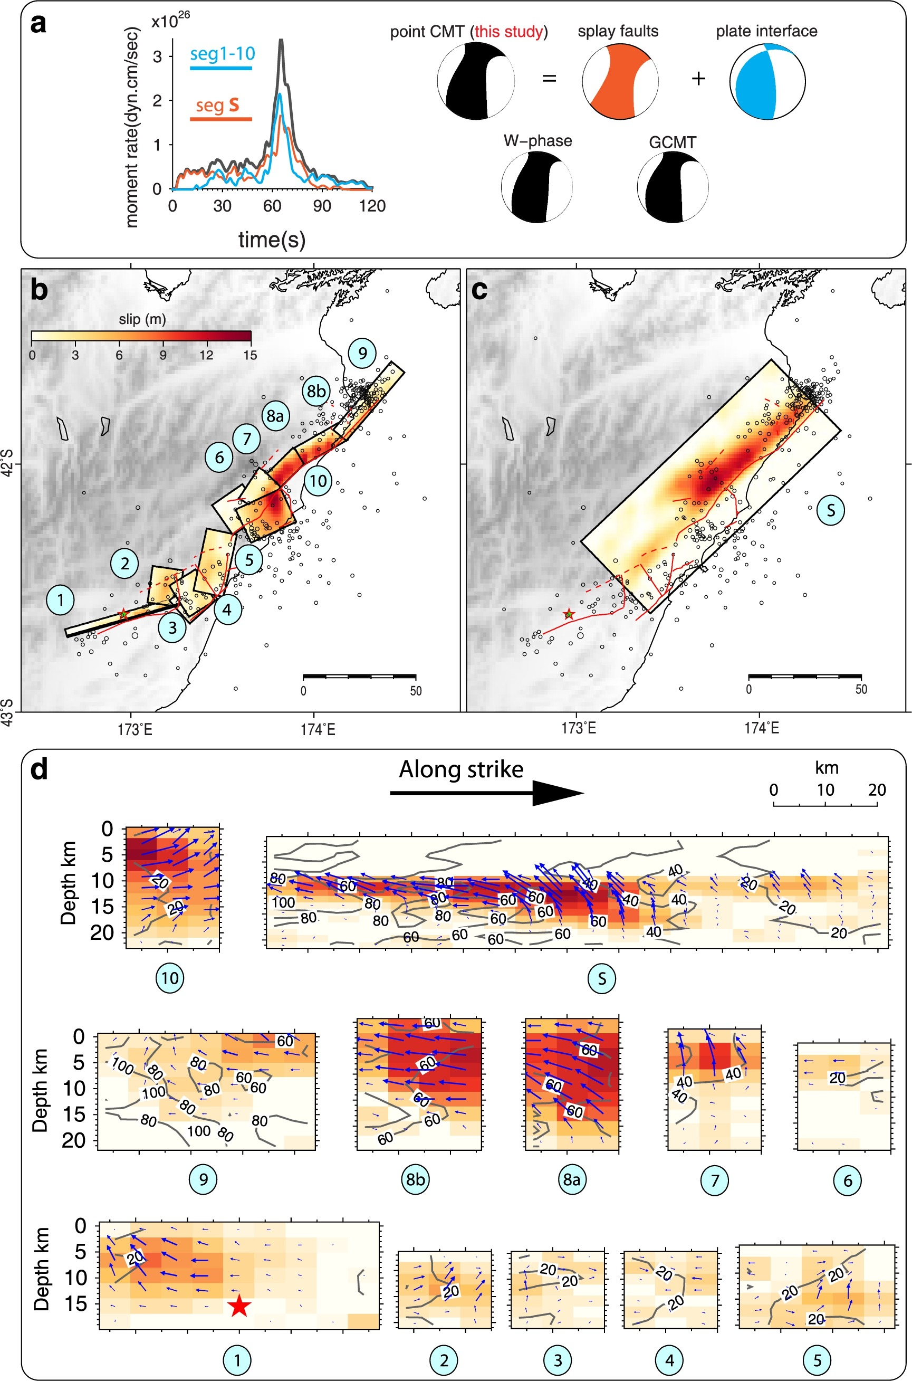
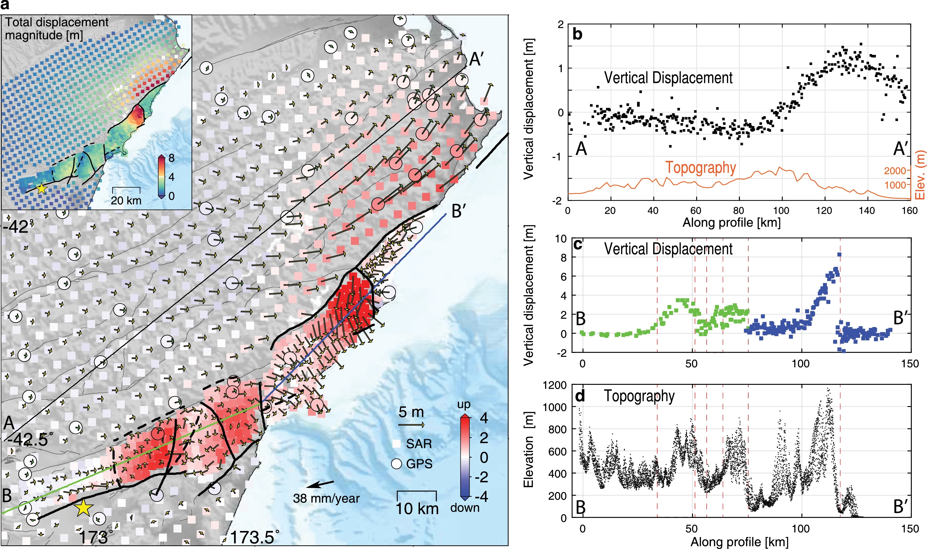
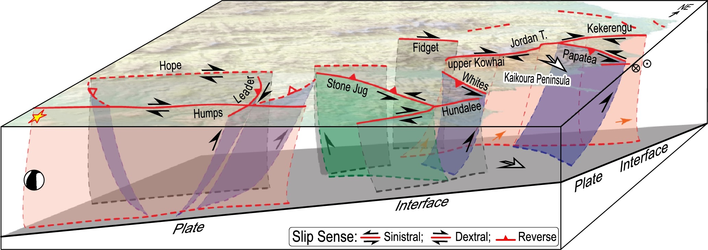
Wang et al., EPSL 2018
Geodesy (both GPS & InSAR) added evidence of much more
complexity than was indicated by seismic source analysis!

Slide 10
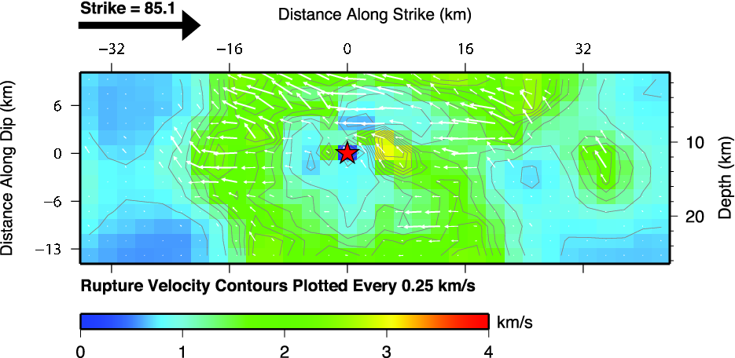
Can use source analysis to get other interesting pieces of
information about the earthquake rupture process…
Most events have very slow propagation (and less slip)
near nucleation… Some (rare) events propagate at
supershear velocities!

Slide 11
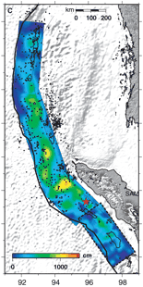
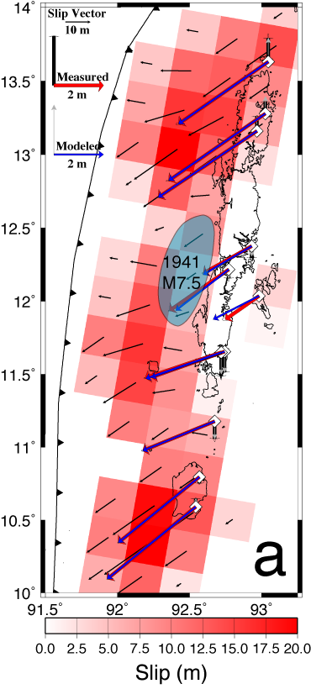
2004 Sumatra-Andaman source:
Radiated seismic
body waves yield
total moment
magnitude M_{w} 9.0-9.1
& suggested moment
release in the
Andaman segment
was small (maximum
slip ~ 5 m near
middle Andaman).
A very different
picture from that
required by
geodesy… Seismologists
interpreted as afterslip
over weeks.
Ammon et al., Science v308
p1133 2005
Paul et al. (2007)
from data in Freymueller et al

Slide 12
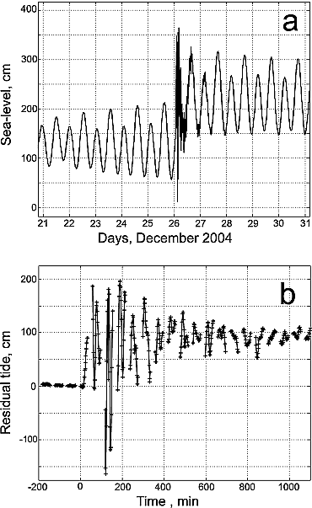
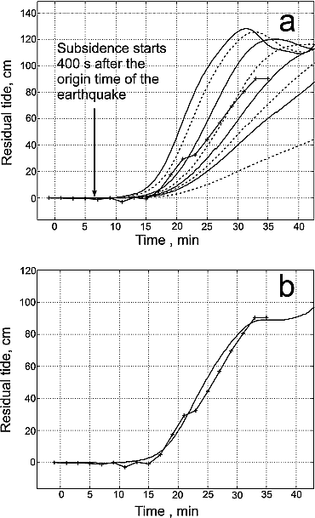
Tide gauge data: from Singh et al. (GRL 2006):
95 cm subsidence
Height change from
before tsunami onset
to after tsunami quiescence was –95
cm. GPS in Port Blair
(after ~2-4 weeks)
gave –96±6
and –84±2 cm….
Normal modes also
indicated the total
moment magnitude
(M_{w} 9.3) was much
greater than that
from body waves
(M_{w} 9.0)!
Best model of observed
tsunami has 60% of
slip in first five
minutes, the
rest in next
30 mins…
Correction for time
error and tides…

