Slide 1
Geology 5640/6640
Introduction to Seismology
24 Sep 2024
Last time: The Equations of Motion (Wave Equation!)
• The elasticity tensor has up to 21 independent terms, but
for an isotropic solid, we only need two (Lame’s
constants λ and μ):
• Any imbalance of stress will be offset by acceleration
(Newton’s 2nd law: ). This leads to the dynamic
equations of motion:
We neglect the (gravitational) body force f_{i} (for now) and express
in terms of displacement, by substituting Hooke’s law and
the definition of the strain tensor. This results in the
P-wave equation:
Read for Thursday 26 September: S&W 53-62 (§2.4); 458-462
© A.R. Lowry 2011-2024

Slide 2
Last time continued: The Wave Equation!
• The seismic wave equations derive from the divergence
( dilatational strain θ) and curl ( shear strain) of
equations of motion:
P-wave equation:
S-wave equation:
in which α and β are the
propagation velocities:
• Hence, velocity is sensitive to both the isotropic elastic
properties of rocks and to their densities
• Elastic properties generally vary more than density!

Slide 3
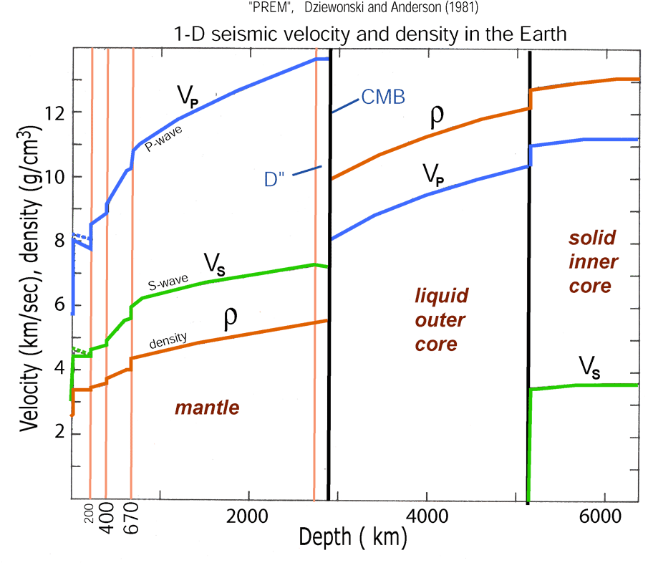
• Here and represent the
propagation velocities for the P and S waves
respectively.
• Note changes in elastic properties contribute more to
velocity variation than changes in density
• Velocity is sensitive to rock chemistry, packing structure,
porosity & fluid type, pressure and temperature. The
tricky part is distinguishing which we’re seeing…

Slide 4
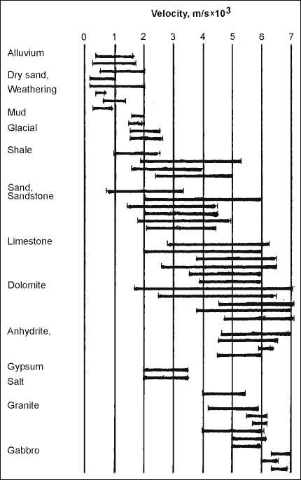
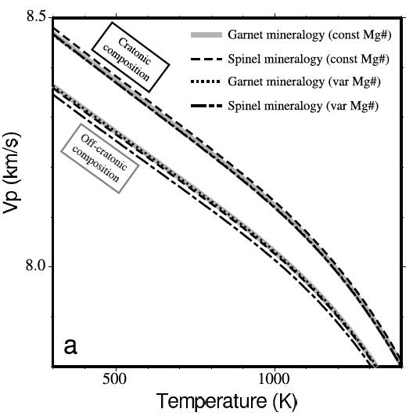
Rock properties that affect seismic
velocity include:
• Porosity
• Rock composition
• Pressure
• Temperature
• Fluid saturation
= V_{p}, β = V_{s} are much more
sensitive to λ and μ than to ρ
Crustal Rocks
Mantle
Rocks (?)

Slide 5
Seismic velocity depends on a lot of fields, but not all
are independent:
Velocity
Temperature
Composition
Partial Melt
Pressure
Porosity/Fluid
Density
And some fields can be determined to within
small uncertainty (e.g. pressure at given depth)

Slide 6
The key takeaway from all of this is
that among the most important properties
we will deal with in seismology is seismic
velocity:
Both because it describes the travel-time
required for a wave to propagate from one
place to another (which we need to locate
sources!) and because it enables us to
remotely sense the interior of the Earth.

Slide 7
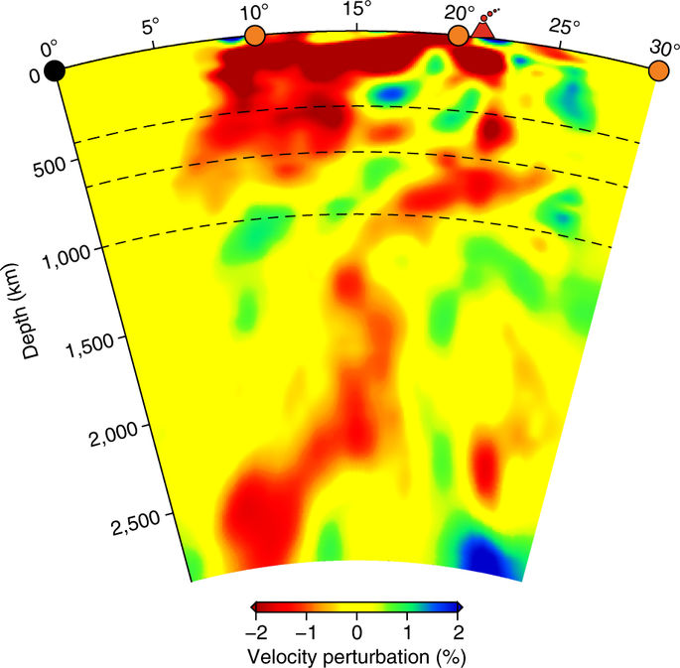
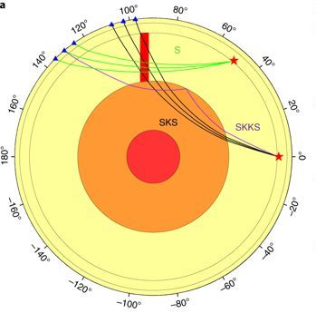
Tomography is an approach to velocity estimation that uses travel-times from multiple source receiver paths that cross at a point to assign a velocity to that point…
Nelson & Grand, Nat. Geosci., 2018
A shear velocity tomogram of the mantle under Yellowstone,
combining S, SKS and SKKS travel-paths or phases…

Slide 8
So now we have our expressions for the wave equation in
terms of displacements:
Question is, how do we solve these?
Solution is simplified by expressing displacements
in terms of displacement potentials. Helmholtz’
decomposition theorem holds that any vector field
can be expressed in terms of a vector potential and
a scalar potential φ as:
In our application, φ is a scalar displacement potential
associated with the P-wave, and is a vector
displacement potential associated with the S-wave.

Slide 9
It’s first worth noting a pair of useful vector identities:
Then, if we substitute our potentials into our P-wave
equation:
Rearranging:
And hence:

Slide 10
Similarly, substituting potentials into the S-wave equation:
Here we take advantage of another vector identity:
Rearranging:
And hence:

Slide 11
So what’s the point of this? We want to find some
solution, e.g. for P-wave displacement potential,
that allows for separation of variables:
The eigenfunctions for a partial differential equation
of this form (i.e., functions which, if plugged into the
equation, will yield solutions of similar form) are:
(called the “d’Alembert solution”). Here,
i is the imaginary number
A is amplitude
ω is angular frequency 2π/T (& T is time period)
k is spatial wavenumber 2π/λ (& λ is wavelength)

