Slide 1
Geology 5640/6640
Introduction to Seismology
26 Nov 2024
Last time: Ray-Tracing in a Spherical Earth
In a spherical geometry, the angle of incidence for a ray at the
top of a uniform-velocity layer is slightly different than the
angle at the bottom.
• We account for this by re-writing Snell’s law to account for the
change in angle of incidence, as:
• Instead of units of slowness, the ray parameter p = dT/dΔ has
units of time per angle in radians
• The ray-tracing relations become (for ζ = r/v):
Read for Tuesday 26 November: S&W 177-184 (§3.6)
© A.R. Lowry 2011-2024

Slide 2
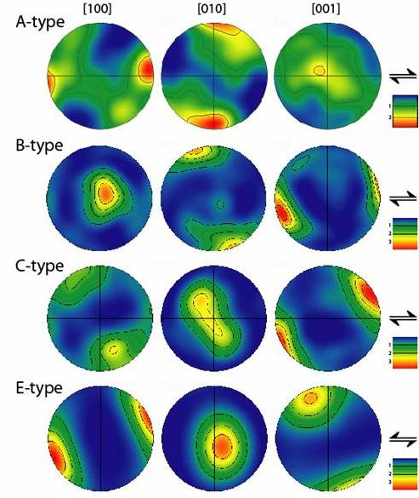
Anisotropy:
Mantle shear wave
anisotropy is “usually”
interpreted as alignment
of the olivine fast axis with
flow direction… But recall
where this comes from!
Hooke’s law generalizes
to:
And there are 81 terms in
the fourth-order elasticity
tensor, with as many as
21 different elastic
constants needed to fully
describe the response!
Here, polar plots of dislocation slip systems (anelastic strain implying foliation direction) plotted vs crystallographic axis directions for olivine… Different types relate to different hydration and deviatoric stress states
(Fast axis)
(Slow axis)

Slide 3
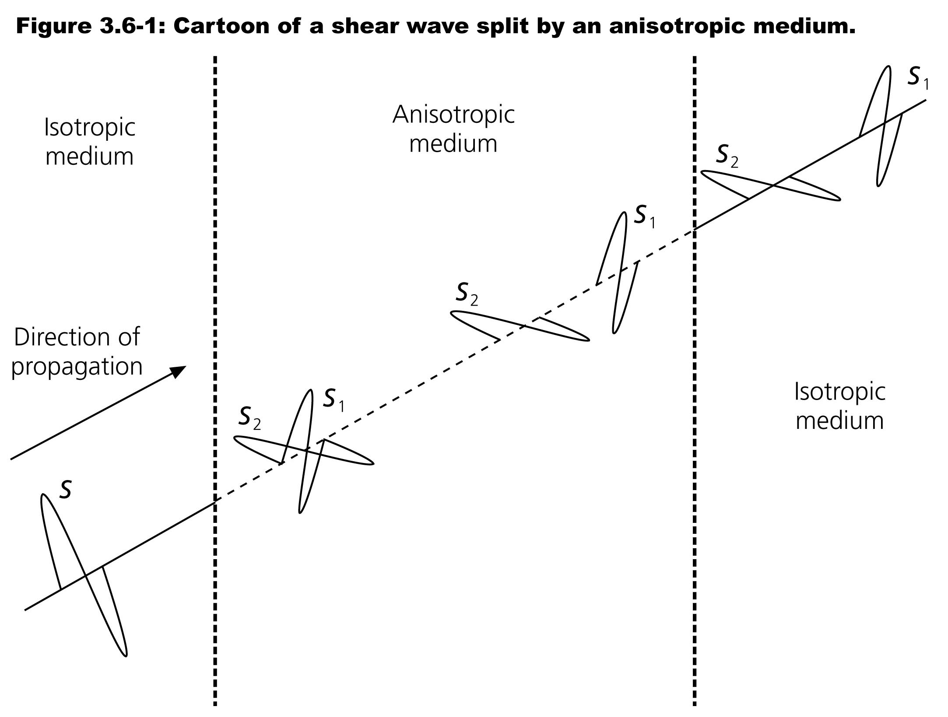
Hence e.g.
the shear
rigidity of
a medium
can be
different in
one
direction
than it is
in another.
If the
directional
dependence
is consistent
over “large
enough” scales, this can result in separation of S arrivals
polarized along the fast and slow axis directions…

Slide 4
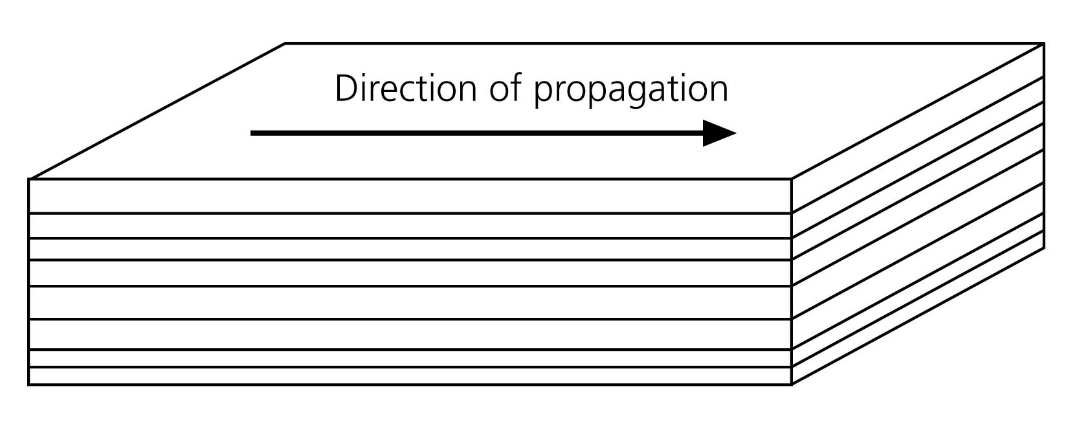
On the scales of sampling of a seismic wave, anisotropy can
occur for any of several different reasons… Common types
include Shape Preferred Orientation (SPO), which is
caused by inhomogeneous distribution of materials…
Simple examples of this type of anisotropy include stacks of
horizontal layers with differing velocity, or an otherwise
uniform medium that contains fluid-filled cracks.

Slide 5
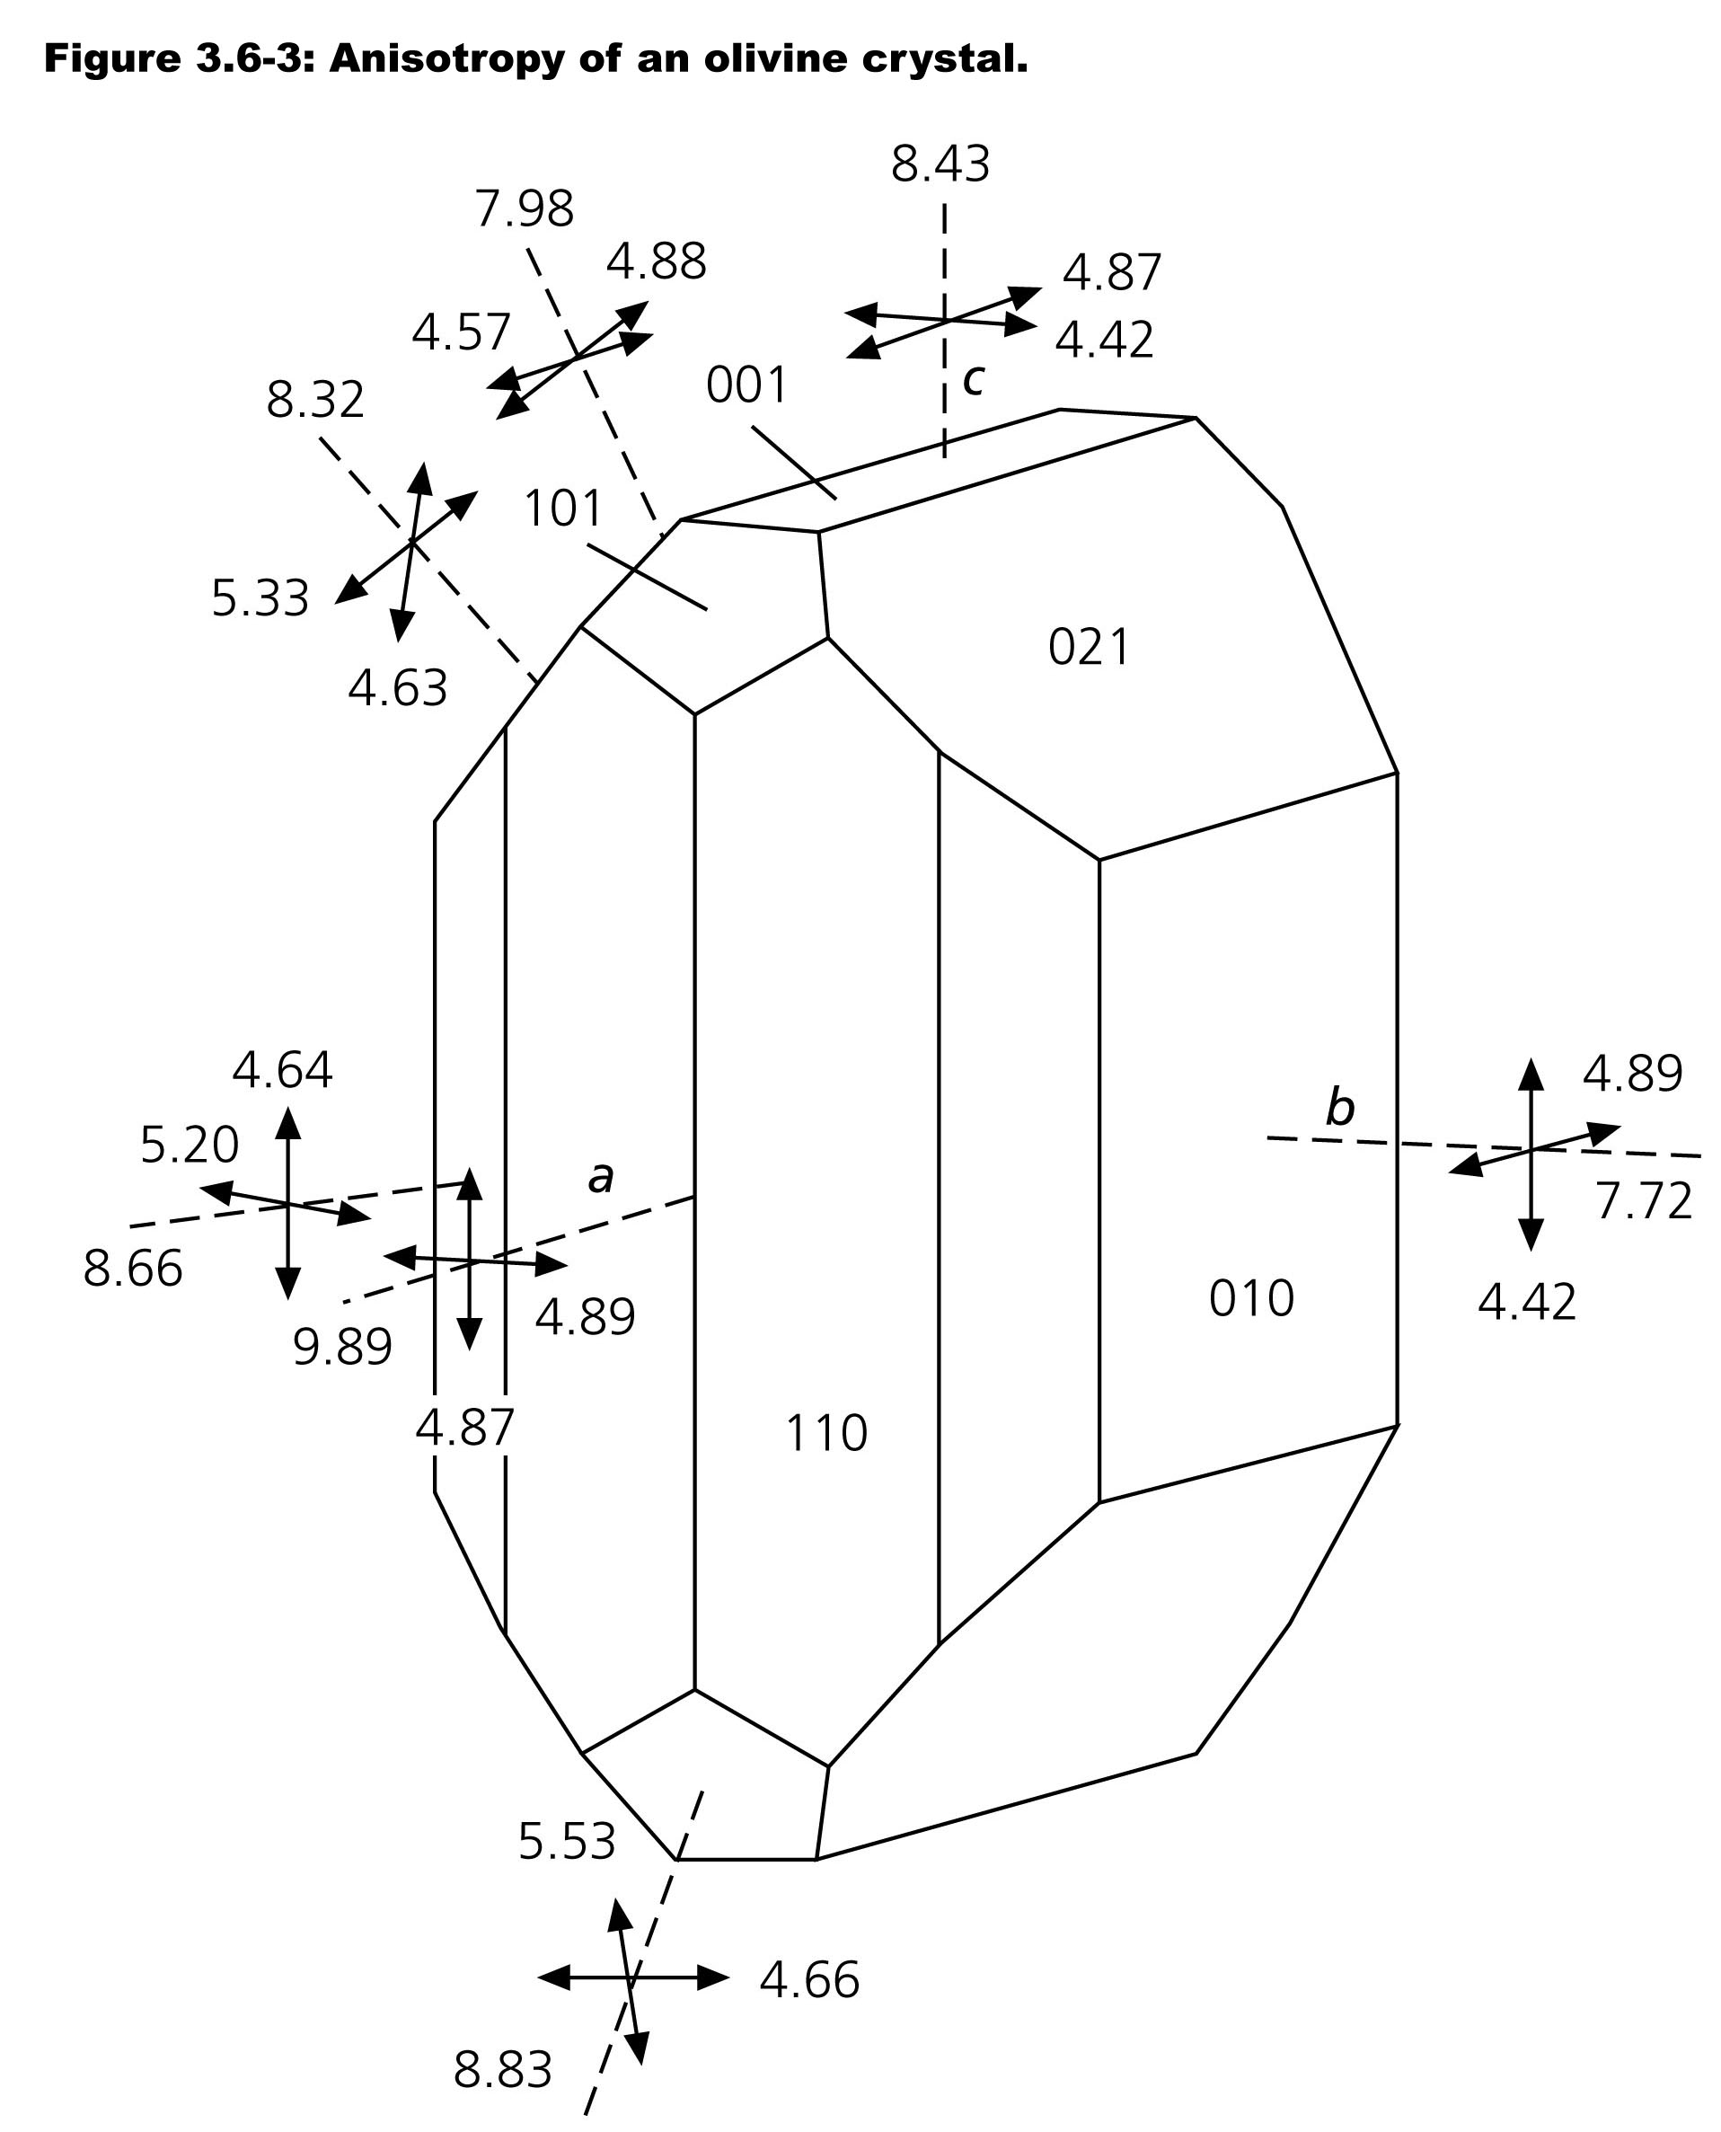
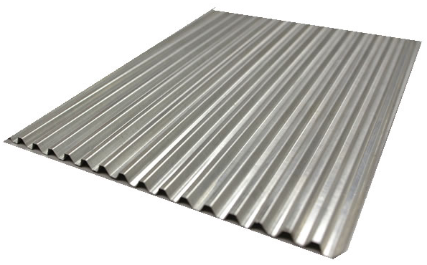
Lattice Preferred
Orientation (LPO) is
used to describe a
medium that is innately
anisotropic (i.e., right
down to the sub-grain,
even molecular, scale of
individual mineral
crystals).
This type dominates most
upper mantle anisotropy!

Slide 6
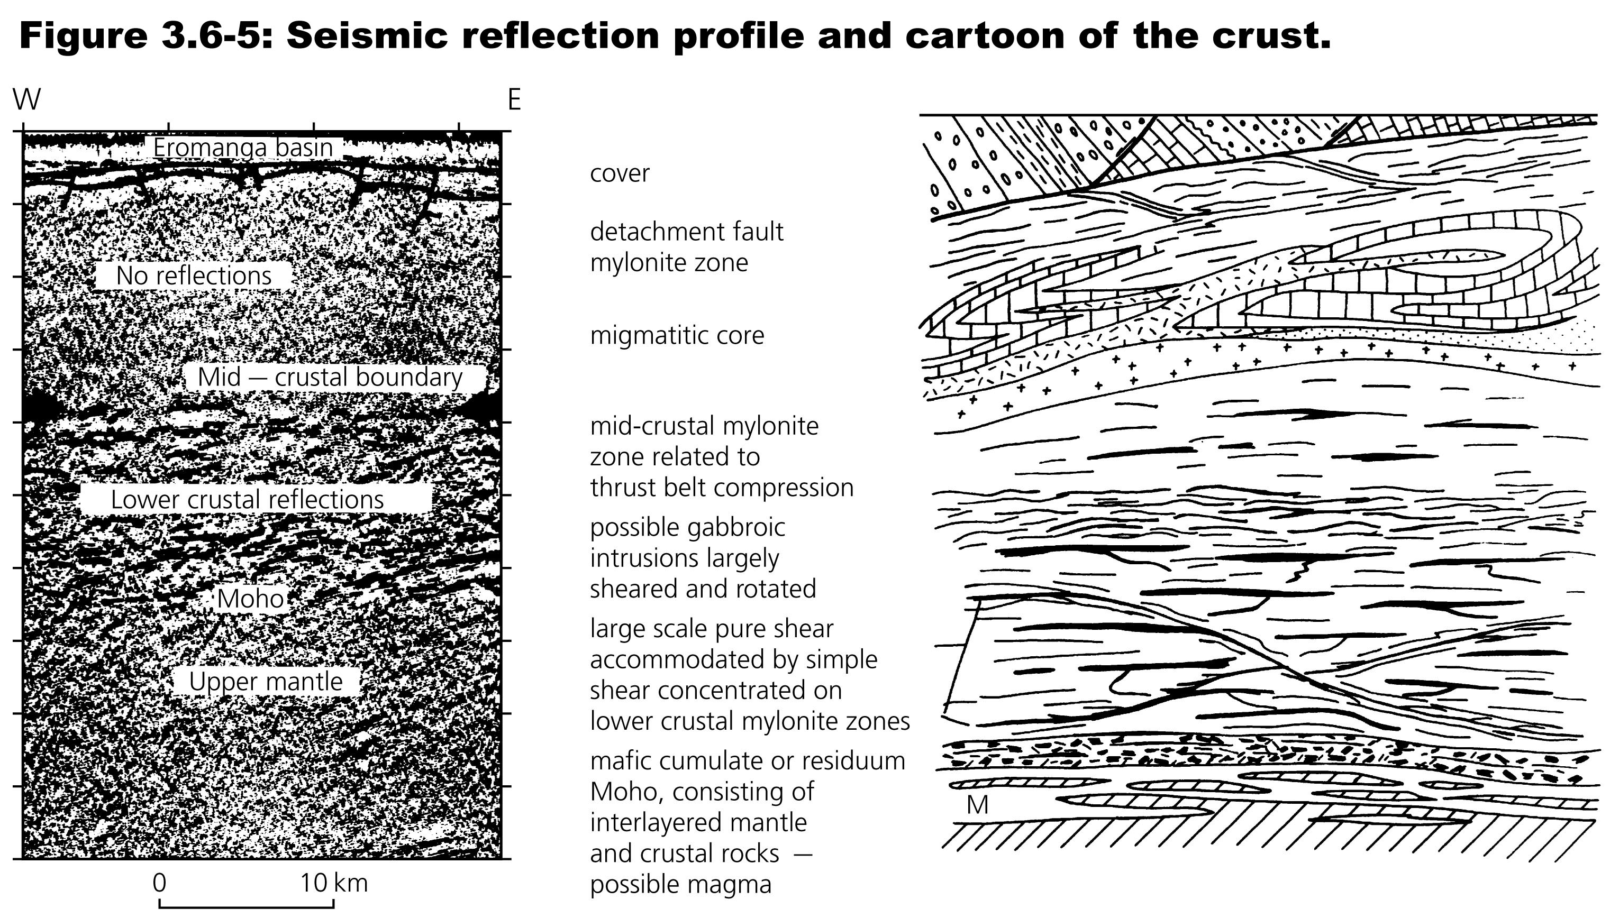
In many instances though observed anisotropy includes a mix
of both shape-preferred and lattice-preferred orientations,
which of course tends to complicate both the modeling and
the interpretation of anisotropy.

Slide 7
The Voight Matrix:
Conceptually an anisotropic elasticity tensor can be simplified
a bit by first exploiting some of the symmetries to reduce the
81 down to 36 coefficients. We then describe all of the
possible permutations of (i,j) and (k,l) pairs as numbers 1 to 6
by letting (1,1) → 1; (2,2) → 2; (3,3) → 3; (2,3) → 4; (1,3) → 5;
and (1,2) → 6. Then we write c_{ijkl} as C_{mn} by mapping (i,j) to
m and (k,l) to n as:

Slide 8
This representation is sometimes called a “Voight matrix”.
The Voight matrix for the isotropic case looks like:
Relevant for
the P-wave:
Relevant for
the S-wave:

Slide 9
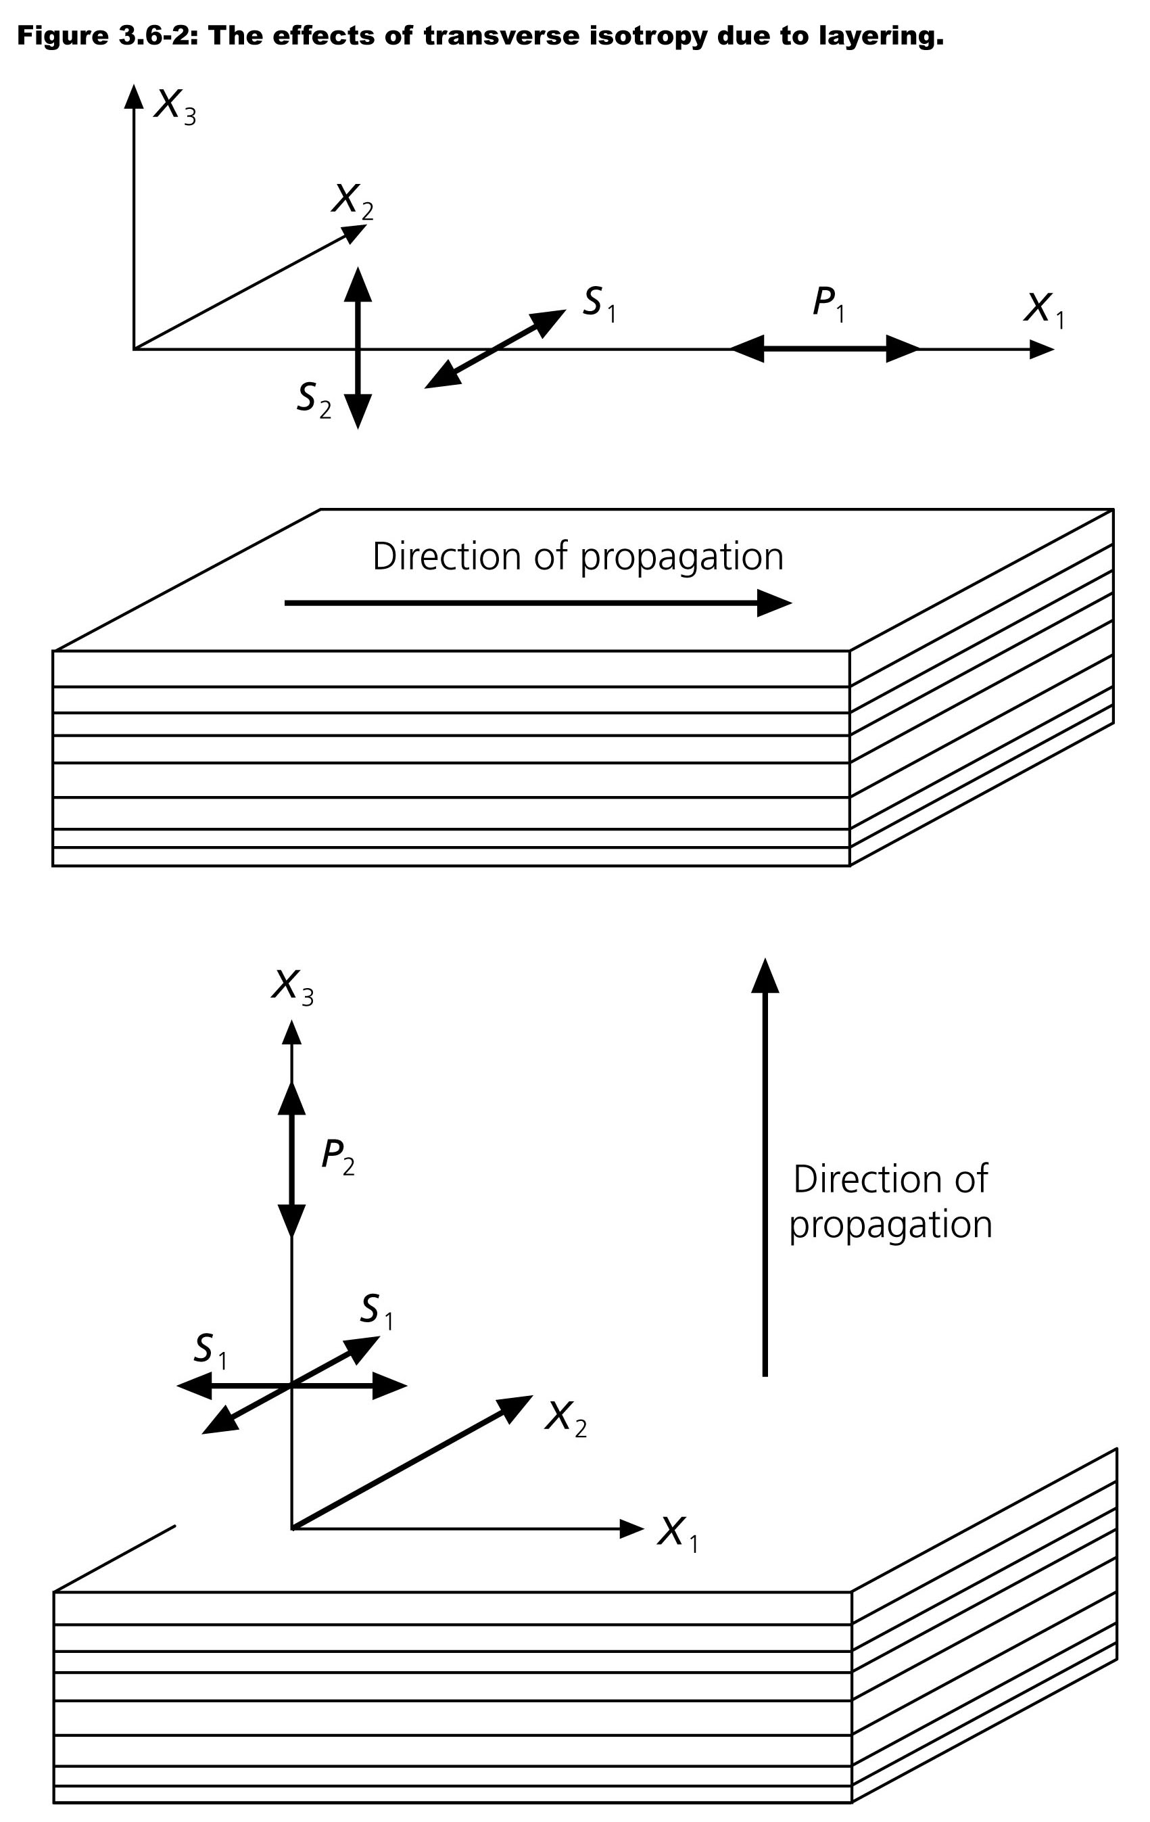
Important types of anisotropy
include transverse isotropy
(also called radial anisotropy)
This has velocity in the x₁ & x₂
directions:
In the x₃ direction,

Slide 10
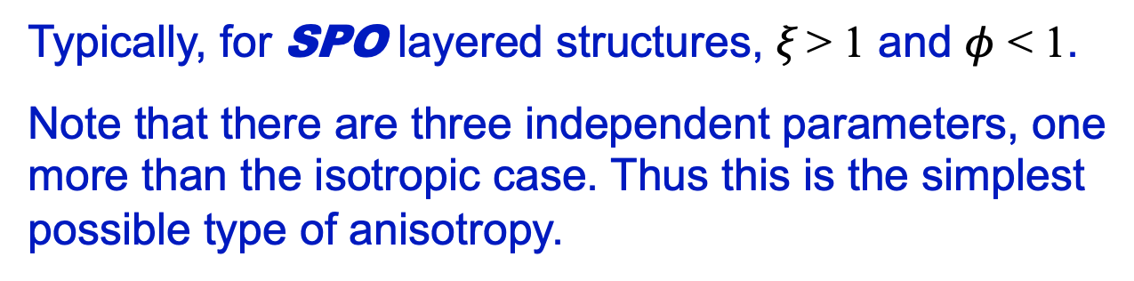
Transverse isotropy can be characterized by three model
parameters ξ, φ and η:
Typically, for SPO layered structures, ξ > 1 and $φ$ < 1.
Note that there are three independent parameters, one
more than the isotropic case. Thus this is the simplest
possible type of anisotropy.

Slide 11
If the x₃ axis is turned horizontally, we get azimuthal
anisotropy, in which P-wave velocity varies with azimuth
(θ) as
This relation can be used to describe the azimuthal variation
for any arbitrary anisotropic velocity (up to 21 coefficients) (but
additional parameters are needed to describe the vertical +
horizontal variation.
In the lithosphere, the magnitude of the 4θ components may
be small and are often ignored in teleseismic studies.

