Slide 1
Geology 5640/6640
Introduction to Seismology
26 Sep 2024
Last time: Velocity, displacement potentials:
• Wave propagation velocities:
depend on (shallow) porosity
& pore fluid, (deeper)
composition, pressure and temperature (leading to
ambiguities in interpretation).
• Packing structure pushes elasticity & density in different
directions; generally elasticity dominates!
• Solution of the wave equation is made easier by expressing
displacement in terms of scalar & vector displacement
potentials:
In that case:
Read for Tuesday 1 October: S&W 53-62 (§2.4); 458-462
© A.R. Lowry 2011-2024

Slide 2
So what’s the point of this? We want to find some
solution, e.g. for P-wave displacement potential,
that allows for separation of variables:
The eigenfunctions for a partial differential equation
of this form (i.e., functions which, if plugged into the
equation, will yield solutions of similar form) are:
(called the “d’Alembert solution”). Here,
i is the imaginary number
A is amplitude
ω is angular frequency 2π/T (& T is time period)
k is spatial wavenumber 2π/λ (& λ is wavelength)

Slide 3
So let’s plug into
and see what we get after differentiating:
Similarly,

Slide 4
Dividing both sides of the equation by
we’re left with:
as a solution to the P-wave equation! Here it’s useful to
recall that wavenumber k is a vector,
so it has a magnitude and a direction:
This is called the wavenumber vector or wave vector,
and it describes the direction and (inverse) spatial
wavelength of a propagating plane wave.
Noting that ω = 2πf, you may recognize this as α = fλ!
x₃
k
k₃
x₂
k₁
k₂
x₁

Slide 5
Hence we can write our general solution to the P-wave
equation as
Note that here we’ve defined a vector property, which
we will call slowness, as:
Because the forms of the equations are very similar, we
can derive similar solutions for the S-wave equation!

Slide 6
Harmonic Wave Motion:
Let’s consider a harmonic wave with angular frequency ω,
amplitude a, and phase φ = x/c (where x is position & c is
velocity). We can
express this as:
f(t) = a cos(ωt + φ).
We can rewrite this
using a trig identity:
a cos(ωt + φ) =
a cosφ cos(ωt) +
a sinφ sin(ωt) =
a₁cos(ωt) + a₂sin(ωt)
Thus a wave with arbitrary phase can be expressed as a
weighted sum of sin & cos functions! The phase φ is given by:
2
2
1
1

Slide 7
Also note that .
We can also express a harmonic wave as f(t) = Re{Ae^{–iωt}},
where A has real and imaginary parts A = x + iy, and e
can be expressed via Euler’s identity such that
f(t) = Re{A [cos(ωt) – i sin(ωt)]}
= Re{(x + iy) (cosωt – isinωt)}
= Re{x cosωt – i²y sinωt + i (y cosωt – x sinωt)}
= x cosωt + y sinωt .
This is the same as f(t) = a₁cos(ωt) + a₂sin(ωt) if
a₁ = x = Re{A} & a₂ = y = Im{A}
so the wave equation can be satisfied using either form.
Other trig identities that are useful for translating:

Slide 8
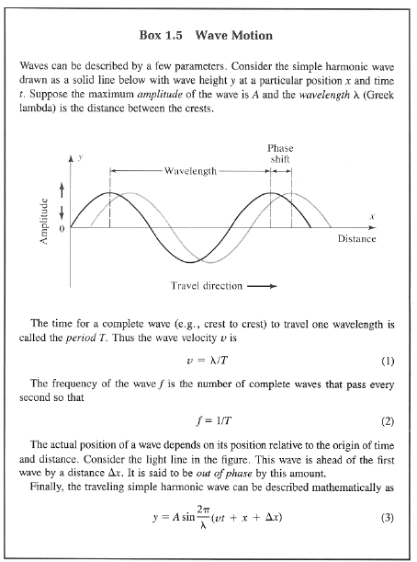
And just in case it’s been
a while since you saw
this in an intro geo class,
Here’s the “Earthquakes &
Volcanoes” (aka “Shake &
Bake”) version from Bolt’s
Earthquakes…
Check out the solution to
the wave equation!

Slide 9
Polarizations of P- and S-waves:
The polarization (or “polarity”) of a wave is a way of
describing the direction of initial particle motion of a wave
(i.e., the “first motion”).
For example, a seismologist might say “The first motion on
the North-South component was down.” This implies a
reference frame however…
First consider a P-wave (scalar displacement potential) with
equation: solution: We could write this as:
where the first part (φ₁) travels in the +x direction, and the
second (φ₂) travels in the –x direction (i.e. a “plane wave”).
Displacement is related to the potential φ by the gradient:

Slide 10
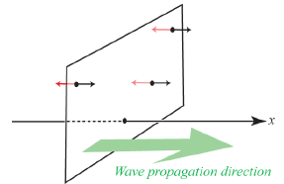
Here our y, z components disappeared because there’s no y, z
dependence for a planar P-wave traveling in the x-direction:
So, u = (–ikφ, 0, 0), and particle displacement is always in ± the
direction of wave propagation, i.e., perpendicular to the wave
front.
If the initial source motion was
outward, all points on the wavefront
move in the propagation direction
(direction of the black arrows =
“positive”or “upward” polarity); if
it was inward, they all move in
the direction of the red arrows. This
is also called longitudinal
displacement…
$$\begin{matrix}φ=Ae^{i\left(ωt−kx\right)} & ⟹ & \vec{∇}φ=\end{matrix}−ikAe^{i\left(ωt−kx\right)}=−ikφ$$

Slide 11
Now consider the S-wave (vector displacement potential)…
Like before we’ll consider a plane wave propagating
only in the x-direction:
equation: solution has three components:
To write this in terms of displacement we take the curl:
Since it’s propagating only in the x-direction, the y- and
z-derivatives again vanish, leaving:

Slide 12
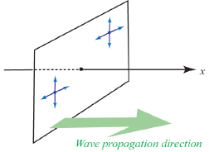
So for an S-wave propagating in the x-direction, particle
motion is only in the y- and z-directions, and not the
x-direction.
We further decompose
the wavefield using a
convention that:
SH = horizontally
polarized shear wave
SV = vertically
polarized shear wave
Both of these are always perpendicular to the propagation
direction, with SH in the horizontal plane and SV in the
direction orthogonal to both the propagation direction
and SH.

