Slide 1
Geology 5640/6640
Introduction to Seismology
27 Aug 2024
Some useful pointers from the syllabus
5640 differs from 6640 in that grad students will complete a
semester project, including an oral presentation and a written
report
• Text (Stein & Wysession) is available as an e-book on Canvas
Grad semester projects should begin in the next couple of
weeks; should be related to your thesis topic; should be
interesting to you!
• Always feel free to ask questions! (It helps!)
• So, what do you want to know about seismology ?
Read for Thu 29 Aug: S&W 1-28
© A.R. Lowry 2011-2024

Slide 2
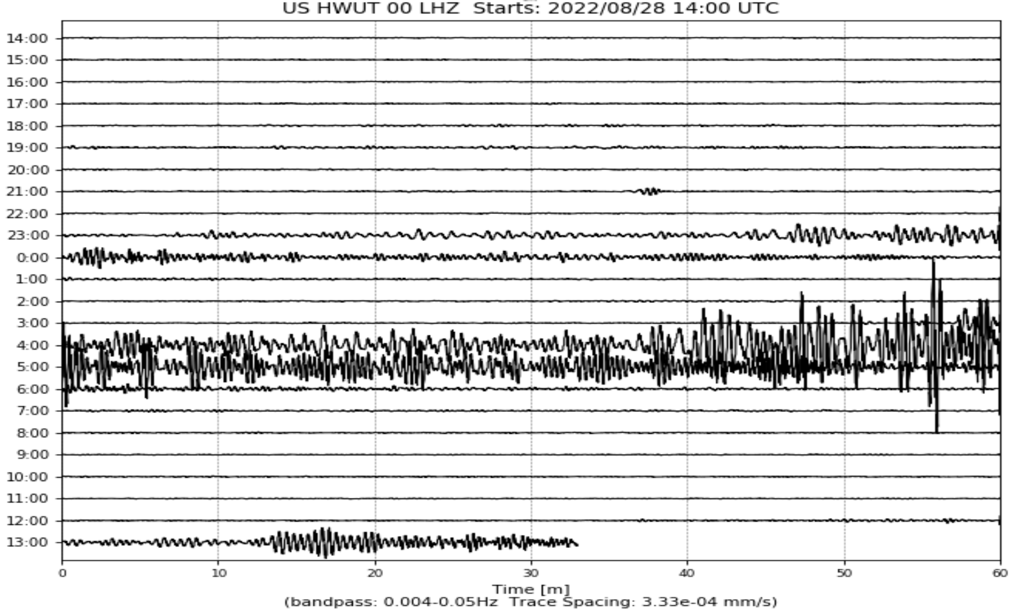
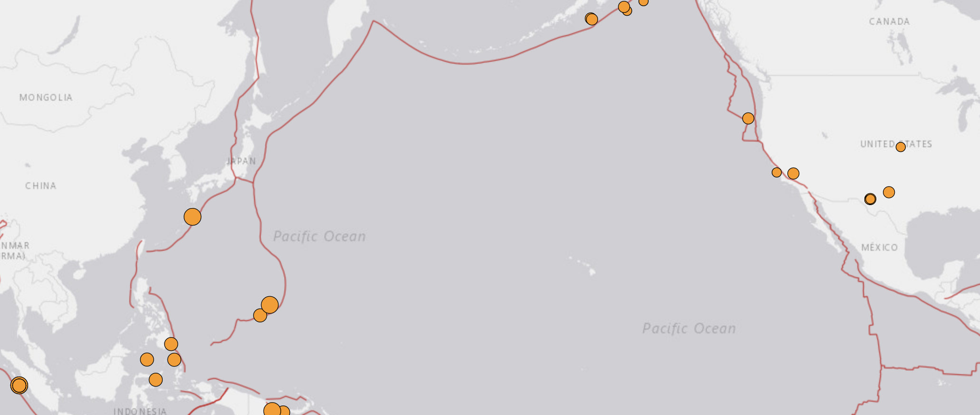
Seismogram Thought Exercise:
Hardware
Ranch, UT:
Aug 29 2022
Large event
is a M5.9
earthquake
near
Indonesia…
M5.5, Pariaman, Indonesia (22:34:36)
M5.9, Pariaman, Indonesia (03:29:13)
M5.7, Yigo Village, Guam (12:55:57)
ANSS heliplot feed (earthquake.usgs.gov)

Slide 3
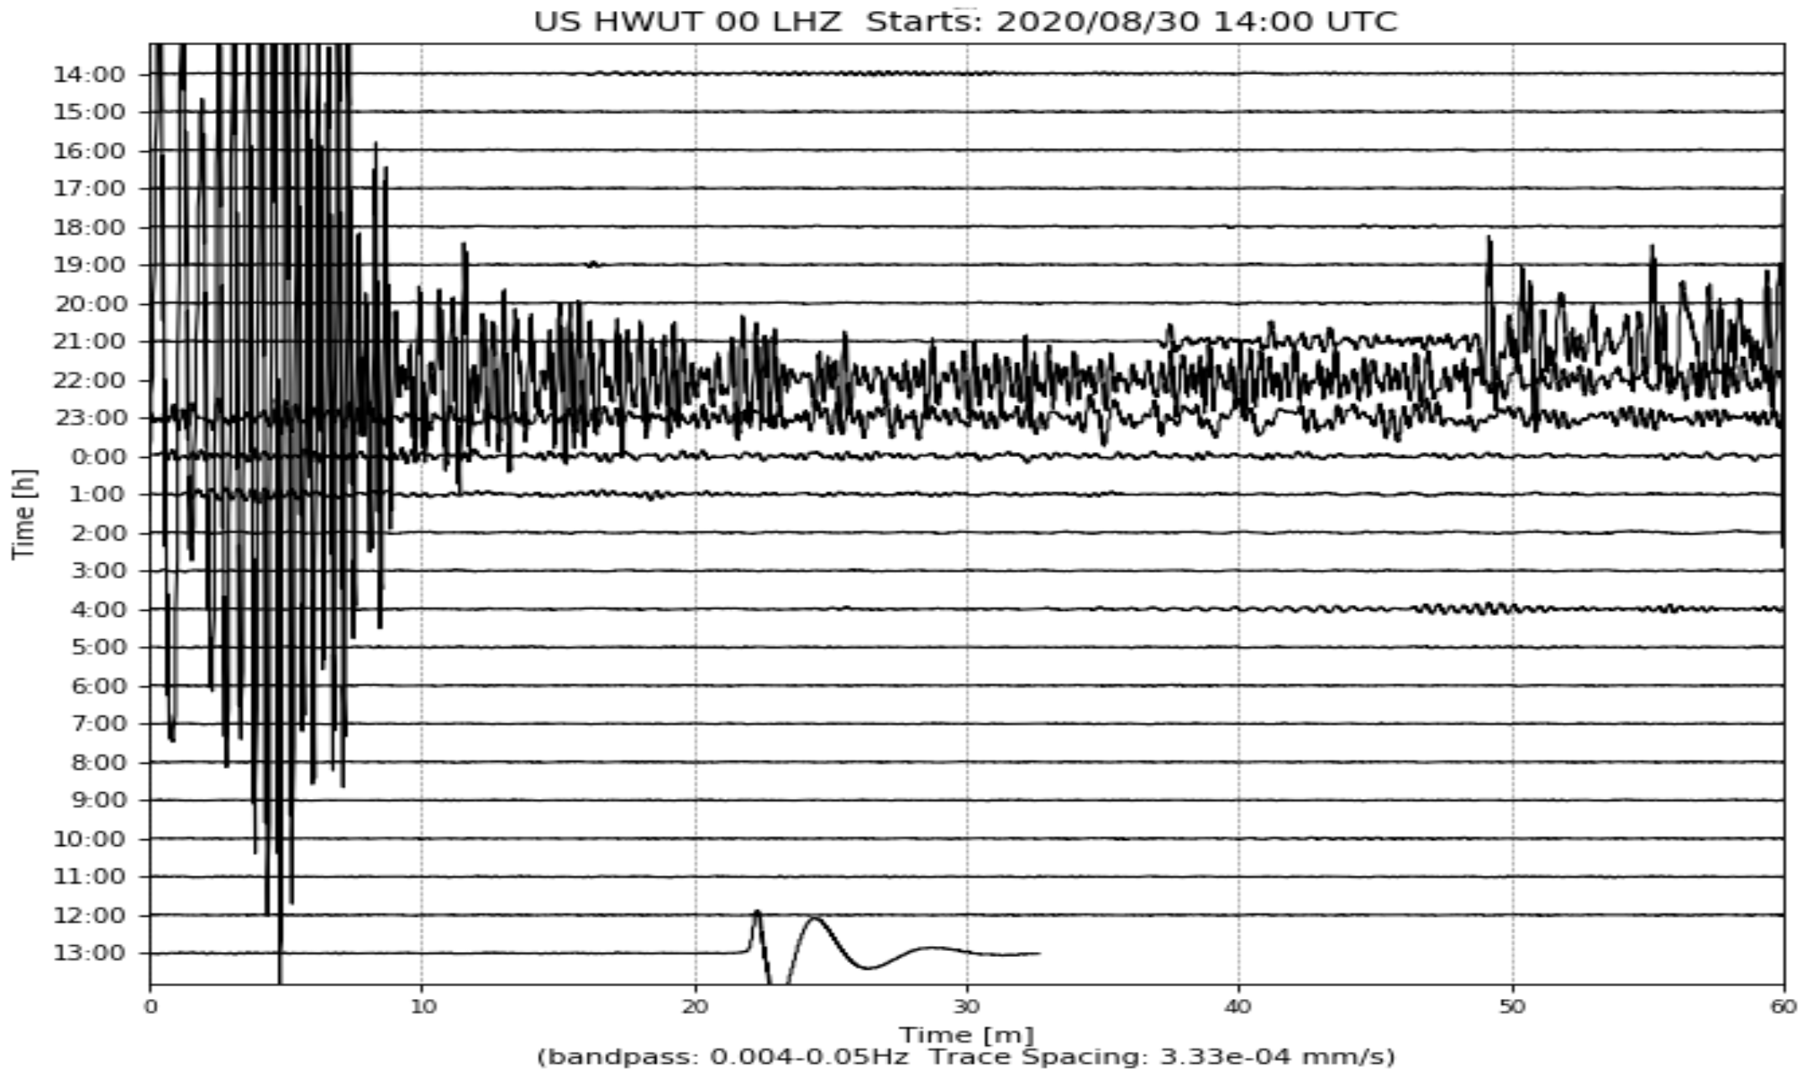
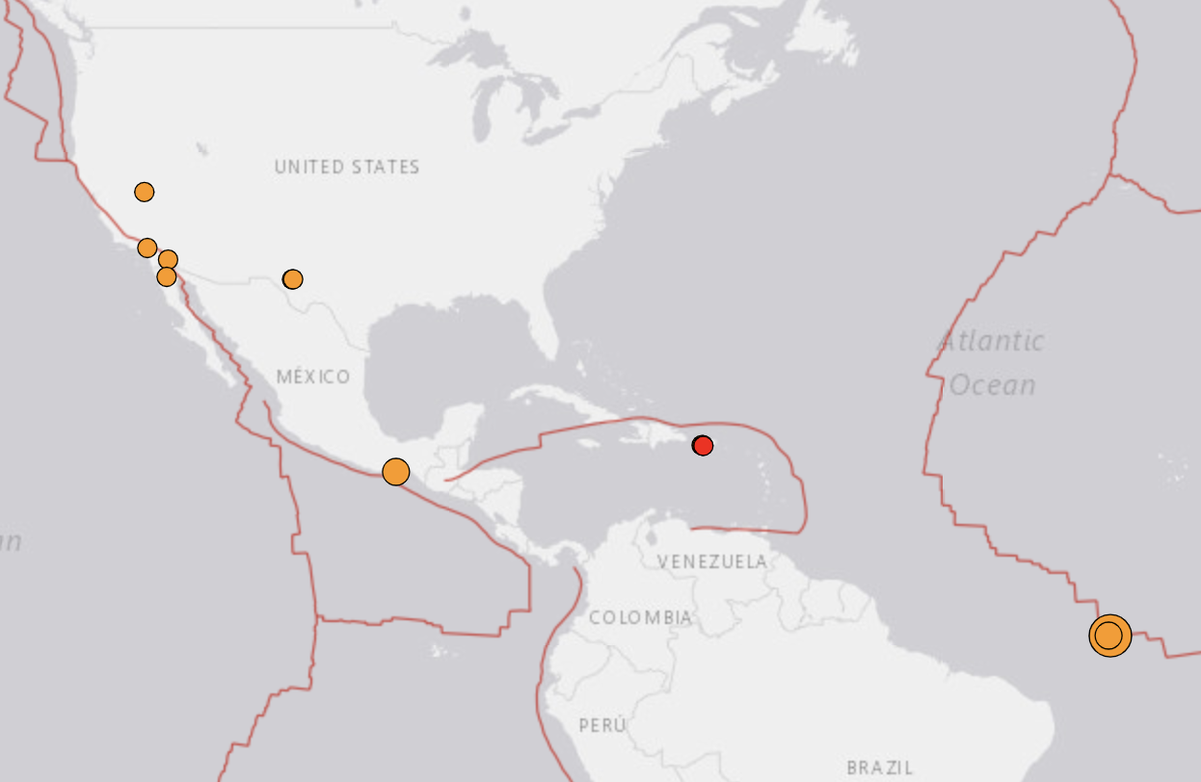
Seismogram Thought Exercise:
Hardware
Ranch, UT:
Aug 31 2020
Large event
is a M6.0
earthquake
near the
Mid-Atlantic
Ridge…
M6.0, Central Mid-Atlantic Ridge (21:20:28)
M5.0, Mohr, Iran (03:28:38)
ANSS heliplot feed (earthquake.usgs.gov)

Slide 4
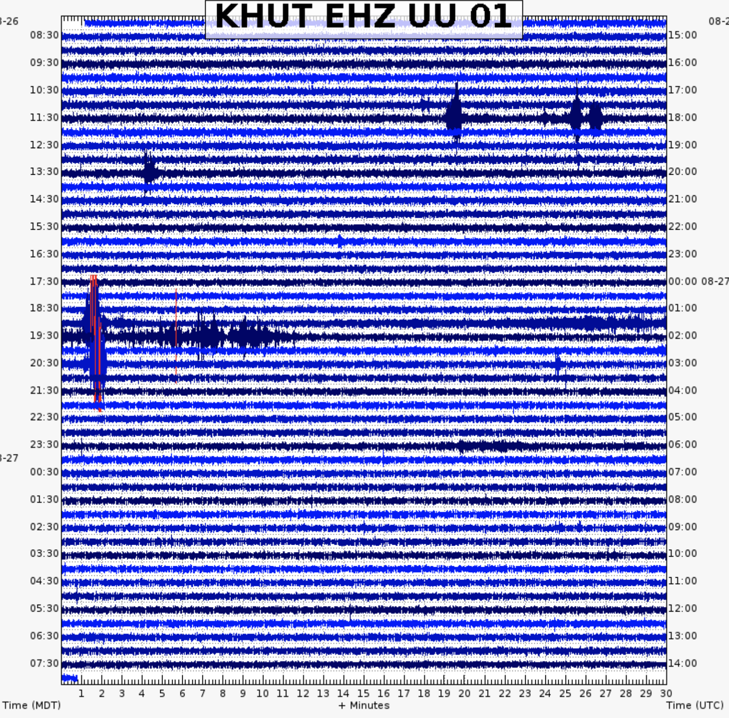
Kindman Hollow,
UT: Aug 27 2024
is less interesting:
Largest of these
events is a M0.9
earthquake at about
6 km depth north of
Great Salt Lake!

Slide 5
A Nifty
Animated
Look…
The 21 February,
2008 Wells (NV)
Earthquake
Vertical only: Red
is up; blue is down;
seismogram at the
circled site shown
on bottom.
(www.iris.edu)

Slide 6
Trabant et al. (2012) Seismol. Res. Lett.
Various Gulf of California earthquakes,
2007-2013

Slide 7
What’s the point of showing this?
Seismology provides crucial
information about the nature of
high energy seismic sources
like earthquakes!

Slide 8
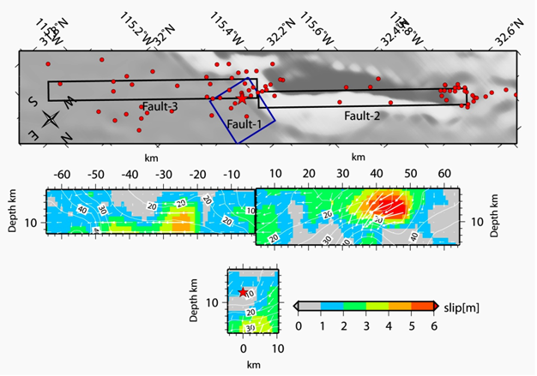
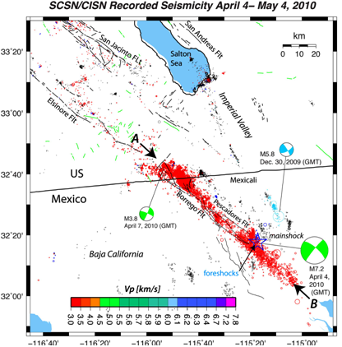
M7.2 El Mayor-
Cucapah
Event (2010)…
Finite fault model
(http://www.geerassociation.org/
GEER_Post%20EQ%20Reports/
Baja%20California_2010/
Baja10_Ch02.html)

Slide 9
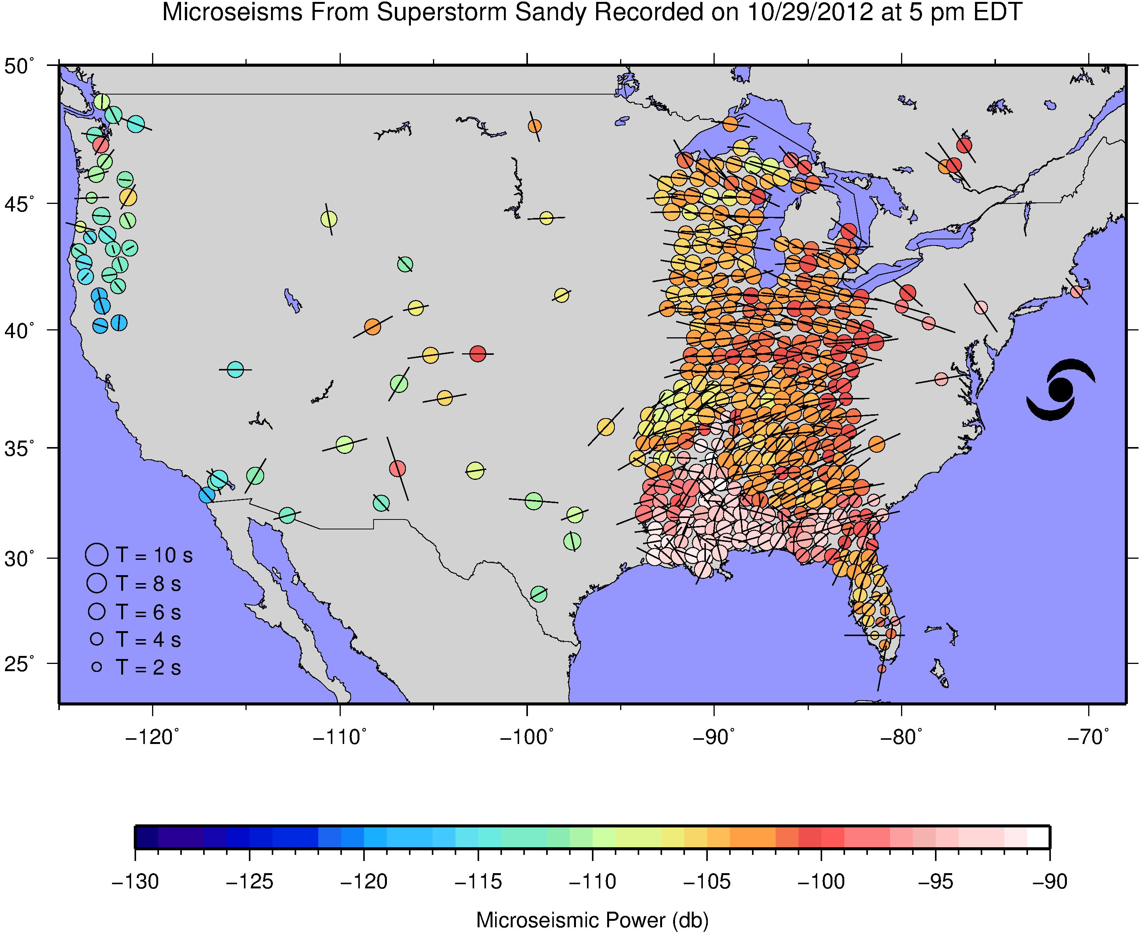
Note however that earthquakes aren’t the only significant
seismic energy source on the block!

