Slide 1
Geology 5640/6640
Introduction to Seismology
29 Aug 2024
Last time: Course overview
Discussed: syllabus, resources, course objectives
The observation: A seismogram is a record of ground
motion (specifically, ground acceleration!) as a function
of time
Discussed animations of vertical movement in
EarthScope’s Transportable Array seismic network
(for the Feb 2008 Wells, NV and several Gulf of
California earthquakes)
• The seismogram is a convolution (or integral of one function
times another over all possible time lags) of the source time
function with the Earth response (with the seismometer
response!)
Read for Fri 31 August: S&W 1-28
© A.R. Lowry 2011-2024

Slide 2
How to use these powerpoints:
• Review them often: Before each class, for exams
and exercises, and (grads) in preparing your projects
• The most important points of each lecture (in my opinion)
are summarized on the first slide of the next lecture
• Note the notation!
→ Arial Black, italic means Important, pay
attention…
→ Arial Black, italic, red font means
Critically Important concept or terminology
that I expect you to understand intimately
for exercises and projects
→ Times New Roman, italic, black font means this is an
equation or an algebraic variable
→ A Red Box with Grey Background means this is an
especially important concept or equation

Slide 3
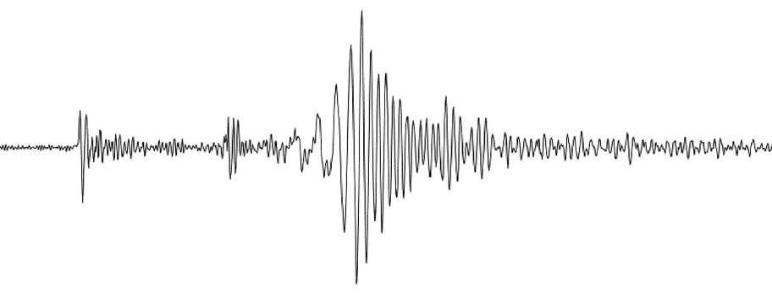
A seismogram is a time-record of motion of an
inertial mass…
Receiver
Source
Medium
Origin
time
Travel
time
Arrival
time
Source
Pulse
Seismogram
(After S&W
Fig. 1.1-1)
… that contains information about the source,
Earth response, and seismometer response.

Slide 4
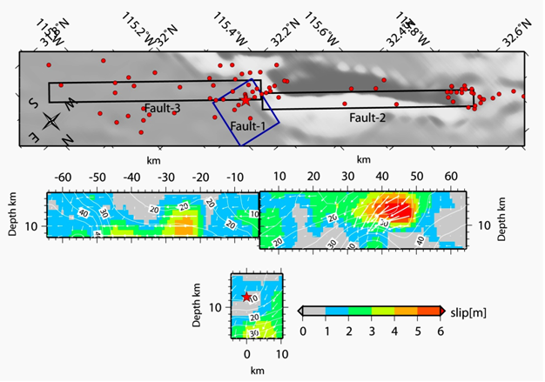
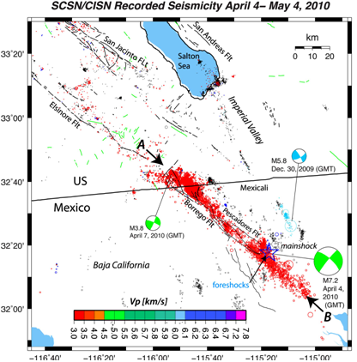
M7.2 El Mayor-
Cucapah
Event (2010)…
Finite fault model
(http://www.geerassociation.org/
GEER_Post%20EQ%20Reports/
Baja%20California_2010/
Baja10_Ch02.html)

Slide 5
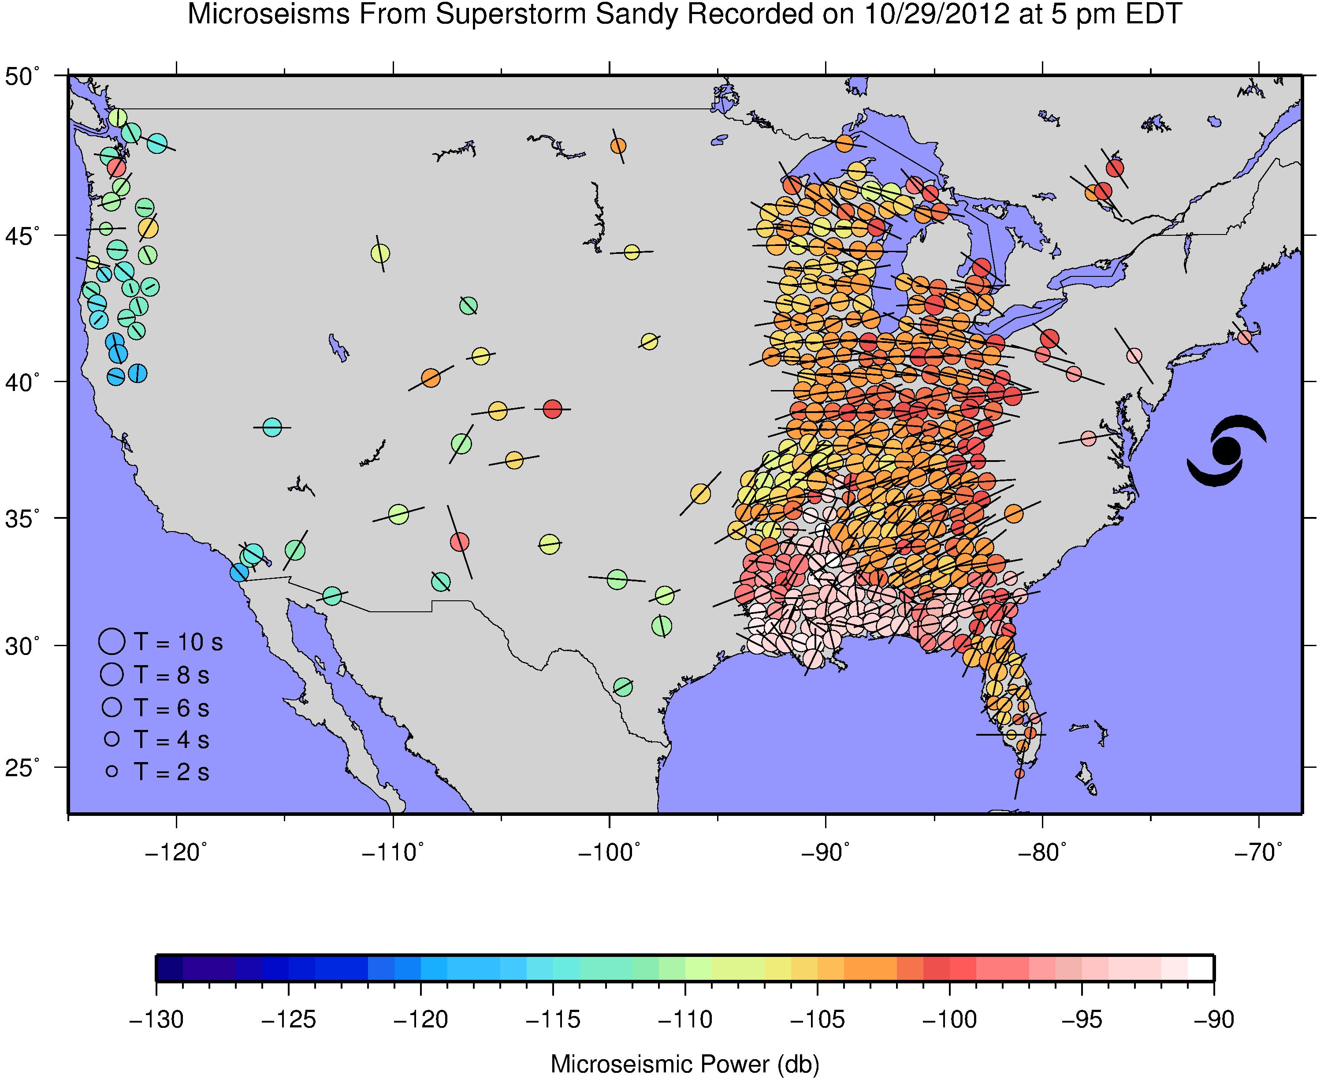
Note however that earthquakes aren’t the only significant
seismic energy source on the block!

Slide 6
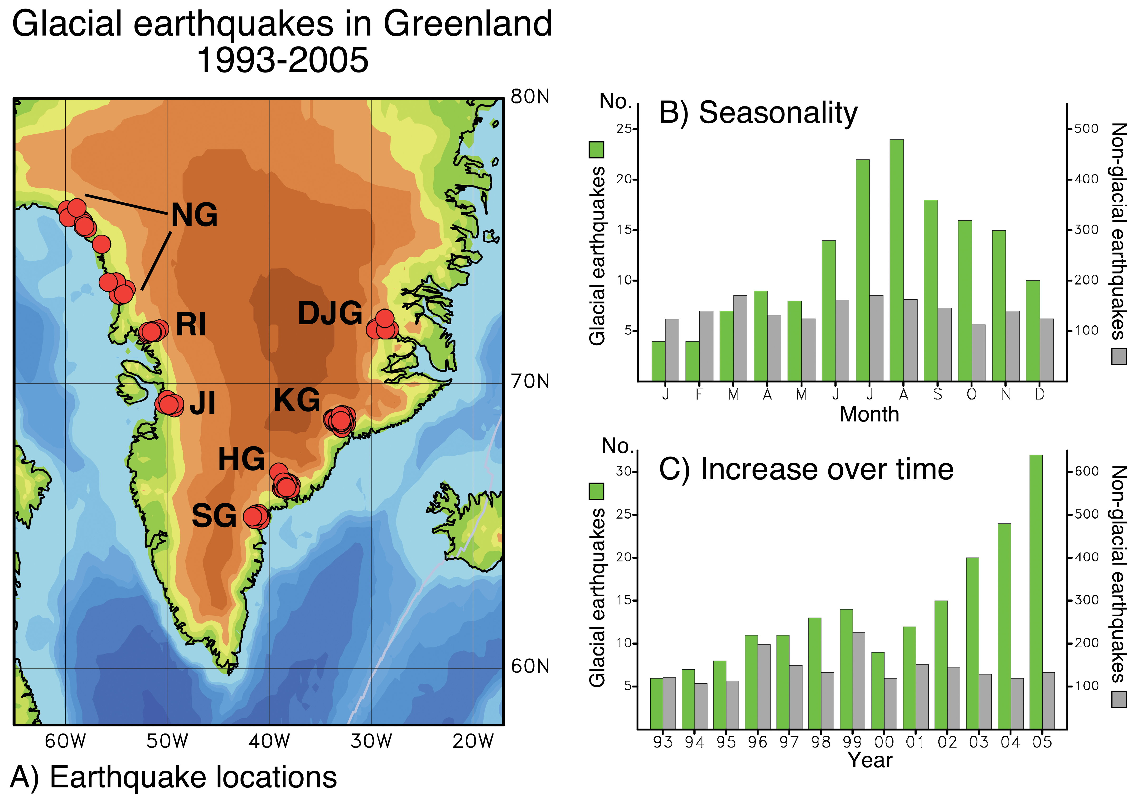
Ekström et al., Science, 2006
Icequakes? Now there’s cryoseismology!

Slide 7
A more familiar use of
seismology, for some of you…
Might be the application to
imaging of the Earth’s
subsurface

Slide 8
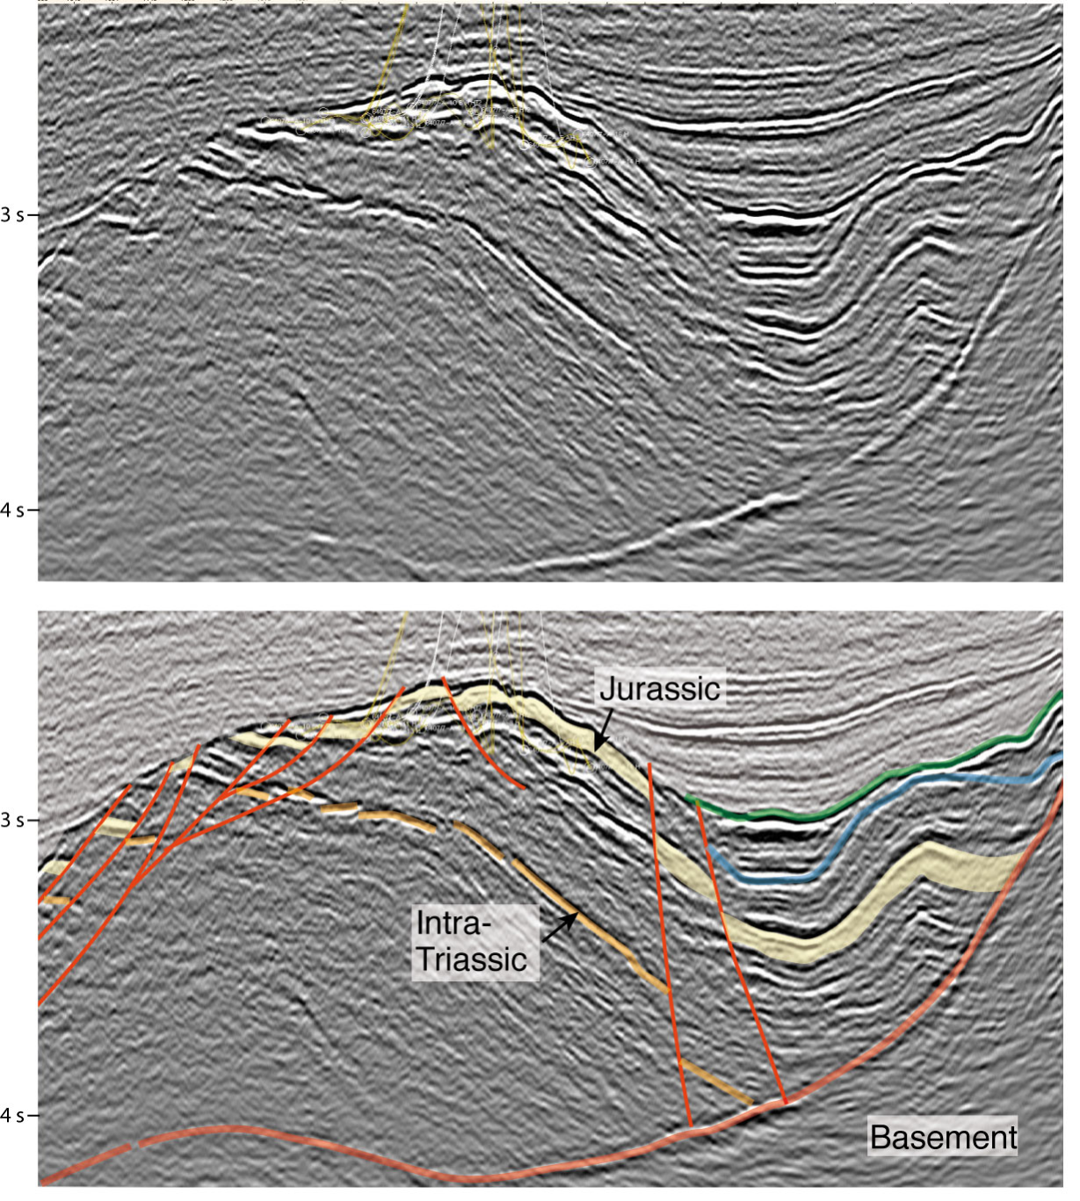
For example, seismic
reflection* imaging as
it is employed in
exploration for petroleum
and natural gas…

Slide 9
Seismic
Reflections*
Seismic impedance
Z = ρV,
where ρ is mass density of the medium and V is seismic propagation velocity!
*Sound waves from explosions
or shaker trucks at the surface
reflect from points in the
subsurface where rock
impedance properties
change (⇒ change in rock
type, porosity, fluid,etc.). Energy
returns are “migrated” to the
approximate time (or spatial)
location of the reflection source
to image the subsurface.

Slide 10
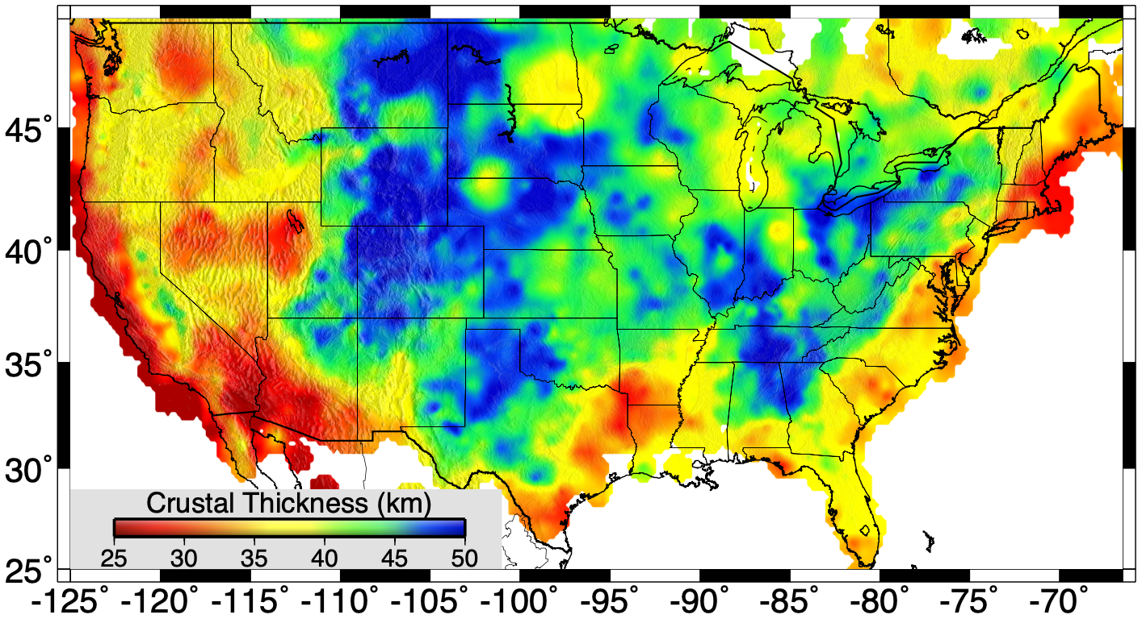
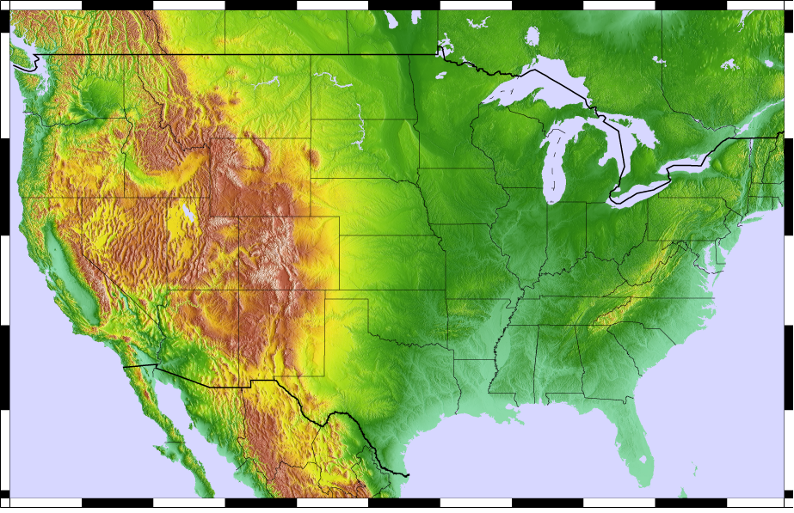
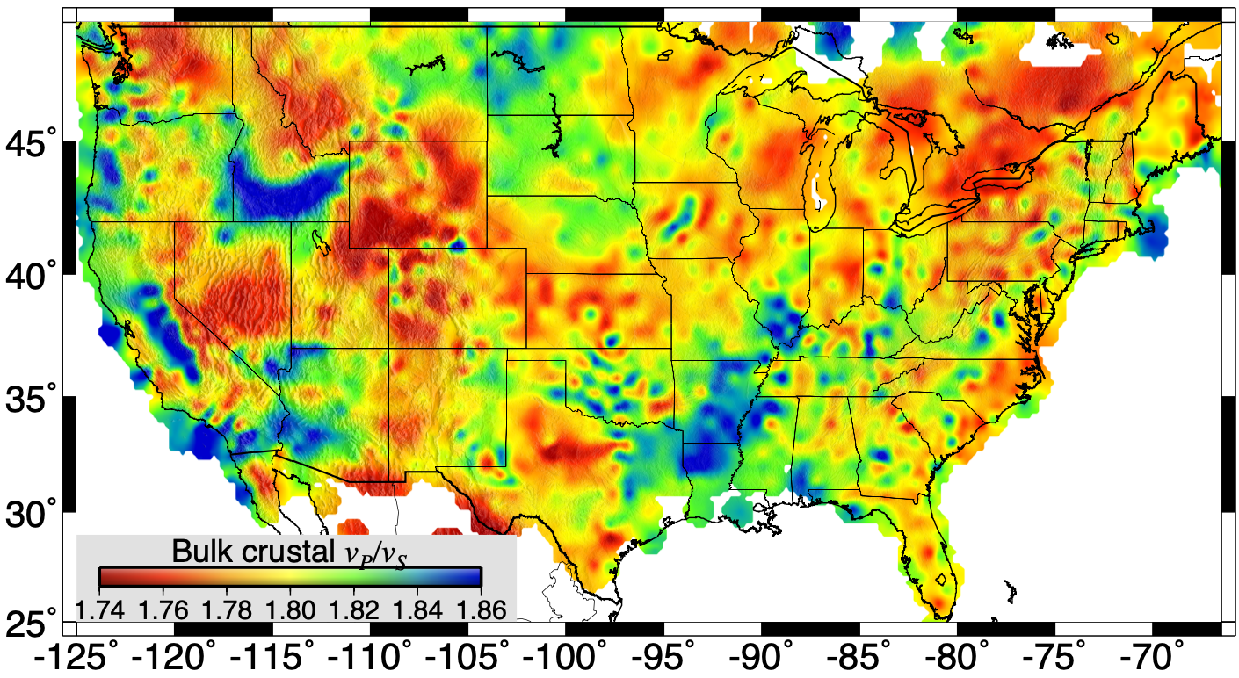
Can also use transmitted
and converted waves:
here crustal thickness &
seismic velocity ratios are
imaged using P-to-S
converted waves from
distant earthquakes

Slide 11
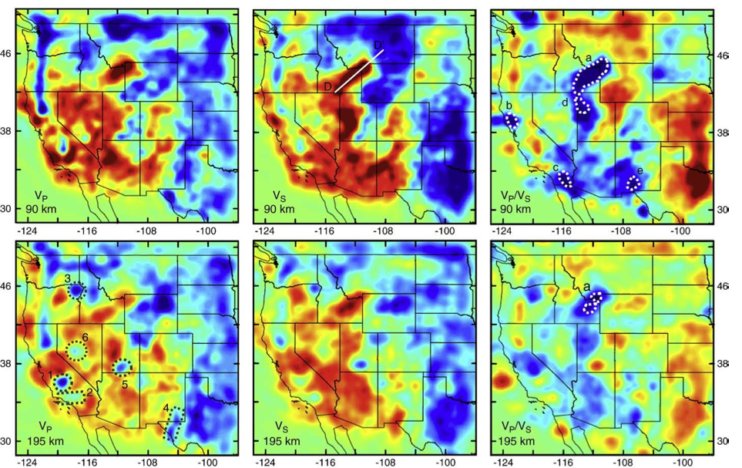
Example of subsurface imaging: Upper mantle V_{P}, V_{S} and V_{P}/V_{S}
velocity ratios imaged by waves from distant earthquakes
(Schmandt & Humphreys, EPSL, 2010)

