Slide 1
Geology 5640/6640
Introduction to Seismology
29 Oct 2024
Last time: Seismic Source Modeling
• Seismic source analysis shows that:
→ Earthquake ruptures (slip pulses) propagate from a
nucleus of initiation outward in seconds to minutes
→ Different regions of the fault slip by different amounts
and often in variable directions
→ Slip is often “patchy”, with areas of large slip & moment
release separated by regions of smaller slip
→ Slip usually propagates at ~ V_{S} but can be supershear
→ Changes in geometry/sense of slip do not always
serve as barriers to rupture propagation!
• Comparison to geodesy shows that some (slower) slip is not
recorded in body waves (so may be larger & more complex!)
Read for Thursday 31 October: S&W 75–86 (§2.6)
© A.R. Lowry 2011-2024

Slide 2
Seismic Wave Energy Partitioning
With Snell’s Law and the wave equations in our tool-belt,
we’re ready to consider what happens to seismic amplitudes
when an incoming wave arrives at a change in properties (and
hence, conversions occur).
One obvious thing that has
to happen is
conservation
of energy, i.e.,
reflected energy +
transmitted energy
= energy of the
incoming wave
As you might expect, energy is related to amplitude A of the
wave.
θ
A
incoming P

Slide 3
Impedance Contrast:
Thus far we’ve focused much of the discussion on concepts
related to velocity & travel-time, but seismic waves also have
amplitude, A, of the particle displacements:
Amplitudes of reflections &
refractions are determined by
energy partitioning at the
boundary. A normally-incident (θ = 0)
P-wave with amplitude A_{i} produces a
reflected P with amplitude:
θ
A
incoming P
(reflection
coefficient)
(transmission
coefficient)
and a refracted P:
where Z_{i} = ρ_{i}V_{i} is the impedance in layer i.

Slide 4
The energy E in a wave is directly proportional to the square of
the amplitude, A², and for this example, sign (i.e. propagation
direction) matters. We’ll use the sign of the z-component
(positive-down) of propagation. Then we have:
Displacement must be continuous
at the boundary so:
A_{i} + A_{rfl} = A_{rfr}
And:
1 + R = T
Note however for the P-wave depicted here, this applies only
to the case where θ_{i} = 0°… (Why?)
A
θ
incoming P

Slide 5
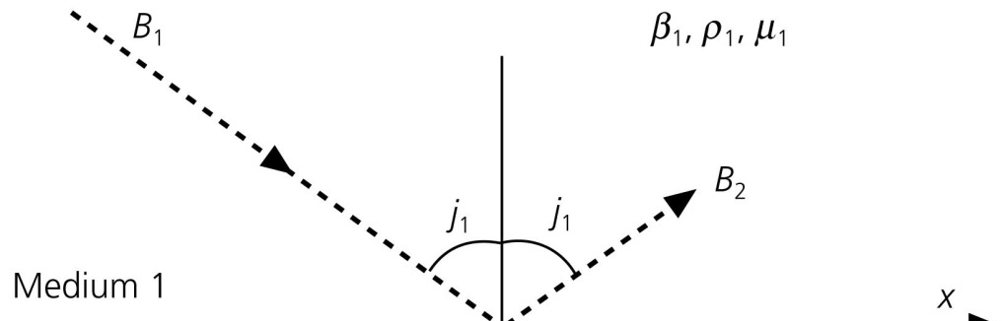
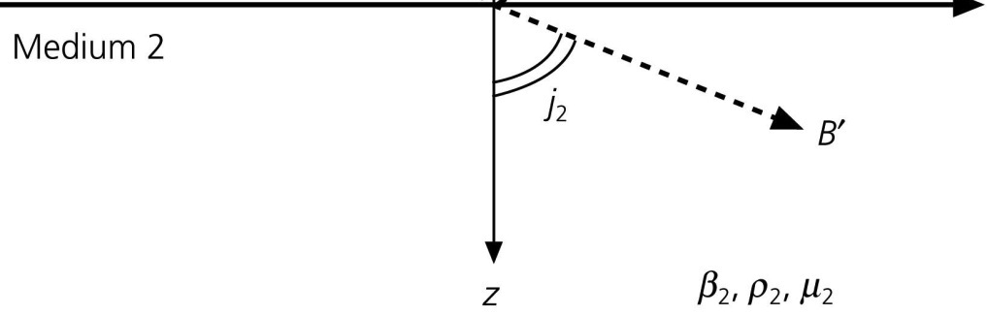
An SH-wave, it turns out, produces no P or SV conversions
at a horizontal boundary. (Why?) So we can consider
an example in which S-
velocities are β₁, β₂;
densities are ρ₁, ρ₂; and
angles of incidence are
j₁, j₂: If the wave propagates
only in the x- & z-directions,
the only non-zero
displacement is u_{y}.
The wave equation must
satisfy:
We’ve derived solutions to similar equations, and S&W write
a solution for this specific case (p66) as
where r_{β} = k_{z}/k_{x} is just a ratio of wavenumbers.

Slide 6
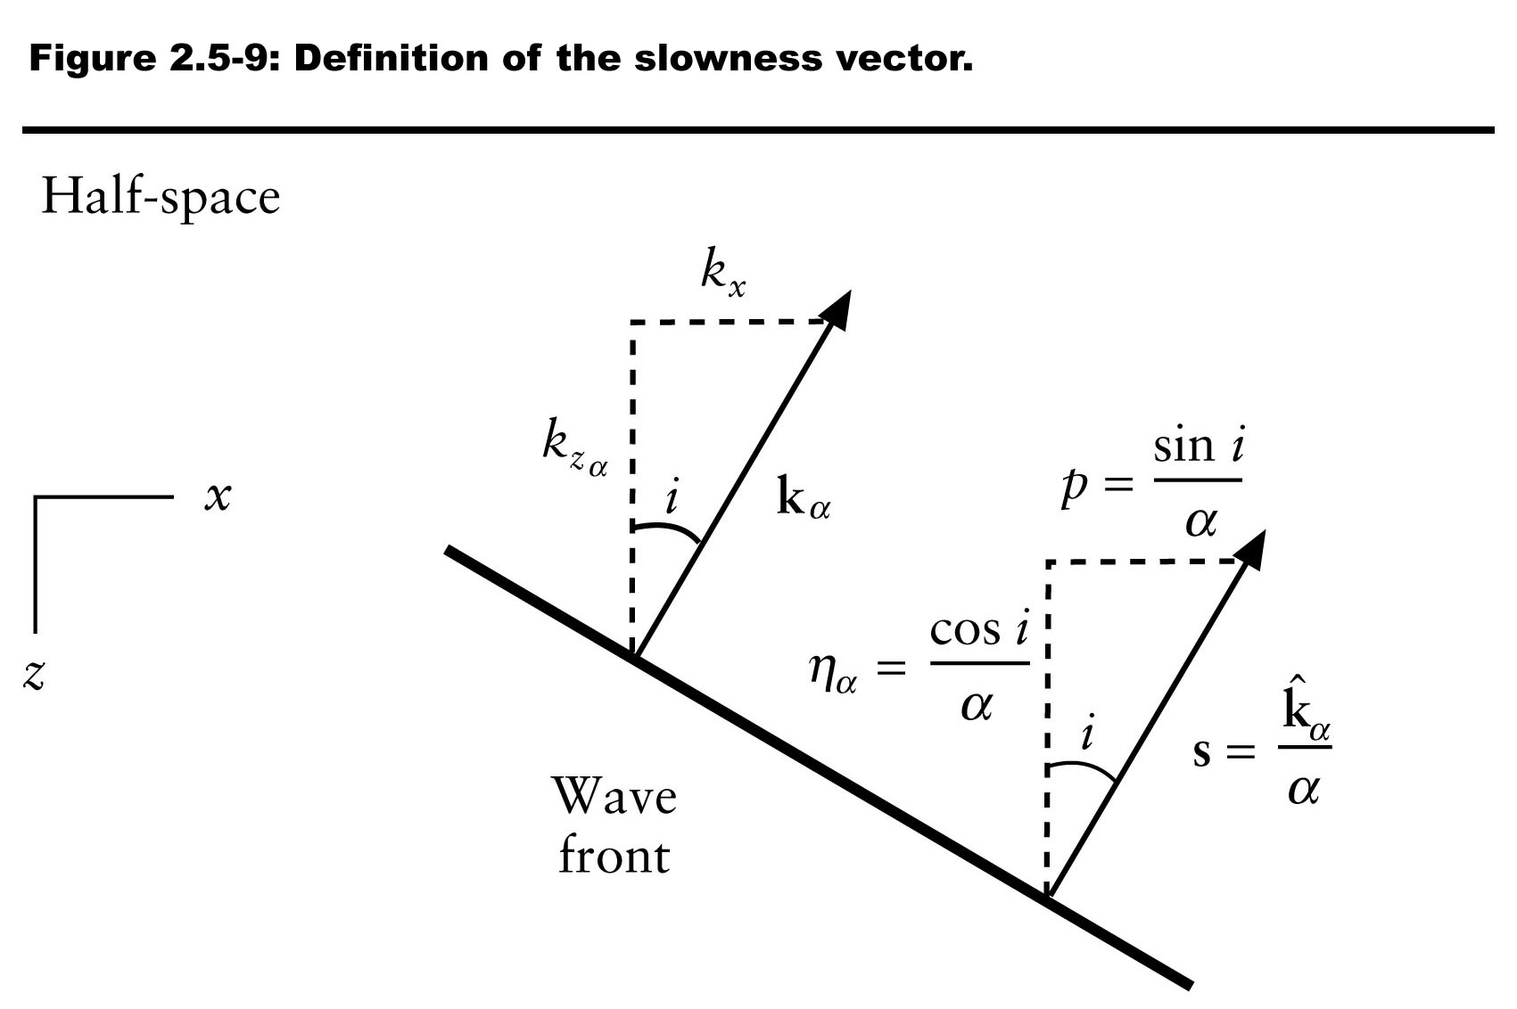
The displacements can be written:
(Here the sign difference in terms
in medium 1 is a function of
propagation direction, and
the wavenumber dependence
in medium 2 comes from
Snell’s Law and our definition
of the slowness vector!)
We need displacement u_{y} to be continuous at the interface for
all choices of x and all t, so we can write:
i.e., B₁ + B₂ = B’, or equivalently, 1 + R = T.
in medium 1 and
in medium 2.

Slide 7
Note that we could do the same exercise for stress & get the
same answer! But also note R & T depend on angles…
Now, in order to get stress tractions to match, we require:

Slide 8
More Generalized Mode Conversion:
A₁
Here, we let:
V_{P} = α
V_{S} = β
θ_{P} = i
θ_{S} = j
A_{P} = A
A_{S} = B
reflected P
A₂
reflected S
i₁
B₁
refracted P
i₂
j₁
B₂
j₂
refracted S
i₀
incoming P
A₀
α₁, β₁, ρ₁
α₂, β₂, ρ₂
Snell’s Law predicts the ray angles: For i₀ ≤ i_{c},
(For i₀ > i_{c}, the rules change a bit.)

Slide 9
Mode Conversions:
A₁
reflected P
A₂
i₁
reflected S
B₁
refracted P
i₂
j₁
B₂
refracted S
j₂
i₀
x₃
incoming P
A₀
x₁
α₁, β₁, ρ₁
α₂, β₂, ρ₂
Consider particle displacements & stress at the interface:
u₁, u₃ are nonzero (in this case we have u₂ = 0) and must be
continuous across the boundary:
Also stress must be continuous:

Slide 10
We also require that energy is conserved: Sum of energy
in wave amplitudes leaving the boundary must equal the
energy in the incident wave. After lots of algebra:

Slide 11
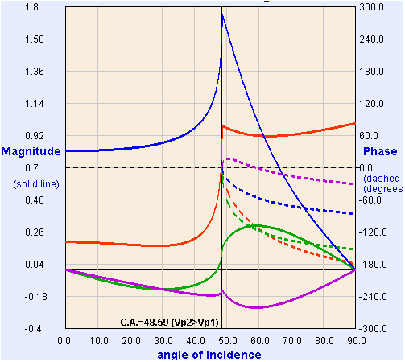
These four equations, with five unknown amplitudes, are called
Zoeppritz’ Equations.
If we fix the amplitude for the incident wave (e.g., A₀ = 1),
we can solve for the other four algebraically.
Model from:
https://crewes.org/
ResearchLinks/
ExplorerPrograms/ZE/
ρ₁ = 2000, ρ₂ = 2200
kg/m³
α₁ = 3000, α₂ = 4000
m/s
β₁ = 1500, β₂ = 2000
m/s
T_{p}
R_{p}
R_{s}
T_{s}
Crewes Zoeppritz Explorer

