Slide 1
Geology 5640/6640
Introduction to Seismology
31 Oct 2024
Last time: Seismic Wave Energy Partitioning
• Displacement continuity for a normal-incidence seismic wave
(θ_{i} = 0) ⇒ A_{i} + A_{rfl} = A_{rfr} and 1 + R = T, where R is the
reflection coefficient and T is transmission:
• Similar requirements (conservation of energy, continuity of
stress and displacement at a boundary) yields for the SH
wave & arbitrary angle of incidence j₁:
• More generally, amplitudes of reflected, refracted and
converted waves are described by Zoeppritz’
equations (four equations in four unknown amplitudes).
Read for Tuesday 5 November: S&W 86–100 (§2.7–2.8)
© A.R. Lowry 2011-2024

Slide 2
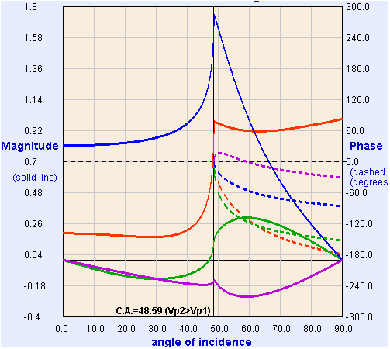
These four equations, with five unknown amplitudes, are called
Zoeppritz’ Equations.
If we fix the amplitude for the incident wave (e.g., A₀ = 1),
we can solve for the other four algebraically.
Model from:
https://crewes.org/
ResearchLinks/
ExplorerPrograms/ZE/
ρ₁ = 2000, ρ₂ = 2200
kg/m³
α₁ = 3000, α₂ = 4000
m/s
β₁ = 1500, β₂ = 2000
m/s
T_{p}
R_{p}
R_{s}
T_{s}
Crewes Zoeppritz Explorer

Slide 3
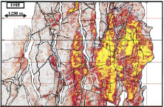
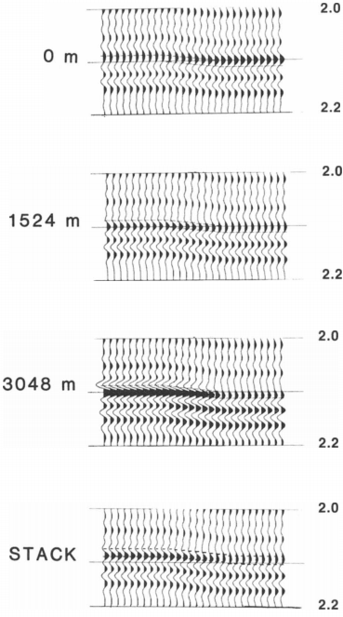
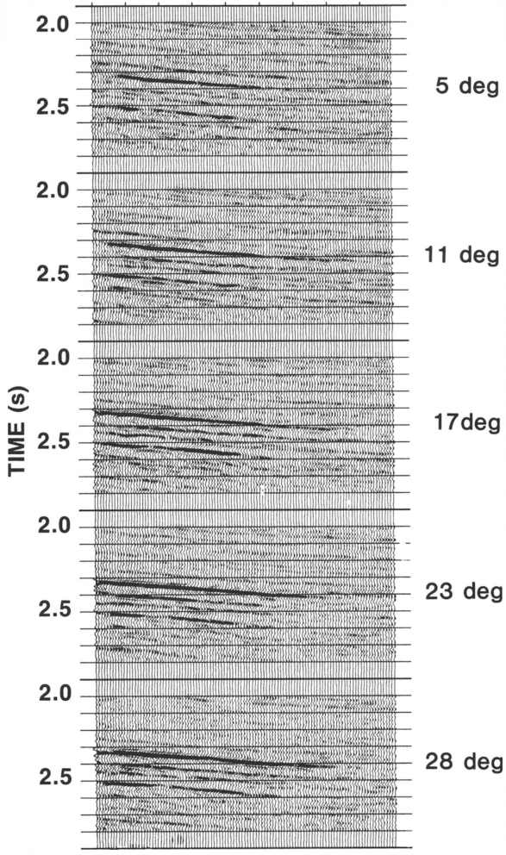
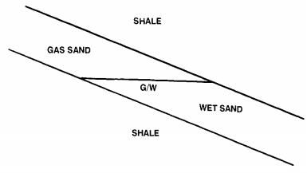
Aside: Amplitudes are the main feature used in industry seismic!
Rutherford & Williams, Geophysics 1989
Amplitude versus offset (AVO) methods give info
about deep layers that are especially useful for evaluating fluid
types & pressures…

Slide 4
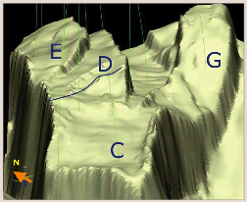
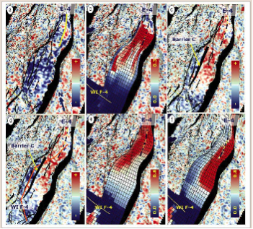
2001-2003
2001-2004
Model
w/out
seismic
Model
with
seismic
4D: imaging
changes in
impedance:
From Osdal
et al., The
Leading
Edge, 2006
Red = gas cap; oil = neutral colors; blue = water

Slide 5
Note that when the incident wave arrives at an angle beyond
the critical angle, the rules change somewhat (because e.g. in
the case shown below, no “real” transmitted P wave is possible.
Dashed lines indicate a phase lag in the waves (in degrees).
Model from:
https://crewes.org/
ResearchLinks/
ExplorerPrograms/ZE/
ρ₁ = 2000, ρ₂ = 2200
kg/m³
α₁ = 3000, α₂ = 4000
m/s
β₁ = 1500, β₂ = 2000
m/s
T_{p}
R_{p}
R_{s}
T_{s}
Crewes Zoeppritz Explorer

Slide 6
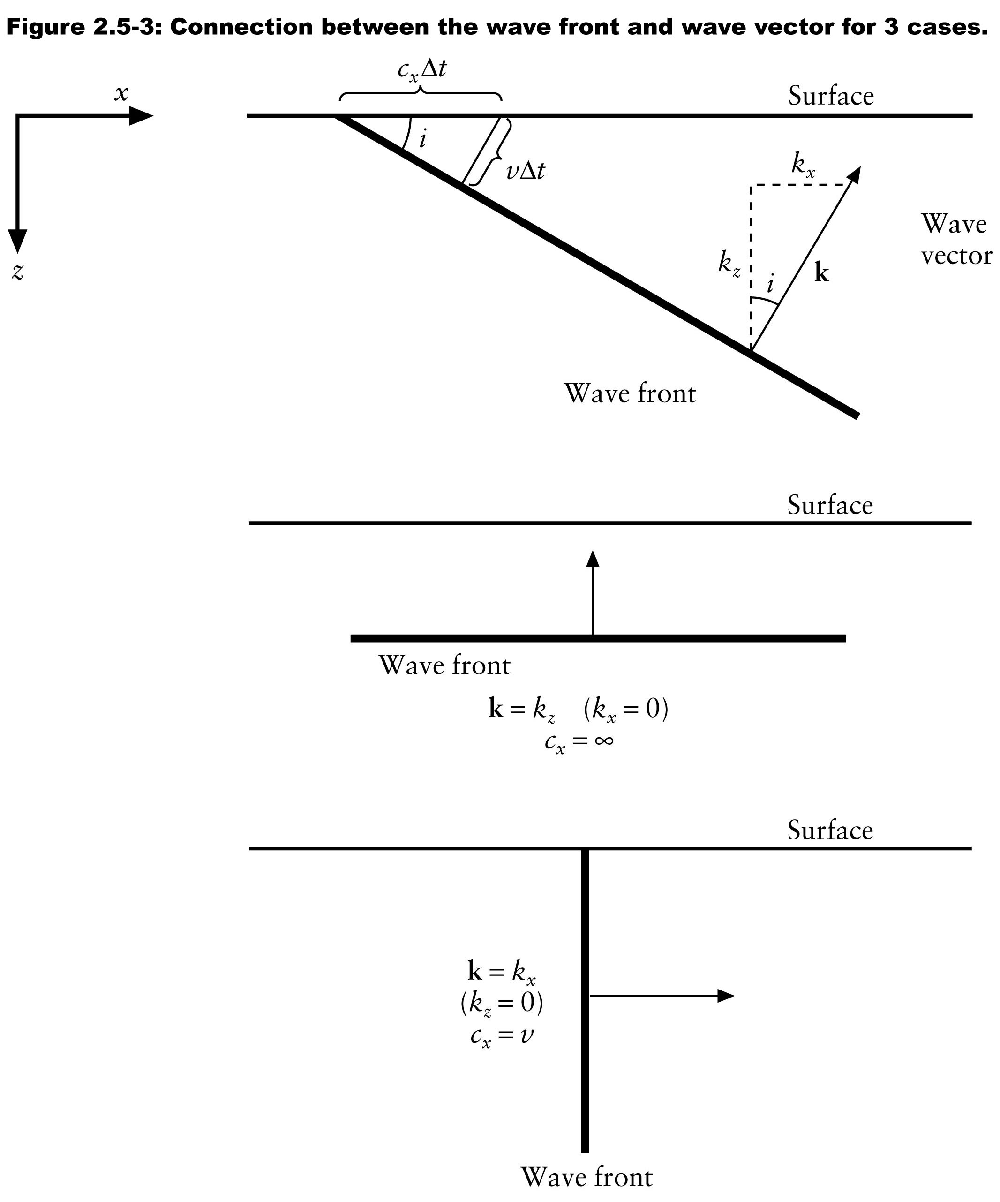
Post-critical transmitted waves:
Let’s think for a moment about the critically-refracted wave
in a horizontal layer (also called the “head wave”). We
define an apparent velocity for the x-direction, c_{x}, as the
speed of propagation of the
wavefront as it would appear to an
observer on the surface:
c_{x} = v/cosθ = v/sini
Note c_{x} is the inverse of the ray
parameter p, so this is another
statement of Snell’s Law!
Let’s assume this is an SH-wave.
For a layer at depth,
But if j₁ > j_{c} = sin⁻¹(β₁/β₂) (i.e., the
critical angle), then sin j₁ > sin j_{c}
and c_{x} < β₂…
θ

Slide 7
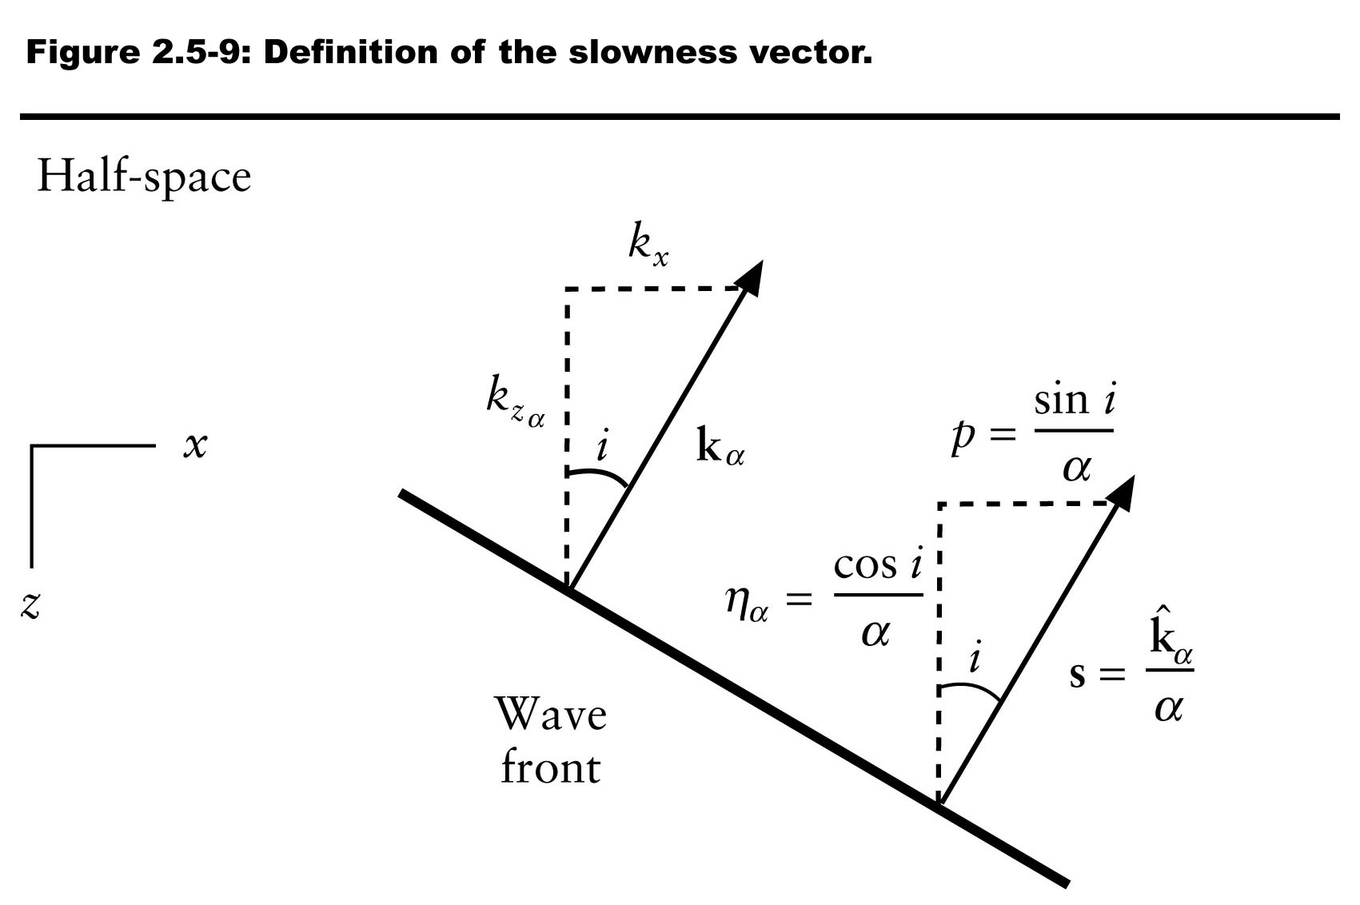
So what happens in the transmitted wave? Recall from
Tuesday that
If c_{x} < β₂, then
is an imaginary number!
The complex conjugate of r_{β 2} is
a real number:
so the z-dependence of the
wave becomes
This is a wave that decays exponentially with z: I.e., it is
trapped at the surface. We call these evanescent or
inhomogeneous waves!
= cot j

Slide 8
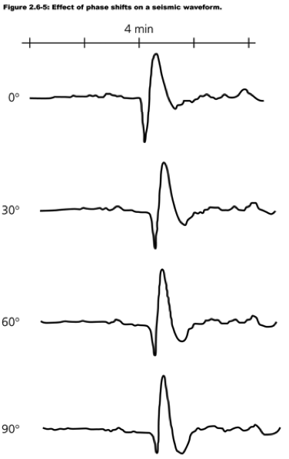
An example of an evanescent wave would be the transmitted
counterpart of a reflection from the Moho at θ₀ > that of P_{n},
the P-wave phase that travels along the Moho (i.e. the
boundary between the crust,
V_{P} ~ 6.5–7 km/s, and mantle,
V_{P} ~ 8 km/s).
If we plug the complex conjugate
into the SH-wave relation for
reflection coefficient R, we get:
This has magnitude 1 but a phase
shift of 2ε where
2ε

Slide 9
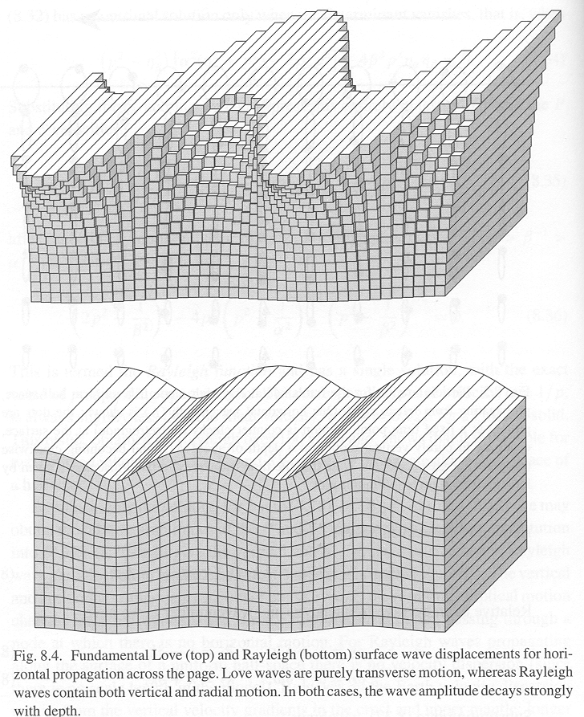
Surface Waves
From our earlier discussion
of types of waves, recall we
had two important types:
Love Waves
Rayleigh Waves

Slide 10
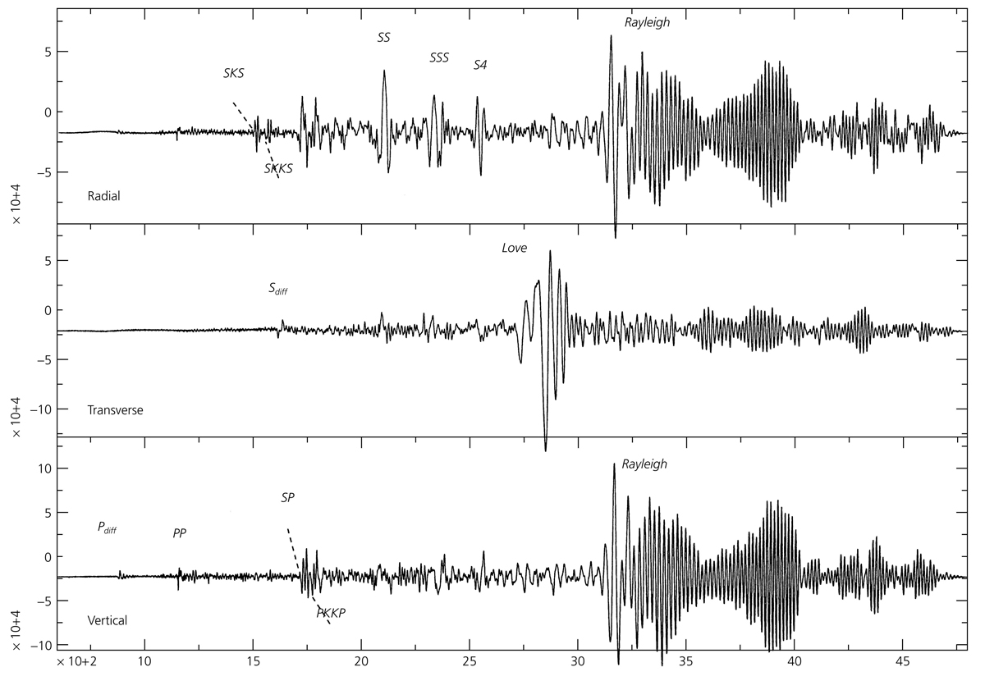
Why are surface waves important?
• Their amplitude decreases less (1/√ ) than body waves (1/r),
so they are often the largest signal on a typical seismogram.
r

Slide 11
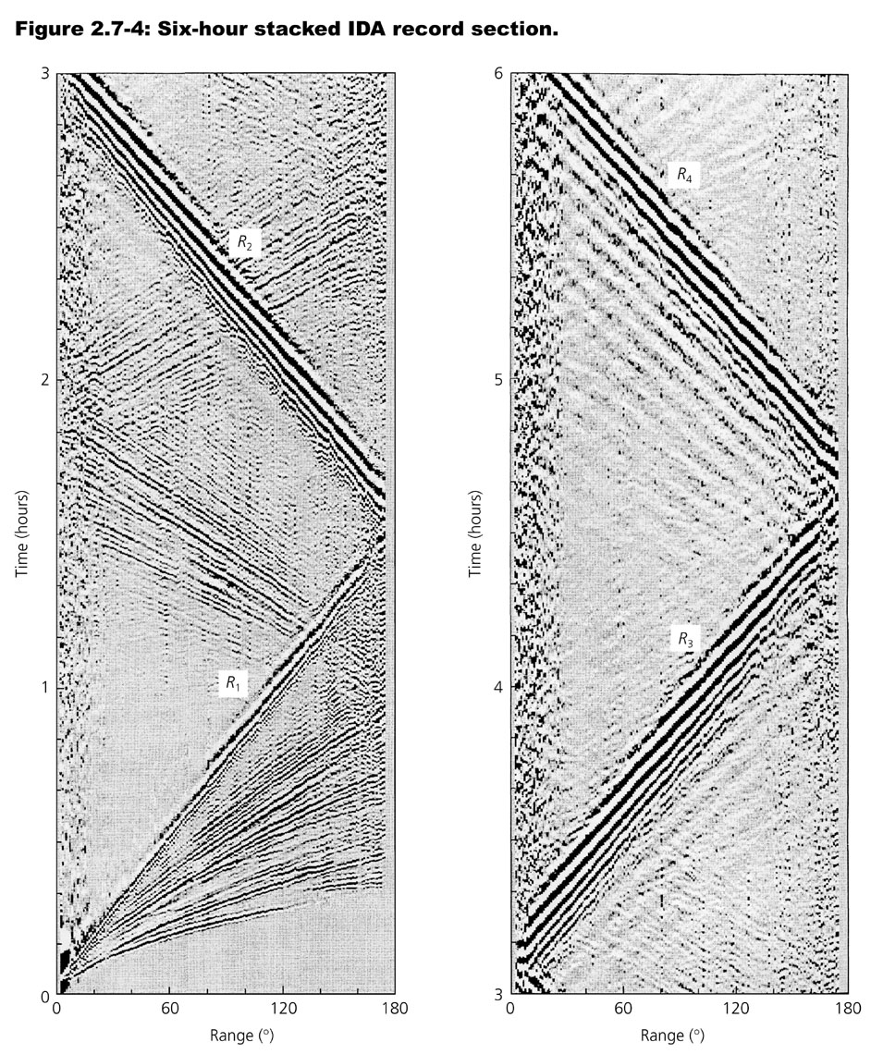
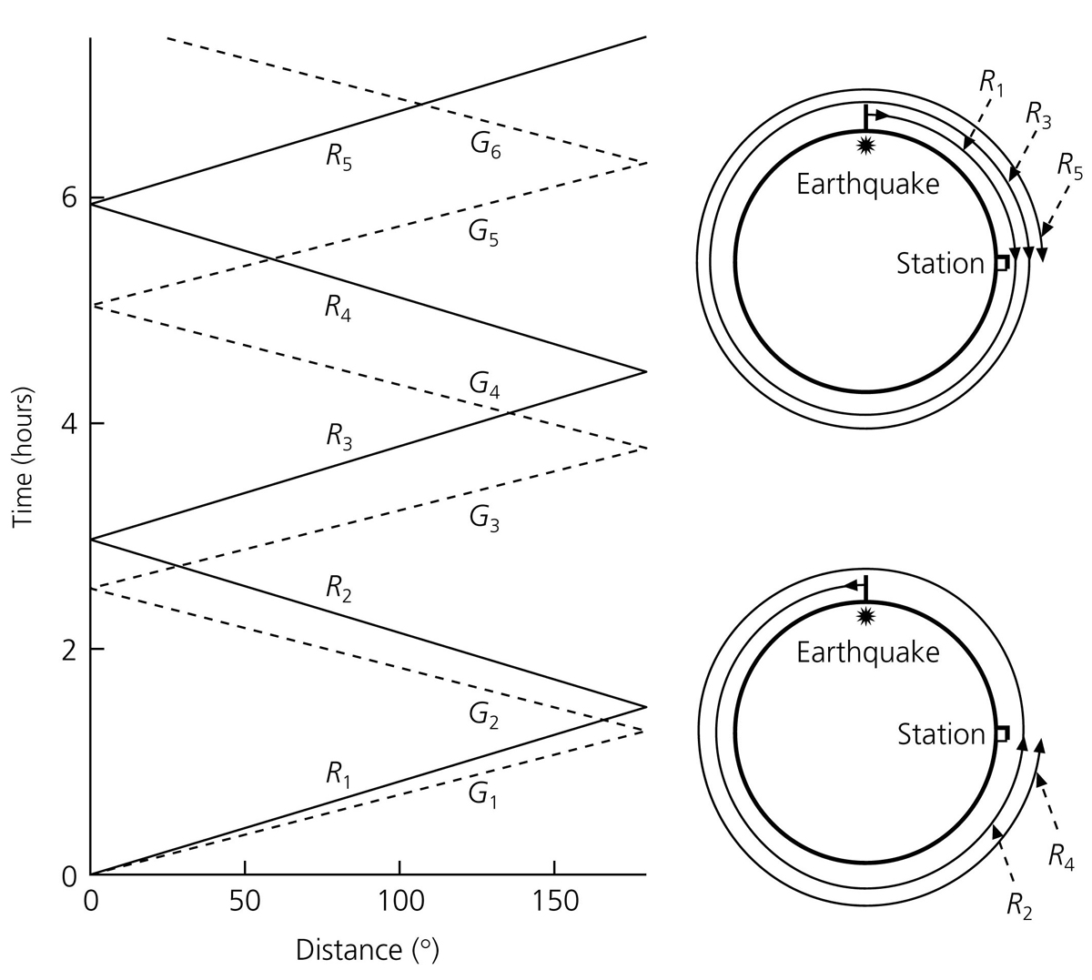
Consequently, for large earthquakes we observe surface waves
that travel all the way around the world!
Peter Shearer

Slide 12
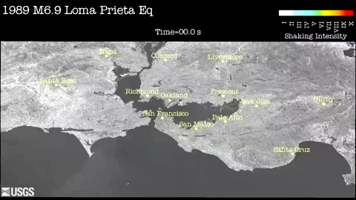
• Surface waves can cause damage to taller buildings at
relatively large distances.

